Slide 1
Word Vectors
Thushan Ganegedara

Slide 2
Why word vectors?
Word vectors are numerical vectors
cat ←(0.41,0.69,0.10)
dog ←(0.44,0.60,0.15)
window ←(0.01,−0.51,0.99)
They are not just random vectors
Words used in similar context will have similar word vectors

Slide 3
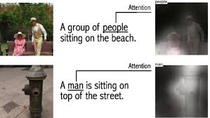


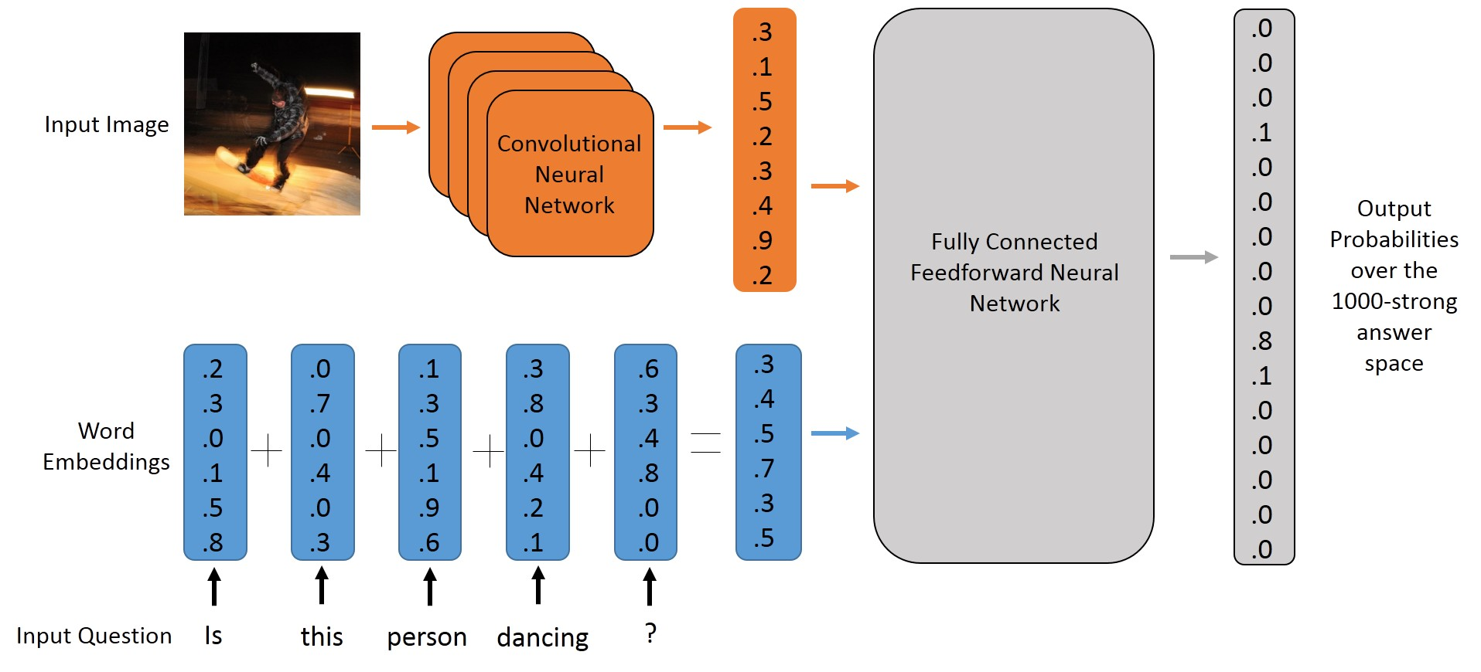
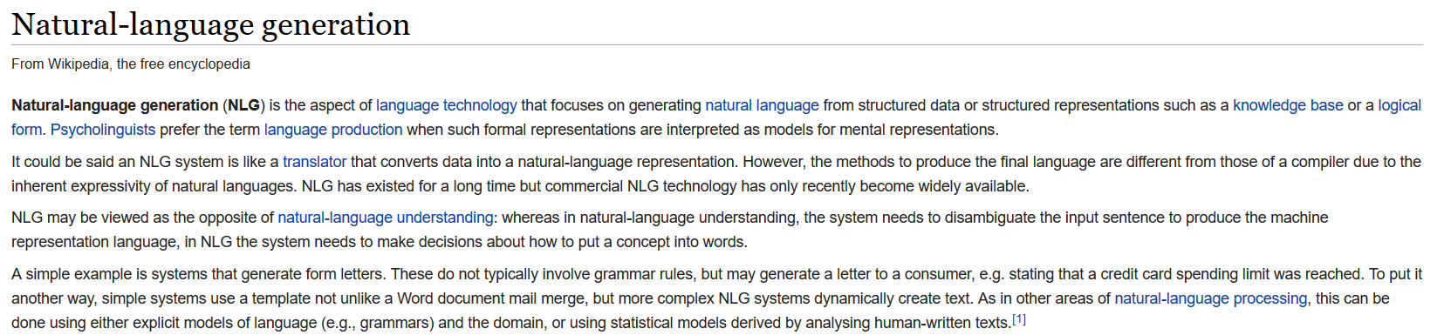
Why word vectors?
Unsung hero empowering almost all NLP models
Machine translation
Image caption generation
Text generation
Question answering
Chatbots, etc.

Slide 4
I’m still not very clear how word vectors help

Slide 5
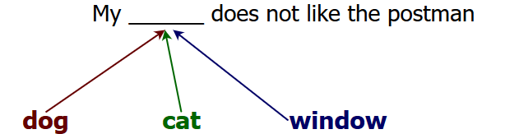
What are word vectors?
The meaning of a word relies on the context
You shall know a word by the company it keeps - J.R. Firth
Exercise:
Mary is a stubborn child. Her pervicacious nature always gets her in trouble
What does “pervicacious” mean?

Slide 6
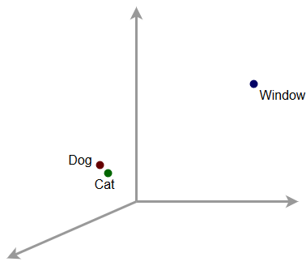
What learnt word vectors might look like?
Word vectors of words used in similar context
Close together
Word vectors of words used in different context
Far apart

Slide 7
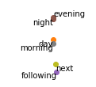
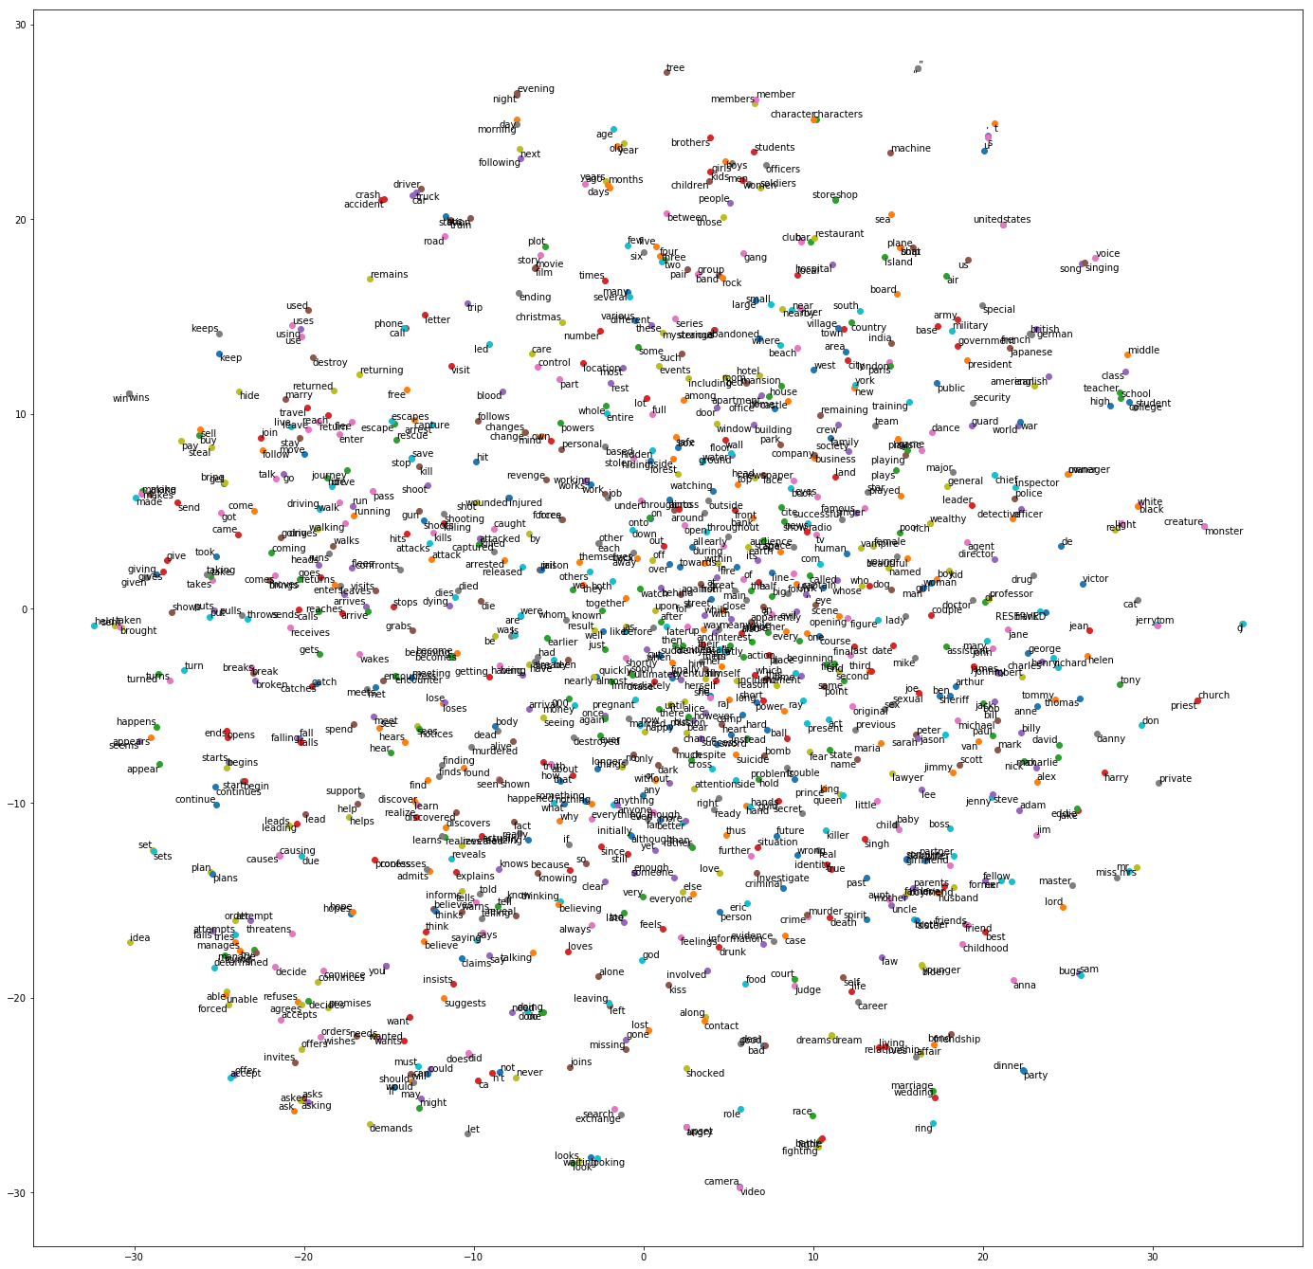
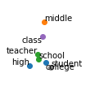
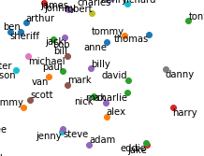


Slide 8

Word2vec Algorithms
More info: Refer chapter 3 of “Natural language processing with TensorFlow”
A particular family of word vector algorithms
Skip-gram
Continuous Bag of Words model
Terminology:
Loss Function:
[ ]
[ ]
The cat pushed the glass off the table
Target word
Context word(s)
Length of corpus
Window size

Slide 9
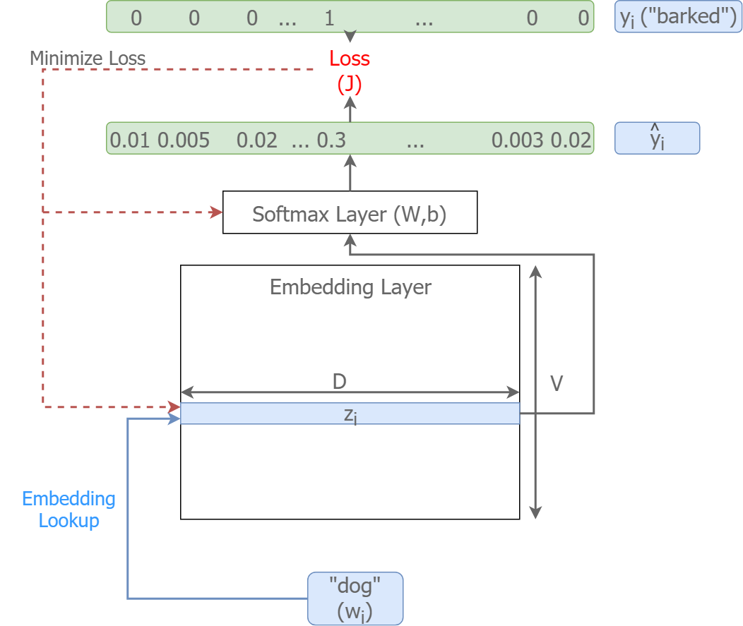
Skip-gram Algorithm
More info: Refer chapter 3 of “Natural language processing with TensorFlow”
Consists of following components
Input word
in the form of an id
Embedding layer
Looks up the embedding for the input
Softmax weights
Convert the embeddings to predictions
Loss
Used to optimize the parameters

Slide 10
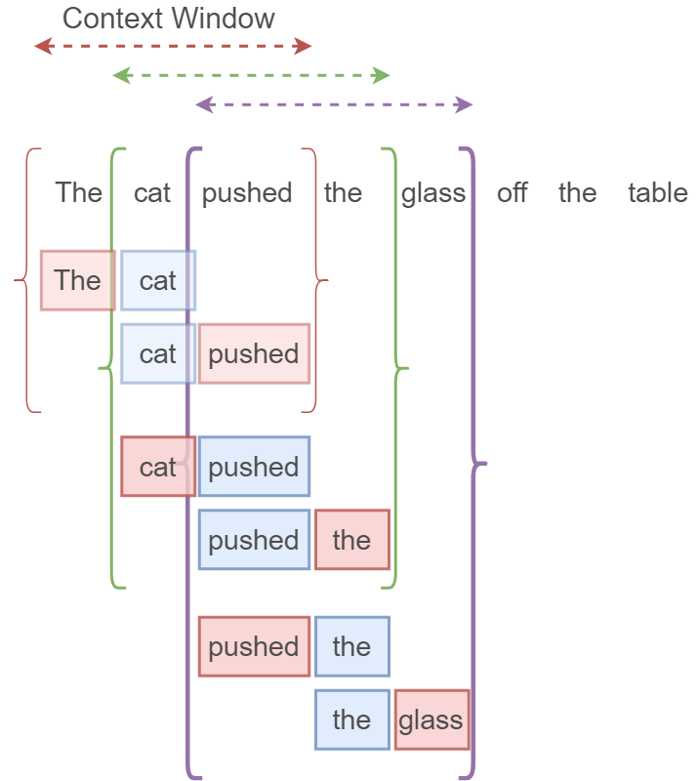
Creating inputs/outputs from text
for i ← m:N-m # Goes through the full corpus
target ← word w[i] # make word i the target
for j ← -m : m ^ j != 0 # traverse the context of word i
context ← w[i-j] # make word j a context word
Input: target
Output: context

Slide 11
Getting to know data

Slide 12
Introduction to data
Movie plots dataset
Link: http://www.cs.cmu.edu/~ark/personas/data/MovieSummaries.tar.gz
More than 40000 movie plots
Movie id <tab separation> Plot text
We will be using the first 10000 plots
One sample
In the 13th century, three women accused of witchcraft are hanged by a priest. While one claims to be a witch out of persuasion from the church, one doesn't deny it and curses the priest. He kills them by hanging and implores the guards to pull them back up for a ritual that will make the so-called witches never come back to life, but the guards refuse, claiming them to be dead enough…

Slide 13
Pre-processing textual data
Convert text to lower case
In the 13th century, three women → in the 13th century, three women
Remove punctuation
in the 13th century, three women → in the 13th century three women
Restrict the vocabulary to 25000?
in the 13th century three women → in the <UNK> century three women
Why would you restrict the vocabulary?
Do you think removing stop words increase/decrease performance?

Slide 14
What else happens when you fit_on_texts?
Words become indices
a → 1
the → 2
women → 3
_____ → 0 ???
You can recover words using
tok.index_word dictionary
tok.index_word[1] → ‘a’

Slide 15
How to convert any arbitrary text to a sequence?
Use tok.texts_to_sequences
In order to use a Tokenizer this we, it must be trained first

Slide 16
Skipgram with TensorFlow

Slide 17
Defining inputs
Input will be a [batch_size] sequence of numbers (word indices)

Slide 18
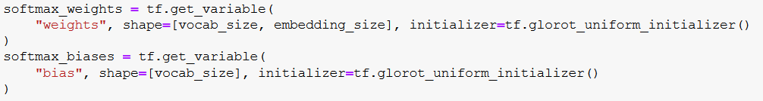
Defining word embeddings and weights
Embeddings: A variable of size [vocab_size, embedding_size]
Softmax weights/bias: A layer that will take the a batch of embeddings and predict context word correctly
What would be the size of softmax_weights?

Slide 19
Defining predictions and outputs
TensorFlow provides a powerful function allowing you to get embeddings for a given set of word IDs
Defining labels for computing the loss

Slide 20
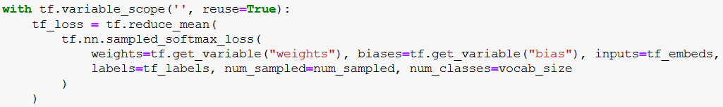
Defining loss
Looks ugly? Not to worry
Layers you have defined already
Label placeholder
A hyperparameter
Vocabulary size

Slide 21
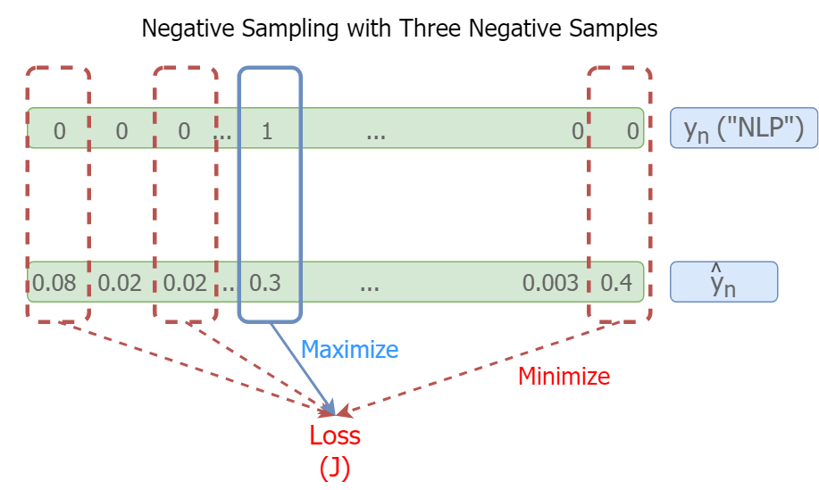
Why this complicated loss?
More info: Refer chapter 3 of “Natural language processing with TensorFlow”
Sampled softmax loss
An approximation of the true crossentropy loss
Cross-entropy loss makes sure
The correct prediction has a high softmax output (ideally 1)
All the incorrect predictions have a low softmax output (ideally 0)
Sampled softmax makes sure:
The correct prediction has a high sigmoidal output (ideally 1)
A sampled set of num_sampled predictions have a low sigmoidal output (ideally 0)

Slide 22
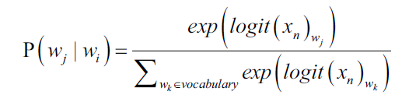
Why not categorical crossentropy?
This is okey for 1000 classes, but not for 100,000
Another alternative is “Hierarchical softmax”

Slide 23
Defining an optimizer
We will be using AdagradOptimizer
What do we need to optimize?
What if we wanted to only optimize the softmax weights?

Slide 24
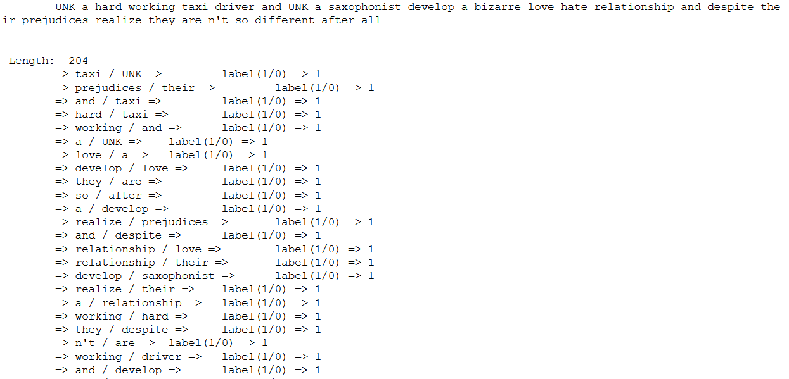
Generating data
Very convenient function provided by keras.preprocessing.sequence

Slide 25
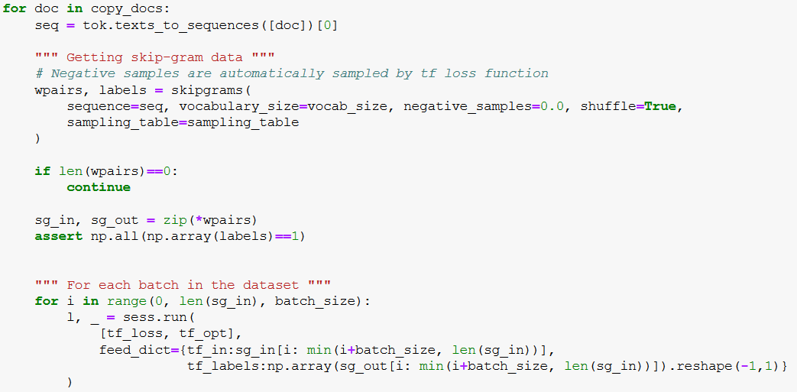
Running skip-gram

Slide 26
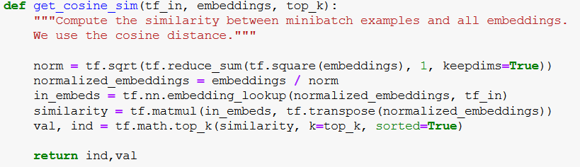
Evaluating word vectors
Given a word w[i] we can compute the cosine distance to all the other words in the vocabulary in the embedding space
vocab_size
j
tf_in
size
d
i

Slide 27
Visualising word vectors

Slide 28

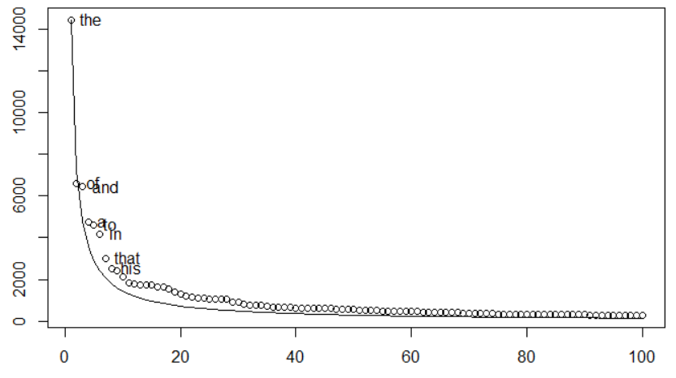
Improving skip-gram
Subsampling the corpus
We ignore a word wi as an input/output with the probability
Word frequencies approximated using Zipf’s Law
Exact equation can be found at: https://keras.io/preprocessing/sequence/

Slide 29
Exercise: Why does subsampling help?
Consider the input/output tuples
(“France” (100), “The” (1000))
(“France” (100), “Paris” (100) )
Assume t = 0.0001
What is the probability
(“France”, “The”) becomes an input?
(“France”, “Paris”) becomes an input?

Slide 30

Subsampling with Keras

Slide 31
Improving skip-gram
More info: Refer chapter 4 of “Natural language processing with TensorFlow”
Unigram candidate sampling
Sample the negative samples for loss computation according to a unigram distribution
U(w[i]) = count(w[i])/Sum(count(w[i]))
U(w[i])^(3/4)/Z

Slide 32
Conclusion
Words used in similar contexts carry similar meanings
Word vectors capture these semantics of words
Word2vec are a family of algorithms trying to do that
Skip-gram attempts to predict context words given the target word
Keras provides various text processing functions as well as a input/output generator for skip-gram
Negative sampling is a common loss for Word2vec
Subsampling the corpus and unigram candidate sampling helps to improve performance

