Slide 1

Module EN 4202 : Project EXPERIMENTING THE SUITABILITY OF WIFI-DIRECT FOR INTELLIGENT TRANSPORTATION SYSTEMS Supervisor : Dr. Tharaka Samarasinghe
Department of Electronics and Telecommunication Engineering University of Moratuwa
22nd July 2016

Slide 2
Group members
120415V Nanayakkara N.P.
120459H Perera B.A.V.
120631E Siriwardhana M.A.A.S.
120700P Welagedara T.D.

Slide 3
Problem Statement
Shortcomings of DSRC for ITS
Hardware available only in newer vehicles
Hardware cost
Likely to take a long time to deploy
Pedestrians cannot be included

Slide 4
Primary Objectives
Create a Wi-Fi direct network
Measure the performance of the network
Suggest and implement improvements for the network
Compare performance

Slide 5
Scope
Create a Wi-Fi Direct network using Android phones
Implement automatic authentication feature in the Wi-Fi network
Monitor network packets using Wireshark
Measure performance measures (packet losses, transmission delays with respect to distance between members, speed and number of members in the group etc.)
Compare measured performance with required performance for an ITS
Suggest and implement suitable improvements for the current network

Slide 6
Literature review
Wi-Fi Direct communication
Device-to-device Communications With Wifi Direct: Overview And Experimentation, Daniel Camps-mur, Andres Garcia-saavedra And Pablo Serrano
Wi-Fi Direct and DSRC comparison
Inter-vehicular communication for collision avoidance using Wi-Fi Direct, Thesis, Chaitra Satish
Nominating a Backup Group Owner (BGO)
Increased Persistence of Wi-Fi Direct Networks for Smartphone-based Collision Avoidance, Thesis, Priyanka Angadi

Slide 7
Literature review
An algorithm for reduction of delay in group formation
WD2: An Improved WiFi-Direct Group Formation Protocol, Hongxu Zhang, Yufeng Wang, and Chiu C. Tan
Wi-Fi Direct implementation using Android
Automatic Android-based Wireless Mesh Networks, Paul Wong, Vijay Varikota, Duong Nguyen and Ahmed Abukmail

Slide 8
Alternative strategies
Devices
Wi-Fi modules – with microcontrollers
Laptops – on Linux
Android phones
Authentication
Manual authentication (WPS)
Root android phones
WPA2 authentication
Monitoring
Log files
Wireshark

Slide 9
Strategies
Android phones + Root Android phones + Wireshark
Android phones + WPA2 Authentication + Wireshark
Android phones + Root Android phones + Log files
Android phones + Manual Authentication + Wireshark
Laptops + Log files
Laptops + Wireshark
Wi-Fi modules + Wireshark

Slide 10
Architecture
Implementing Automatic Authentication
Wi-Fi Direct Network:
Android Phones
Wi-Fi Network with Automatic Authentication
Test Environment:
Changing Distance between the Members in the Network (Members are still)
Changing the Moving Speed of Members (Keeping the Distant Constant)
Changing the Number of Members in the Group
Optimizations
WireShark Tool
Measuring Performances: Packet Loss, Transmission Delay
Compare
Required Performance measures by ITS

Slide 11
Benefits and Beneficiaries
ITS designers
General Public
3rd World Communities – Since DSRC penetration is very low and availability of Wi-Fi Direct
Research Community
Notes:
GM Cadillac CTS

Slide 12
RISKs and plans
Variability of performance of app due to different Android versions
Use phones with the same Android OS
Risk of damaging phones after rooting

Slide 13
Resource Requirements
Android phones
Wi-Fi signal free area

Slide 14
Budget and Funding
Grant is already available for the simulation project
If the available number of Android phones is sufficient, no further funding is required.

Slide 15
Task Delegation
 | Nanayakkara N.P. | Perera B.A.V. | Siriwardhana M.A.A.S. | Welagedara T.D.
Creating the basic network
Implementing automatic authentication
Monitoring network traffic
Designing suitable performance measures
Measuring performance
Implement possible improvements

Slide 16
Timeline
START
TODAY
END
7/25/2016
10/13/2016
1/20/2017
2016
Jul
Aug
Sep
Oct
Nov
Dec
2017
2017
Today
Research
7/25/2016 - 12/30/2016
Creating a basic network
8/8/2016 - 8/19/2016
Implementing automatic authentication
8/22/2016 - 9/30/2016
Monitoring network traffic
8/29/2016 - 9/9/2016
Performance measures
10/3/2016 - 10/21/2016
Measuring performance
10/24/2016 - 10/28/2016
Suggesting and implementing improvements
10/31/2016 - 1/20/2017

Slide 17
progress
Measuring Wi-Fi Direct signal range
Approximately 50m
Inside moving vehicles : 30-40m

Slide 18
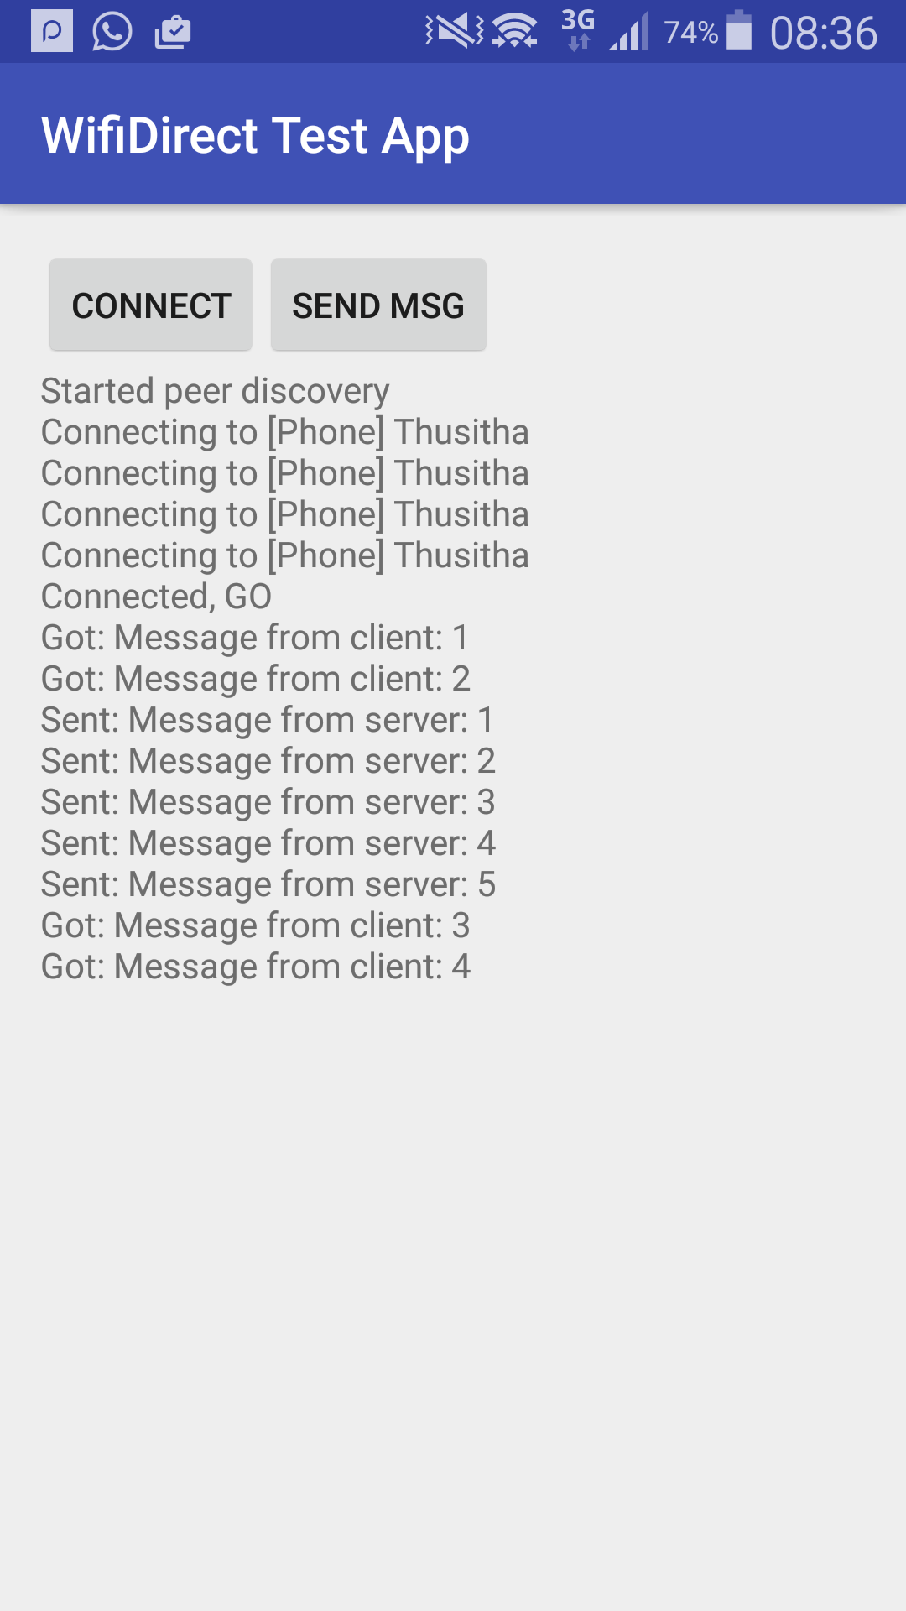
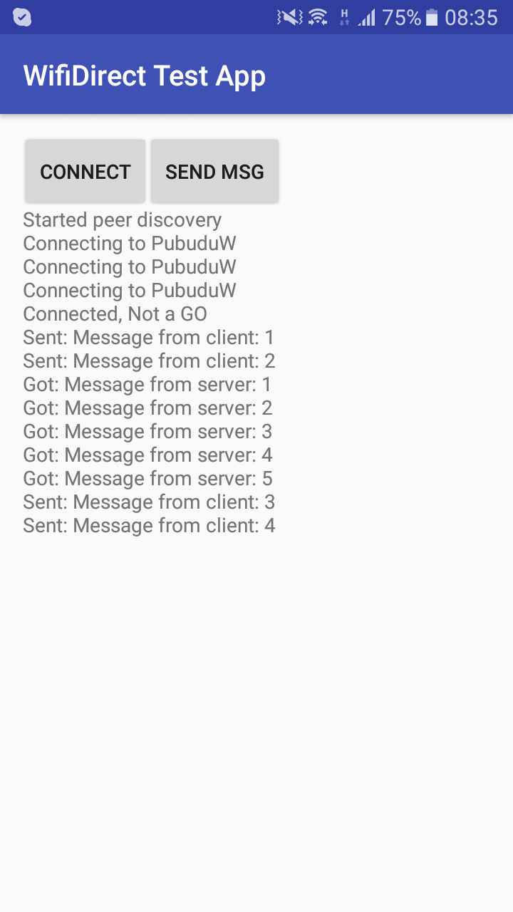
progress
Wi-Fi Direct Android app
Manual authentication
Exchange messages between group owner and group members

Slide 19
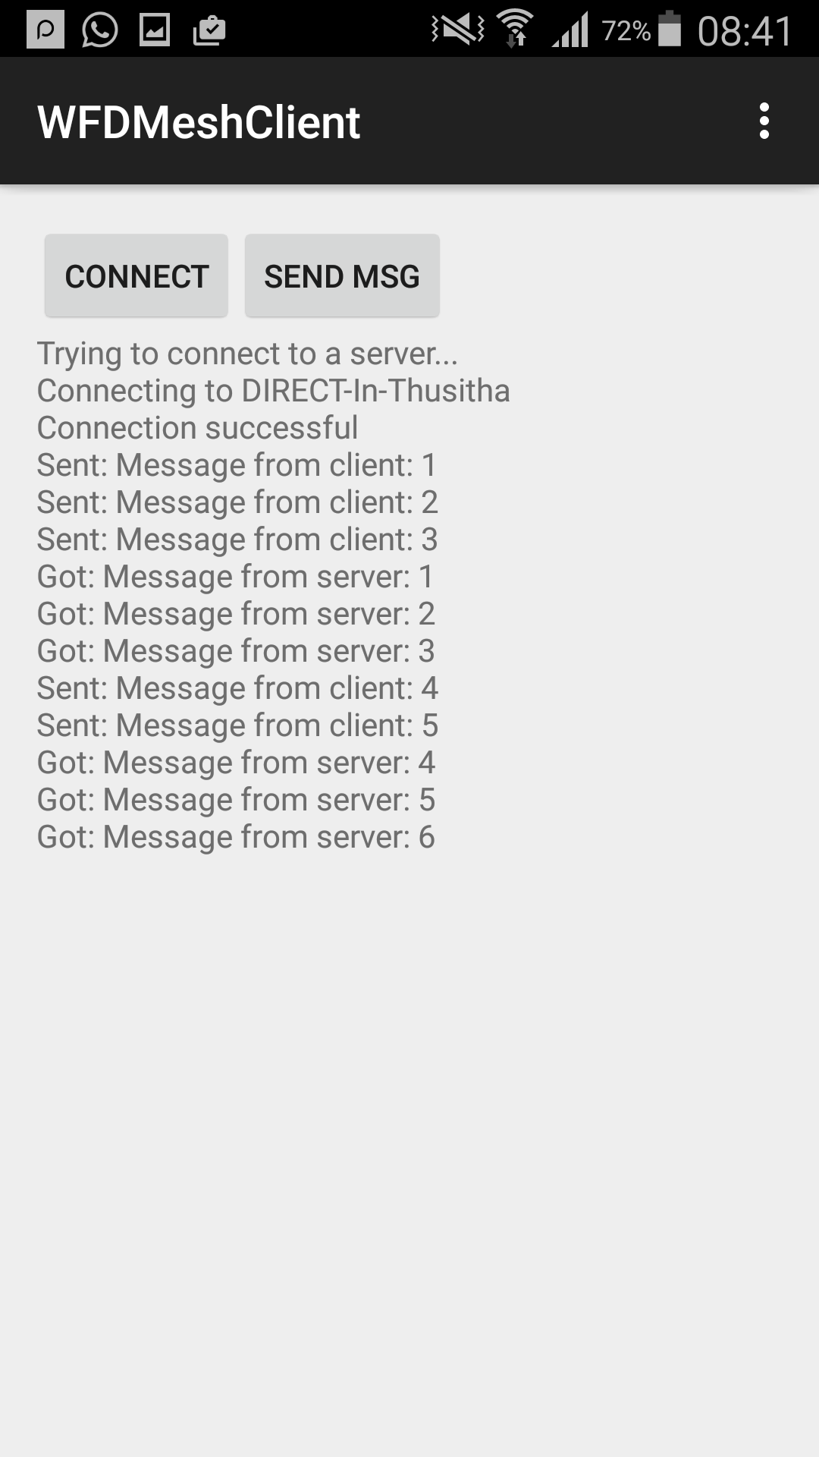
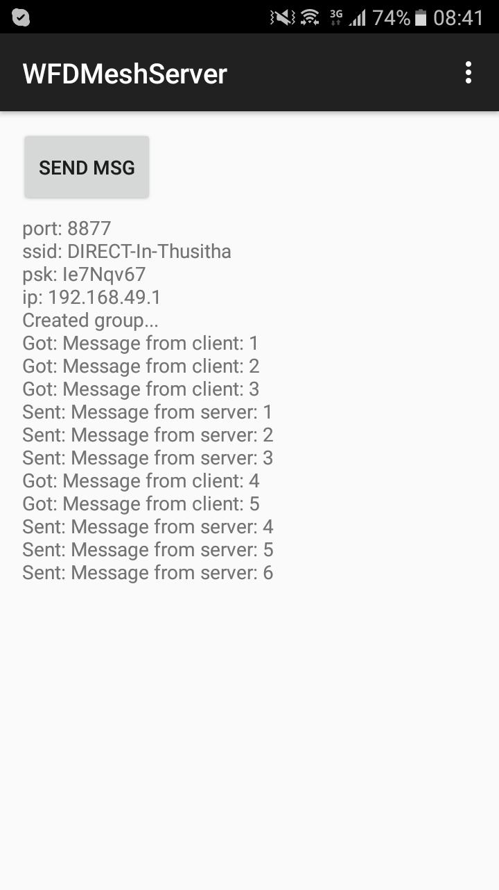
progress
Wi-Fi Direct Android app
Automatic authentication (WPA2)
Exchange messages between group owner and group members

Slide 20
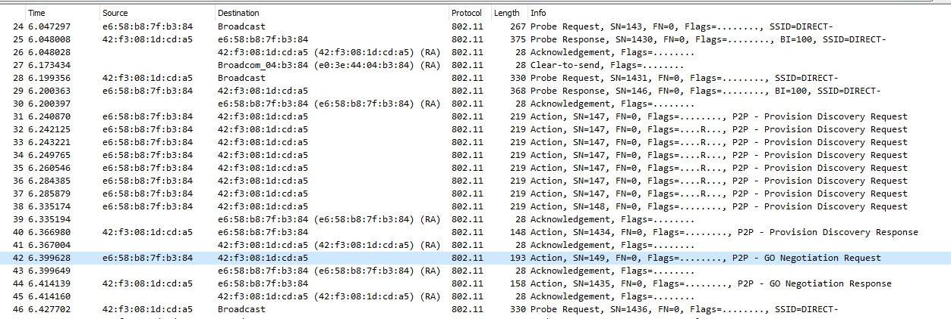
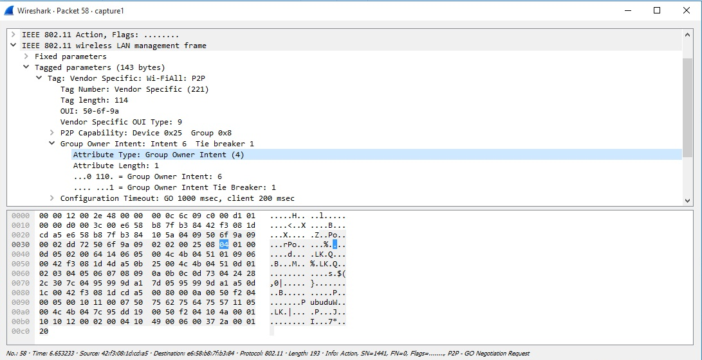
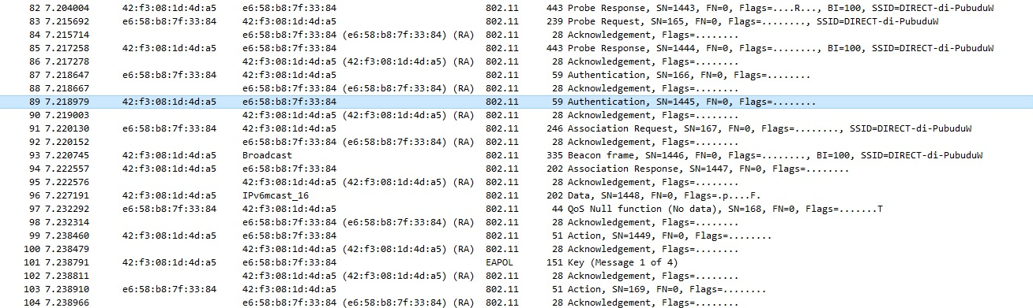
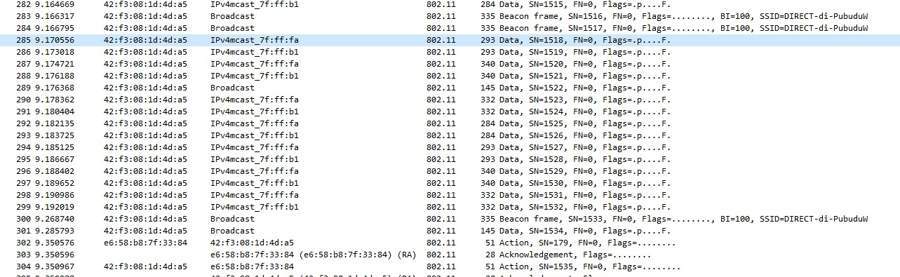
progress
Monitoring packets with Wireshark
Decryption of messages

Slide 21
Thank you…..!
Notes:
There are some application level
shortcomings identified in WD, such as, user intervention
required for connection, ambiguity in selecting a group to
join while more groups are available and implementation
differences between operating systems and versions. These
shortcomings also need to be addressed to fine tune WD for
VANETs.

