Slide 1



Thusitha Kariyawasam

Slide 2
Flow
Getting Started with angular
File Organization
Understanding Modules
Organizing modules
Definitions and roles
Controllers
Services
Directives
Scope
Communicating between components
Avoiding FOUC
Thinking Declaratively
Directives as a DSL
Breaking Down A Page into Components
$resource
Restangular
Betclic best practices
Security

Slide 3

Way of think with pure JavaScript
I won’t say I shed a tear, but I was a little frustrated because I’ve been using JavaScript since the 90’s and usually I pick up on stuff pretty quickly so I figured

Slide 4

When familiar with angular
AngularJS truly in my opinion is an awesome framework and so a lot of light bulbs went off. Once that started happening all the pieces fitted in and made total sense to me.

Slide 5
Single Page Application (SPA)
View 1
View 2
View 4
View 3

Slide 6
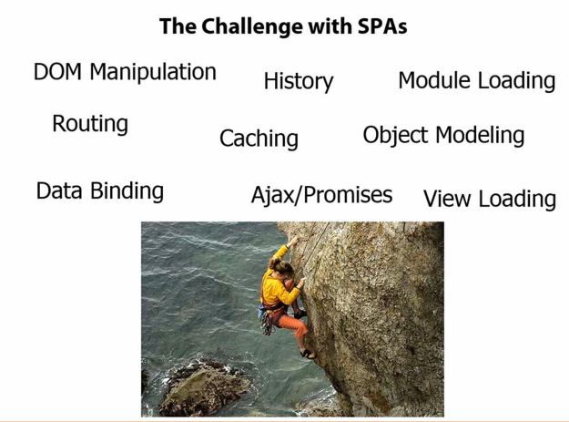
Challenge with SPA’s
Routing becomes a huge issue because you have to have some way to track “Where are we? And where are we going?”
All of this type of stuff you’re going to see is built into Angular. Now we can certainly do all this with different scripts out there.
But Angular, you’re going to see, provides a lot of cool features.

Slide 7
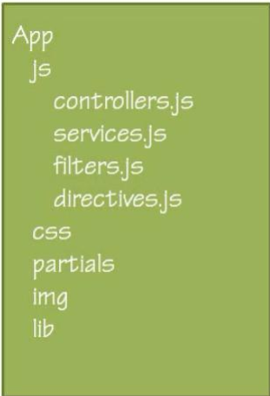
File Organization
Only for small

Slide 8
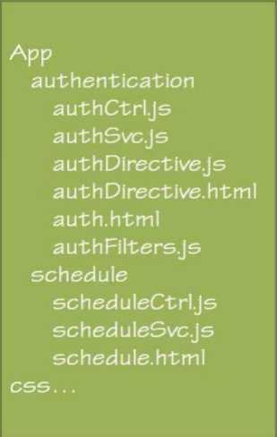
File Organization
For Feature app

Slide 9
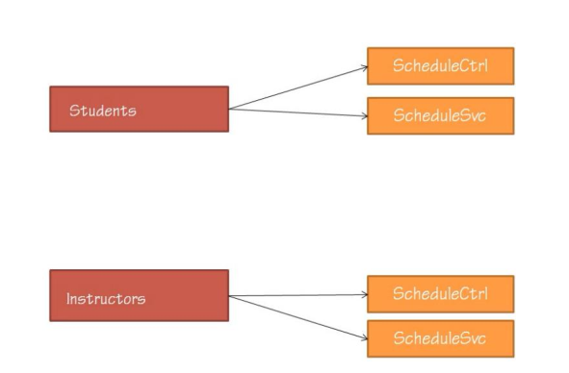
Namespacing and file naming
Why naming ?
– Object type reading
– Avoid collisions

Slide 10
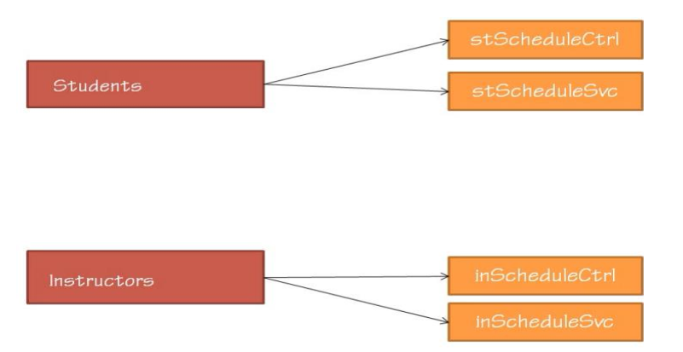
Namespacing

Slide 11
File naming
Controllers : ScheduleCtrl
• Services : ScheduleSvc
• Filters : RatingFilter
• Directives : small-schedule
• Partials :
– if my controller is ScheduleCtrl ScheduleCtrl.html
– If my directives is small-schedule small-schedule.html

Slide 12
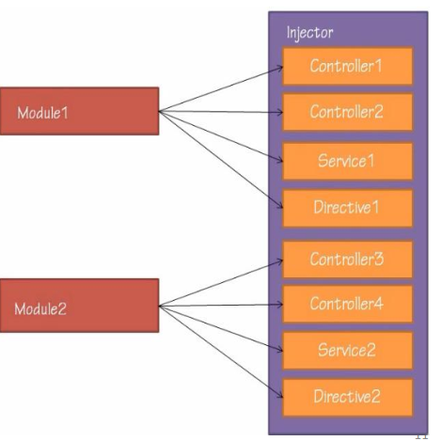
Understand Module
Modules have nothing to do
with object naming (so far…)
• The Injector has the list of all
the objects in our application
• Only one injector exists in each
Angular application

Slide 13
Organizing Module
One Module
+ it's the simplest option by far
you don't have to worry about how your module organization reflects the
organization of your files and folders, and you still only need to deliver the code
you want running in the browser.
- if you have code that you are sharing amongst several applications, then they
all need to have the same module name.
- delivering code as a third party or publishing it to the open source community
is not really a possibility

Slide 14
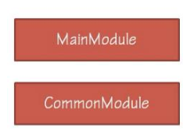
Organizing Module
Two Modules
One for code custom to the current application, and one for any shared code.
+ simplicity
- increased complexity, and some rigidity when sharing or publishing code.
This strategy works best if you will be building multiple applications that may
share some code, or if you intend to publish a portion of your code to third
parties, or you plan to open source it, say a library of widgets.

Slide 15
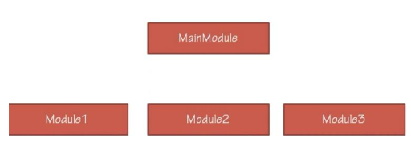
Organizing module
MainModule with several sub-modules
The MainModule may or may not have any actual objects in it, it might just be a
collection of sub-modules.
+ you have tons of organization for your code
Modules become an extra way to organize and deliver just the parts of your
application that you want to deliver.
- increased complexity of managing those different modules.
- build system will have to be more complex as well

Slide 16
Main Module with several sub-modules Example
var servicesA = angular.module('servicesA', []);
var servicesB = angular.module('servicesB', []);
var serviceApp = angular.module('serviceApp', ['servicesA‘, 'servicesB']);

Slide 17
Definitions and roles
•Controllers
– setup the scope
– view interaction
• Services
– handle non-view logic
– communicate with the server
– hold data & state (not the only one)
– DOM manipulation (code smell ;))
– Business
• Directives
– Manipulate DOM
– Receive View Events
• Views
– Display the application
– Declare bindings & directives

Slide 18
Controllers – Design guidelines
coordinate View and Model
Nothing else, the ctrl shouldn’t knwon the business logic or the model structure
angular.module('app').controller('scheduleCtrl',function($scope, schedule) {
$scope.schedule = schedule;
$scope.register = function(newClass) {
$scope.schedule.register(newClass);
}
});
• Limited # of collaborators
split the ctrl in smaller ones
Facade pattern
• Testable

Slide 19
Services - creation
A service is treated as a singleton, that is there is only one instance of a specific service available during the whole lifetime of the Angular application.This is different from e.g. a controller of which many instances can be created.
app.service(‘registration’, function() {
return {
title: ‘Service from Service’
}
});
But in Angular there are actually several way to create service

Slide 20
Services – constant
The constant function is essentially the same as the value function, except it's available during the app configuration phase.
app.constant(‘myValService’, ‘someValue’);
The difference between a value and a constant service is that the former can only be injected (and thus be used) in a service or a controller while the latter can also be injected into a module configuration function..
Dependancy Injection is not possible.

Slide 21
Services – constant
Example
app.constant(‘myValService’, ‘someValue’);
var app = angular.module('app', []);
app.config(function ($provide) {
$provide.constant('movieTitle', 'The Matrix');
});
app.controller('ctrl', function (movieTitle) {
expect(movieTitle).toEqual('The Matrix');
});

Slide 22
Next Day

