Slide 1
OFFLINE SIRI

Slide 2
User sends a query to the number provided
In order to get a number which can be used as a portal for the web we can get it using Twilio, it’s a service providing SMS and many other gateways and API’s.
You can buy a number from them for $1
Sends query
Returns with info
API takes in SMS requests
We can create our own API (maybe using Python or Java) which can take in requests.
Then the API which we have created can contact other API’s through Twilio responding with the information required by the user.
Thus inputting an automated response.
Sends query
Returns with info
The API we created then calls other API’s like Google Maps, Weather, Search etc
In order to make something so simple a little bit complex, we could use neural networks and machine learning to understand queries.

Slide 3
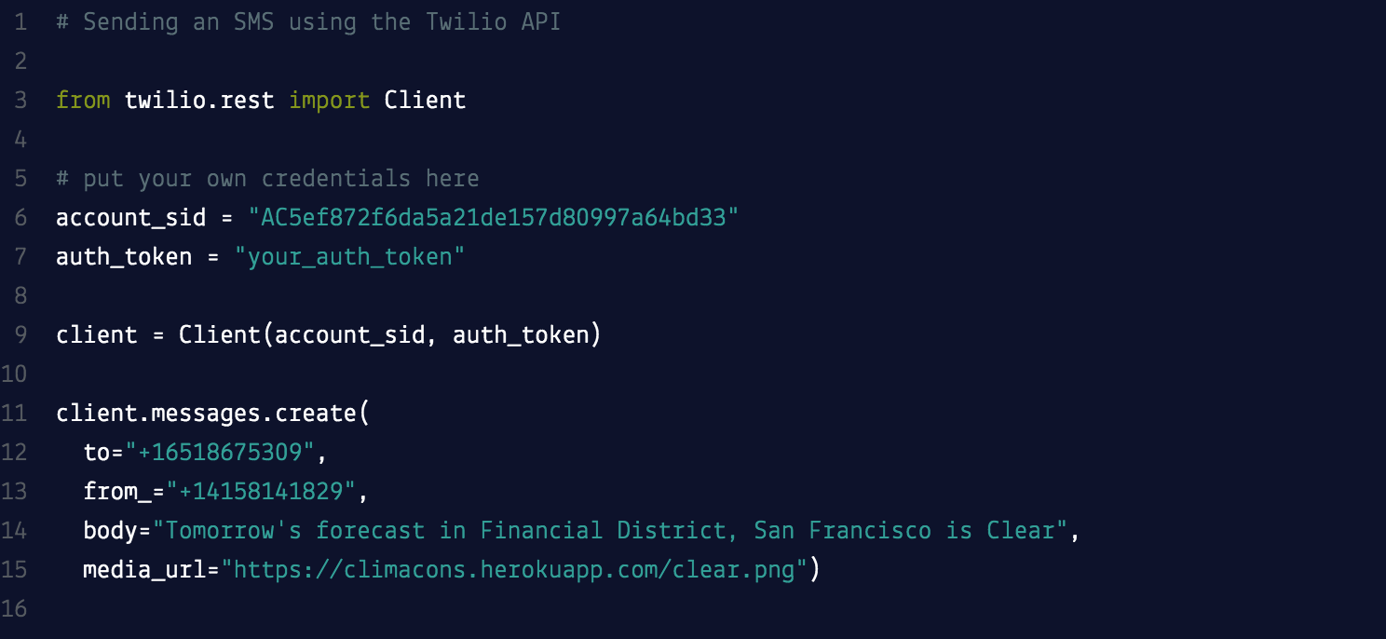
Example of sms api in python

Slide 4
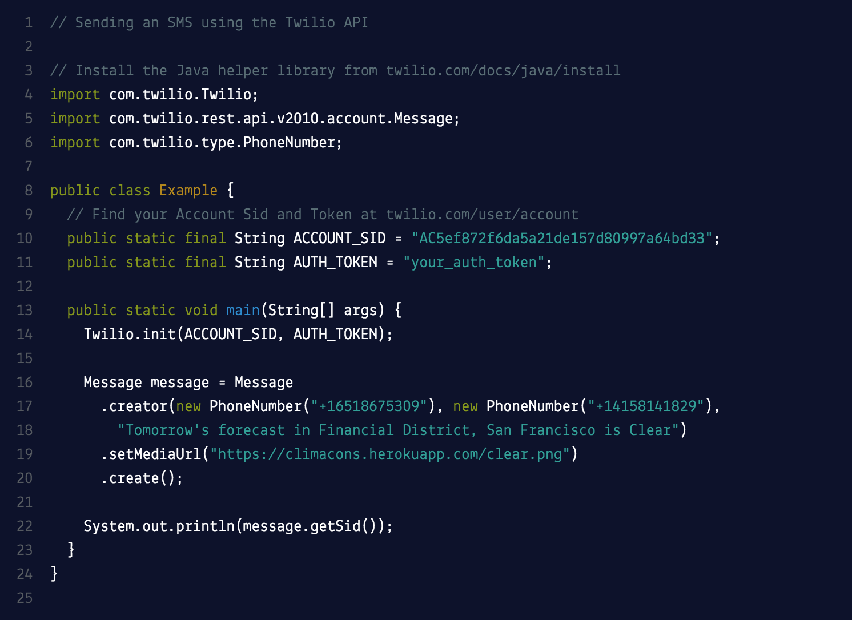
Example of sms api in java

Slide 5
Other languages
They also provide SMS API’s in these other languages:
PHP
Node
Ruby
.NET (C#) (These all depend on which one we are more comfortable using as a group)

Slide 6
PROS & CONS
Pros:
7/10 people (non computer science students) said they’d be willing to make use of such a service
There aren’t many things in the market already doing the same thing
Useful for when you don’t have data and need to use the web to search something important
Cons:
There isn’t much demand out there for a product like this, which could mean it may be unsuccessful too
We need to have knowledge of implementing security to pull something like this off efficiently
Could be slightly challenging

