Slide 1
MethodTrace Analyzing
Team Name: BitCoders
College:
Swami Keshvanand Institute of Technology Management & Gramothan jaipur
Team Size : 4
Team Members :
Talib hussain
Siddhant sharma
Sumit maindoliya
Mamta Siyak

Slide 2




Team Information
Talib Hussain
(ROLE : Team Leader
Java Backend developer)
Siddhant Sharma
(ROLE : Java Backend developer)
Sumit Maindoliya
(ROLE : Designing)
Mamta Siyak
(ROLE : Designing)

Slide 3
Index:
Problem
Proposed Work
Real Time Usage
Requirements
Creation of LOG file
LOG file
Technologies
Flow Diagram
Snapshot

Slide 4
Problem:
Method tracing is one of the commonly used post-mortem diagnostic method to identify problems. It consists of timestamp of entry and exit points for each method invocation. They may also contain stack-trace for each invocation. Depending upon the time for which trace data is collected, the file-size for these traces can be huge. Parsing them manually is a time-consuming and error-prone task. Gathering and comparing these data is time-consuming and prone to human error.
The challenge is to create an application to aid developers in debugging Java method trace files.

Slide 5
Proposed Work
Develop a Java based GUI application which can parse and compare multiple method trace files.
The primary goals would be to –
Compare two trace files: one from failing and passing case each and find out the anomaly.
Parse one or more trace file and suggest anomalies - I.e. Flag methods which are not completing their execution / Taking longer to execute. This will be helpful in addressing hang and performance related problems.
Parse one or more trace file and create a tabular and graphical view for the number of
times each method is invoked. Comparative view in case of multiple files.
Compare code-flow and stack trace for failing and passing case and find anomalies.

Slide 6
Real Time Usage
Debugging JAVA code
Analyzing and Visualizing file
Finding Number of Occurrence of any methods
Time taken by methods
Finding Abnormal execution of program.
Finding particular method that get Abnormally executed

Slide 7
Requirements
Desktop having necessary library installed.
OpenJDK installed.
Compiled JAVA file.

Slide 8
Creation of LOG file
1. java –Xtrace:none -Xtrace:methods=<class name>,maximal=mt,
trigger=“method{<class name>,jstacktrace}”,output=<trc file name>.trc
<class name>
2. java com.ibm.jvm.TraceFormat <trc file name>.trc <log file name>.log

Slide 9
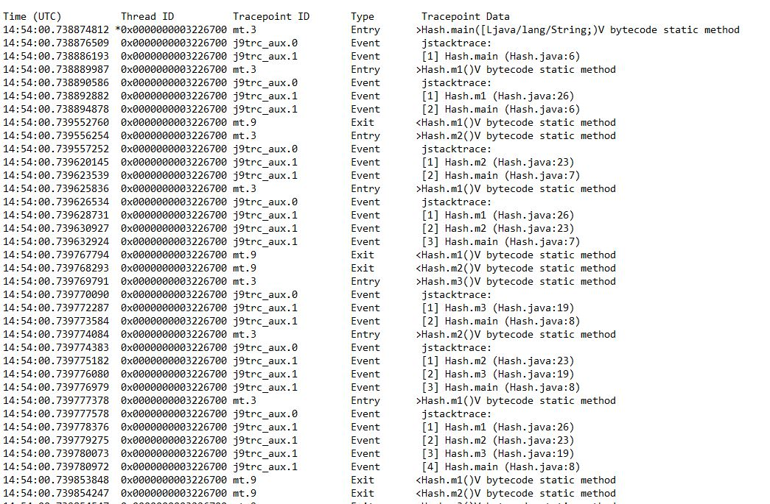
Log file

Slide 10

Tech and PL’s
Technologies
AWT
Swing
Java Libraries
java.jFreeChart
java.util.ArrayList
java.util.Stack
java.util.HashMap
java.util.Set
java.io.File
JFreeChart
Jcommon
Languages Used
JAVA
Requirements
OpenJDK
JFreeChart
IDE Used
NETBEANS

Slide 11
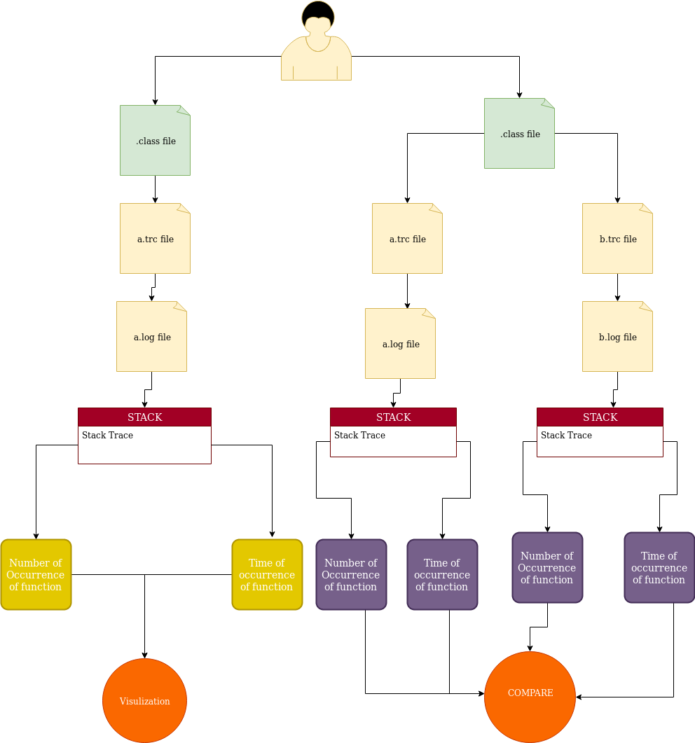
Flow Diagram

Slide 12
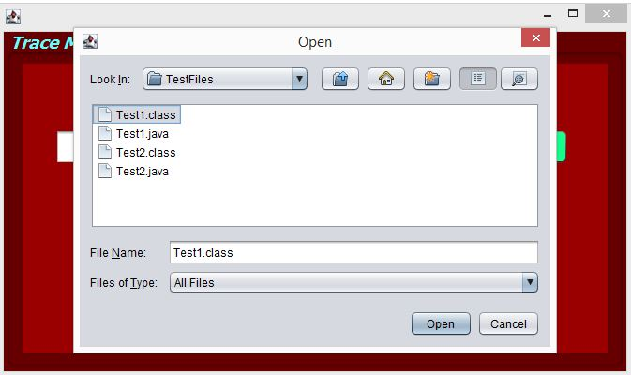
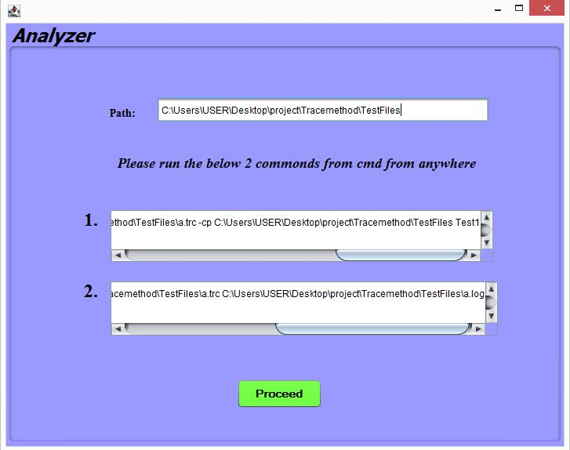
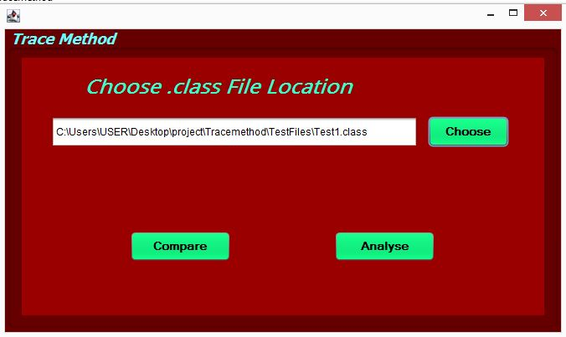
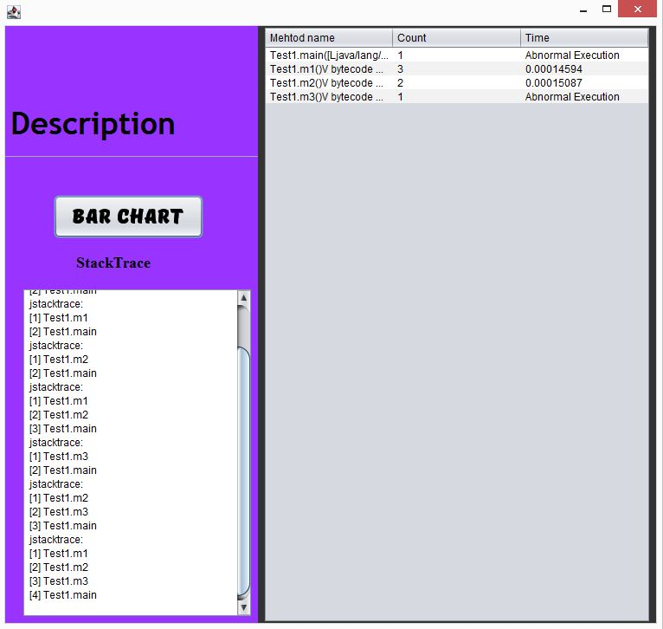
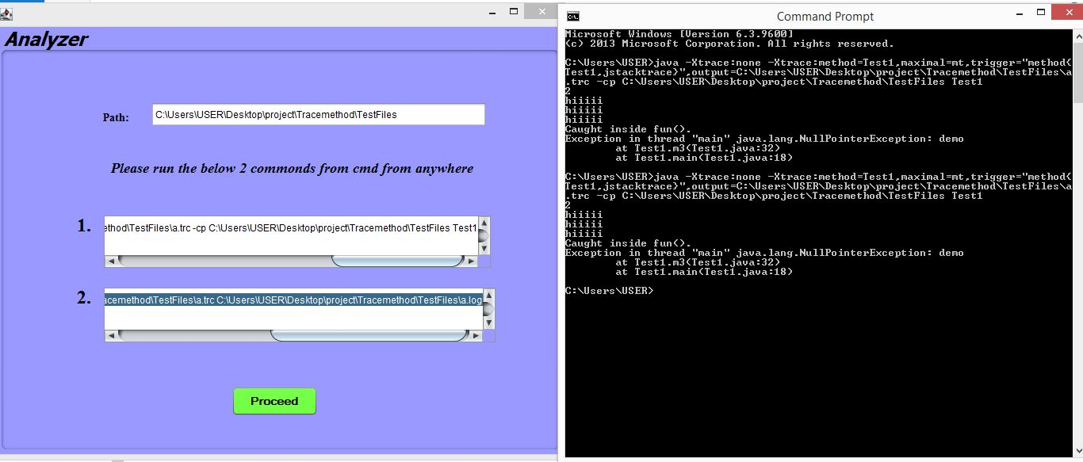
SnapShot Of Our Project

Slide 13
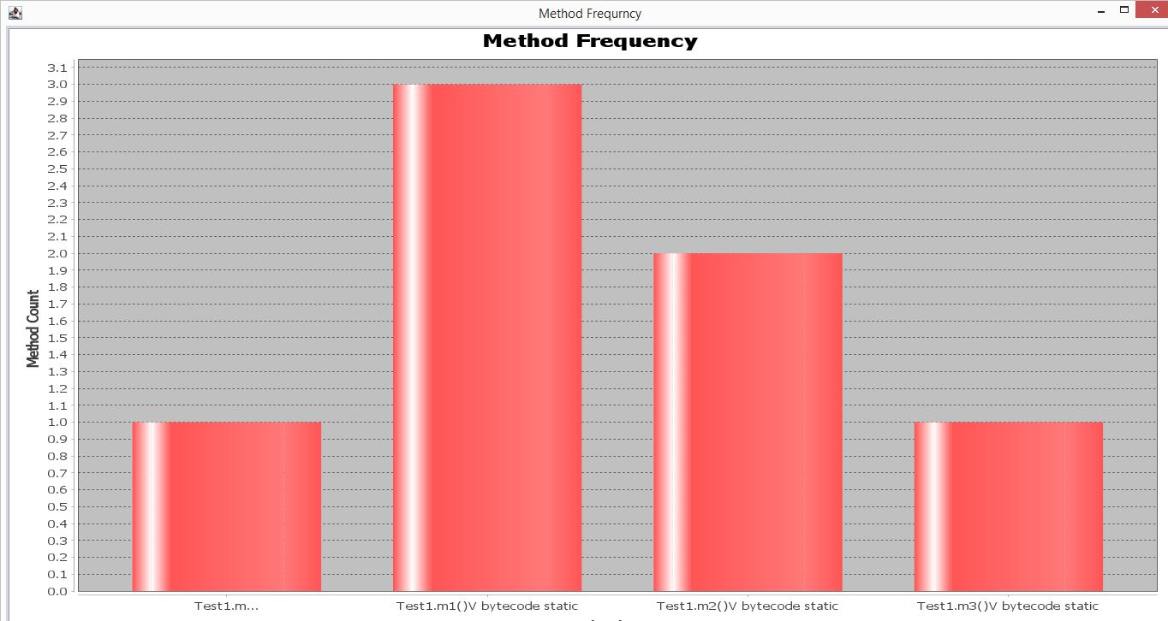
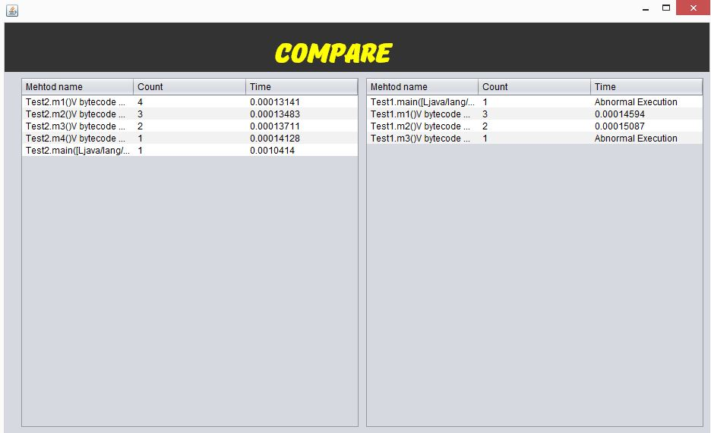
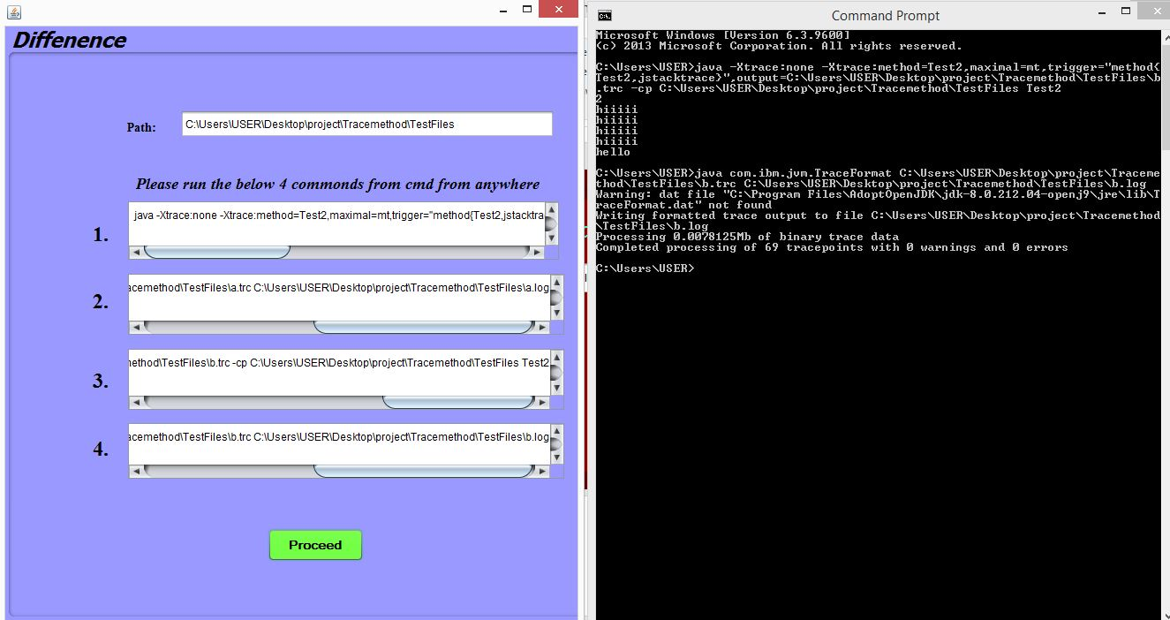

Slide 14
REFRENCES
Download IBM JVM (OPENJ9) with OpenJDK -
http://adoptopenjdk.net/
To learn more about IBM Java Method trace, please read –
https://www.ibm.com/support/knowledgecenter/SSYKE2_8.0.0/com.ibm.java.vm.80.doc/docs/trace_method_trace.html
Various Method tracing option -
https://www.ibm.com/support/knowledgecenter/SSYKE2_8.0.0/com.ibm.java.vm.80.doc/docs/trace_method_trace_examples.html
Example and explanation of what method trace looks like –
https://www.ibm.com/support/knowledgecenter/SSYKE2_8.0.0/com.ibm.java.vm.80.doc/docs/trace_method_trace_output.html
More information on IBM java tracing -
https://www.ibm.com/support/knowledgecenter/SSYKE2_8.0.0/com.ibm.java.vm.80.doc/docs/tracing.html

Slide 15
Thanks for Holding Up!!
Any questions?
Please let us know!!

