Slide 1

BIGMART SALES PREDICTION SYSTEM
A Project By
J.Thusyanthan
18/ENG/109
EN91392

Slide 2

CONTENTS
Introduction
Main objective
Timeline
Milestones
Methodology
Resources
Demonstration
Results
Challenges
Future developments
Conclusion

Slide 3
Introduction
Bigmart is a big supermarket chain, with stores all around the country and its current board set out a challenge to all Data Scientist out there to help them create a model that can predict the sales, per product.
The shop has collected sales data of products in different cities over a given period of time.
To find out what role certain properties of an item play and how they affect their sales by understanding Big Mart sales, the key factors that can increase their sales and what changes could be made to the product or store’s characteristics.

Slide 4
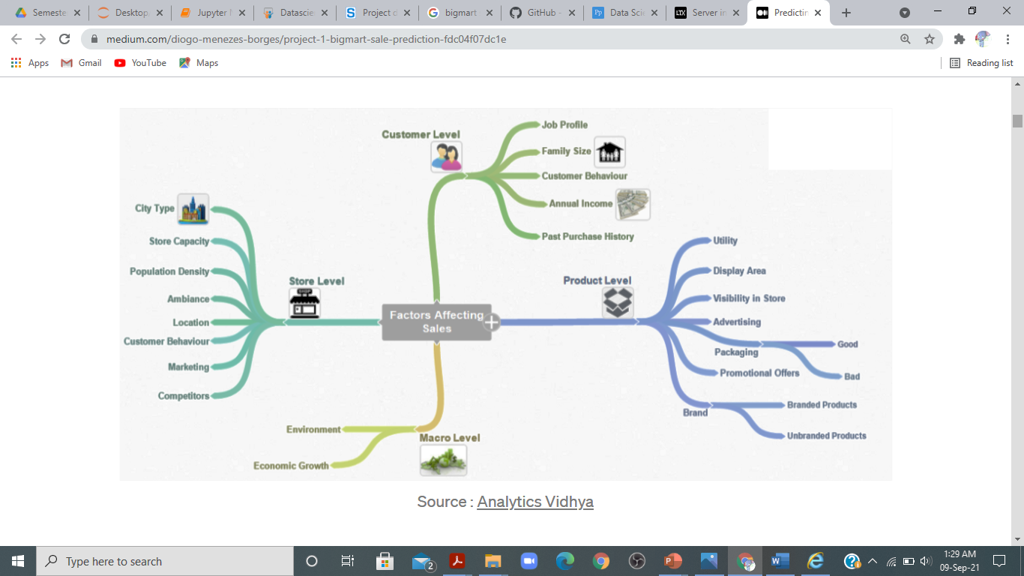


Slide 5
Table 1-Dataset characteristics
Variable | Description
Item identifier | Product Unique id
Item weight | Product Weight
Item fat content | Fat content of the product
Item visibility | Total percentage of product visible to customer from the store
Item type category | Product belong to which category
Item MRP | Price of the product
Outlet identifier | Store unique id
Outlet Establishment year | Established year of the store
Outlet size | Store size
Outlet location type | Type of located cities
Outlet type | Supermarket sort
Item outlet sales | Product sales in particular area

Slide 6
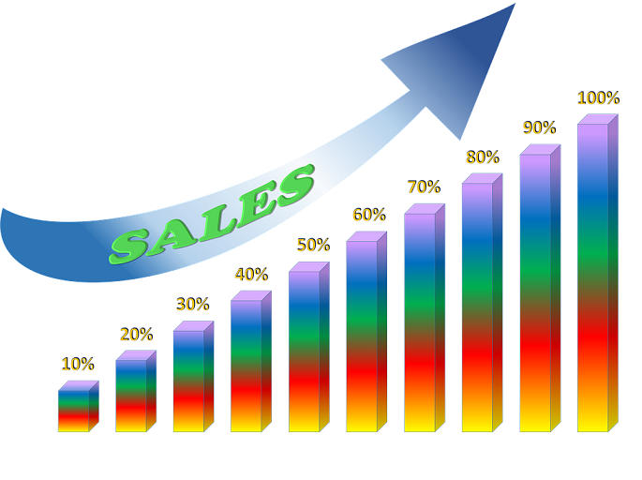
Main objective
Many Big mart sales businesses earning money at start and after some years some of their branches have net loss. Because of they haven’t much knowledge in predicting which product will sale high in future demanded products and which branch having high demand.
The aim of this project is to conduct a complete study of the sales prediction for big mart and build a predictive model and predict the sales of product.

Slide 7
Timeline
Activity | Week
 | 1 | 2 | 3 | 4 | 5 | 6 | 7 | 8 | 9 | 10
Case study
Data collection
Preprocessing
Algorithm design
Model development
Prediction phase
Interface development
System testing

Slide 8
Milestones
Collection of data.
Analyzing, preprocessing and feature extraction of the data set by handling the missing data and outliers.
Model building using various algorithms such as Linear Regression, Random Forest Regressor, Gradient Boosting Regressor, XGB Regressor, Ada Boost Regressor and Decision tree regressor.
Checking the accuracy of each algorithms to compare the accuracy of the model.
Design and implementation of predictive interface .

Slide 9
Methodology
Data set collection
Data Exploration
Data cleaning
Model building
Feature Engineering
Model validation
Results

Slide 10
Resources
Tools
Programming languages
Jupyter notebook
Visual studio code
Flask framework
GitHub
YouTube
Python
Html
CSS
Java script

Slide 11
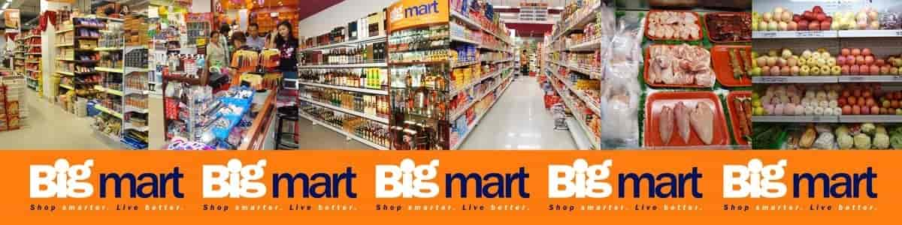
Demonstration
Let's go on a demonstration

Slide 12
Results
Algorithm | Accuracy(%)
Linear Regression | 56.44
Decision Tree Regressor | 100
Random Forest Regressor | 93.74
Ridge | 56.44
Gradient Boosting Regressor | 65.56
Ada Boost Regressor | 43.69
XGB Regressor | 85.76

Slide 13
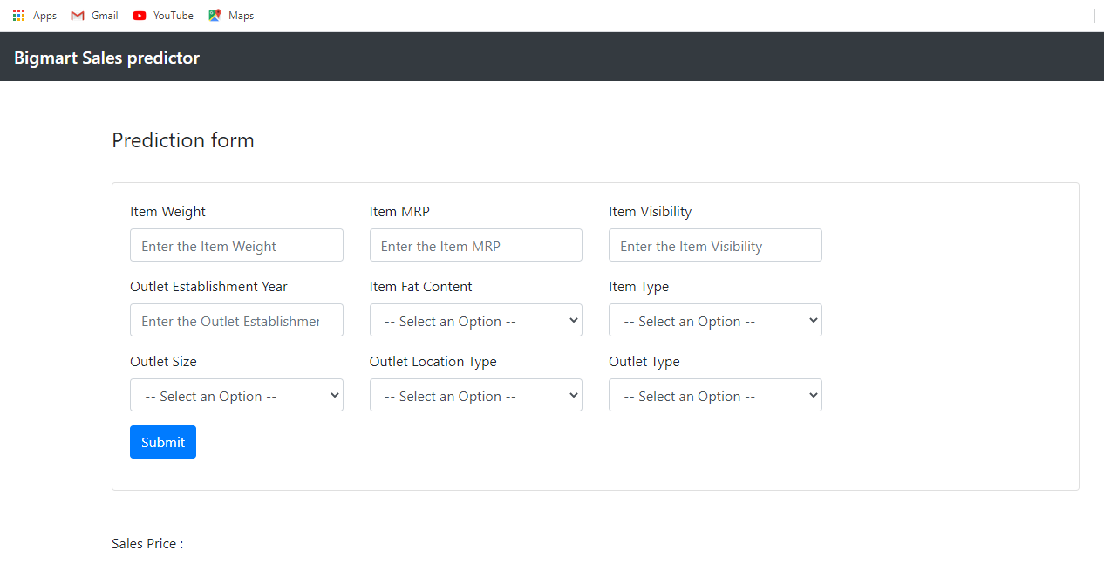
Screenshot of Interface

Slide 14

Challenges
Data set data is confidential, not original data so predictions may be gone wrong.
There are many algorithms for predictions so have to choose best algorithms among all.
Finish the project effectively on time.
Solve the bugs can be harder at the end of project.
Failure in system when presenting.

Slide 15

Future Developments
Can use both classification and clustering algorithms also.
Also can user hybrid of classification and clustering algorithms.
Design the user interface more user friendly.

Slide 16
Conclusion
Finally developed a bigmart sales prediction system using machine learning knowledge and developed as a web application.

Slide 17

THANK YOU!

