Slide 1
BUILD A PROGRAM TO SHARE PRINTERS ON NETWORK
Students: Hoang Vu Da Quynh 19IT6
Thai Thi Thu Xuan 19IT5
Instructor: M.Sc. Nguyen Thanh Cam

Slide 2
TABLE OF CONTENTS
01
02
03
INTRODUCTION
THEORETICAL BASIS
PROGRAM INTERFACE
General Introduction To The Topic
Analyze the operating principle of the program
Program interface and functions

Slide 3
PROBLEM
In the daily work of office workers, they often have to print a lot of different documents for meetings or customer contact, but each office usually has only 1 printer. Therefore, each printing will be very time consuming, especially if you have to print in large quantities.

Slide 4
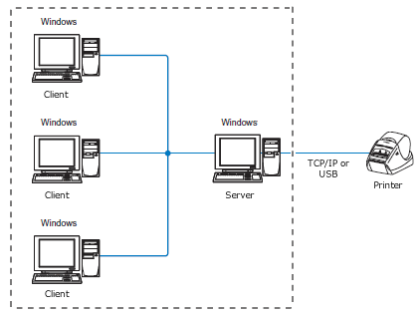
OUR SOLUTIONS
BUILD A PROGRAM TO SHARE PRINTERS ON NETWORK
A java program, to share printers over LAN so that all employees can share, is programmed according to the client - server model.

Slide 5
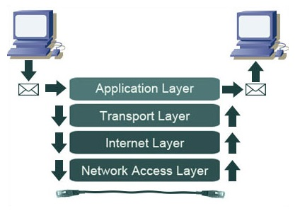
THEORETICAL BASIS
TCP/IP protocol

Slide 6
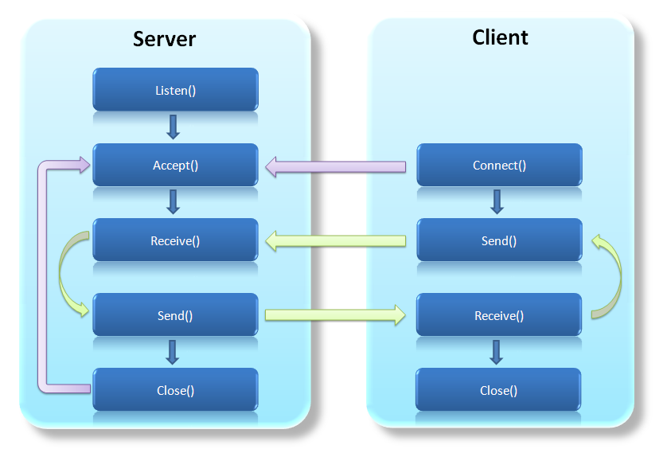
THEORETICAL BASIS
Client/Server model

Slide 7
PROGRAM INTERFACE

Slide 8
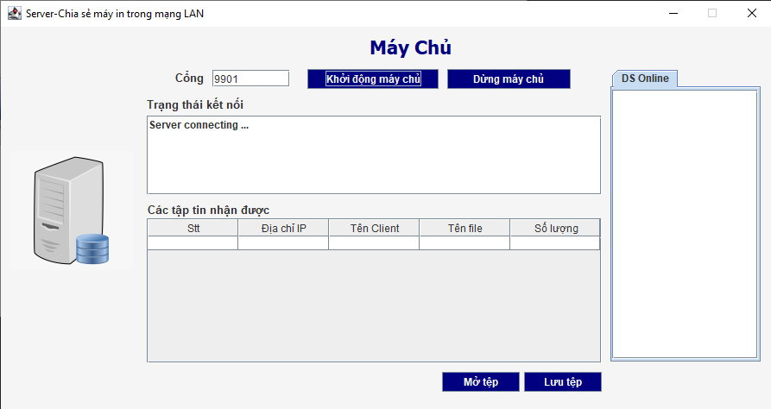
SERVER

Slide 9
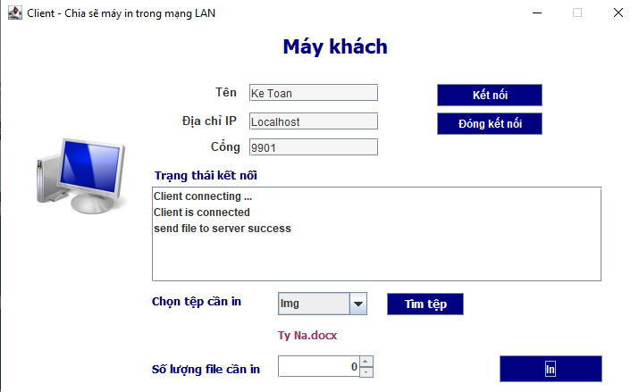
CLIENT

Slide 10
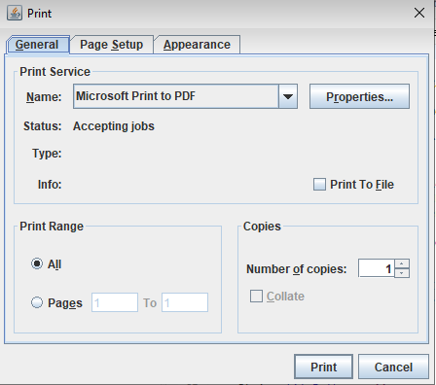
PRINT

Slide 11
THANKS FOR YOUR LISTENING
Do you have any questions?

