Slide 1
EDLD610 Final Project presentation Multilateral Environmental Treaties 1857 - 2016
Thuy Nguyen

Slide 2
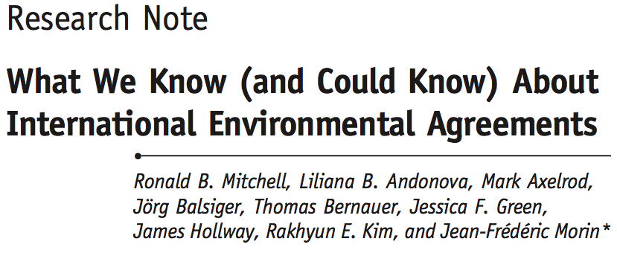
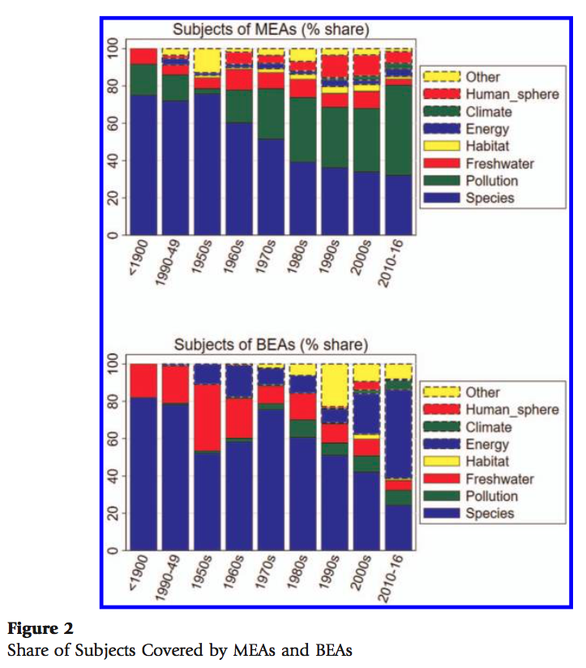
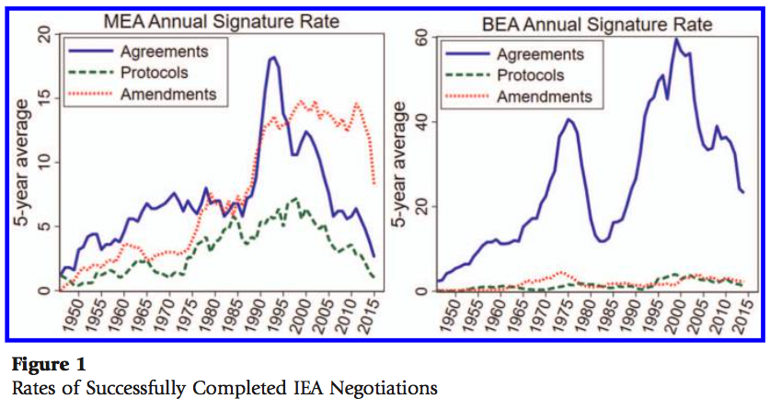
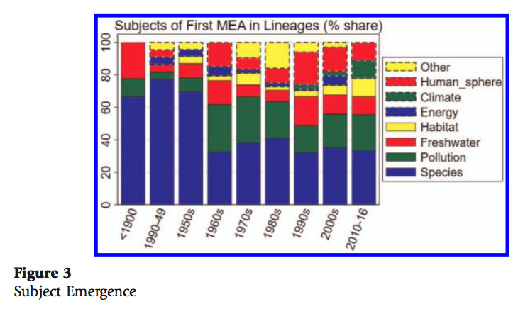

Slide 3
Change in number of agreements over time

Slide 4
Change in type of agreements over time

Slide 5
Change in type of agreements over time

Slide 6
Change in type of agreements over time

Slide 7
Change of subjects

Slide 8
break in time period geom_text(nudge_y = -1, size = 2) patchwork color! Changes of type of subjects (Manually done)

