Slide 1
Table Views and Collection Views
Presenter: ThúyNTP
Date: 31/10/2014

Slide 2
Contents
Table Views
Table View Cells
Table View Data
Table View Selection
Table View Scrolling and Layout
Table View State Restoration
Table View Searching
Table View Editing
Table View Menu
Collection Views

Slide 3
Table View Cells
Built-In Cell Styles
initWithStyle:reuseIdentifier:
Có 4 style sau:
UITableViewCellStyleDefault: có một UILabel và một UIImageView ở bên trái (optional).
UITableViewCellStyleValue1: có 2 UILabel và một UIImageView ở bên trái (optional).
textLabel: căn trái
detailTextLabel: căn phải. Nếu textLabel quá dài thì detailTextLabel sẽ không xuất hiện.
UITableViewCellStyleValue2: có 2 UILabel.
textLabel: căn phải, fixed size, text sẽ bị cắt bớt nếu quá dài
detailTextLabel: căn trái, nt.
UITableViewCellStyleSubtitle: có 2 UILabel, căn trái và một UIImageView ở bên trái (optional).

Slide 4
Table View Cells
Custom Cells
Overriding a cell’s subview layout
Adding subviews in code
Designing a cell in a nib

Slide 5
Table View Data
Table view Sections
- (NSString *)tableView:(UITableView *)tableView titleForHeaderInSection:(NSInteger)section;
- (UITableViewCell *)tableView:(UITableView *)tableView cellForRowAtIndexPath:(NSIndexPath *)indexPath;
- (NSInteger)tableView:(UITableView *)tableView numberOfRowsInSection:(NSInteger)section;
- (NSInteger)numberOfSectionsInTableView:(UITableView *)tableView;

Slide 6
Table View Data
Refreshing Table View Data
[self.tableView reloadData];
[self.refreshControl addTarget:self action:@selector(doRefresh: ) forControlEvents:UIControlEventValueChanged];

Slide 7
Table Views
Table View Selection
tableView:shouldHighlightRowAtIndexPath: (new in iOS 6)
tableView:didHighlightRowAtIndexPath: (new in iOS 6)
tableView:didUnhighlightRowAtIndexPath: (new in iOS 6)
tableView:willSelectRowAtIndexPath:
tableView:didSelectRowAtIndexPath:
tableView:willDeselectRowAtIndexPath:
tableView:didDeselectRowAtIndexPath:

Slide 8
Table Views
Table View Scrolling
[self.tableView scrollToRowAtIndexPath:(NSIndexPath *) atScrollPosition:(UITableViewScrollPosition) animated:(BOOL)];
[self.tableView scrollToNearestSelectedRowAtScrollPosition:(UITableViewScrollPosition) animated:(BOOL)];

Slide 9
Table Views
Table View Editing
Inserting Table Items
Editable Content in Table Items
Delete Table Items

Slide 10
Table Views
Table View Menus
- (BOOL)tableView:(UITableView *)tableView shouldShowMenuForRowAtIndexPath:(NSIndexPath *)indexPath;
- (BOOL)tableView:(UITableView *)tableView canPerformAction:(SEL)action forRowAtIndexPath:(NSIndexPath *)indexPath withSender:(id)sender;
- (void)tableView:(UITableView *)tableView performAction:(SEL)action forRowAtIndexPath:(NSIndexPath *)indexPath withSender:(id)sender;

Slide 11
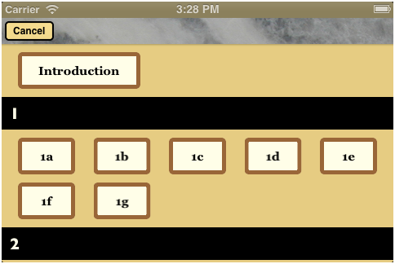
Collection Views

Slide 12
Collection Views
numberOfSectionsInCollectionView
numberOfItemsInSection
cellForItemAtIndexPath
sizeForItemAtIndexPath

