Slide 1


RICHFIELD CHAIRS
E-PROJECT
Implementation Group: NGUYEN DUC HIEU (Leader)
Teacher’s Guide: NGUYEN VAN HOANG
Class: ACCP1911

Slide 2
Introduction Subject
  Company Introduction
Richfield Chairs is an organization selling Chairs. They produce various chairs of different types suiting every requirement and into various sizes, starting from kids to office to home and etc.
  Main missions
The site should work well in all leading browsers including Chrome, IE, Fire fox etc.
The website will help the customers in choosing the chair as per their requirements.
The website is to be developed for the Windows Platform using HTML5, JavaScript and Geolocation

Slide 3
Introduction Subject
  Hardware Requirements
A minimum computer system that will help you access all the tools in the courses is a Pentium 166 or better
64 Megabytes of RAM or better
  Software Requirements
Notepad/HTML editor
Dreamweaver
IE 10.0/ Netscape 6.0/Chrome/Firefox

Slide 4

Introduction Subject
RESPONSIVE DESIGN
WITH BOOTSTRAP 4

Slide 5
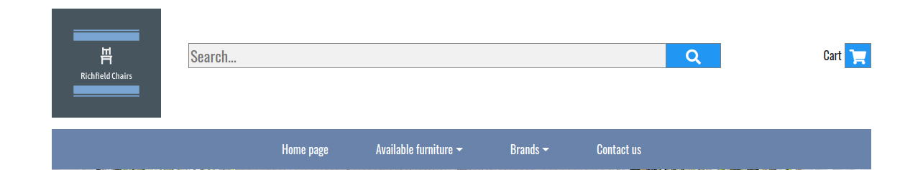
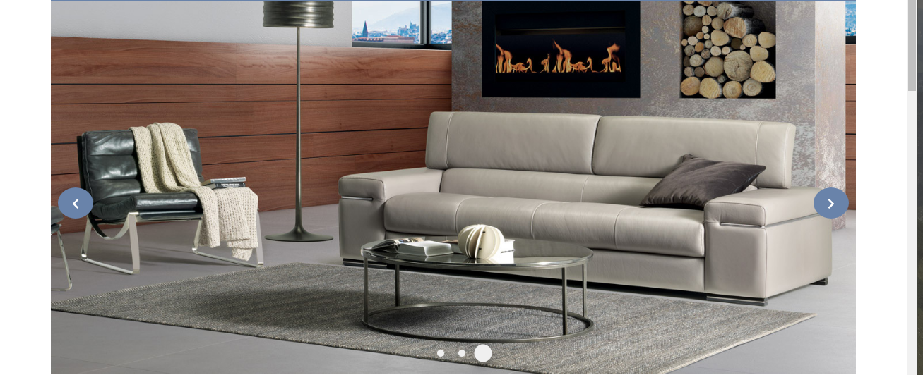
Analysis Design
The Home Page should be created making use of Sections with a suitable logo, the header section can be added which will show images chairs.

Slide 6
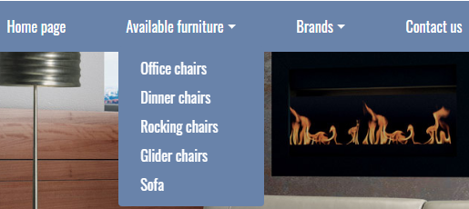
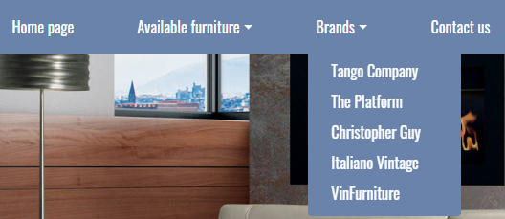
Analysis design
The site must contain the links to navigate through any category for the information.
The site should display a menu which will contain the options for brief introduction about the various furniture’s available, location of the shop and any other information if required.
The information should be categorized according to the brand names of the chairs like if a User wants to see only “LEO” chairs or any other companies chairs then he/she can click on a Link/button/menu etc and can see only that Brand chairs.

Slide 7
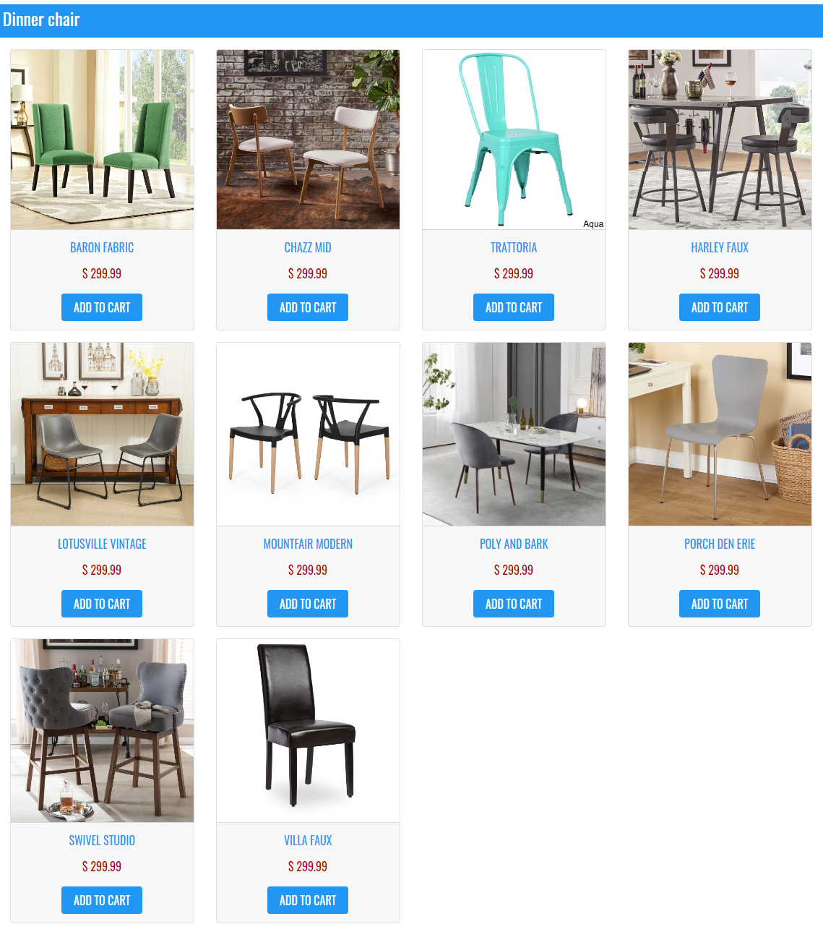
Analysis Design
When a user selects any particular brand, a list of chairs for that brand will be displayed

Slide 8
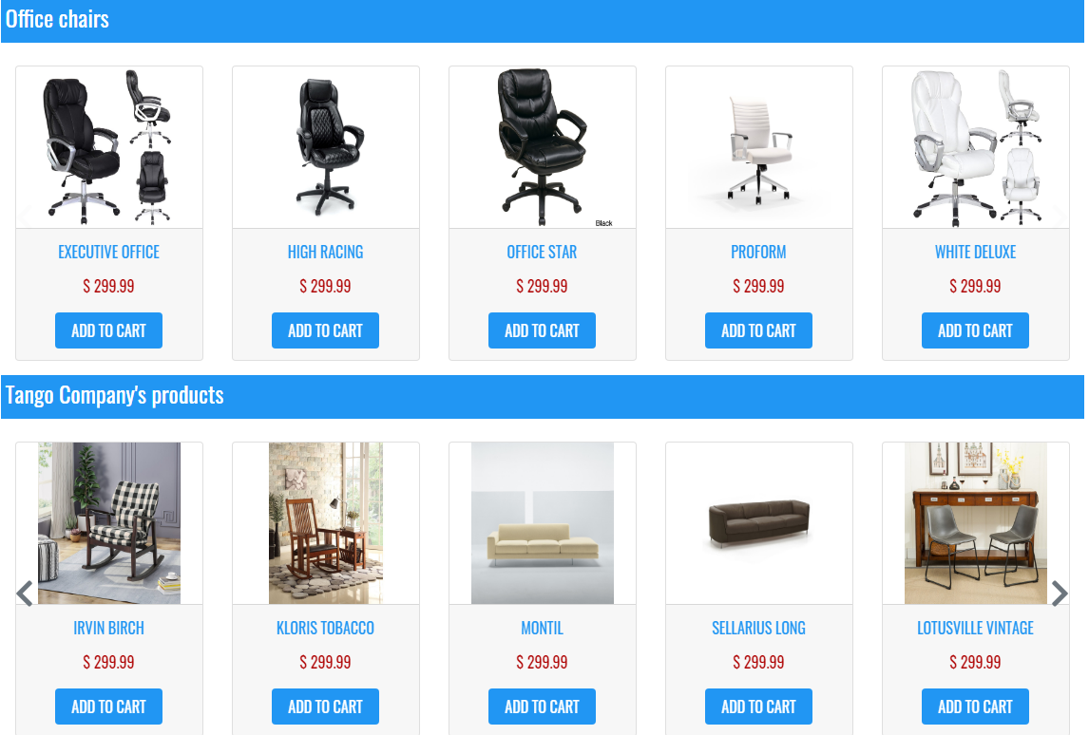
Analysis Design
The user should also be able to compare the various chairs of different as well as similar brands.

Slide 9
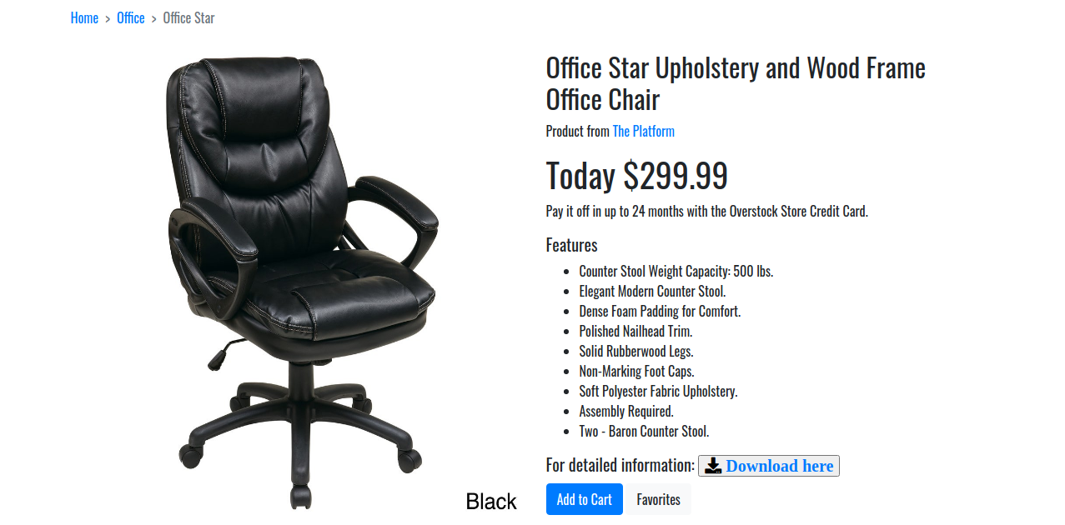
Analysis Design
A brief summary of features of the chairs should be displayed on the Web Page along with the picture but detailed Features should be stored in Individual Word documents which can be downloaded or viewed by the User who wishes to see the same.

Slide 10
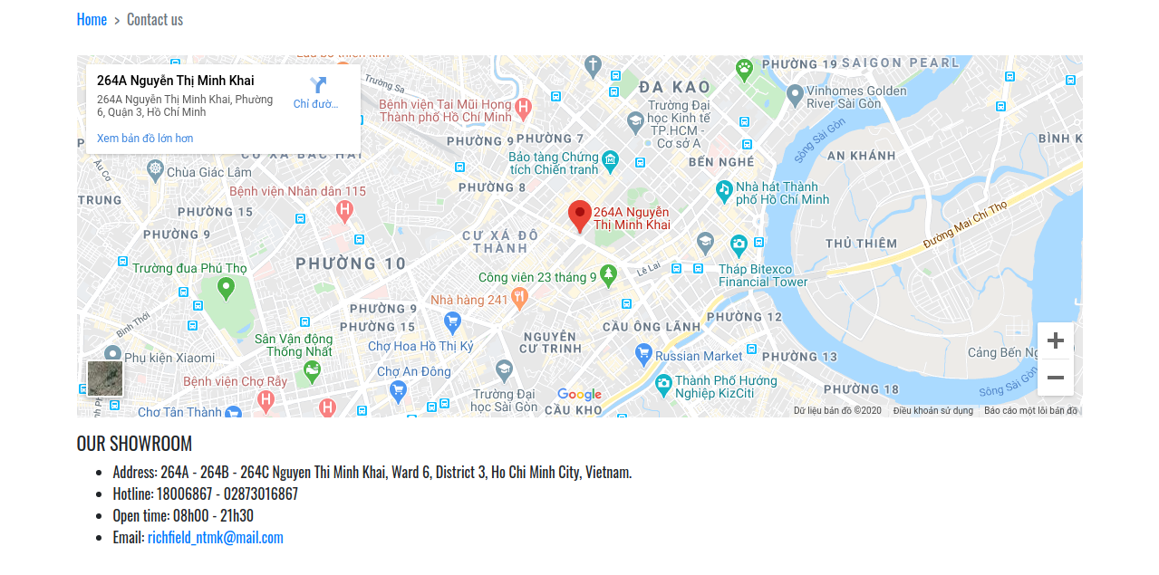
Analysis Design
There should be a “Contact Us” page which will have the Address of the Company which should be displayed using GeoLocation API (eg. GoogleMaps) and the email address which when clicked will invoke the local mail client from where they can send an email.

Slide 11
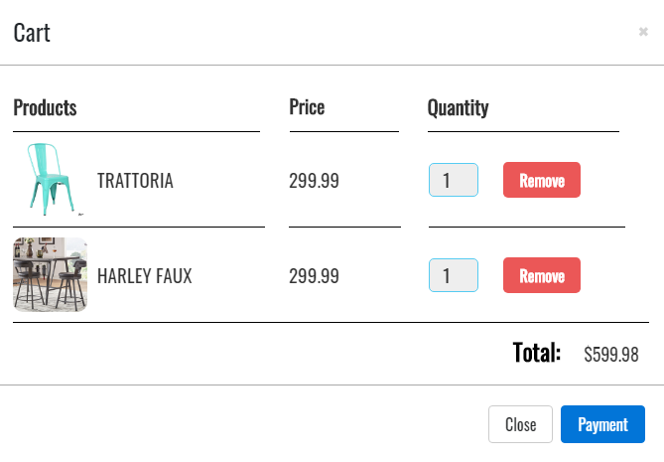
Shopping Cart
Add products to cart.
Increase or decrease quantity of chosed products.
Remove chosed product.
Total price will be showed.
Payment successful.

Slide 12
DEMO

