Slide 1
CS522 – Big Data PROJECT PRESENTATION
Students:
Thi Luong Dinh 985443
Dinh Tan Luong 985408

Slide 2
Pseudo code for PAIR approach
class Reducer
total = 0
method Reduce(pair p; counts [c1; c2; …])
s = 0
for all count c in counts [c1; c2; …] do
s = s + c
if (u in pair (w; u) == *)
total = s
else
Emit(pair p; count s/total)
class Mapper
method Map(docid a; doc d)
for all term w in doc d do
for all term u in Neighbors(w) do
Emit(pair (w; u); count 1)
Emit (pair (w; *); count 1)

Slide 3
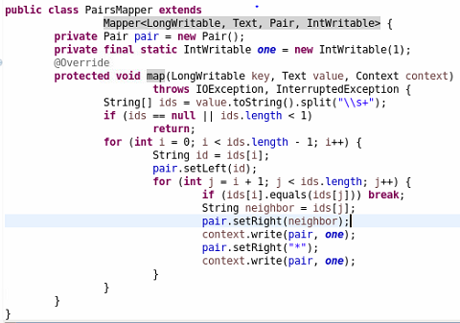
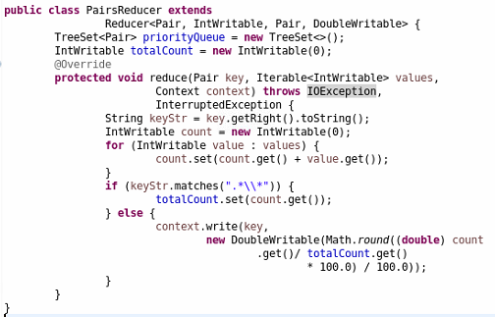
Java code for PAIR approach

Slide 4

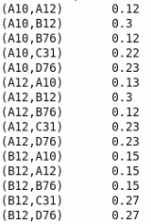
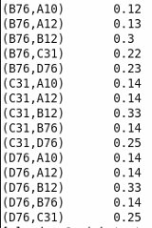
Result of PAIR approach

Slide 5
Pseudo code for STRIPE approach
class Mapper
method Map(docid a; doc d)
for all term w in doc d do
H = new AssociativeArray
for all term u in Neighbors(w) do
H{u} = H{u} + 1 . //Tally words co-occurring with w
Emit(Term w; Stripe H)
class Reducer
method Reduce(term w; stripes [H1;H2;H3; : : :])
Hf = new AssociativeArray
count = 0
for all stripe H in stripes [H1;H2;H3; …] do
count += Sum(Hf; H)
Hf = Hf / count
Emit(w; Hf )

Slide 6
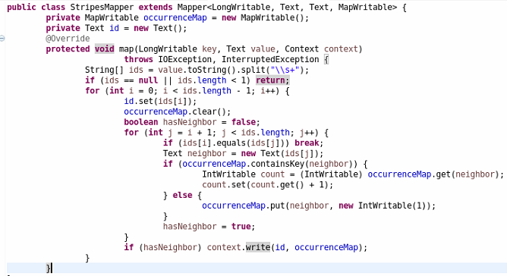
Java code for STRIPE approach - Mapper

Slide 7
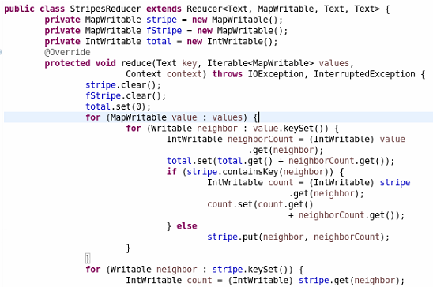
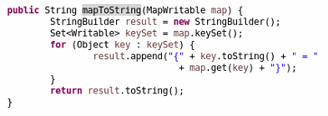

Java code for STRIPE approach - reducer

Slide 8
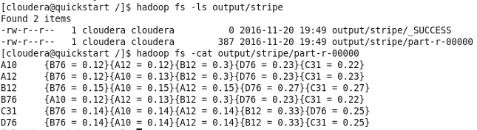
Result of STRIPE approach
Pair approach results

Slide 9
Pseudo code for HYBRID approach
class Reducer
method Initialize
w = null
H = new AssociativeArray
total = 0
method Reduce(pair p; counts [c1; c2; ...])
if (w != p.w)
if (w != null)
Emit(w, H/total)
H = new AssociativeArray
total = 0
w = p.w
u = p.u
count = Sum (counts [c1; c2; ...])
total += count
H{u} += count
method close
Emit(w, H/total)
class Mapper
method Map(docid a; doc d)
for all term w in doc d do
for all term u in Neighbors(w) do
Emit(pair (w; u); count 1)

Slide 10
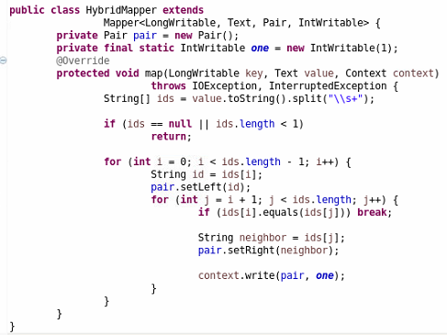
Java code for HYBRID approach - MAPPER

Slide 11
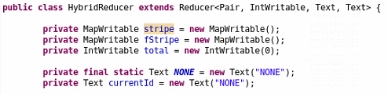
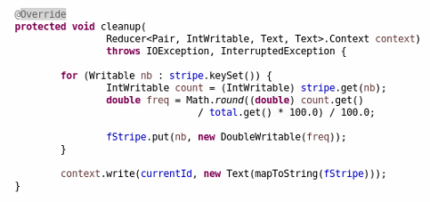
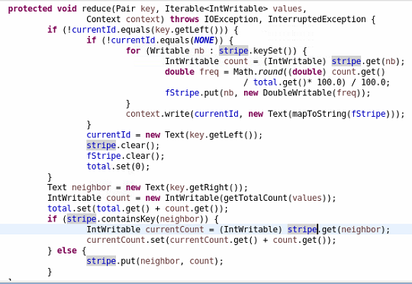
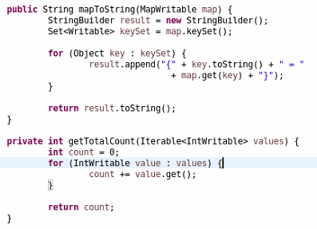
Java code for HYBRID approach - REDUCER

Slide 12
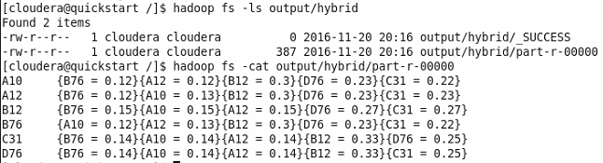
Result of HYBRID approach
Stripe Approach
Results

Slide 13
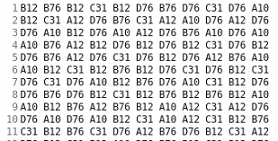
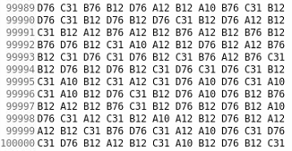
Comparison
Input data
100,000 records
Time consuming
SLOWEST
FASTEST
No | Pairs | Stripes | Hybrid
1 | 2 m 15 s | 56 s | 1 m 4 s
2 | 1 m 45 s | 54 s | 1 m
3 | 1 m 47 s | 55 s | 1 m 9 s
4 | 2 m | 57 s | 1 m 3 s

Slide 14
Apache Log Analysis
Computing the frequency of each response code
Computing the average, max, min of content size
All IP Addresses that have accessed more than N times
Generating a list of URLs, sorted by hit count
64.242.88.10 - - [07/Mar/2004:16:47:12 -0800] "GET /robots.txt HTTP/1.1" 200 68
IP Address
Requested URL
Response code
Content size

Slide 15
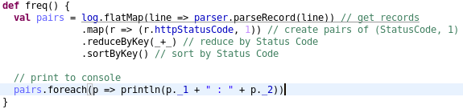
Computing the frequency of each response - code

Slide 16
Computing the frequency of each response - RESULTS
Code | Count
200 | 1274
302 | 6
304 | 137
401 | 123
404 | 5
408 | 1

Slide 17
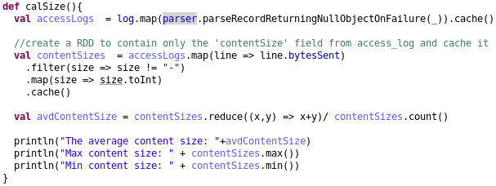
Computing the average, max, min of content size – code

Slide 18
Computing the average, max, min of content size – Result (byte)
Max | 138789
Min | 0
Average | 7777

Slide 19
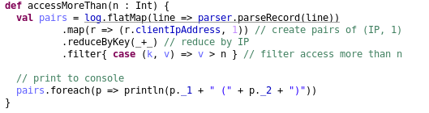
All IP Addresses that have accessed more than 40 times - code

Slide 20
All IP Addresses that have accessed more than 40 times - results
IP Addresses | Count
10.0.0.153 | 270
cr020r01-3.sac.overture.com | 44
64.242.88.10 | 452
h24-71-236-129.ca.shawcable.net | 51

Slide 21
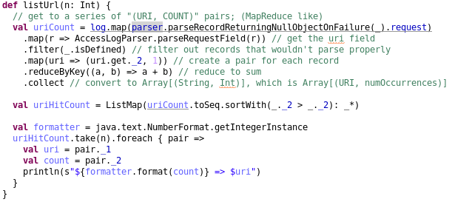
Generating a list of URLs, sorted by hit count – code

Slide 22
Generating a list of URLs, sorted by hit count –
Result
URL | Count
/twiki/pub/TWiki/TWikiLogos/twikiRobot46x50.gif | 64
/ | 47
/twiki/bin/view/Main/WebHome | 41
/icons/gnu-head-tiny.jpg | 37
/icons/PythonPowered.png | 37

