Slide 1
What’s a bootloader and why its needed ??
Bootloader :
Bootloader is nothing but a small piece of code stored in the MCU flash or ROM to act as an application loader as well as a mechanism to update the applications whenever required.

Slide 2
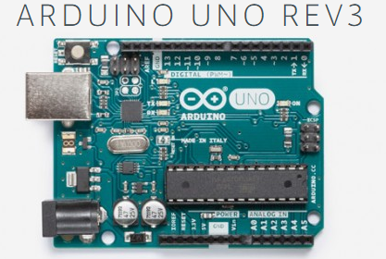
ATmega328P
Does this MCU come with on chip Bootloader ?
Yes it is !
Does it run whenever MCU undergoes reset ?
Yes. Upon reset, Arduino bootloader runs first
What’s the main use of bootloader ?
To Download Arduino sketches to the board.(IAP)

Slide 3
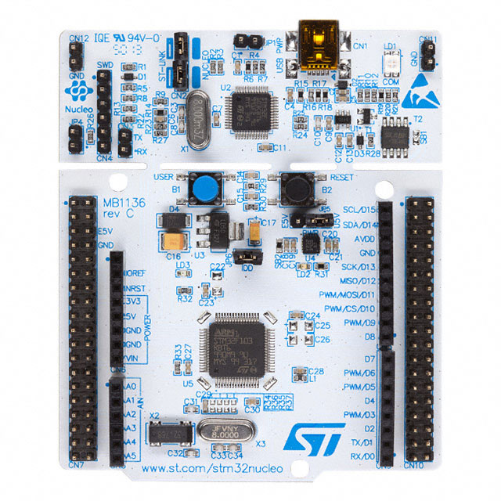
STM32f446RE
STM32f446RE Nucleo 64
Does this MCU come with on chip Bootloader ?
Yes it is !
Does it run whenever MCU undergoes reset ?
No. Should activate changing the status of boot pins
What's the main use of bootloader ?
To Download/Upload binaries (IAP)

Slide 4
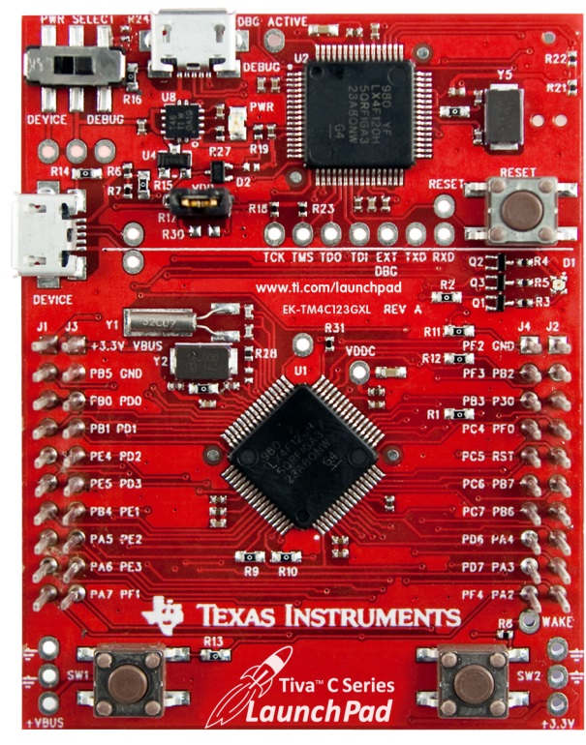
TM4C123G
TM4C123G LaunchPad
Does this MCU come with on chip Bootloader ?
Yes. TivaWare Bootloader
Does it run whenever MCU undergoes reset ?
No. Should activate changing the status of boot pins
What's the main use of bootloader ?
To Download/Upload binaries (IAP)

Slide 5
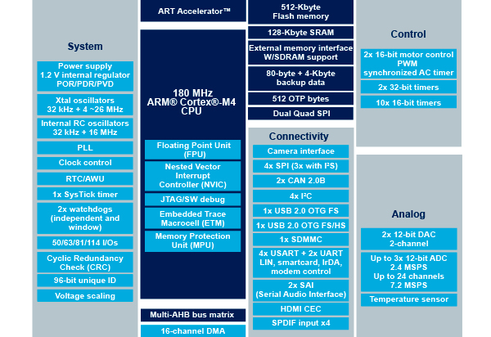

Slide 6
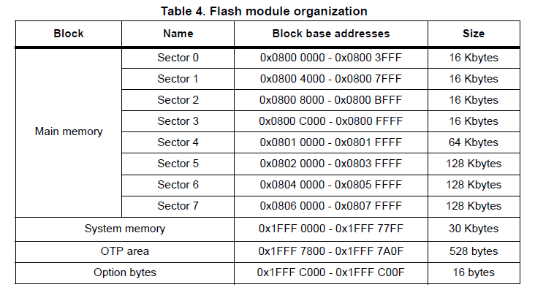

Slide 7
STM32F446XX Memory Organization
Internal Flash memory also called as Embedded Flash memory of 512KB
Internal SRAM1 of 112KB
Internal SRAM2 of 16KB
System Memory (ROM) of 30KB
OTP memory of 528 bytes
Option bytes memory of 16bytes.
Backup RAM of 4KB

Slide 8
Internal Flash memory
Size is 512KB
Begins @ 0x0800 0000
Ends @ 0x0807 FFFF
Used to store your application code and read only data of the program
Non volatile

Slide 9
Internal SRAM1
Size is 112KB
Begins @ 0x2000_0000
Ends @ 0x2001_BFFF
Used to store your application global data, static variables
Also used for Stack and Heap Purpose
Volatile
You can also execute code from this memory

Slide 10
Internal SRAM2
Size is 16KB
Begins @ 0x2001_C000
Ends @ 0x2001_FFFF
Used to store your application global data, static variables
Also can be used for Stack and Heap Purpose
Volatile
You can also execute code from this memory

Slide 11
All ARM Cortex M Based MCUs right after reset does,
Load value @ Memory addr. 0x0000_0000 in to MSP
Load value @ Memory addr. 0x0000_0004 in to PC (Value = Addr of the reset handler)
In STM32 Microcontroller ,
MSP value stored at 0x0800_0000
Vector table starts from 0x0800_0004
Address of the reset handler found at 0x0800_0004
So , Don’t you think we should somehow link 0x0800_0000 to 0x0000_0000 ??

Slide 12

0x0800_0008
0x0800_0004
Reset Hndlr Adr.
0x0800_0000
MSP
Our User flash begins here
(Depends on MCU)
Memory Aliasing
0x0000_000C
0x0000_0008
0x0000_0004
0x0000_0000
After reset Processor looks here
Processor Memory Map
Notes:
Depends on MCU

Slide 13
System Memory ( ROM)
Size is 30KB
Begins @ 0x1FFF_0000
Ends @ 0x1FFF_77FF
All the ST MCUs store Bootloader in this memory
This Memory is Read only
By default MCU will not execute any code from this memory but you can configure MCU to boot or execute bootloader from this memory .

Slide 14
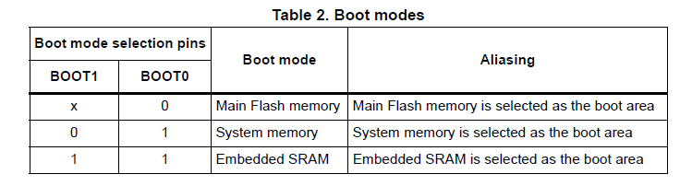
Boot Configuration of STM32F446xx

Slide 15
Bootloader : Code Placement in Flash
Our Bootloader
ROM (30KB)
ST Bootloader
Sector 0 (16KB)
Sector 1 (16KB)
Sector-2 to Sector-7 will be used for storing user application

Slide 16
Host – Bootloader Communication
HOST
MCU
(Bootloader)
Command Packet
ACK/NACK + Length to follow
(2bytes)
Reply ( of “length to follow” bytes)

Slide 17
Bootloader
Virtual COM Port
From PC
USART2
To PC
Debug port
USART3
To PC
STM32

Slide 18
Command Name : BL_GET_VER
Length
to follow
Command
Code
CRC
1
1
4
Bootloader command
Total Bytes of the packet = 6
“Length to follow ” field will contain the value : 5
Command Code : 0x51
Boot loader version number
(1 byte)
Bootloader reply

Slide 19
Command Name : BL_GET_HELP
Length
to follow
Command
Code
CRC
1
1
4
Bootloader command
Total Bytes of the packet = 6
“Length to follow ” field will contain the value : 5
Command Code : 0x52
Supported Commands codes
Bootloader reply

Slide 20
Command Name : BL_GET_CID
Length
to follow
Command
Code
CRC
1
1
4
Bootloader command
Total Bytes of the packet = 6
“Length to follow ” field will contain the value : 5
Command Code : 0x53
MCU chip Id
LSB
MCU chip Id
MSB
(2 bytes)
Bootloader reply

Slide 21
Command Name : BL_GET_RDP_STATUS
Length
to follow
Command
Code
CRC
1
1
4
Bootloader command
Total Bytes of the packet = 6
“Length to follow ” field will contain the value : 5
Command Code : 0x54
RDP status
(1 bytes)
Bootloader reply

Slide 22
Command Name : BL_GO_TO_ADDR
Length
to follow
Command
Code
Memory address
(LE)
CRC
1
1
4
4
Bootloader command
Base Memory Addr. :
4 Byte base address to jump
Total Bytes of the packet = 10
“Length to follow ” field will contain the value : 9
Command Code : 0x55
status
(1 byte)
Bootloader reply

Slide 23
Command Name : BL_FLASH_ERASE
Length
to follow
Command
Code
Sector
Number
Number
of sectors
CRC
1
1
1
1
4
Bootloader command
Sector number : 0 , 1 , 2 , 3 , 4 ,5 , 6 ,7
Number of sectors : 0 to 7
Total Bytes of the packet = 8
“Length to follow ” field will contain the value : 7
Command Code : 0x56
status
(1 byte)
Bootloader reply

Slide 24
Command Name : BL_MEM_WRITE
Length
to follow
Command
Code
Base Memory address
(LE)
Payload
Length(X)
payload
CRC
1
1
4
1
X
4
Bootloader command
Base Memory Addr. :
4 Byte base address
Payload len: No. of bytes to write
Payload : bytes to write
Total Bytes of the packet = 11+X
“Length to follow ” field will contain the value : 10+X
Command Code : 0x57
status
(1 byte)
Bootloader reply

Slide 25
Command Name : BL_MEM_READ
Length
to follow
Command
Code
Base Memory addr.
(LE)
len
CRC
1
1
4
1
4
Bootloader command
Base Memory Addr. :
4 Byte base address from which data has to be read
len : No. of bytes to read
Total Bytes of the packet = 11
“Length to follow ” field will contain the value : 10
Command Code : 0x59
status
“len” number of bytes
(1+”len” bytes )
Bootloader reply

Slide 26
Command Name : BL_READ_SECTOR_STATUS
Length
to follow
Command
Code
CRC
1
1
4
Bootloader command
Total Bytes of the packet = 6
“Length to follow ” field will contain the value : 5
Command Code : 0x5A
All Sectors status
(2 bytes)
Bootloader reply

Slide 27
Command Name : BL_EN_R_W_PROTECT
Length
to follow
Command
Code
Sector
Details
Protection
Mode
CRC
1
1
1
1
4
Bootloader command
Sector details : sector numbers encoded in 8bits (ex: 0th bit is sector 0)
1: protection
0: No protection
Protection Mode :
1(Write Protection )
2 (R/W protection)
Total Bytes of the packet = 8
“Length to follow ” field will contain the value : 7
Command Code : 0x58
status
(1 bytes)
Bootloader reply
Notes:
Sector number : 0 , 1 , 2 , 3 , 4 ,5 , 6 ,7
Operation Code : 0(No Protection) , 1(Write Protection ) , 2 (R/W protection)

Slide 28
Command Name : BL_DIS_R_W_PROTECT
Length
to follow
Command
Code
CRC
1
1
4
Bootloader command
Disables Active protection on all the sectors (resumes to default state)
Total Bytes of the packet = 6
“Length to follow ” field will contain the value : 5
Command Code : 0x5C
status
(1 bytes)
Bootloader reply

Slide 29
Reset of MCU
Bootloader Code Flow Chart
Inits:
HAL
GPIO
UARTx
CRC
Clock
Y
User Button pressed?
N
bootloader_uart_read_data()
bootloader_jump_to_user_app()

Slide 30
bootloader_uart_read_data()
Read “length” number of bytes
Poll UART for data
Decode command
Length byte received ?
N
Y
Handle_X_command
Finish Handle_X_command

Slide 31
Handle_X_command
Good CRC?
Y
N
Send “NACK”
Send “ACK”
Obtain reply
Finish : Handle_X_command
Send reply
bootloader_uart_read_data()

