Slide 1



LAB • SESSION 1
Document format
Recognise and lay out each formal component correctly on an A4 page.
Do Thuy Huong, Lecturer
Lab • Room A0105 – Economics Simulation • Class 261b, Semester 1, 2026 – 2027
© Do Thuy Huong, 2026 — Prepared for in-person teaching. Please credit the source.
Notes:
OPENING THE LAB (3 minutes)
• Check: how many brought a laptop, how many have Word installed.
• Pair anyone without a machine with someone who has one.
• Say what they leave with: one Word file, submitted before they go.

Slide 2
OBJECTIVES OF THIS LAB
Session 1 — 0/6/12
1
Recognise — all nine required formal components, and the optional ones, on a specimen document.
2
Set up — paper size, margins, typeface and point size correctly in Microsoft Word.
3
Explain — the complete formal part of an administrative document for the case you are given.
Je m'appelle Huong • Do Thuy Huong, Lecturer • EC1103
Lab – Session 1
2
Notes:
OBJECTIVES (2 minutes) — read the three; press it: today the FORMAT is marked closely, the content only needs a few lines.

Slide 3
CONTENTS
What we will practise
1
1.1 — The formal elements a document must carry
2
1.2 — Laying those elements out on the computer
Je m'appelle Huong • Do Thuy Huong, Lecturer • EC1103
Lab – Session 1
3
Notes:
CONTENTS (1 minute) — two parts: identifying the components, then setting one out in practice.

Slide 4
HOW THE LAB RUNS
How we will work this session
LECTURER DEMONSTRATES
STUDENTS FOLLOW
WORK ON YOUR OWN CASE
PEER MARKING
SUBMIT & REVISE
The lecturer works through a specimen on the projector, component by component.
Students work at their machines; the lecturer goes desk to desk.
Each student lays out a document for their own case.
Swap in pairs and check each other against the checklist.
Submit, take the feedback, revise.
Je m'appelle Huong • Do Thuy Huong, Lecturer • EC1103
Lab – Session 1
4
Notes:
THE FIVE STEPS (2 minutes)
• Explain how the session runs; press the PEER-MARKING step — the person next to you checks your work.
• Say it up front: you will walk the room, hands up if stuck.

Slide 5
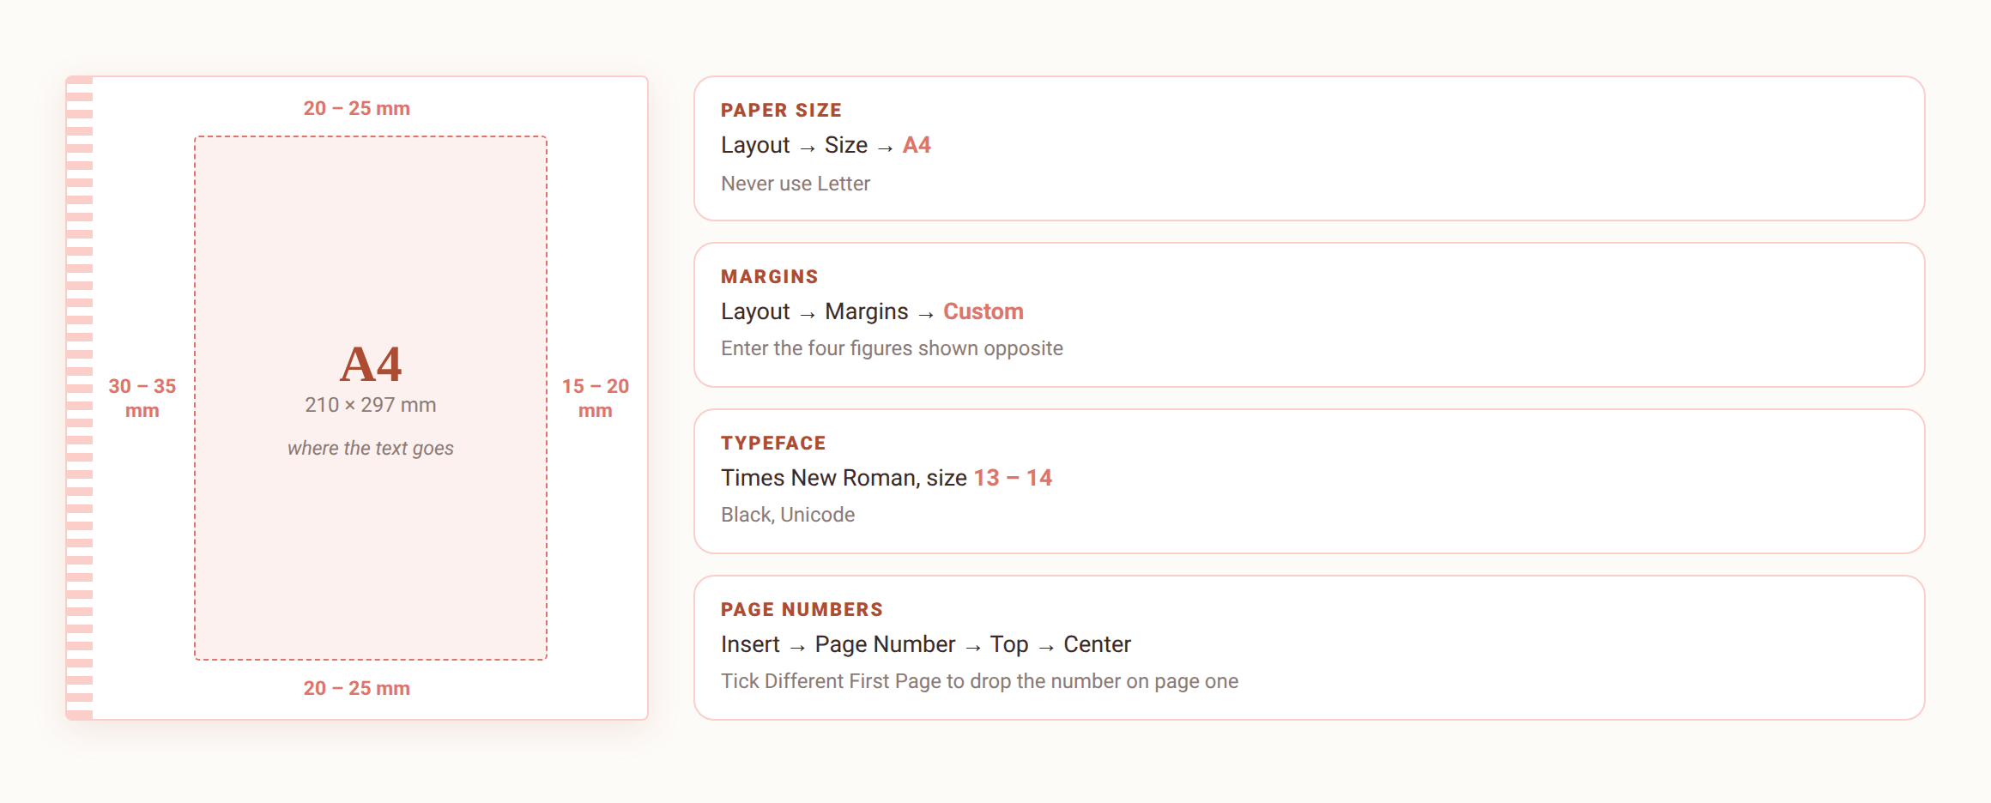
STEP 1
Setting up the page in Word
Four margin figures, one for each side — the left is wider because the file is bound there.
Je m'appelle Huong • Do Thuy Huong, Lecturer • EC1103
Lab – Session 1
5
Notes:
STEP 1 — DEMONSTRATION ON THE PROJECTOR (8 minutes)
• Open Word and do it FOR REAL, slowly, with students following on their own machines.
• Layout → Size → A4. Press: NOT Letter (the default on many machines).
• Layout → Margins → Custom. Type each figure, saying it aloud as you type.
• Set Times New Roman 13 pt, and check that Vietnamese diacritics type correctly.
• Insert → Page Number → Top of Page → Center, then tick Different First Page.
• Stop and ask: "Hands up anyone who hasn't got there."''

Slide 6
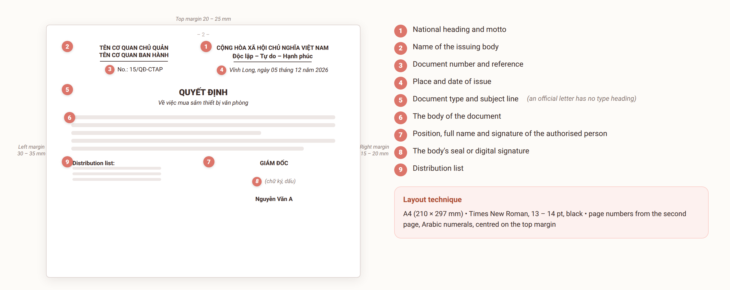
STEP 2
Laying out the head of the document
Je m'appelle Huong • Do Thuy Huong, Lecturer • EC1103
Lab – Session 1
6
Notes:
STEP 2 — THE HEAD OF THE DOCUMENT (10 minutes)
• Demonstrate the national heading and motto, showing the right alignment and the rule beneath them.
• Common mistakes: typing the motto without hyphens, or using the wrong dash.
• Reference numbers: write examples of three types on the board — QĐ (decision), TTr (submission), and an official letter (no type name).
• The date: press the rule of ADDING A LEADING ZERO for days and months below 10.

Slide 7
STEP 3
Laying out the middle and the foot
Type heading and subject line
Centred, capitals, bold. An official letter is the exception: no type heading; the subject line sits under the reference and begins “V/v…”.
Body text
Justified, line spacing 1.0 – 1.5; first-line indent 1 – 1.27 cm.
Position, name, signature
Bottom right; the authority prefix (TM., KT., TL.) in capitals; leave 3 – 4 blank lines for the signature; full name in bold.
Distribution list
Bottom left; the line “Nơi nhận:” in bold italic; list each recipient, the last line being “- Lưu: VT, …”.
Je m'appelle Huong • Do Thuy Huong, Lecturer • EC1103
Lab – Session 1
7
Notes:
STEP 3 — THE BODY AND THE FOOT (8 minutes)
• The subject line: short, and true to the content. Have the class try one for a given situation.
• The signature block: press LEAVE 3–4 BLANK LINES for the signature — students forget, and then the signature lands on the text.
• The distribution list: the last line is ALWAYS "- Filed: Registry, …".

Slide 8
CHECKLIST
Check your own work before submitting — eight points
1
A4 paper, left margin wide enough for binding (30 – 35 mm)?
2
Times New Roman, 13 – 14 pt, consistent throughout?
3
National heading and motto in the right place, correctly capitalised and hyphenated?
4
Number and reference in the right structure for this document type?
5
Leading zero on the date where needed; the place matching where it was issued?
6
Subject line short, and true to the main content?
7
Enough space to sign; the signer's authority and position correct?
8
Distribution list complete, and always carrying the “Lưu: VT” line?
Je m'appelle Huong • Do Thuy Huong, Lecturer • EC1103
Lab – Session 1
8
Notes:
THE CHECKLIST (5 minutes)
• Have students check their own work against the eight points and tick them off in their notebooks.
• Then SWAP with the person beside them, check each other's, and write down two faults found.
• Say it plainly: you mark against exactly these eight points.

Slide 9

ASSIGNMENT
What you submit from this lab
SUBMISSION 1 (individual, in class)
Lay out the complete formal part of a Notice issued by An Phat Co., Ltd announcing the Lunar New Year holiday schedule to all staff (the body needs only 3 – 5 lines; the marking is on the format).
THE GROUP'S TASK
1
Include all nine formal components, correctly placed and capitalised per Decree 30/2020/ND-CP.
2
Set the paper size, margins, typeface, point size and page numbers correctly.
3
Self-check against the eight-point list, swap with your neighbour for peer marking, then submit the Word file at the end of the session.
Je m'appelle Huong • Do Thuy Huong, Lecturer • EC1103
Lab – Session 1
9
Notes:
THE EXERCISE (20 minutes)
• Hand out the situations; remind them the body is only 3–5 lines.
• Walk the room helping, and note the common mistakes.
• Five minutes left: remind the class to save the file as "FullName_Class_Lab1.docx" and submit.
• Close the session: name the three most common mistakes you just watched them make.

Slide 10
MARKING CRITERIA
How your work is marked
Correct format (40%)
All nine components per Decree 30/2020; A4, correct margins, Times New Roman 13 – 14 pt, page numbers in the right place.
Correct content and layout for the type (40%)
Content fits the case; layout matches the type; administrative register, no spelling errors.
On time, and revised on feedback (20%)
Submitted by the deadline; the lecturer's comments taken up and a final version resubmitted.
Je m'appelle Huong • Do Thuy Huong, Lecturer • EC1103
Lab – Session 1
10
Notes:
MARKING CRITERIA (2 minutes) — read the three criteria and their weights so students know where to put the effort.

Slide 11
READING
Course materials
Main textbook
Ha Nam Khanh Giao (2023), Business Communication, Finance Publishing House.
Required legal text
Decree 30/2020/ND-CP of 5 March 2020 on records management — the rules on format and layout of administrative documents.
Lecturer's own materials
Slides, document templates, cases and exercises written by Do Thuy Huong; provided after each session.
Je m'appelle Huong • Do Thuy Huong, Lecturer • EC1103
Lab – Session 1
11
Notes:
CLOSING (1 minute) — next time: Lab 2, drafting five administrative documents; watch the guide video beforehand.

