Slide 1



LAB • SESSION 2
Drafting administrative
documents
Five documents used daily in every organisation — get them right first time.
Do Thuy Huong, Lecturer
Lab • Room A0105 – Economics Simulation • Class 261b, Semester 1, 2026 – 2027
© Do Thuy Huong, 2026 — Prepared for in-person teaching. Please credit the source.
Notes:
OPENING (3 minutes)
• Hand back Lab 1 and name the three faults the class made most often (no names of students).
• Press: today keeps every format requirement from Lab 1 and adds the STRUCTURE of each document type.

Slide 2
OBJECTIVES OF THIS LAB
Session 2 — 0/15/30
1
Draft — a decision and a submission in correct layout, issued by the right authority.
2
Draft — the common kinds of official letter used in an organisation.
3
Produce — meeting minutes and a work report in the correct structure.
4
Self-check — and revise your own document against the format checklist from Session 1.
Je m'appelle Huong • Do Thuy Huong, Lecturer • EC1103
Lab – Session 2
2
Notes:
OBJECTIVES (2 minutes) — four of them; press it: everyone drafts two documents, drawn by lot.

Slide 3
CONTENTS
What we will practise
1
2.1 — Drafting a Decision
2
2.2 — Drafting a Submission
3
2.3 — Drafting the kinds of official letter
4
2.4 — Drafting Minutes
5
2.5 — Drafting a Report
Je m'appelle Huong • Do Thuy Huong, Lecturer • EC1103
Lab – Session 2
3
Notes:
CONTENTS (1 minute) — five document types.

Slide 4
HOW THE LAB RUNS
How we will work this session
ANALYSE A SPECIMEN
LECTURER GUIDES
STUDENTS PRACTISE
PEER MARKING
FINALISE
Read the specimen and name the layout that marks out each type.
The lecturer drafts a passage, flagging the usual mistakes.
Each student drafts for the case they are given.
Swap within the group and comment against the checklist.
Revise on the comments and submit at the end of the session.
Je m'appelle Huong • Do Thuy Huong, Lecturer • EC1103
Lab – Session 2
4
Notes:
THE PROCEDURE (2 minutes) — press the step of analysing the specimen before drafting.

Slide 5
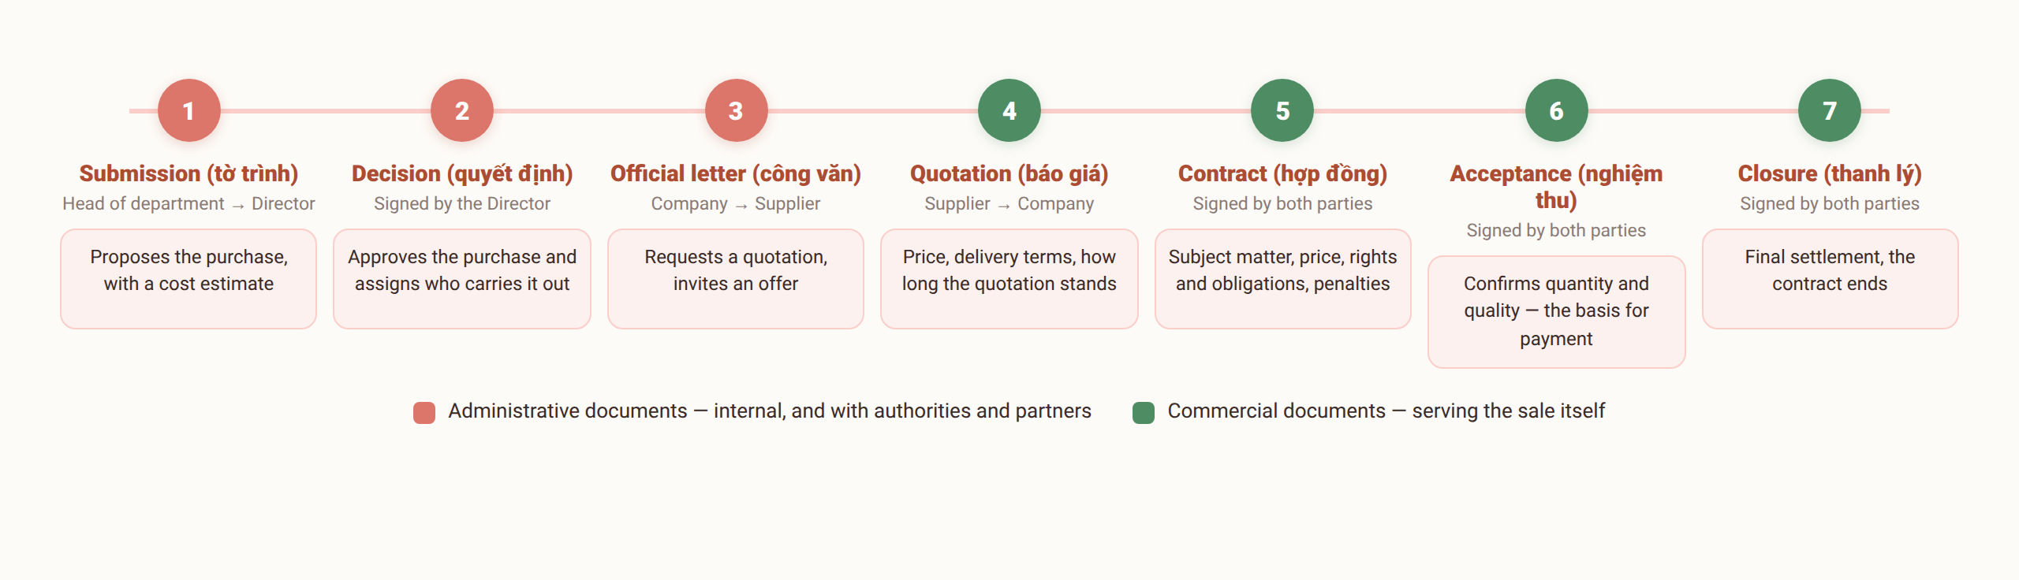
2.1
Drafting a Decision
Submission 2 covers steps 1 – 3 of the chain; steps 4 – 7 are the content of Lab 3.
Je m'appelle Huong • Do Thuy Huong, Lecturer • EC1103
Lab – Session 2
5
Notes:
THE DECISION (10 minutes)
• Put the specimen up and have the class POINT OUT the recitals and the articles.
• Type the recitals yourself on the projector, saying each line aloud.
• Press the punctuation: each recital ends in a SEMICOLON, the last in a FULL STOP.
• Read out the list of common faults at the foot of the slide — tell students to mark them in their notebooks.

Slide 6
2.2
Drafting a Submission
Opening
State the legal grounds and the situation behind the proposal: “Pursuant to… In implementation of… At present, [the unit] faces…”
Body text
Set out the plan: what is proposed, quantities, estimated cost, timing, and an analysis of benefit and feasibility.
Closing
“Respectfully submitted to [the competent level] for consideration and approval.” Attach the file list and the cost estimate.
Common mistakes
A vague proposal with no figures • no benefit analysis • submitted to the wrong level • the cost estimate forgotten.
Je m'appelle Huong • Do Thuy Huong, Lecturer • EC1103
Lab – Session 2
6
Notes:
THE SUBMISSION (8 minutes)
• Analyse the specimen in its three parts.
• Have the class write two opening sentences of a submission for the computer-purchase case, then call on two to read them out.
• Press: it must come with figures and a cost estimate attached.

Slide 7
2.3
Drafting an official letter
Letter of request
Open: the grounds and the reason → Body: exactly what is requested and by when → Close: “We look forward to your kind attention and cooperation. Yours faithfully./.”
Letter of reply
Open: “In reply to Official Letter No.… dated… from… regarding…” → Body: answer each point raised → Close: courteous, leaving the door open.
Letter of reminder
Restate the requirement already issued, report on progress, set a new deadline; firm in tone but never insulting.
Common mistakes
Adding a centred type heading “CÔNG VĂN” (wrong) • a subject line not starting with “V/v” • several subjects in one letter • the closing “./.” left off.
Je m'appelle Huong • Do Thuy Huong, Lecturer • EC1103
Lab – Session 2
7
Notes:
THE OFFICIAL LETTER (10 minutes)
• Put a CORRECT and an INCORRECT official letter side by side (the wrong one has "OFFICIAL LETTER" typed in the middle) — have the class find the fault.
• Demonstrate the opening sentence of a letter of reply.
• Press: ONE subject per letter; it closes with "Yours faithfully./."''

Slide 8
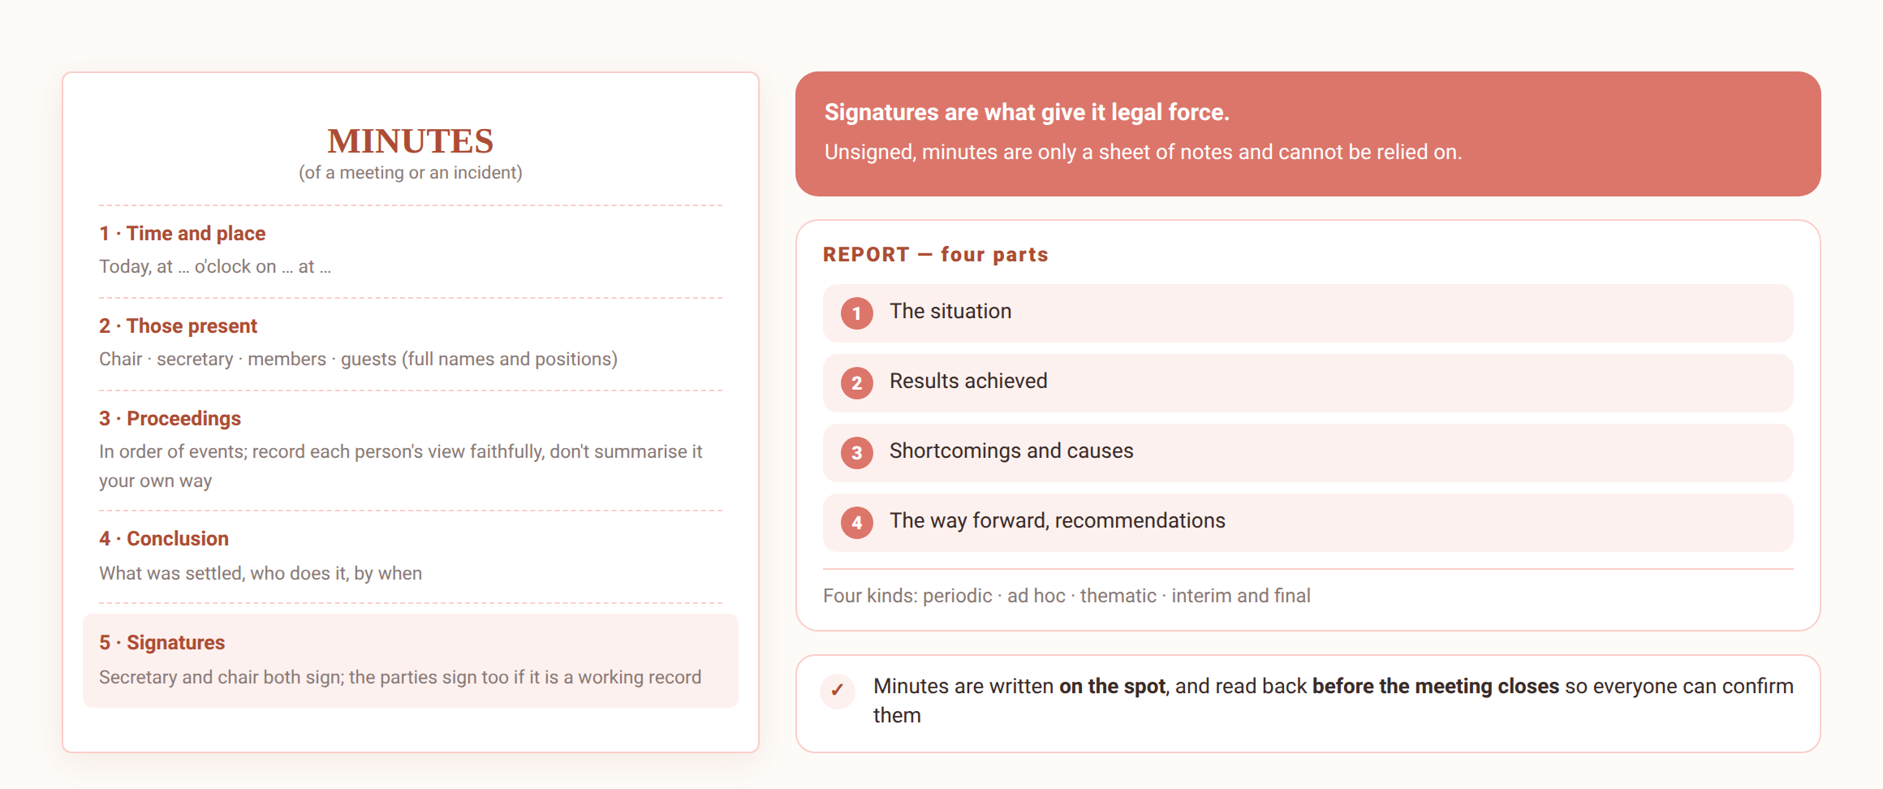
2.4 – 2.5
Minutes and Report
Minutes are written on the spot and carry legal weight only when fully signed; a report follows four parts.
Je m'appelle Huong • Do Thuy Huong, Lecturer • EC1103
Lab – Session 2
8
Notes:
MINUTES AND REPORTS (10 minutes)
• Minutes: press WRITTEN ON THE SPOT and SIGNED by both parties.
• Try it live: read out a short passage of meeting dialogue, students write the minutes in 3 minutes, then compare a few.
• Reports: press that the shortcomings must appear too; the figures must agree between sections.

Slide 9

ASSIGNMENT
What you submit from this lab
SUBMISSION 2 (individual, case drawn by lot)
The Accounting Department of An Phat Co., Ltd needs ten more computers. From this case each student draws and drafts two of five documents: a submission proposing the purchase • a decision approving it • an official letter asking suppliers to quote • minutes of the supplier-selection meeting • a report on the equipment delivered.
THE GROUP'S TASK
1
Draft both documents drawn, in correct Decree 30/2020 format and in the layout proper to each type.
2
Self-check against the Session 1 list and the common-mistakes table for each type.
3
Submit the Word file at the end of the session; revise on the lecturer's feedback and resubmit within a week.
Je m'appelle Huong • Do Thuy Huong, Lecturer • EC1103
Lab – Session 2
9
Notes:
THE EXERCISE (30 minutes)
• The draw: have the slips ready, two document types on each.
• Remind them to reuse the eight-point checklist from Lab 1.
• Walk the room; help first whoever drew the decision and the minutes (the hardest two).
• End of session: collect the work, remind them the revised version is due in a week.

Slide 10
MARKING CRITERIA
How your work is marked
Correct format (40%)
All nine components per Decree 30/2020; A4, correct margins, Times New Roman 13 – 14 pt, page numbers in the right place.
Correct content and layout for the type (40%)
Content fits the case; layout matches the type; administrative register, no spelling errors.
On time, and revised on feedback (20%)
Submitted by the deadline; the lecturer's comments taken up and a final version resubmitted.
Je m'appelle Huong • Do Thuy Huong, Lecturer • EC1103
Lab – Session 2
10
Notes:
MARKING CRITERIA (2 minutes) — restate the three criteria.

Slide 11
READING
Course materials
Main textbook
Ha Nam Khanh Giao (2023), Business Communication, Finance Publishing House.
Required legal text
Decree 30/2020/ND-CP of 5 March 2020 on records management — the rules on format and layout of administrative documents.
Lecturer's own materials
Slides, document templates, cases and exercises written by Do Thuy Huong; provided after each session.
Je m'appelle Huong • Do Thuy Huong, Lecturer • EC1103
Lab – Session 2
11
Notes:
CLOSING (1 minute) — next session is in pairs; tell students to pair up beforehand.

