Slide 1



LAB • SESSION 3
Drafting administrative
commercial documents
Letters, quotations and contracts — the file that carries a deal from offer to closure.
Do Thuy Huong, Lecturer
Lab • Room A0105 – Economics Simulation • Class 261b, Semester 1, 2026 – 2027
© Do Thuy Huong, 2026 — Prepared for in-person teaching. Please credit the source.
Notes:
OPENING (3 minutes)
• Hand back Lab 2 and name the common faults.
• Split into buyer–seller pairs at the start so the whole session runs in pairs.

Slide 2
OBJECTIVES OF THIS LAB
Session 3 — 0/9/18
1
Draft — commercial letters meeting the 5C rule for the common trading situations.
2
Produce — a quotation carrying full trading terms and a validity period.
3
Draft — a sales contract with its acceptance record and closure record.
Je m'appelle Huong • Do Thuy Huong, Lecturer • EC1103
Lab – Session 3
2
Notes:
OBJECTIVES (2 minutes) — three of them; press it: what they leave with is a COMPLETE FILE.

Slide 3
CONTENTS
What we will practise
1
3.1 — Drafting commercial letters
2
3.2 — Drafting a quotation
3
3.3 — Drafting the contract, the acceptance record and the closure record
Je m'appelle Huong • Do Thuy Huong, Lecturer • EC1103
Lab – Session 3
3
Notes:
CONTENTS (1 minute) — the letter, the quotation, the contract and the two records.

Slide 4
HOW THE LAB RUNS
How we will work this session
ANALYSE A SPECIMEN
LECTURER GUIDES
WORK IN PAIRS
SWAP AND REVIEW
FINALISE
Read and comment on specimen letters, quotations and contracts.
Analyse the risky clauses and how they are worded.
The two of you play buyer and seller and draft matching documents.
Swap files and find what works against your own side.
Revise and submit the complete file.
Je m'appelle Huong • Do Thuy Huong, Lecturer • EC1103
Lab – Session 3
4
Notes:
THE PROCEDURE (2 minutes) — press the step where pairs SWAP FILES to hunt for terms that disadvantage them.

Slide 5
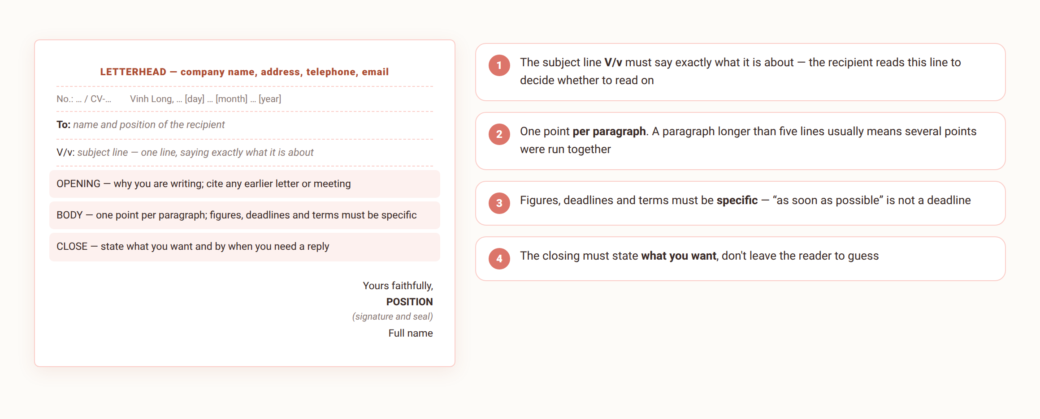
3.1
Commercial letters — correct, and well judged
This is exactly the layout students must type into Word for Submission 3.
Je m'appelle Huong • Do Thuy Huong, Lecturer • EC1103
Lab – Session 3
5
Notes:
BUSINESS LETTERS (10 minutes)
• Put a badly written and a well written letter up, and have the class compare them against the 5Cs.
• Press the mistakes students make in email: a subject line reading "A letter", SHOUTING IN CAPITALS, emoji, forgetting the attachment.
• Have each pair write the SUBJECT LINE and two opening sentences of a sales letter; read a few out.

Slide 6
3.2
Quotation — what it must contain
The head
Company details (name, address, tax code, contact); addressed to the customer; quotation number and date.
The goods table
No. • item and model • unit • quantity • unit price • amount • VAT • total (in figures and in words).
Trading terms
Delivery time • place of delivery • method and schedule of payment • warranty • discount if any.
Validity and signature
How long the quotation stands (say 15 days from issue); the preparer and the authorised signatory, with the seal.
Je m'appelle Huong • Do Thuy Huong, Lecturer • EC1103
Lab – Session 3
6
Notes:
THE QUOTATION (10 minutes)
• Open the specimen Excel/Word file and point at each column of the goods table.
• Press: the total goes in BOTH FIGURES AND WORDS, and the two must agree.
• Press the VALIDITY PERIOD — ask the class what happens if it is left out.

Slide 7
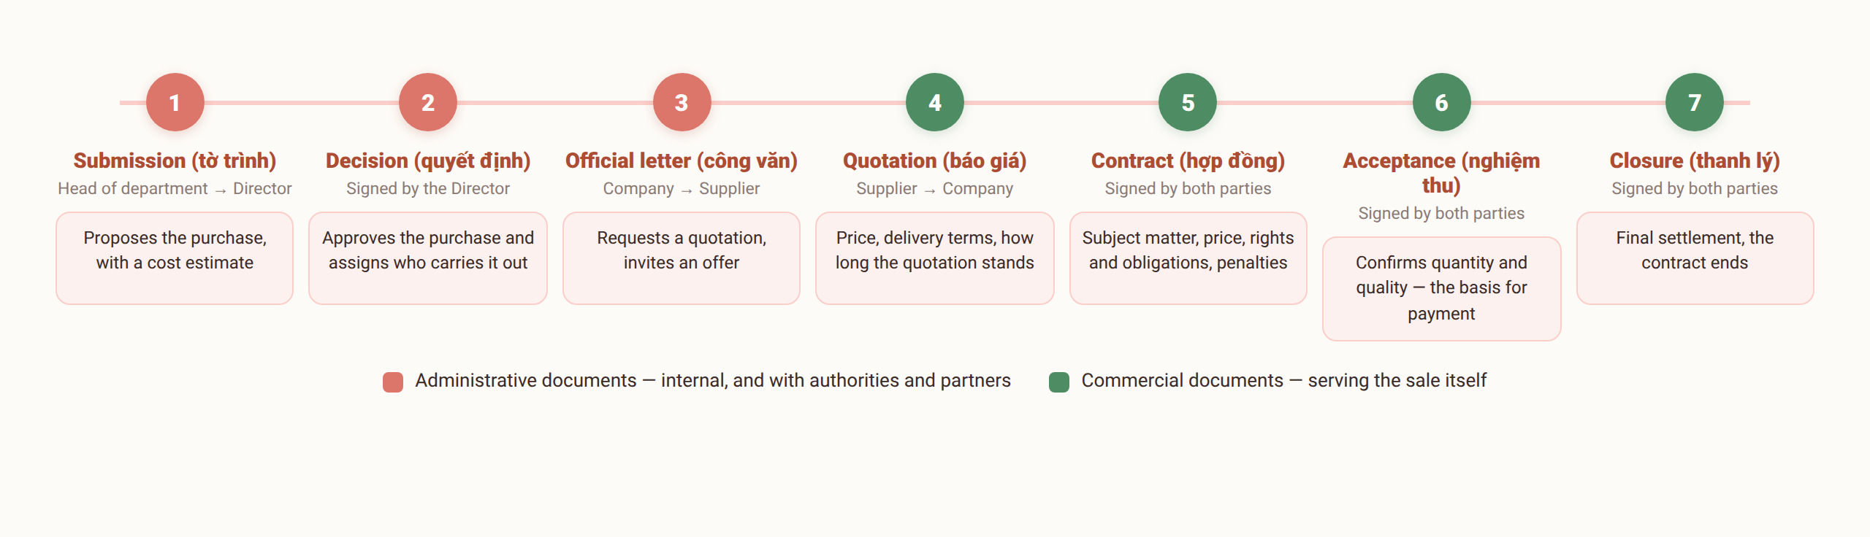
3.3
Contract — the clauses it must have
Je m'appelle Huong • Do Thuy Huong, Lecturer • EC1103
Lab – Session 3
7
Notes:
THE CONTRACT (12 minutes)
• Walk the seven clauses, one risk to watch for each.
• The penalty clause: give the rate under the Commercial Law and why it has to be stated.
• A quick discussion: which clauses favour the buyer, which favour the seller.

Slide 8
3.3
Acceptance and closure of the contract
Acceptance record
Pursuant to contract No.…; who attends from each side; what is being accepted (type, quantity, quality actually received against the contract); the pass/fail conclusion; both signatures.
Closure record
Confirms both sides have discharged their obligations; reconciles what has been paid and what remains; confirms the contract has ended; both undertake to raise no later claim.
Common mistakes
An acceptance record without the contract number • no penalty clause • figures and words not matching • closing before the accounts are reconciled.
Je m'appelle Huong • Do Thuy Huong, Lecturer • EC1103
Lab – Session 3
8
Notes:
ACCEPTANCE AND LIQUIDATION (8 minutes)
• Press: the acceptance record must STATE THE CONTRACT NUMBER.
• Liquidation is signed only after the ACCOUNTS HAVE BEEN RECONCILED.
• Ask the class: if two items are missing from the delivery, what goes in the acceptance record?

Slide 9

ASSIGNMENT
What you submit from this lab
SUBMISSION 3 (in pairs — buyer and seller)
From the very purchase of 20 computers negotiated in Chapter 4, each pair completes the full commercial file for their own deal.
THE GROUP'S TASK
1
The seller drafts: an offer letter and a quotation with full trading terms and a validity period.
2
Both draft the sales contract with all its basic clauses, plus the acceptance record and the closure record.
3
Swap files with another pair and name at least three disadvantages or gaps; revise and submit the complete file within a week.
Je m'appelle Huong • Do Thuy Huong, Lecturer • EC1103
Lab – Session 3
9
Notes:
THE EXERCISE (30 minutes)
• Each pair produces the full file; remind them to reuse their own group's case from Chapter 4.
• 20 minutes drafting, 10 minutes swapping files with another pair to hunt for faults.
• Require each pair to write down three disadvantageous terms they found — this is where you are marking their thinking.
• Close the course: remind students of the examination date and what it covers.

Slide 10
MARKING CRITERIA
How your work is marked
Correct format (40%)
All nine components per Decree 30/2020; A4, correct margins, Times New Roman 13 – 14 pt, page numbers in the right place.
Correct content and layout for the type (40%)
Content fits the case; layout matches the type; administrative register, no spelling errors.
On time, and revised on feedback (20%)
Submitted by the deadline; the lecturer's comments taken up and a final version resubmitted.
Je m'appelle Huong • Do Thuy Huong, Lecturer • EC1103
Lab – Session 3
10
Notes:
MARKING CRITERIA (2 minutes) — restate them; say plainly that this piece counts towards the coursework mark.

Slide 11
READING
Course materials
Main textbook
Ha Nam Khanh Giao (2023), Business Communication, Finance Publishing House.
Required legal text
Decree 30/2020/ND-CP of 5 March 2020 on records management — the rules on format and layout of administrative documents.
Lecturer's own materials
Slides, document templates, cases and exercises written by Do Thuy Huong; provided after each session.
Je m'appelle Huong • Do Thuy Huong, Lecturer • EC1103
Lab – Session 3
11
Notes:
END OF THE COURSE (2 minutes)
• Thank the class; remind them of the examination date and the structure of the paper.
• Remind them: the 200 multiple-choice questions and the 8 revision videos are already on the class group.

