Slide 1



CHAPTER 1
An overview of communication
in business
The foundation of every professional skill: understand communication before drilling technique.
Do Thuy Huong, Lecturer
EC1103 – Communication and Document Drafting Skills (2:1) • Class 261b, Semester 1, 2026 – 2027
© Do Thuy Huong, 2026 — Prepared for in-person teaching. Please credit the source.
Notes:
OPENING THE SESSION (2 minutes)
• Greet the class, introduce yourself briefly.
• Open question: "What percentage of a working day do you think we spend communicating?" (For reference: 70–80%.)
• Land it: this course teaches two families of skill — SPEAKING and WRITING — and both are how you will earn a living.
BRIDGE: "Before we drill technique, we have to understand what communication actually is."''

Slide 2
COURSE MAP
How we will work together
Theory — 10 sessions
Sat & Sun mornings • 5 chapters • room C0105
Lab — 3 sessions
Sat / Sun afternoons • room A0105, Economics Simulation Lab
Assessment — 3 components
Attendance • Coursework • Final examination
Je m'appelle Huong • Do Thuy Huong, Lecturer • EC1103
Chapter 1
2
Notes:
THE CLASS CONTRACT (2 minutes)
• Stress: this class is NOT just listening — every session has a case and hands-on work.
• Say three things plainly: at least 80% attendance; assignments on time; phones on silent.
• Invite students to say what they expect from the course (2–3 speak).
BRIDGE: "Now let's start with what this chapter is for."''
THE FULL VERSION (moved off the slide)
• Theory: 10 Saturday and Sunday mornings, 05/12/2026 – 03/01/2027, room C0105 — Ch.1 Overview; Ch.2 Professional skills; Ch.3 Specific situations; Ch.4 Negotiation; Ch.5 Document drafting.
• Lab: Saturday/Sunday afternoons, 26/12 – 24/01, room A0105 Economics Simulation — Session 1 Format; Session 2 Administrative documents; Session 3 Commercial documents.
• Assessment: attendance (≥ 80% present, all assignments in); coursework (multiple choice + written + lab); a practical final examination.

Slide 3
OBJECTIVES
By the end of this chapter, students can
1
Explain — what business communication is, what marks it out, and the process model behind it.
2
Distinguish — the means and forms of communication, and the strengths and weaknesses of each.
3
Analyse — the factors that shape how well communication works in a real situation.
4
Apply — the principles of communication to a specific business situation.
Je m'appelle Huong • Do Thuy Huong, Lecturer • EC1103
Chapter 1
3
Notes:
CHAPTER OBJECTIVES (1 minute)
• Skim the four objectives, do NOT read them out word for word.
• Stress: objective 4 (applying the principles) is what the end-of-chapter case will test.
• Tell students to photograph this slide so they can check themselves against it when revising.

Slide 4
CONTENTS
What we will go through
1
1.1 — What business communication is, and what marks it out
2
1.2 — The means of communication
3
1.3 — The forms of communication
4
1.4 — The factors that shape the communication process
5
1.5 — The principles of communication
Je m'appelle Huong • Do Thuy Huong, Lecturer • EC1103
Chapter 1
4
Notes:
THE CHAPTER MAP (1 minute)
• Point down the five sections, one sentence each, quickly.
• Stress: 1.2 (means) and 1.5 (principles) are the parts that tend to come up in the exam.

Slide 5
SECTIONS 1.1 – 1.2
The nature and means of communication
Understand the nature first: what communication is, what stages it passes through, by what means.
Je m'appelle Huong • Do Thuy Huong, Lecturer • EC1103
Chapter 1
Notes:
SECTION BREAK (30 seconds) — one linking sentence, then move on. This is the marker that tells the class where they are in the lesson.

Slide 6
1.1
Communication, and communication in business
What is communication?
Exchanging information to reach a purpose
And in business?
Tied to a work goal, and legally binding
Why learn it?
Employers rank it among the top requirements
Je m'appelle Huong • Do Thuy Huong, Lecturer • EC1103
Chapter 1
5
Notes:
THE CONCEPT (3 minutes)
• Write two words on the board: INFORMATION – PURPOSE. Communication always has both.
• Draw the line: small talk ≠ business communication. Business communication is always tied to a WORK OBJECTIVE.
• Quick example: a call to an old customer just to say hello — what is the real purpose? (Keeping the relationship warm for the next sale.)
ASK THE CLASS: "Have you had a business conversation today?" (Buying coffee, asking the office about a form…)
THE FULL VERSION (moved off the slide)
• Communication: the process of exchanging information, ideas and feelings between people to reach a purpose — through speech, writing and wordless behaviour alike.
• Business communication: tied to the running of a business — the firm with its customers, partners, regulators, and among its own people — aimed at a specific business objective.
• Why study it: employer surveys have for years put communication among the most demanded skills — you sell the idea before you sell the product.

Slide 7
1.1
What marks out business communication
Always purposeful
Every meeting serves a work objective
Many kinds of counterpart
Each one comes with its own norms
Binding on interests and in law
What you say can create an obligation
Both science and art
There are rules, but they need judgement
Je m'appelle Huong • Do Thuy Huong, Lecturer • EC1103
Chapter 1
6
Notes:
FOUR DEFINING FEATURES (3 minutes)
• Feature 3 (LEGALLY BINDING) is the most important — press hard on it.
• A real example: a salesperson verbally promises a 20% discount to a customer → the company still has to honour it, because that was its representative speaking.
• Tie it to the course: this is exactly why Chapter 5 teaches you to PUT EVERY AGREEMENT IN WRITING.
BRIDGE: "So what stages does an exchange actually pass through?"''
THE FULL VERSION (moved off the slide)
• Purposeful: every meeting, call and email serves a work objective — a sale, a partnership, a problem solved.
• Many kinds of counterpart: customers, superiors, colleagues and government bodies all at once — each with its own norms.
• Binding: words and documents in business can create obligations, contracts, liability.
• Science and art: there are rules and procedures to learn; applying them flexibly to the person and the moment is what makes them work.

Slide 8
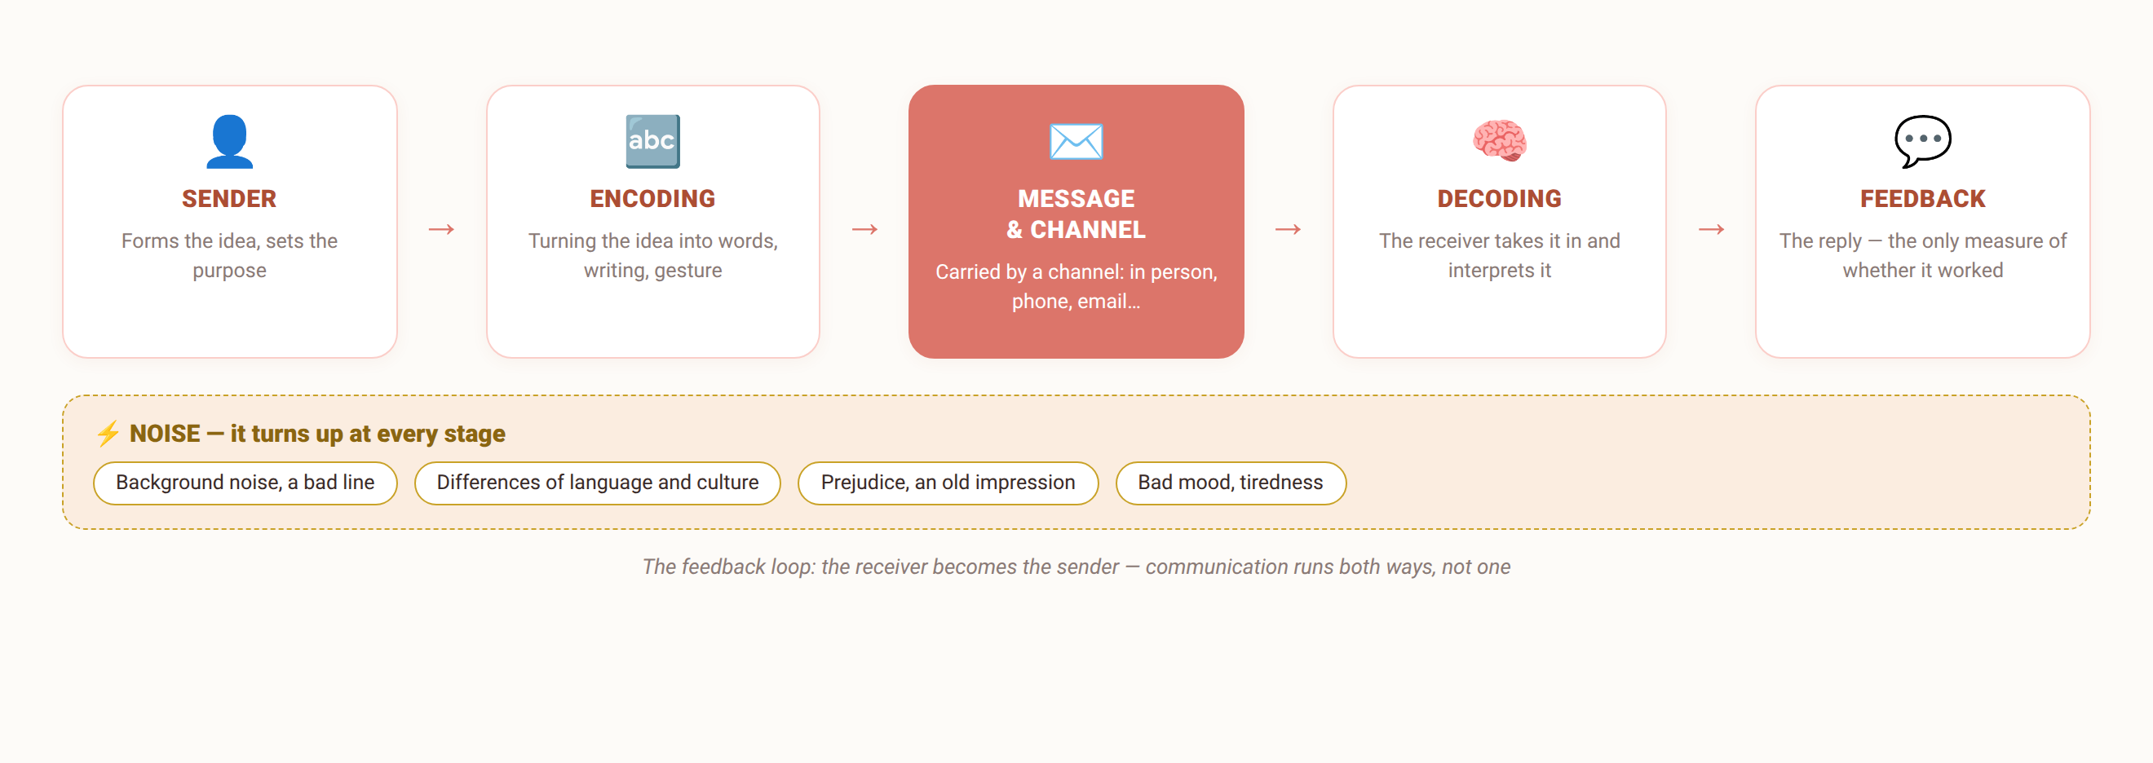
1.1
The communication process model
Communication runs both ways — to fix one that failed, trace it back stage by stage.
Je m'appelle Huong • Do Thuy Huong, Lecturer • EC1103
Chapter 1
7
Notes:
THE CENTRAL DIAGRAM OF THE CHAPTER (4 minutes)
• Redraw the diagram on the board while you talk — students remember it better when they watch it being drawn.
• Walk each stage: SENDER → ENCODING → MESSAGE/CHANNEL → DECODING → FEEDBACK.
• The key point: NOISE sits at EVERY stage, not just on the wire.
• Oral exercise: "A manager emails a task, the employee does it wrong. Which stage broke?" — let the class guess, then unpack it: the encoding may have been poor (a vague email), the decoding may have failed (the employee misread it), or feedback may be missing (they never asked back).
• LAND IT: when an exchange fails, don't apportion blame — TRACE IT BACK STAGE BY STAGE.
THE FULL VERSION (moved off the slide)
• Sender: forms the idea, settles what it is for.
• Encoding: turning the idea into speech, writing, gesture.
• Message: the content carried by a channel — in person, telephone, email…
• Decoding: the receiver takes it in and interprets it.
• Feedback: the receiver answers — the only evidence that it worked.
• NOISE: background noise, a bad line, differences of language and culture, prejudice, bad mood… present at every stage. A good communicator cuts the noise at each step deliberately.

Slide 9
1.2
Means of communication: language
Spoken language
Fast and expressive — but spoken words blow away
Written language
Precise and on the record — the ground for Chapter 5
Choosing your words
Clear • courteous • positive • brief
Je m'appelle Huong • Do Thuy Huong, Lecturer • EC1103
Chapter 1
8
Notes:
SPOKEN AND WRITTEN (2 minutes)
• Quick comparison: speech is FAST and expressive but "spoken words blow away"; writing is SLOWER but STAYS ON THE RECORD AS EVIDENCE.
• The working rule: on anything important, an agreement reached in speech must be CONFIRMED BY EMAIL.
• Career link: this is precisely the skill of the second half of the course.
THE FULL VERSION (moved off the slide)
• Speech: direct, fast, expressive, feedback at once — but "spoken words blow away", and it goes wrong easily without preparation. Mind your pronunciation, pace, volume, intonation.
• Writing: precise, considered, kept as evidence — the ground for Chapter 5. Mind your spelling, format, register.
• Word choice: clear, courteous, positive; avoid colloquialisms, slang and ambiguous words; prefer active, short sentences.

Slide 10
1.2
Means of communication: non-verbal
Eyes and face
The strongest expressive channel
Gesture and posture
Upright and open earns goodwill
Distance
Intimate · personal · social · public
Dress, voice, punctuality
Being on time is itself a message
7%
38%
55%
WORDS
TONE OF VOICE
BODY
Mehrabian — for emotional messages
Je m'appelle Huong • Do Thuy Huong, Lecturer • EC1103
Chapter 1
9
Notes:
NON-VERBAL (4 minutes) — THE PART STUDENTS LIKE MOST
• Demonstrate it live: say "Very pleased to meet you" twice — first looking at the floor in a flat voice, then meeting their eyes with a smile. Ask which one they believe.
• Introduce Mehrabian's 7 – 38 – 55%, but SAY THE LIMIT OUT LOUD: it holds for EMOTIONAL messages only, not for every situation.
• Distance: bring two students to the front and have them stand at three different distances for the class to watch.
• LAND IT: never let your body say the opposite of your words.
THE FULL VERSION (moved off the slide)
• Eyes, face, smile: the strongest expressive channel; meeting someone's eyes reads as confidence and respect.
• Gesture, posture, walk: upright and open earns goodwill; folded arms or a glance at your watch signal closed-off and impatient.
• Distance: intimate (<0.5 m) – personal – social (1.2–3.5 m) – public; the wrong one makes people uncomfortable.
• Dress, tone, time: dress for the setting; tone decides how the message lands; being on time is itself a message.
• The three numbers on the slide are Mehrabian's, for EMOTIONAL MESSAGES — don't generalise them to all communication. Land it: never let your body "say" the opposite of your words.

Slide 11
THE NUMBER TO REMEMBER
How does an emotional message travel?
7%
WORDS
The words themselves — the smallest share, though we usually invest the most here
38%
TONE OF VOICE
Volume, pace, intonation, pauses
55%
BODY LANGUAGE
Eyes, face, gesture, posture, distance
Albert Mehrabian's study — it applies to EMOTIONAL messages only, not to every situation.
Je m'appelle Huong • Do Thuy Huong, Lecturer • EC1103
Chapter 1
Notes:
THE MEHRABIAN NUMBERS (2 minutes)
• Put the slide up, let them look for five seconds before you speak.
• STATE THE LIMIT CLEARLY: these figures hold for emotional messages only — do not conclude "content is only 7%".
• What it means in practice: when the words and the body disagree, the listener BELIEVES THE BODY.
• Ask the class: "How do you know someone is upset even when they say 'I'm fine'?"''

Slide 12
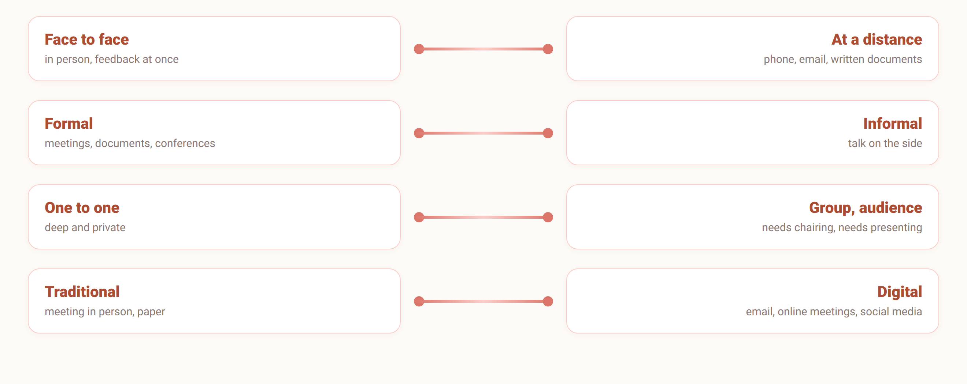
1.3
The forms of communication
These four pairs are not exclusive — any exchange sits somewhere on all four axes at once.
Je m'appelle Huong • Do Thuy Huong, Lecturer • EC1103
Chapter 1
10
Notes:
FORMS OF COMMUNICATION (2 minutes)
• Four contrasting pairs — go quickly, don't dwell.
• Press the last pair: TRADITIONAL ↔ DIGITAL. Ask the class: "What does a work email sent at 11 at night say about the sender?"
• Remind them: digital communication is held to the same standards as meeting in person.
THE FULL VERSION (moved off the slide)
• Face to face: rich, immediate feedback. At a distance (phone, documents, email): crosses distance, leaves evidence — but is easily misread.
• Formal: meetings, documents, conferences under the rules. Informal: talk on the side, rumour — a good manager uses both.
• One to one: deep and private. Group: needs chairing. Audience: needs presentation skill, taught in Chapter 2.
• Digital: email, online meetings, social media, group chats — the new norms are replying on time, on the right channel, and keeping a professional digital presence.

Slide 13
SECTIONS 1.4 – 1.5
Influencing factors, and principles
What breaks an exchange, and the five principles that keep it from breaking.
Je m'appelle Huong • Do Thuy Huong, Lecturer • EC1103
Chapter 1
Notes:
SECTION CHANGE (30 seconds) — remind them the rest of the chapter is the part that comes up in the exam.

Slide 14
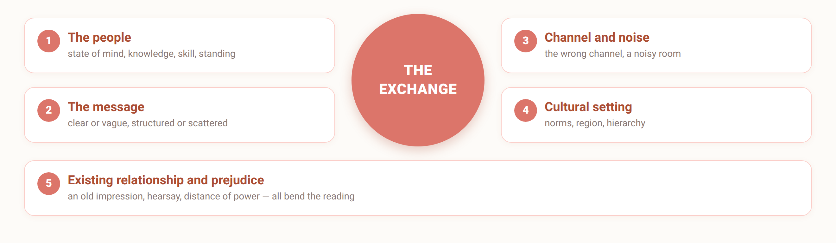
1.4
Factors that shape the communication process
Fix the factor that actually broke — don't blame it all on “poor wording”.
Je m'appelle Huong • Do Thuy Huong, Lecturer • EC1103
Chapter 1
11
Notes:
FACTORS THAT SHAPE IT (2 minutes)
• Press the PREJUDICE factor — the hardest to see and the one that wrecks the most exchanges.
• Examples: hearing a regional accent and judging competence; seeing someone young and assuming inexperience.
• Link to Chapter 3: the section on communicating across cultures comes back to this.
THE FULL VERSION (moved off the slide)
• The people: state of mind, mood, health, knowledge, skill, standing.
• The message: clear or vague, sensibly structured or scattered, pitched at the listener or not.
• Channel and noise: the wrong channel (something serious sent as a text), a bad line, a noisy room.
• Cultural and social setting: norms, religion, region, hierarchy — what is ordinary in one place can be an offence in another.
• Relationship and prejudice: an old impression, hearsay, distance of power — all bend the reading.

Slide 15
1.5
Principles of business communication
1
Respect — for the person, their time, their interests, their differences
2
Goodwill and cooperation — win the argument, lose the customer
3
Listen first — understand correctly, then speak
4
Fit the context — right role, right moment, right channel
5
Keep your word — a promise made is a promise kept
Je m'appelle Huong • Do Thuy Huong, Lecturer • EC1103
Chapter 1
12
Notes:
THE FIVE PRINCIPLES (3 minutes)
• This is the part STUDENTS MUST KNOW BY HEART — it is used again in the case that follows immediately.
• RESPECT: say plainly that respect shows in concrete behaviour — being on time, not interrupting, remembering the other person's name.
• KEEPING YOUR WORD: press "your word is a business asset" — one broken promise loses a customer.
BRIDGE: "Now let's try applying the whole chapter to one situation."''
THE FULL VERSION (moved off the slide)
• Respect the person, their time, their interests and their differences.
• Goodwill and cooperation: aim at both sides gaining — win the argument and you may lose the customer.
• Listen and understand first: get their need right before you set out your own position.
• Fit the context: right role, right moment, right place, right channel, right degree of formality.
• Standards and keeping your word: speech and documents consistent; a promise made is a promise kept — your word is a business asset.

Slide 16

GROUP WORK
Case: a first meeting that failed
THE CASE (groups of 4–5, 15 minutes)
Salesperson A meets a client for the first time: arrives 10 minutes late because of traffic but sends no warning; wears a T-shirt because “it's the weekend”; sits down and immediately pitches the product for 20 minutes straight; the phone rings twice and A takes both calls. At the end the client says “let me look at it and get back to you”, and never does.
THE GROUP'S TASK
1
List every communication mistake A made, and place each one at a stage of the process model.
2
Which principle from section 1.5 does each mistake break?
3
Build a five-step “standard script” for a first client meeting and present it to the class (3 minutes).
Je m'appelle Huong • Do Thuy Huong, Lecturer • EC1103
Chapter 1
13
Notes:
GROUP WORK (15 minutes)
• Groups of 4–5, hand out A3 sheets or let them use their notebooks.
• Time it: 10 minutes of discussion, 5 minutes for two groups to present.
• SUGGESTED ANSWERS: arriving late without warning (breaks respect and keeping your word) • the T-shirt (noise at the non-verbal encoding stage) • talking for 20 minutes without a question (no feedback, breaks the listening principle) • taking two calls (breaks respect, creates noise).
• The customer's line "let me look at it and get back to you" — ask the class: is that an appointment or a refusal? (Links forward to Chapter 3, communicating across cultures.)
• LAND IT: every one of those mistakes maps back to the five stages and the five principles just taught.

Slide 17
SUMMARY
Three things to remember
It has a purpose, and it has rules
This is not idle conversation
Whichever stage broke, go back to that stage
Five stages, plus noise
The non-verbal carries more than we think
It speaks first, and it speaks louder
Je m'appelle Huong • Do Thuy Huong, Lecturer • EC1103
Chapter 1
14
Notes:
SUMMARY (2 minutes)
• Read the three points slowly, pausing two seconds after each.
• Ask the class: "Who can name the five stages of the communication model?" — call on one student.
• Set the work: do the 40 multiple-choice questions for Chapter 1 before the next session.
THE FULL VERSION (moved off the slide)
• Business communication is not idle conversation: every exchange serves an objective and carries norms and obligations, in interest and in law.
• To fix an exchange that failed, trace back each stage: idea – encoding – channel – decoding – feedback.
• Dress, eyes, tone, punctuality… "speak" first and speak louder than words — make them say the same thing you do.

Slide 18
REVIEW & PREPARATION
Review questions
1
Analyse the parts of the communication process model using a real example of your own.
2
Compare the strengths and weaknesses of spoken and written communication in business.
3
Why is business communication called “both a science and an art”?
4
State and illustrate the five principles of business communication.
PREPARING FOR THE NEXT SESSION: Chapter 2 – Professional communication skills. Each group prepares a 3-minute talk on a topic of its choice, to be delivered in class.
Je m'appelle Huong • Do Thuy Huong, Lecturer • EC1103
Chapter 1
15
Notes:
REVIEW QUESTIONS (1 minute)
• Don't work them in class — leave them for students to do at home.
• Say plainly: these four are within the scope of the mid-term test.

Slide 19
READING
Course materials
Main textbook
Ha Nam Khanh Giao (2023), Business Communication, Finance Publishing House.
Further reading
Thai Tri Dung (2012), Communication and Negotiation Skills in Business, Labour – Social Publishing House. • Decree 30/2020/ND-CP on records management (used in Chapter 5 and the lab sessions).
Lecturer's own materials
Slides, cases and exercises written by Do Thuy Huong; posted to the class group after each session.
Je m'appelle Huong • Do Thuy Huong, Lecturer • EC1103
Chapter 1
16
Notes:
READING (1 minute)
• Say exactly which chapter of the main textbook to read for next time.
• Remind them: your own materials go up on the class group after each session.
• Close the session: thank the class, remind them of the next date.

