Slide 1



CHAPTER 2
Professional communication
skills
Four skills you will use every working day: making an impression, presenting, listening, and the telephone.
Do Thuy Huong, Lecturer
EC1103 – Communication and Document Drafting Skills (2:1) • Class 261b, Semester 1, 2026 – 2027
© Do Thuy Huong, 2026 — Prepared for in-person teaching. Please credit the source.
Notes:
OPENING (2 minutes)
• One sentence back to the previous chapter: the five-stage model and the five principles.
• Go in with a question: "Have you ever judged someone within ten seconds of meeting them?"
• Land it: this chapter is four skills you will use every working day of your life.

Slide 2
OBJECTIVES
By the end of this chapter, students can
1
Build — a professional first impression, and observe workplace etiquette correctly.
2
Prepare and deliver — a structured talk, and deliver it confidently to an audience.
3
Practise — active listening and effective questioning in work conversations.
4
Communicate by telephone — to professional standards, both making and answering calls.
Je m'appelle Huong • Do Thuy Huong, Lecturer • EC1103
Chapter 2
2
Notes:
OBJECTIVES (1 minute)
• Skim. Press the point: this chapter is more PRACTICE than theory.

Slide 3
CONTENTS
What we will go through
1
2.1 — First impressions and etiquette
2
2.2 — Presentation skills
3
2.3 — Listening and questioning skills
4
2.4 — Telephone skills
Je m'appelle Huong • Do Thuy Huong, Lecturer • EC1103
Chapter 2
3
Notes:
THE MAP (1 minute)
• Four skills, roughly 15 minutes each including the hands-on part.

Slide 4
SECTION 2.1
First impressions and etiquette
The first twenty seconds settle most of how someone will see you.
Je m'appelle Huong • Do Thuy Huong, Lecturer • EC1103
Chapter 2
Notes:
SECTION CHANGE (30 seconds).

Slide 5
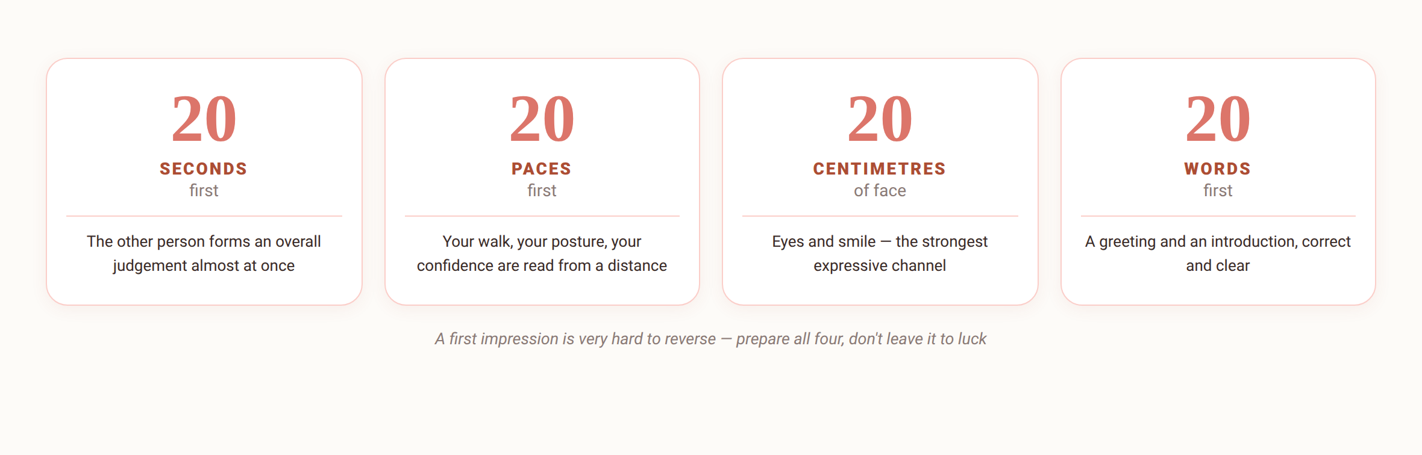
2.1
A first impression — you only get one
Je m'appelle Huong • Do Thuy Huong, Lecturer • EC1103
Chapter 2
4
Notes:
THE 4×20 RULE (4 minutes)
• Ask before you teach: "How long do you think it takes someone to form an impression of you?"
• Walk the four twenties, one short example each.
• DEMONSTRATE: walk into the room twice — once head down and hurried, once head up, shoulders open, smiling. Ask the class what changed.
• LAND IT: a first impression is PREPARED, not lucky.
THE FULL VERSION (moved off the slide)
• The first few seconds: the brain forms a judgement almost instantly from appearance, bearing and greeting — and a first impression is very hard to reverse later.
• The 4×20 rule in full: the first 20 seconds • the first 20 steps • the 20 cm of your face (eyes, smile) • the first 20 words — prepare all four properly.
• Three pillars: dress that fits the setting AND the position; a bearing that is confident and friendly; a greeting and introduction that are clear and correctly formed.

Slide 6
THE NUMBER TO REMEMBER
The 4 × 20 rule — four gates a first impression passes
20
SECONDS
The other person forms an overall judgement
20
PACES
Your walk and posture are read from a distance
20
CENTIMETRES
The eyes and the smile on your face
20
WORDS
Your greeting and first introduction
A first impression forms almost instantly and is very hard to reverse — it must be PREPARED, not left to luck.
Je m'appelle Huong • Do Thuy Huong, Lecturer • EC1103
Chapter 2
Notes:
THE 4×20 RULE (2 minutes)
• This slide is for students to PHOTOGRAPH.
• Read each number, one one-sentence example each.
• Ask: "Of these four gates, which are you most and least confident at?"''

Slide 7
2.1
Basic etiquette
Greeting and introducing
The junior greets first; introduce the less senior to the more senior
The handshake
Stand up, meet the eyes, firm grip for 2–3 seconds
Giving and receiving a card
Both hands, text facing them; read it before putting it away
Shared spaces
Keep it quiet, give way, knock before entering
Je m'appelle Huong • Do Thuy Huong, Lecturer • EC1103
Chapter 2
5
Notes:
ETIQUETTE (4 minutes) — HANDS-ON NOW
• Get the whole class on their feet, turn to the person beside them and PRACTISE THE HANDSHAKE: stand up, meet their eyes, firm grip, 2–3 seconds.
• Correct on the spot: the limp handshake, the crushing handshake, looking elsewhere.
• Business cards: demonstrate giving and receiving with both hands, READ IT before putting it away — press the point: pocketing it straight away is rude.
• A way to remember the order of introductions: introduce the LESS senior person TO the more senior one.
THE FULL VERSION (moved off the slide)
• Greeting: the younger greets the elder, staff greet their superiors first; state your name, title and unit clearly.
• Handshake: the more senior person, or the woman, offers a hand first; not too loose, too hard, or too long.
• Business cards: don't stuff it into your trouser pocket — this is where students slip most often.
• Shared spaces: lifts, meeting rooms, open-plan desks — no loud private conversation.

Slide 8
SECTION 2.2
Presentation skills
From preparation to delivery: how to make the audience remember your point.
Je m'appelle Huong • Do Thuy Huong, Lecturer • EC1103
Chapter 2
Notes:
SECTION CHANGE (30 seconds) — remind them the end-of-term group presentation is marked against this section.

Slide 9
2.2
Presenting: five steps of preparation
ANALYSE THE AUDIENCE
SET THE OBJECTIVE
BUILD THE CONTENT
DESIGN THE SLIDES
REHEARSE
Who are they, what do they care about, what do they expect?
After the talk, what should they know / believe / do?
Pick 3 main points, with evidence and examples.
Few words, more pictures; slides support the speaker, they don't replace them.
Say it out loud, time it, prepare for the hard questions.
Rule of thumb: one minute of talk takes about an hour of preparation on a new topic — rehearsal is the thing an audience “sees” most clearly.
Je m'appelle Huong • Do Thuy Huong, Lecturer • EC1103
Chapter 2
6
Notes:
PREPARING A PRESENTATION (3 minutes)
• Press step 1: ANALYSE YOUR AUDIENCE — most students skip it.
• The slide rule: FEW WORDS, MORE PICTURES. Point at the slide on screen as the example.
• Remind them: the end-of-term group presentation is marked against exactly these five steps.

Slide 10
2.2
The structure of a talk
Opening (10–15%) — win their attention
A curious question, a number, a short story — then give them the map
Body (70–80%) — three main points at most
Each point: claim → evidence → example; put the strongest first or last
Close (10–15%) — leave them with one thing
Recap the three points, press the message, ask for a specific action
Je m'appelle Huong • Do Thuy Huong, Lecturer • EC1103
Chapter 2
7
Notes:
STRUCTURE (3 minutes)
• The 10–15 / 70–80 / 10–15% split.
• Press: AT MOST 3 MAIN POINTS. Any more and the audience remembers none of them.
• Open with a question, a number or a story — have the class try one opening line for a topic of their choice.
THE FULL VERSION (moved off the slide)
• Opening 10–15%: a question that intrigues, a striking number, or a short story; introduce yourself, then tell the audience where the talk is going.
• Body 70–80%: THREE main points at most; each with a clear bridge into the next.
• Conclusion 10–15%: leave ONE thing behind; have your question-and-answer ready.

Slide 11
2.2
Delivering with confidence
Body language
Stand firm, shoulders open, eyes moving round the room; hands natural
Voice
Loud and clear, vary the pace; pause 1–2 seconds before a key point
Getting past the nerves
Prepare well • arrive early • breathe deeply • think about the message
Handling questions
Hear it out, thank them, answer briefly; unsure — promise an answer later
Je m'appelle Huong • Do Thuy Huong, Lecturer • EC1103
Chapter 2
8
Notes:
DELIVERY (3 minutes)
• Three concrete things: stand on both feet, open your shoulders, move your eyes around the whole room in turn.
• The pause: STOP FOR 1–2 SECONDS before an important point — demonstrate it on the spot so the class feels it.
• Nerves: say honestly that everyone gets nervous; the answer is preparing thoroughly, arriving early, breathing deeply, and focusing on the MESSAGE rather than on yourself.
• Hard questions: hear it out → thank them → answer briefly; if you aren't sure, PROMISE AN ANSWER LATER — never invent one.
THE FULL VERSION (moved off the slide)
• Body language: move with purpose; hands out of pockets, stop fidgeting with the pen.
• Voice: vary both pace and pitch — silence is the seasoning of a talk.
• Nerves: being nervous is NORMAL; arrive early and get used to the room; focus on the message instead of on yourself.
• Questions: if you aren't sure, promise an answer later — honesty beats guessing.

Slide 12
SECTIONS 2.3 – 2.4
Listening, questioning, and the telephone
The two least-taught skills, and the two that decide most of daily work.
Je m'appelle Huong • Do Thuy Huong, Lecturer • EC1103
Chapter 2
Notes:
SECTION CHANGE (30 seconds).

Slide 13
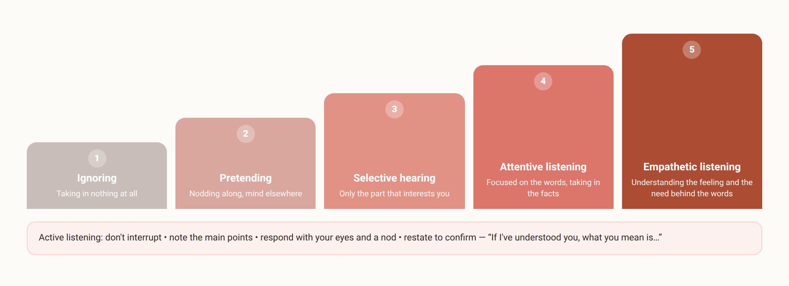
2.3
Hearing is not listening: five levels
Je m'appelle Huong • Do Thuy Huong, Lecturer • EC1103
Chapter 2
9
Notes:
THE 5 LEVELS OF LISTENING (3 minutes)
• Climb the ladder from the bottom up.
• ASK THE CLASS STRAIGHT OUT: "For the last 30 minutes, which level have you been on?" — they usually laugh, which loosens the room.
• Press level 5, EMPATHIC LISTENING: hearing the feeling and the need behind the words.
• The paraphrase: "If I've understood you correctly, you mean…" — have the class practise saying it.
THE FULL VERSION (moved off the slide)
• Active listening in full: give the speaker your whole attention • don't interrupt, don't rush to judge • note the main points • respond with your eyes and a nod • paraphrase to confirm: “If I've understood you correctly, you mean…”.

Slide 14
2.3
Questioning skills
Closed question
Yes / No or a single fact — to confirm and to settle
Open question
Why • How • What — to uncover what they need
Probing question
“Specifically…?” — to sharpen a vague answer
When you ask
One question at a time; ask, then wait in silence
Je m'appelle Huong • Do Thuy Huong, Lecturer • EC1103
Chapter 2
10
Notes:
ASKING QUESTIONS (3 minutes)
• Separate CLOSED questions (pinning down facts) from OPEN ones (uncovering needs).
• Press: good selling is good ASKING, not good TALKING.
• Mistakes to avoid: firing several questions at once; leading the witness; asking and then talking on without waiting.
• THE GOLDEN RULE: ask, then BE QUIET and wait for the answer.
THE FULL VERSION (moved off the slide)
• A closed question, for example: “Have you received the quotation?”
• An open question invites the other person to talk.
• Probing and digging: “Specifically…?”, “Could you give me an example?”
• Watch out for: pressing, leading questions; and don't answer your own question.

Slide 15
2.4
The telephone: making a professional call
1
Before you dial — purpose, content, pen and paper; pick a sensible hour
2
Open correctly — greet, give your name and organisation, ask for five minutes
3
Be brief, check understanding — get to the point; read back the time, the place, the action
4
Close politely — thank them, say goodbye; let the client hang up first
Je m'appelle Huong • Do Thuy Huong, Lecturer • EC1103
Chapter 2
11
Notes:
THE TELEPHONE — MAKING THE CALL (3 minutes)
• Four steps; press step 1, PREPARE FIRST: your purpose, your points, pen and paper, the right moment.
• Model the standard opening: "Good morning, this is… calling from…. Is now a convenient moment to talk for about five minutes?"
• Closing: SUMMARISE the time, the place and what happens next before you hang up.
THE FULL VERSION (moved off the slide)
• Preparation: avoid calling too early, too late, or over the lunch break.
• A model opening: “Good morning, this is… from…. Do you have five minutes?”
• The body: speak clearly; read back the agreement — time, place, what each side will do.
• Closing: let the more senior person, or the customer, hang up first.

Slide 16
2.4
Answering calls, and phone manners at work
Answering
Pick up within ~3 rings; greet and give your name; write the message down
When the person is away
Note: who called – about what – contact number – when you'll reply
Mobiles at work
Silent in meetings; no personal calls while with a client
Je m'appelle Huong • Do Thuy Huong, Lecturer • EC1103
Chapter 2
12
Notes:
THE TELEPHONE — TAKING THE CALL (3 minutes)
• Pick up within three rings; greet the caller and NAME YOUR ORGANISATION.
• A trick: SMILE while you speak — the caller hears it in your voice.
• A message needs four things: who called – about what – their number – when you will get back to them.
• Office culture: don't take personal calls while you have a visitor or are in a meeting.
THE FULL VERSION (moved off the slide)
• A bright voice — the caller “hears” your smile; write it down and READ IT BACK.
• A message must be passed on in full and in time.
• Work messages on Zalo or by text hold to the same standards as email.

Slide 17

GROUP WORK
Practising two skills in class
A DOUBLE TASK (groups of 4–5, 25 minutes to prepare and perform)
Draw a lot: (a) call to arrange a meeting with a prospect, or (b) call to handle a late delivery.
THE GROUP'S TASK
1
Role-play a 3-minute call; the class marks it against the checklist in 2.4.
2
The other group gives a 3-minute talk; the class comments on opening – body – close.
3
Each group names three things it would do differently next time.
Je m'appelle Huong • Do Thuy Huong, Lecturer • EC1103
Chapter 2
13
Notes:
PRACTICAL ACTIVITY (15 minutes)
• Pairs; each pair draws a situation.
• 5 minutes to prepare, 2 minutes to perform in front of the class, then the class comments against the criteria just taught.
• Watch and note 2–3 common mistakes to land at the end of the session.
• Praise good work by name; give the criticism to the room as a whole, never naming who fell short.
THE FULL VERSION (moved off the slide)
• Situation (a): a first call to a prospective customer, asking for a meeting to present the product.
• Situation (b): a call handling a late delivery for an unhappy customer.
• Role play: one plays the employee, one the customer.
• Presentation: the topic prepared at home; the class comments on body language too.

Slide 18
SUMMARY
Three things to remember
A first impression is prepared, not lucky
Dress, bearing, greeting, etiquette — every one of them can be rehearsed.
A good talk starts with the audience
Audience → objective → three points → rehearsal; talk to the room, not to the slide.
Listening and questioning are the best “selling” skills there are
Understand the need first, present second; the telephone is a company's face in sound.
Je m'appelle Huong • Do Thuy Huong, Lecturer • EC1103
Chapter 2
14
Notes:
SUMMARY (2 minutes)
• Recap the 4×20 rule and the 5 levels of listening — have a student say them back.
• Set the work: the 40 multiple-choice questions for Chapter 2; prepare a topic for the group presentation.

Slide 19
REVIEW & PREPARATION
Review questions
1
Explain the 4×20 rule and how to apply it in a job interview.
2
Build a detailed structure for a 5-minute talk introducing a product of your choice.
3
Distinguish the five levels of listening; give a work example of empathetic listening.
4
Write the script of a call arranging a client meeting, following the four standard steps.
PREPARING FOR THE NEXT SESSION: Chapter 3 – Communication in specific situations. Each group brings a real awkward workplace situation (kept anonymous) for discussion.
Je m'appelle Huong • Do Thuy Huong, Lecturer • EC1103
Chapter 2
15
Notes:
REVISION (1 minute) — students work through this at home.

Slide 20
READING
Course materials
Main textbook
Ha Nam Khanh Giao (2023), Business Communication, Finance Publishing House.
Further reading
Thai Tri Dung (2012), Communication and Negotiation Skills in Business, Labour – Social Publishing House. • Decree 30/2020/ND-CP on records management (used in Chapter 5 and the lab sessions).
Lecturer's own materials
Slides, cases and exercises written by Do Thuy Huong; posted to the class group after each session.
Je m'appelle Huong • Do Thuy Huong, Lecturer • EC1103
Chapter 2
16
Notes:
READING (1 minute) — remind them to read the section on internal communication before the next session.

