Slide 1



CHAPTER 3
Communication in specific
situations
One set of skills, four sets of rules: inside the organisation, with customers, at the table, across cultures.
Do Thuy Huong, Lecturer
EC1103 – Communication and Document Drafting Skills (2:1) • Class 261b, Semester 1, 2026 – 2027
© Do Thuy Huong, 2026 — Prepared for in-person teaching. Please credit the source.
Notes:
OPENING (2 minutes)
• The way in: "The same skill, but every setting has its own rules of play."
• Ask the class: "What is different about talking to your boss and talking to a close friend?"''

Slide 2
OBJECTIVES
By the end of this chapter, students can
1
Behave appropriately — with superiors, subordinates and colleagues inside the organisation.
2
Communicate professionally — with customers, partners, government bodies and the press; and handle a customer complaint.
3
Correctly perform — the etiquette of the business table correctly.
4
Adapt — to cultural difference when working across cultures.
Je m'appelle Huong • Do Thuy Huong, Lecturer • EC1103
Chapter 3
2
Notes:
OBJECTIVES (1 minute) — press the point: this chapter has more real situations in it than any other.

Slide 3
CONTENTS
What we will go through
1
3.1 — Communication inside the organisation
2
3.2 — Communication with customers, partners, government bodies and the press
3
3.3 — Communication at the table
4
3.4 — Communication across cultures
Je m'appelle Huong • Do Thuy Huong, Lecturer • EC1103
Chapter 3
3
Notes:
THE MAP (1 minute) — four settings: inside the organisation, outside it, the dinner table, across cultures.

Slide 4
SECTION 3.1
Communication inside the organisation
With superiors, subordinates and colleagues — each relationship has its own conduct.
Je m'appelle Huong • Do Thuy Huong, Lecturer • EC1103
Chapter 3
Notes:
SECTION CHANGE (30 seconds).

Slide 5
3.1
Communicating with your superior
Taking on a task
Listen – note – ask until it's clear; confirm by email
Reporting
Result first, explanation second; bad news early, with a plan
When you disagree
Right moment, right place, on the data; respect the final call
Je m'appelle Huong • Do Thuy Huong, Lecturer • EC1103
Chapter 3
4
Notes:
WITH YOUR SUPERIORS (4 minutes)
• Three situations: taking on a task – reporting – disagreeing.
• Press the technique of CONFIRMING IN WRITING after being given a task — it heads off "but that's not what I understood".
• The golden rule for reporting: THE RESULT FIRST, the explanation after. Your manager is busy; don't narrate the process.
• BAD NEWS EARLY, with an option attached — press it: hiding bad news is the worst mistake of all.
• Disagreeing: pick a private moment, argue from DATA and the COMMON INTEREST, and respect the final decision.
THE FULL VERSION (moved off the slide)
• Taking on a task: ask until you are clear on the REQUIREMENT, the DEADLINE and the RESOURCES — miss one of the three and the work comes out wrong.
• Reporting: result first, explanation after. Bad news EARLY and with an option attached; never buried.
• Disagreeing: pick a private moment; argue from data and the common interest; once you have said it, respect the final decision.

Slide 6
3.1
With subordinates and colleagues
Delegating
Clear goal – deadline – standard; hand over the resources too
Praise and criticism
Praise in public • criticise in private, at the behaviour not the person
With colleagues
Argue about the work, not the person; keep out of factions
Meetings that work
Agenda sent ahead • a clear conclusion • who does what
Je m'appelle Huong • Do Thuy Huong, Lecturer • EC1103
Chapter 3
5
Notes:
WITH YOUR STAFF AND COLLEAGUES (3 minutes)
• Delegate three things clearly: THE OBJECTIVE – THE DEADLINE – THE STANDARD.
• The rule: PRAISE IN PUBLIC, CRITICISE IN PRIVATE. Write it large on the board.
• Criticism aims at the BEHAVIOUR, not the PERSON: "This report was two days late", not "You're irresponsible".
• With colleagues: argue about the work, never attack the person; keep out of factions.
THE FULL VERSION (moved off the slide)
• Delegate with TRUST and RESOURCES; check progress proportionately, don't micromanage.
• Praise in public, promptly, specifically. Criticise in private, with a way to put it right.
• Colleagues: no factions, no talking behind backs.
• Meetings: an agenda sent in advance, short contributions, and minutes at the end naming who owns each action.

Slide 7
SECTION 3.2
Communication outside the organisation
Customers, partners, government bodies, the press — four groups, four sets of rules.
Je m'appelle Huong • Do Thuy Huong, Lecturer • EC1103
Chapter 3
Notes:
SECTION CHANGE (30 seconds) — flag it in advance: the most important thing in the chapter is in here (the LAST procedure).

Slide 8
3.2
Communicating with customers
A service mindset
Every point of contact either builds trust or breaks it
The golden rules
Hear the need before you pitch • tell the truth • keep your promises
Never do this
Argue to win • promise beyond your means • vanish after the sale
Je m'appelle Huong • Do Thuy Huong, Lecturer • EC1103
Chapter 3
6
Notes:
WITH CUSTOMERS (3 minutes)
• The stance is SERVICE — neither begging nor granting favours.
• Every point of contact either BUILDS or BREAKS trust.
• Four things never to do — press the first: ARGUING TO WIN with a customer. Win the point and lose the customer and you have lost.
BRIDGE: "So what do you do when a customer is angry?"''
THE FULL VERSION (moved off the slide)
• Every point of contact — the greeting, the advice, the delivery, the after-sales — builds or breaks trust.
• The golden rules: greet warmly, use the customer's NAME where you can; tell the truth about the product; keep your promises on timing.
• Never: promise beyond what you can do; blame a colleague or "the process"; abandon the customer once the sale is closed.

Slide 9
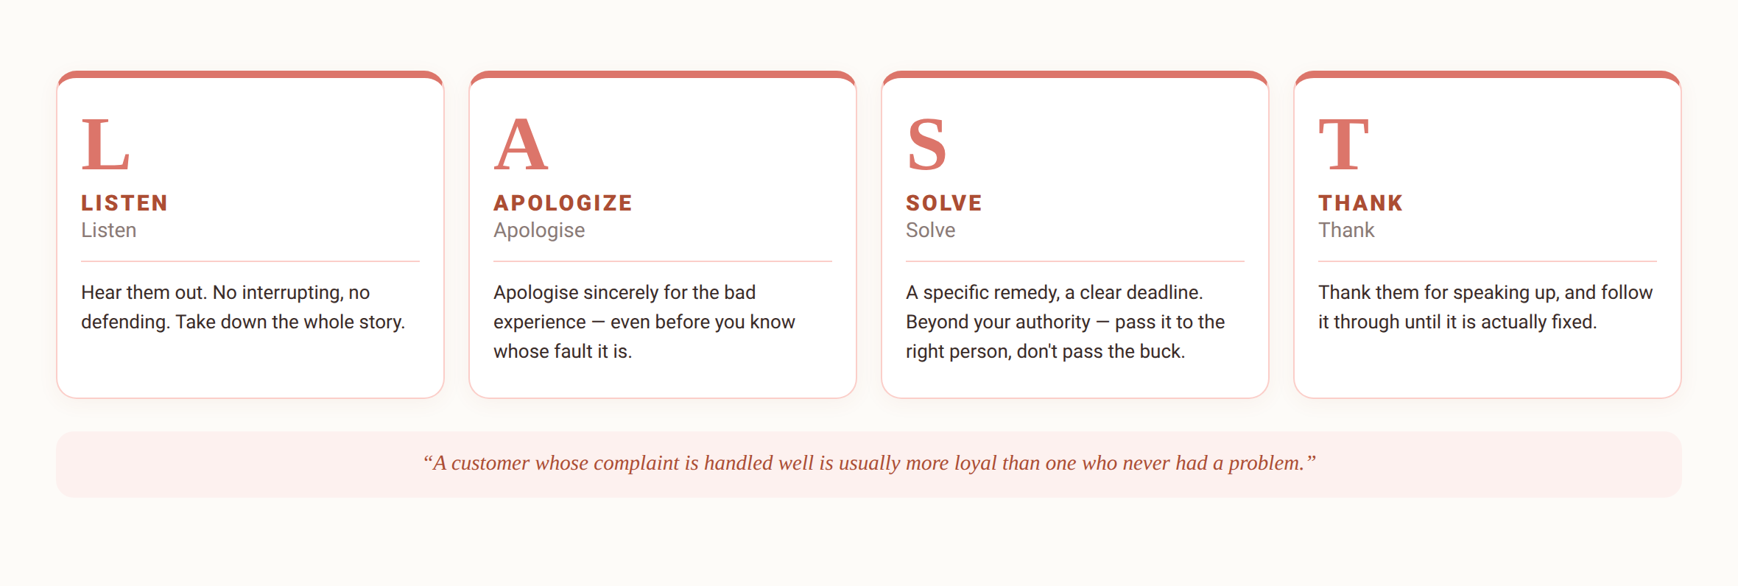
3.2
Handling a customer complaint — the LAST procedure
Je m'appelle Huong • Do Thuy Huong, Lecturer • EC1103
Chapter 3
7
Notes:
THE LAST PROCEDURE (5 minutes) — THE MOST IMPORTANT THING IN THE CHAPTER
• Write the four letters L-A-S-T on the board.
• L: listen to the WHOLE thing, no interrupting, no defending. Press it: don't rush to explain while the customer is still angry.
• A: apologise for the EXPERIENCE — even before you know whose fault it was. Students argue about this one, so explain it carefully: apologising ≠ admitting fault.
• S: a SPECIFIC option, with a CLEAR deadline. Beyond your authority, hand it to the right person — don't pass the parcel.
• T: thank them and FOLLOW IT THROUGH TO THE END.
• The closing figure: a customer whose complaint is handled well is usually MORE LOYAL than one who never had a problem.
• Have the class practise one short case at once: an order that arrived three days late.

Slide 10
3.2
With partners, government bodies and the press
Business partners
Keep your word, be transparent; the long relationship beats the short gain
Government bodies
Right procedure, right authority, documents in correct format
Press and media
Only the authorised spokesperson; in a crisis, answer fast
Je m'appelle Huong • Do Thuy Huong, Lecturer • EC1103
Chapter 3
8
Notes:
PARTNERS – GOVERNMENT – THE PRESS (3 minutes)
• Partners: the LONG relationship matters more than the short advantage.
• Government bodies: the right procedure, the right authority, PAPERWORK IN THE CORRECT FORMAT — this leads into Chapter 5.
• The press: ONLY AN AUTHORISED PERSON speaks. Staff never answer journalists on their own.
• A crisis: respond FAST, own the part that is genuinely yours.
THE FULL VERSION (moved off the slide)
• Partners: the long relationship matters more than the short advantage — this is the ground for Chapter 4.
• Government bodies: files and documents in the correct format (Chapter 5); a serious manner, on time; absolutely no “short cuts” outside the rules.
• The press: consistent, truthful information; in a crisis, own the part that is genuinely yours and don't dodge.

Slide 11
SECTIONS 3.3 – 3.4
The table, and working across cultures
Where business carries on even though nobody mentions business.
Je m'appelle Huong • Do Thuy Huong, Lecturer • EC1103
Chapter 3
Notes:
SECTION CHANGE (30 seconds) — this is the part students enjoy most; keep it light but keep the standard.

Slide 12
3.3
Communication at the table
Before the meal
RSVP on time • arrive on time • wait for the host to seat you
During the meal
The host starts first; work your cutlery from the outside in
Toasts
The junior holds their glass lower; never press someone who isn't drinking
Table talk
Do: food, sport, travel • Don't: politics, religion, income
Je m'appelle Huong • Do Thuy Huong, Lecturer • EC1103
Chapter 3
9
Notes:
AT THE TABLE (4 minutes) — STUDENTS LOVE THIS PART
• Before: confirm on time, arrive on time, dress for the occasion, WAIT FOR THE HOST TO SEAT YOU.
• During: the host starts first; cutlery is used FROM THE OUTSIDE IN; don't talk with your mouth full.
• Toasts: the more junior person HOLDS THEIR GLASS LOWER when clinking. Demonstrate it with a water glass.
• PRESS THIS: respect anyone who doesn't drink, and NEVER PUSH THEM. Teach students how to decline politely: "I'm driving, could I have water instead?"
• Topics to raise and to avoid — press: no politics, no religion, no income, no private life.
THE FULL VERSION (moved off the slide)
• Before: dress for the kind of occasion; where you sit signals rank, so wait for the host to place you.
• During: don't talk while chewing, don't tap your chopsticks, don't keep turning the dishes towards yourself.
• Toasts: keep them short and pitched at the right person; respect anyone who doesn't drink.
• Conversation: business only when the host opens it.

Slide 13
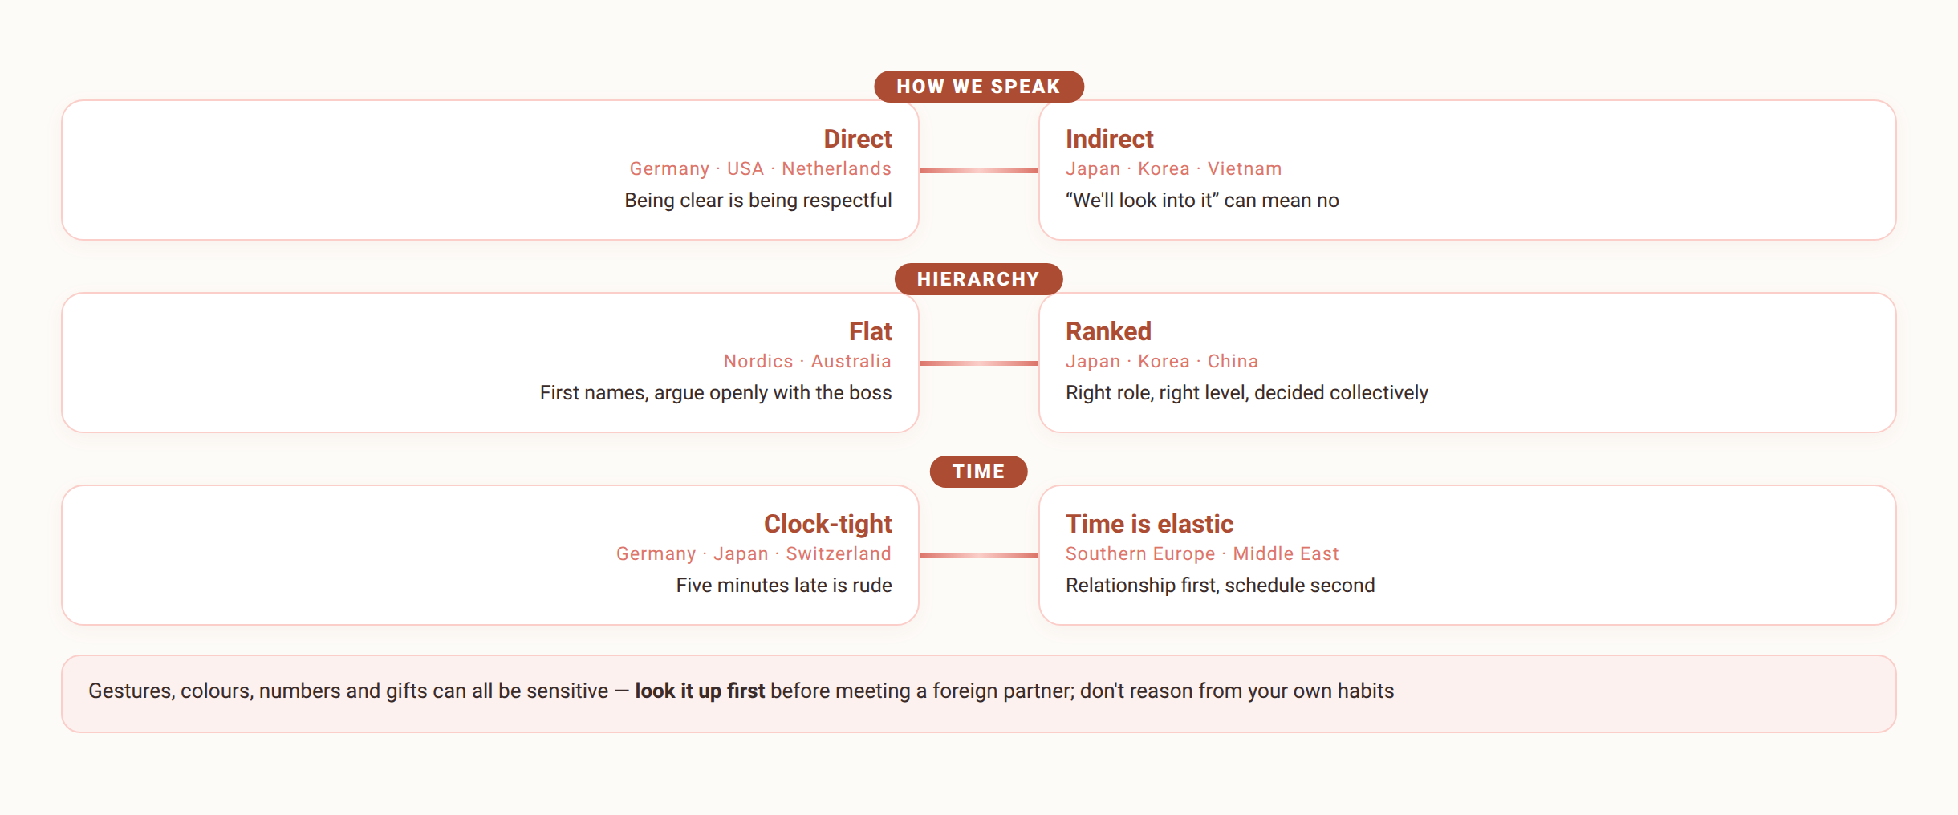
3.4
Communicating across cultures: spotting the differences
Neither pole is more correct — the work is knowing where you stand on the axis.
Je m'appelle Huong • Do Thuy Huong, Lecturer • EC1103
Chapter 3
10
Notes:
ACROSS CULTURES (3 minutes)
• Four differences: how things are said, hierarchy, time, gesture and taboo.
• The best example: "We will consider it" in Japanese business culture is usually A POLITE NO.
• Ask the class: has anyone worked or interned with people from another country — tell us one difference you met.

Slide 14
3.4
Principles for adapting across cultures
1
Read up first — how they greet, and what they consider taboo
2
Watch and adjust — how they greet, hand over a card, keep their distance
3
Don't read it by your own norms — a “strange” behaviour may be perfectly ordinary to them
4
Speak slowly and clearly, confirm in writing — avoid slang; summarise the agreement by email
5
Be humble and willing to learn — apologise when you trip over a taboo
Je m'appelle Huong • Do Thuy Huong, Lecturer • EC1103
Chapter 3
11
Notes:
ADAPTING (2 minutes)
• Five principles — press "DON'T READ OTHERS BY YOUR OWN NORMS".
• The practical trick: speak slowly and clearly, and CONFIRM IN WRITING after a multinational meeting.
THE FULL VERSION (moved off the slide)
• Read up before any meeting that matters; don't wait until you are at the table.
• Watch, then match — imitation is the fastest way to learn.
• Ask politely instead of judging.
• Across languages: speak slowly and clearly, avoid idiom; summarise the agreement by email afterwards.
• Willingness to learn is recognised in every culture.

Slide 15

GROUP WORK
Two hard cases — solved in class
THE CASE (groups of 4–5, 20 minutes, draw one of two)
Case A: a customer comes to the counter shouting because the product has failed for the second time this month, with other customers watching. Case B: the company is receiving a Japanese delegation for the first time — your group must prepare the reception plan and a dinner.
THE GROUP'S TASK
1
Case A: write the handling script following the four LAST steps and role-play it (staff – customer – manager).
2
Case B: list what must be done and what must never be done (greeting, cards, seating, gifts, topics of conversation).
3
The class cross-reviews: what met the chapter's standards, what needs adjusting?
Je m'appelle Huong • Do Thuy Huong, Lecturer • EC1103
Chapter 3
12
Notes:
GROUP WORK (15 minutes)
• Two situations; split the class in half, each half takes one and then presents.
• The customer case: require all four LAST steps, spoken as actual lines of dialogue.
• The dinner case: require the ACTUAL WORDS of the refusal, not a general description.
• Land it yourself: the principles are the same, the words have to fit the moment.

Slide 16
SUMMARY
Three things to remember
Strong outside starts with sound inside
Taking work, reporting, responding upwards; delegating, praising and correcting downwards — all of it can be learned.
A complaint is an opportunity
LAST: Listen – Apologise – Solve – Thank; don't win the argument and lose the customer.
Across cultures: understand first, judge never
Read up – observe – adapt; confirm agreements in writing to get past the language barrier.
Je m'appelle Huong • Do Thuy Huong, Lecturer • EC1103
Chapter 3
13
Notes:
SUMMARY (2 minutes)
• Call on a student to recite the four LAST steps.
• Set the work: the 40 multiple-choice questions for Chapter 3.

Slide 17
REVIEW & PREPARATION
Review questions
1
Explain how to report bad news to a superior, using a concrete example.
2
Apply the LAST procedure to a complaint situation of your choice.
3
Name five things to do and five to avoid when dining with a business partner.
4
Analyse one East–West cultural difference and how to adapt to it at work.
PREPARING FOR THE NEXT SESSION: Chapter 4 – Negotiation in business. Each group recalls its most recent haggle (buying a bike, renting a room…): what made it work, or not?
Je m'appelle Huong • Do Thuy Huong, Lecturer • EC1103
Chapter 3
14
Notes:
REVISION (1 minute) — at home.

Slide 18
READING
Course materials
Main textbook
Ha Nam Khanh Giao (2023), Business Communication, Finance Publishing House.
Further reading
Thai Tri Dung (2012), Communication and Negotiation Skills in Business, Labour – Social Publishing House. • Decree 30/2020/ND-CP on records management (used in Chapter 5 and the lab sessions).
Lecturer's own materials
Slides, cases and exercises written by Do Thuy Huong; posted to the class group after each session.
Je m'appelle Huong • Do Thuy Huong, Lecturer • EC1103
Chapter 3
15
Notes:
READING (1 minute) — read the negotiation section before the next session.

