Slide 1



CHAPTER 4
Negotiation
in business
The art of reaching agreement without losing the relationship — the most directly profitable skill in business.
Do Thuy Huong, Lecturer
EC1103 – Communication and Document Drafting Skills (2:1) • Class 261b, Semester 1, 2026 – 2027
© Do Thuy Huong, 2026 — Prepared for in-person teaching. Please credit the source.
Notes:
OPENING (2 minutes)
• A strong way in: "In business you don't get what you deserve — you get what you NEGOTIATE."
• Ask the class: "Who has haggled over a price? That was already a negotiation."''

Slide 2
OBJECTIVES
By the end of this chapter, students can
1
Explain — what negotiation is, what marks it out, and the three styles of it.
2
Describe — the five stages of a negotiation and the key task of each.
3
Apply — the core skills: preparing a BATNA, questioning, conceding on condition.
4
Recognise — the common tactics used at the table, and how to answer them professionally.
Je m'appelle Huong • Do Thuy Huong, Lecturer • EC1103
Chapter 4
2
Notes:
OBJECTIVES (1 minute) — press it: the chapter ends with a graded role play.

Slide 3
CONTENTS
What we will go through
1
4.1 — What negotiation is, what marks it out, and its three styles
2
4.2 — The five stages, from preparation to what follows the deal
3
4.3 — Negotiation skills, and how to spot the common tactics
Je m'appelle Huong • Do Thuy Huong, Lecturer • EC1103
Chapter 4
3
Notes:
THE MAP (1 minute) — the concept, the five stages, the skills.

Slide 4
SECTION 4.1
What negotiation is, and its styles
Understand its double nature: cooperative and competitive at once.
Je m'appelle Huong • Do Thuy Huong, Lecturer • EC1103
Chapter 4
Notes:
SECTION CHANGE (30 seconds).

Slide 5
4.1
What is negotiation?
The idea
Parties with both shared and conflicting interests working towards an agreement
A double nature: cooperation + competition
Cooperate to grow the pie • compete when dividing it
Three sources of power at the table
Information • Time • Leverage
Je m'appelle Huong • Do Thuy Huong, Lecturer • EC1103
Chapter 4
4
Notes:
THE CONCEPT (3 minutes)
• Press the DOUBLE NATURE: cooperative (so there is a pie at all) and competitive (when it is divided).
• Three sources of strength: INFORMATION – TIME – LEVERAGE (how many alternatives you have).
• An example: someone who must sell in a hurry is always in the weaker position — why? (the power of time).
THE FULL VERSION (moved off the slide)
• The full definition: negotiation is a process in which parties who have both shared and conflicting interests exchange and persuade their way to an agreement all of them can accept.
• The double nature: forget the cooperative half and you lose the partner; forget the competitive half and you take the loss.
• Three sources of strength: INFORMATION — who understands the other side better; TIME — who is under less pressure to finish; LEVERAGE — who has more alternatives.

Slide 6
4.1
What marks out business negotiation
1
Economic interest at the centre — every clause comes back to value, cost and risk
2
Parties both dependent and independent — they need each other, yet each has an alternative
3
The agreement must be put in writing — it is safe only as a contract in correct form
4
It runs inside limits — time, authority and budget — on both sides
5
Shaped by culture and relationship — a one-off deal is nothing like a long partnership
Je m'appelle Huong • Do Thuy Huong, Lecturer • EC1103
Chapter 4
5
Notes:
DEFINING FEATURES (2 minutes)
• Five features, move quickly.
• Press AN AGREEMENT MUST BE PUT IN WRITING — this leads straight into Chapter 5.
THE FULL VERSION (moved off the slide)
• A good negotiator knows their OWN limit exactly and can estimate the OTHER SIDE's.
• Asian and European negotiating styles differ; a one-off deal is nothing like a long partnership.
• The outcome is only safe once it is a properly formed contract — the bridge to Chapter 5.

Slide 7
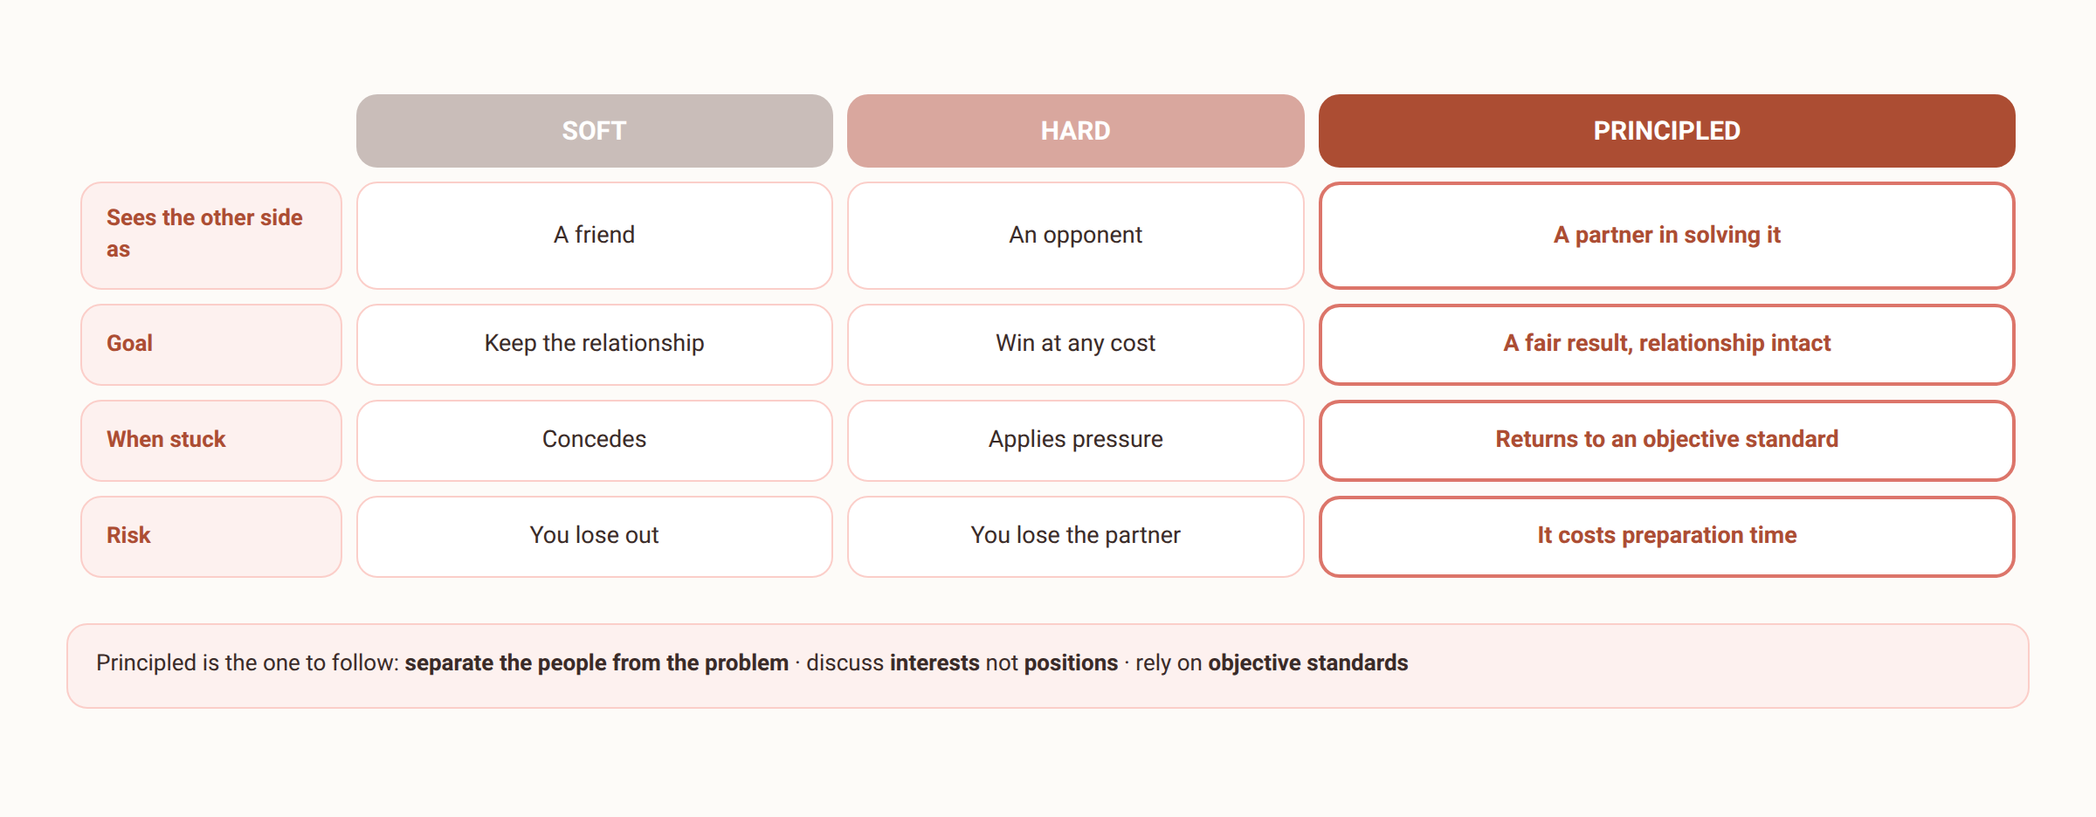
4.1
Styles of negotiation
The three styles differ on just four points — the table shows all four at a glance.
Je m'appelle Huong • Do Thuy Huong, Lecturer • EC1103
Chapter 4
6
Notes:
STYLES OF NEGOTIATION (4 minutes)
• SOFT – HARD – PRINCIPLED. Draw the three-column comparison on the board.
• Ask the class: "Which style do Vietnamese people tend to use?" (usually soft — a reluctance to displease).
• Press the PRINCIPLED style (Harvard): SEPARATE THE PEOPLE FROM THE PROBLEM; work on INTERESTS instead of digging into POSITIONS.
• The classic example: two sisters fight over an orange — one wants the peel for a cake, the other the flesh for juice. Cutting it in half is the poor answer. Ask about interests and the good answer appears.
• Distributive ↔ integrative: making the pie BIGGER out of differences in priority.

Slide 8
SECTION 4.2
The five stages of a negotiation
Seventy per cent of the result is settled before either side sits down.
Je m'appelle Huong • Do Thuy Huong, Lecturer • EC1103
Chapter 4
Notes:
SECTION CHANGE (30 seconds) — press the 70% figure right here on this slide.

Slide 9
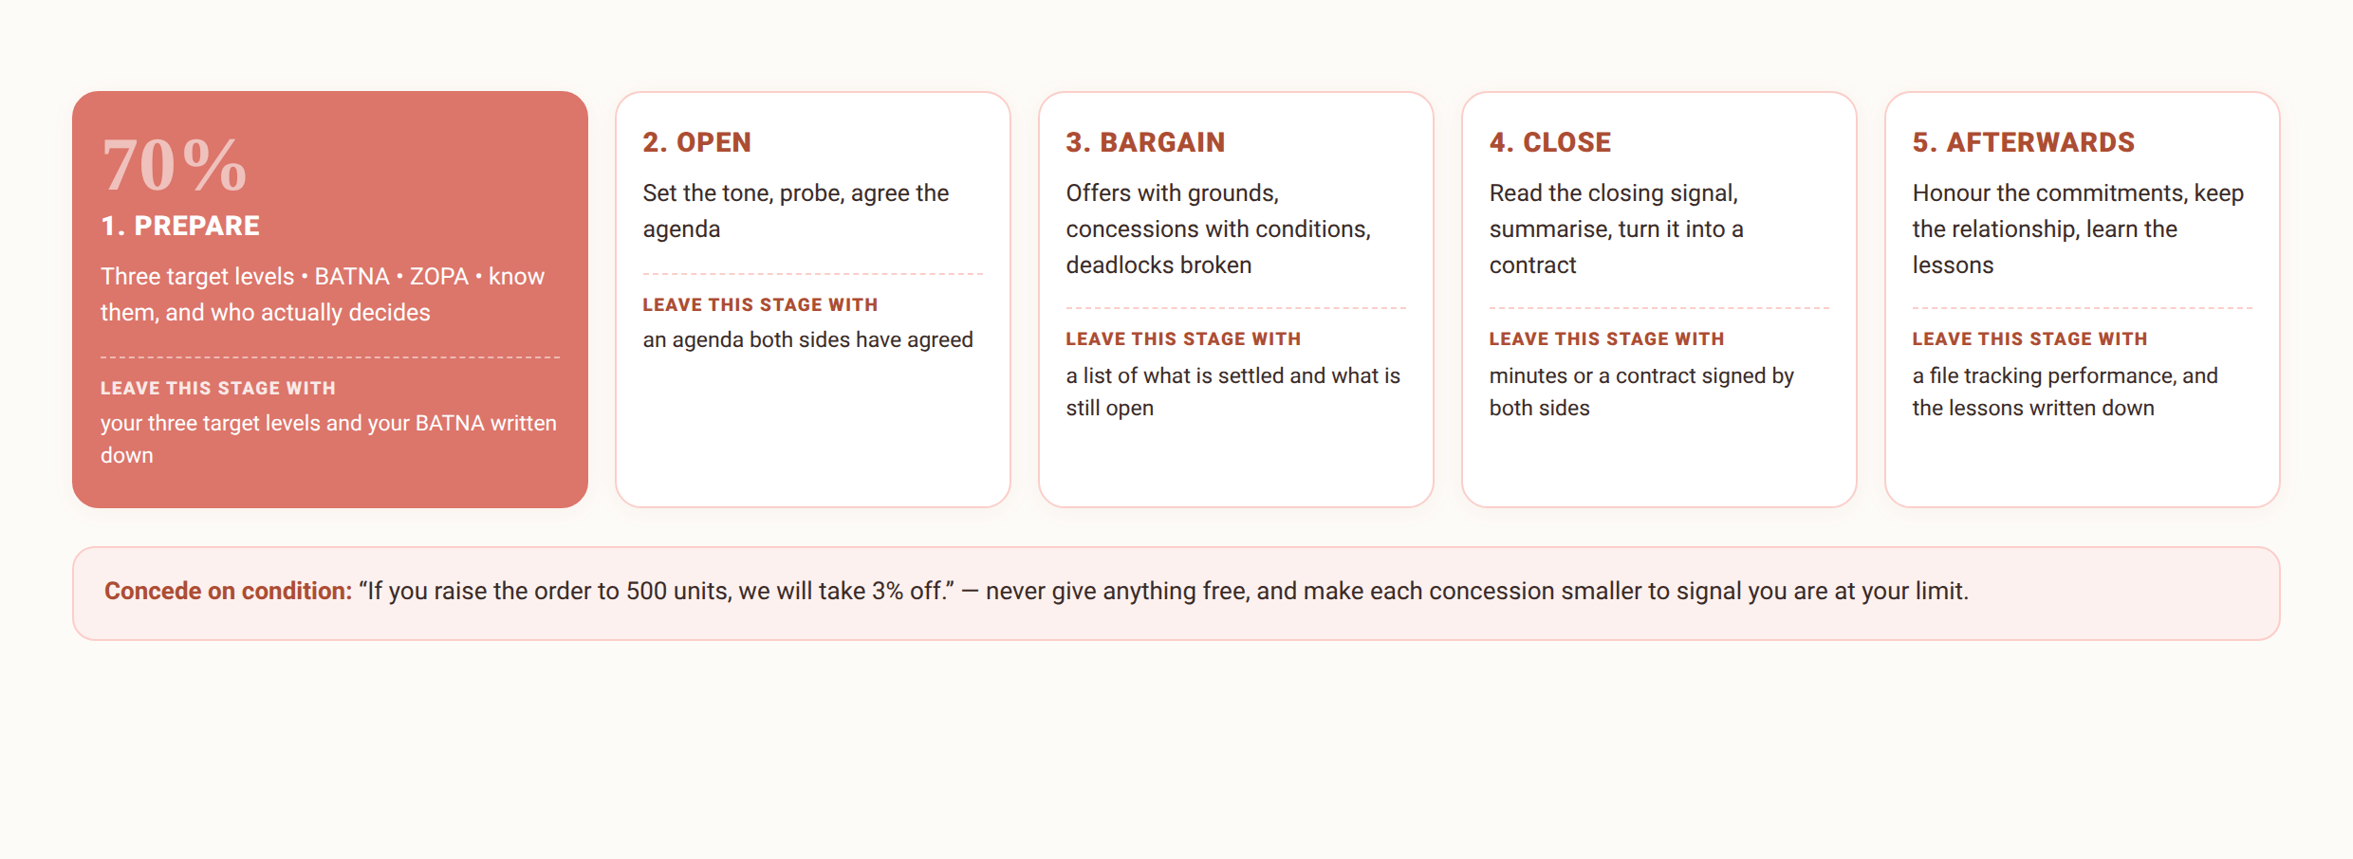
4.2
The negotiation process: five stages
Je m'appelle Huong • Do Thuy Huong, Lecturer • EC1103
Chapter 4
7
Notes:
THE FIVE STAGES (2 minutes)
• Skim the five, then stop at stage 1.
• Say the figure out loud: PREPARATION DECIDES 70% OF THE OUTCOME.
• The closing line: "Not preparing is preparing to concede."''

Slide 10
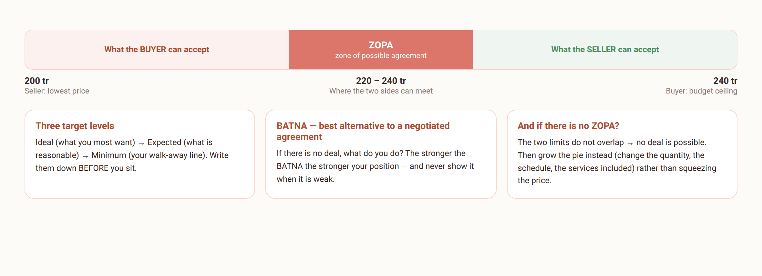
4.2
Preparation — the strongest weapon you have
Whether the ZOPA is narrow or wide depends on both sides' real limits — prepare well enough to know where you stand on it.
Je m'appelle Huong • Do Thuy Huong, Lecturer • EC1103
Chapter 4
8
Notes:
PREPARATION: BATNA AND ZOPA (5 minutes) — THE HARDEST PART OF THE CHAPTER
• Three levels of objective: IDEAL – EXPECTED – MINIMUM. Make students WRITE THEM DOWN before they sit at the table.
• BATNA: explain it slowly with the job-hunting example — hold another offer and you are visibly more confident.
• Press: a STRONG BATNA makes your position solid; a WEAK BATNA is something you DON'T REVEAL.
• ZOPA: point at the diagram on the slide and walk the money axis left to right.
• A question for the class: "What if there is no ZOPA?" — the answer: enlarge the pie (change quantities, timing, added services) rather than squeeze the price.
THE FULL VERSION (moved off the slide)
• Three levels of objective: ideal (what you most want) – expected (what is reasonable) – minimum (the walk-away line).
• BATNA = Best Alternative To a Negotiated Agreement. The stronger it is the firmer you stand — and DON'T REVEAL it when it is weak.
• ZOPA: estimate it so you know which offers are workable and which will break the table.
• Understanding your counterpart: the real need behind the demand; who actually has authority to decide.

Slide 11
THE NUMBER TO REMEMBER
Why does preparation matter so much?
70%
OF THE RESULT
is settled during preparation, before either side sits down
3
TARGET LEVELS
Ideal – Expected – Minimum: write them down before you negotiate
1
BATNA
Best Alternative To a Negotiated Agreement — the real source of power at the table
The line to remember: “Failing to prepare is preparing to concede.”
Je m'appelle Huong • Do Thuy Huong, Lecturer • EC1103
Chapter 4
Notes:
THE PREPARATION FIGURE (2 minutes)
• Press the 70% — this is the number that surprises students.
• Tie it in: the role play at the end of the session marks the preparation (the three levels plus a written BATNA).
• Read the closing line slowly: "Not preparing is preparing to concede."''

Slide 12
4.2
Opening and bargaining
Set the tone, and probe
Open questions, so they show their need before you name a price
Offer and haggle
The first offer needs grounds; answer theirs with “on what basis?”
Concede on condition
Never give anything free; make each concession smaller
Breaking a deadlock
Take a break • change the person or the topic • let an objective standard arbitrate
Je m'appelle Huong • Do Thuy Huong, Lecturer • EC1103
Chapter 4
9
Notes:
BARGAINING (4 minutes)
• Anchoring: a first offer WITH A BASIS shapes the whole negotiation.
• When you are anchored: answer with a question — "On what basis?" — and have the class practise saying it.
• CONDITIONAL CONCESSIONS: "If you raise the order to 500, we'll take 3% off." Never give anything away free.
• Make each concession SMALLER than the last, to signal you have reached your limit.
• Deadlock: break – change the person, the issue, or the approach – go back to the underlying interests – bring in an objective standard.
THE FULL VERSION (moved off the slide)
• A few minutes of proper small talk — it warms the room and lets you read their mood.
• The first offer is a psychological anchor — so it has to have a basis.
• Conditional concessions, for example: “If you raise the order to 500, we'll take 3% off.” Make them smaller each time to signal your limit.
• Deadlock: take a break; change the person, the issue, the approach; go back to the underlying interests.

Slide 13
4.2
Closing, and afterwards
Knowing when to close
They ask about rollout, payment, delivery — that is the signal
Put it in writing at once
A verbal agreement is not the end — it must become a document
After the deal
Honour the commitments • keep in touch • hold a lessons-learned meeting
Je m'appelle Huong • Do Thuy Huong, Lecturer • EC1103
Chapter 4
10
Notes:
CLOSING (3 minutes)
• The signal to close: they start asking about IMPLEMENTATION detail, payment, delivery dates.
• Press: SUMMARISE AND PUT IT IN WRITING AT ONCE — a memorandum or a contract.
• Afterwards: deliver what you promised, keep the relationship, take the lesson.
• The closing line: "A negotiation with no paperwork isn't finished."''
THE FULL VERSION (moved off the slide)
• Signs they are ready to close: questions about implementation detail, payment terms, delivery dates.
• Put it in writing immediately: a memorandum, then a contract with all the basic clauses — the drafting technique is taught in Chapter 5.
• Afterwards: honouring what you agreed is the capital you bring to the next negotiation.

Slide 14
SECTION 4.3
Skills, and tactics, at the table
What to train, and what to recognise so you are not led.
Je m'appelle Huong • Do Thuy Huong, Lecturer • EC1103
Chapter 4
Notes:
SECTION CHANGE (30 seconds).

Slide 15
4.3
The core skills at the table
Listening and questioning
Listen more than you speak; a well-placed silence is itself a move
Persuade with interest and evidence
Speak in the language of their interest, with figures and precedent
Keeping your temper
Losing your temper hands them the controls
Working as a team
Clear roles; never disagree with each other in front of the other side
Je m'appelle Huong • Do Thuy Huong, Lecturer • EC1103
Chapter 4
11
Notes:
SKILLS (3 minutes)
• Listen more than you speak; SILENCE AT THE RIGHT MOMENT is a weapon.
• Persuade in THE OTHER SIDE'S LANGUAGE OF INTEREST, with figures and precedent.
• Emotional control: "losing your temper hands them the controls".
• The team: assign a lead, a technical expert, a note-taker; NEVER disagree with each other in front of the counterpart.
THE FULL VERSION (moved off the slide)
• Silence at the right moment: many concessions appear simply because the other side can't bear the pause.
• Persuade with figures, precedent and objective rules — not with feeling.
• Separate the people from the problem; stay calm under provocation.
• The team: a lead, a technical expert, a note-taker; agree your private signals beforehand.

Slide 16
4.3
Spotting the common tactics
1
The shock anchor — an outlandish offer to drag your expectations → hold to objective standards
2
Good cop, bad cop — one hard, one friendly → discuss the substance only
3
The fake deadline — “today only” → check it, be ready to walk
4
Salami slicing — asking for a little more each time → bundle the clauses together
5
The last-minute demand — a new request just before signing → ask for something equal in return
Je m'appelle Huong • Do Thuy Huong, Lecturer • EC1103
Chapter 4
12
Notes:
TACTICS (4 minutes) — STUDENTS ENJOY THIS
• Run through five: the shock anchor, good cop – bad cop, the false deadline, SALAMI SLICING, the last-minute demand.
• Salami: explain it carefully, it is the most common — asking for a little more after the deal is done. The answer: PACKAGE ALL THE TERMS together.
• The last-minute demand: PUT A PRICE on it and ask for something of equal value; don't just give in to be finished.
• Ask the class: who has been told "this price is only good today" buying something online?
THE FULL VERSION (moved off the slide)
• The shock anchor: hold to objective criteria, don't move your own target in a hurry.
• Good cop – bad cop: name it to yourself, then negotiate only on substance.
• The false deadline: test whether it is real; with a BATNA in hand, be ready to leave the table.
• Salami slicing: package all the terms — “if that one opens, the whole package opens”.
• The last-minute demand: calmly put a price on it and ask for something of equal value.

Slide 17

GROUP WORK
Role-play: negotiating an equipment purchase
THE CASE (two groups per pair, 25 minutes; each side gets its own “confidential brief” from the lecturer)
Company X needs 20 computers for a new office, a budget of at most 240 million dong, delivery within 3 weeks. Supplier Y wants a good price but is holding stock of an older model and wants a long maintenance contract. Neither side knows the other's limits.
THE GROUP'S TASK
1
Ten minutes to prepare: set the three target levels, the BATNA and a concession strategy from your brief.
2
Negotiate for ten minutes in front of the class; observers note the anchor, the concessions, and any tactics used.
3
The class analyses: where in the ZOPA did the deal land? Which side prepared better, and why?
Je m'appelle Huong • Do Thuy Huong, Lecturer • EC1103
Chapter 4
13
Notes:
ROLE PLAY (20 minutes) — THE MAIN ACTIVITY OF THE SESSION
• Pairs, buyer and seller; hand each side its own briefing sheet (with different budgets and floor prices).
• 5 minutes to prepare: the three levels of objective and the BATNA must be written down.
• 10 minutes to negotiate, 5 minutes to close and debrief.
• Walk the room and note 2–3 good moments to analyse with everyone.
• To close: ask the pairs who reached agreement how they enlarged the pie.

Slide 18
SUMMARY
Three things to remember
A negotiation is won before you sit down
Three target levels + BATNA + knowing them = 70% of the result; failing to prepare is preparing to concede.
Negotiate interests, don't dig into positions
Ask “why” to find the real interest; every concession carries a condition; aim at a deal both sides can actually perform.
A deal is safe only in writing
Once closed, it must become a contract in correct form — that is Chapter 5: Drafting and laying out documents.
Je m'appelle Huong • Do Thuy Huong, Lecturer • EC1103
Chapter 4
14
Notes:
SUMMARY (2 minutes)
• Say it again: you win before you sit down; negotiate over INTERESTS; put the result in writing.
• Set the work: the 40 multiple-choice questions for Chapter 4; read Chapter 5 in advance.

Slide 19
REVIEW & PREPARATION
Review questions
1
Distinguish soft, hard and principled negotiation; when should each be used?
2
What are BATNA and ZOPA? Build a BATNA for a student renting a room.
3
Set out the five stages of a negotiation and the main task of each.
4
Name three common negotiating tactics and how to answer them.
PREPARING FOR THE NEXT SESSION: Chapter 5 – Drafting and laying out documents: read Decree 30/2020/ND-CP beforehand (the section on document format); in the lab you will draft the contract for the very deal you negotiated today.
Je m'appelle Huong • Do Thuy Huong, Lecturer • EC1103
Chapter 4
15
Notes:
REVISION (1 minute) — at home.

Slide 20
READING
Course materials
Main textbook
Ha Nam Khanh Giao (2023), Business Communication, Finance Publishing House.
Further reading
Thai Tri Dung (2012), Communication and Negotiation Skills in Business, Labour – Social Publishing House. • Decree 30/2020/ND-CP on records management (used in Chapter 5 and the lab sessions).
Lecturer's own materials
Slides, cases and exercises written by Do Thuy Huong; posted to the class group after each session.
Je m'appelle Huong • Do Thuy Huong, Lecturer • EC1103
Chapter 4
16
Notes:
READING (1 minute) — remind them to download Decree 30/2020 for the next session.

