Slide 1



CHAPTER 5
Drafting and laying out
documents
From speech to writing: turning every agreement into a properly formed document with legal force.
Do Thuy Huong, Lecturer
EC1103 – Communication and Document Drafting Skills (2:1) • Class 261b, Semester 1, 2026 – 2027
© Do Thuy Huong, 2026 — Prepared for in-person teaching. Please credit the source.
Notes:
OPENING (2 minutes)
• The way in: "Chapter 4 taught you to reach an agreement in speech. Chapter 5 teaches you to turn speech into a document with legal force."
• Ask the class: "Who has written a letter asking for leave from class? Was it in the correct format?"''

Slide 2
OBJECTIVES
By the end of this session, students can
1
Explain — what a document is, and tell apart the groups of documents an organisation uses.
2
Apply — the content requirements and the nine formal components under Decree 30/2020/ND-CP.
3
Draft — a decision, a submission, an official letter, minutes and a report in correct layout.
4
Draft — commercial letters, quotations and contracts for business dealings.
Je m'appelle Huong • Do Thuy Huong, Lecturer • EC1103
Chapter 5
2
Notes:
OBJECTIVES (1 minute) — press it: this chapter runs straight into the three computer-lab sessions.

Slide 3
CONTENTS
What we will go through
1
5.1 — What a document is, and its groups
2
5.2 — Requirements of content and of formal layout
3
5.3 — Drafting the common administrative documents
4
5.4 — Drafting commercial documents
Je m'appelle Huong • Do Thuy Huong, Lecturer • EC1103
Chapter 5
3
Notes:
THE MAP (1 minute) — four parts: the concept, the format, administrative documents, commercial documents.

Slide 4
SECTIONS 5.1 – 5.2
Definition, groups and formal layout
The legal and technical ground: what a document is, and what a correct page looks like.
Je m'appelle Huong • Do Thuy Huong, Lecturer • EC1103
Chapter 5
Notes:
SECTION CHANGE (30 seconds).

Slide 5
5.1
What is a document?
The general sense
A means of recording and conveying information in language or signs
The legal definition — Decree 30/2020/ND-CP
“Information put into writing… laid out in the prescribed form and technique.”
What it does
Management • legal basis • record-keeping • the organisation's image
Je m'appelle Huong • Do Thuy Huong, Lecturer • EC1103
Chapter 5
4
Notes:
THE CONCEPT (3 minutes)
• Read the Decree 30/2020 definition slowly — this sentence WILL BE ON THE EXAM.
• Press the phrase "SET OUT IN THE FORMAT AND TO THE TECHNICAL STANDARD PRESCRIBED": good content in the wrong format still comes back rejected.
• Its roles: press "legal basis" — give the example of a contract dispute in court, where what the court looks at is THE DOCUMENT.
THE FULL VERSION (moved off the slide)
• The full legal definition, Decree 30/2020/NĐ-CP: “A document is written information conveyed in language or symbols, arising in the work of an agency or organisation and set out in the format and to the technical standard prescribed.”
• The everyday reading: arising in the work of an agency, an organisation, a BUSINESS — not only state bodies.
• Four roles: an instrument of management; a legal basis; a record; and a display of the organisation's professionalism.

Slide 6
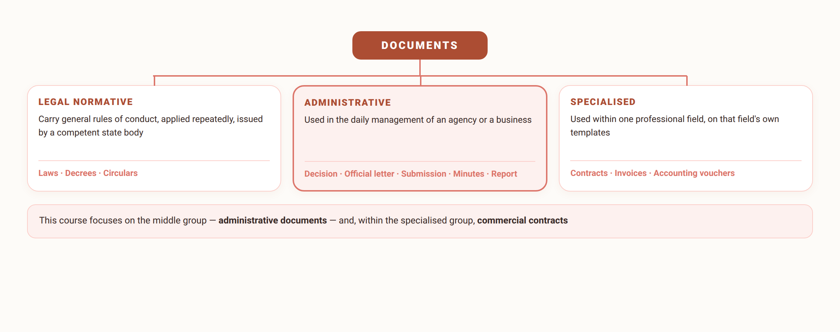
5.1
Groups of documents
Only once you know the group do you know which template to use and who may sign.
Je m'appelle Huong • Do Thuy Huong, Lecturer • EC1103
Chapter 5
5
Notes:
CLASSIFICATION (3 minutes)
• Four groups — draw the tree on the board.
• Press: a business does NOT issue legal instruments, but must comply with them.
• A number to remember: 29 TYPES of administrative document under Decree 30/2020.

Slide 7
5.2
Four requirements of content
Right purpose, right authority
One subject per document, issued within your function
Accurate and objective
Figures with grounds, verifiable — one wrong number carries legal consequences
Clear, brief, easy to follow
One reading is enough to get the drafter's meaning
Lawful, in administrative register
In line with current rules; formal register, no colloquialisms
Je m'appelle Huong • Do Thuy Huong, Lecturer • EC1103
Chapter 5
6
Notes:
REQUIREMENTS OF CONTENT (3 minutes)
• Four requirements, one real mistake as an example for each.
• Press requirement 2: "One wrong figure in a document can carry very large legal consequences" — for example a unit price mistyped in a contract.
• Requirement 4: read out a few sub-standard COLLOQUIAL lines for the class to spot ("hope you'll be nice and understanding about it").
THE FULL VERSION (moved off the slide)
• Right purpose: each document covers ONE subject; issued within the issuer's proper function.
• Accuracy: one wrong figure can carry large legal consequences — press this hard with students.
• Clarity: the recipient reads it ONCE and takes the intended meaning.
• Administrative register: serious, courteous, no colloquialism.

Slide 8
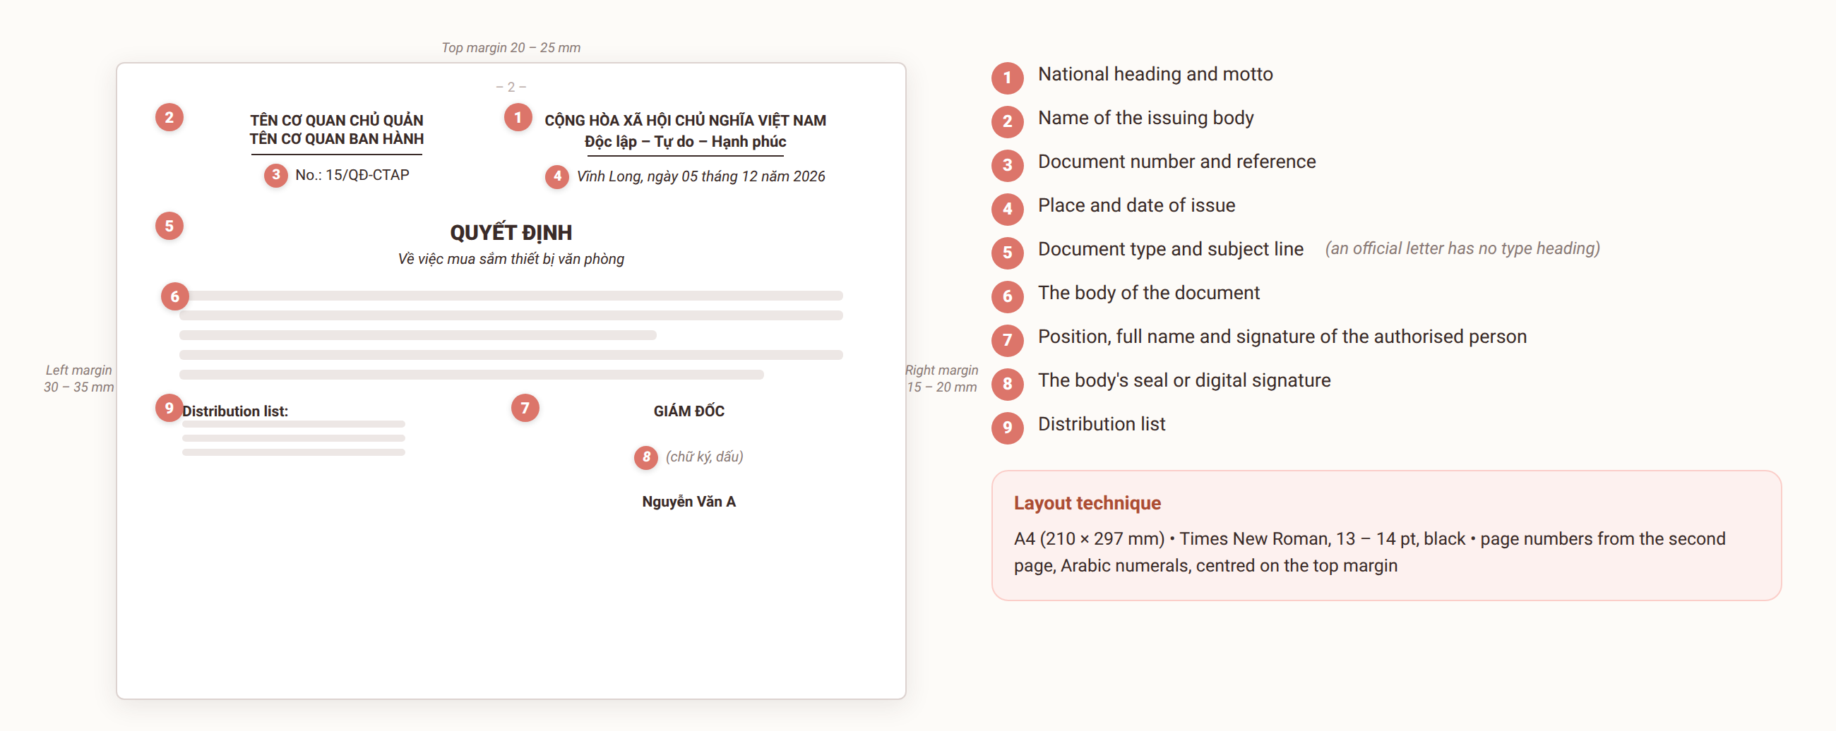
5.2
The nine formal components — Decree 30/2020/ND-CP
Je m'appelle Huong • Do Thuy Huong, Lecturer • EC1103
Chapter 5
7
Notes:
THE FORMAT DIAGRAM (5 minutes) — THE MOST IMPORTANT SLIDE OF THE COURSE
• Tell the whole class to PHOTOGRAPH THIS SLIDE.
• Point at each number on the diagram in order 1 → 9; for each, give the position plus one thing to watch.
• Press component 5: AN OFFICIAL LETTER (công văn) HAS NO DOCUMENT-TYPE NAME, and its subject line starts with "V/v" (re:).
• Press component 9: the distribution list ALWAYS ends with the line "Filed: Registry".
• Say it plainly: all three lab sessions ahead are marked against this diagram.

Slide 9
5.2
Layout technique — the numbers you must know by heart
Paper size and margins
A4 • top and bottom 20–25 mm • left 30–35 mm • right 15–20 mm
Typeface
Times New Roman, Unicode, 13 – 14 pt, black.
Page numbers
From the second page, Arabic numerals, centred on the top margin.
Language
Standard Vietnamese; capitals and abbreviations per the rules
Je m'appelle Huong • Do Thuy Huong, Lecturer • EC1103
Chapter 5
8
Notes:
THE NUMBERS (3 minutes)
• Read each figure slowly and have students write it down.
• How to remember the 30–35 mm LEFT MARGIN: it is the widest because it takes the BINDING for the archive.
• Press: Times New Roman, Unicode, 13–14 pt. Not Arial, not the old TCVN3 encoding.
• Page numbers: FROM THE SECOND PAGE, centred in the TOP margin (many students put them at the bottom — wrong).
THE FULL VERSION (moved off the slide)
• The left margin of 30–35 mm is wider because it has to leave room for BINDING.
• Font Times New Roman, Unicode encoding, 13–14 pt, black.
• Page numbers: from the SECOND page, Arabic numerals, centred on the top margin.
• Language: capitalisation and abbreviation as prescribed; figures in Arabic numerals.

Slide 10
THE NUMBER TO REMEMBER
Four numbers that make a page correct
A4
PAPER
210 × 297 mm — never Letter
30–35
MILLIMETRES
The left margin, widest because the file is bound there
13–14
POINT SIZE
Times New Roman, Unicode, black
9
COMPONENTS
The formal components required by Decree 30/2020
Top and bottom margins 20 – 25 mm • right margin 15 – 20 mm • page numbers from the second page, centred on the top margin.
Je m'appelle Huong • Do Thuy Huong, Lecturer • EC1103
Chapter 5
Notes:
FOUR NUMBERS (2 minutes)
• This is the slide students must KNOW BY HEART — it is on the exam and used throughout the three lab sessions.
• Read each figure slowly; have the whole class write them down.
• How to remember that the left margin is widest: it is for BINDING.
• Test it at once: call on two students to recite them without looking at the slide.

Slide 11
SECTION 5.3
Drafting the common administrative documents
Five documents used every day in every organisation.
Je m'appelle Huong • Do Thuy Huong, Lecturer • EC1103
Chapter 5
Notes:
SECTION CHANGE (30 seconds) — remind them lab session 2 uses exactly these five types.

Slide 12
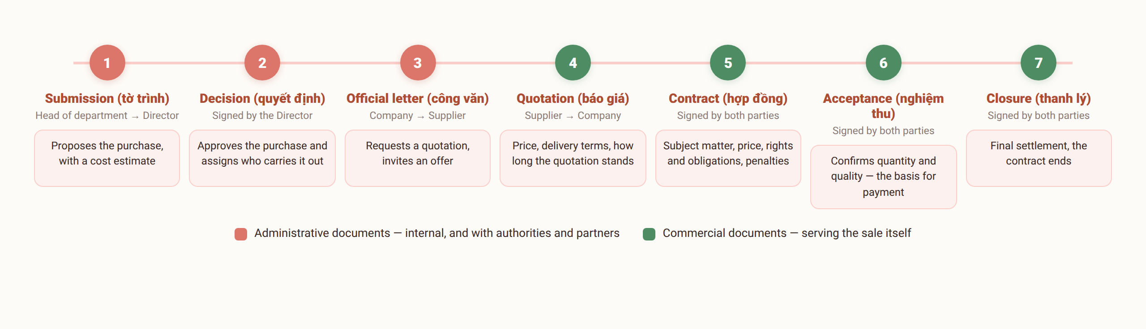
5.3
Five common administrative documents
The chain of documents behind one deal — students will draft this same chain in the lab.
Je m'appelle Huong • Do Thuy Huong, Lecturer • EC1103
Chapter 5
9
Notes:
THE DOCUMENT CHAIN (3 minutes)
• Point along the chain: submission (tờ trình) → decision (quyết định) → official letter (công văn) → contract → acceptance record → liquidation record.
• Say it plainly: lab session 2 covers the front of the chain, session 3 the back.
• Ask the class: "What is the risk of skipping the acceptance record?" (no basis for payment).

Slide 13
5.3
Decision and Submission
Decision — what it is
A document issued by an authorised person to settle one specific matter.
Decision — layout
The grounds → the substance in Articles → the last Article states when it takes effect
Submission — what it is
Asking the competent level to approve a policy or a plan
Submission — three parts
The reason → the plan and its benefits → the request for approval
Je m'appelle Huong • Do Thuy Huong, Lecturer • EC1103
Chapter 5
10
Notes:
DECISION AND SUBMISSION (4 minutes)
• A decision (quyết định): the RECITALS, then the ARTICLES. The last article STATES WHEN IT TAKES EFFECT.
• A common mistake: using the word "request" in a decision — wrong; a decision uses THE LANGUAGE OF COMMAND.
• A submission (tờ trình) has three parts: the reason → the proposal → the request for approval.
• Press: a submission must carry FIGURES and a COST ESTIMATE, or the person above has nothing to approve on.
THE FULL VERSION (moved off the slide)
• A decision: the recitals cover both the LEGAL and the FACTUAL basis, each ending in a semicolon and the last in a full stop. The final article states the effective date and who must carry it out.
• A submission: the opening gives the reason and the need; the body sets out the proposal, the benefit and the feasibility; the close asks for approval. Remember to attach the file and the cost estimate.

Slide 14
5.3
Official letter, Minutes and Report
Official letter (công văn)
No document-type heading — only number, reference and subject line. One subject each
Minutes (biên bản)
Written on the spot. Time – those present – proceedings – conclusion – signatures
Report (báo cáo)
The situation → results → shortcomings and causes → the way forward
Je m'appelle Huong • Do Thuy Huong, Lecturer • EC1103
Chapter 5
11
Notes:
OFFICIAL LETTER, MINUTES, REPORT (4 minutes)
• The official letter (công văn): say again it has NO DOCUMENT-TYPE NAME; ONE subject each; it closes with "Yours faithfully./."
• Minutes (biên bản): WRITTEN ON THE SPOT; the parties' signatures are what give them LEGAL FORCE; the note-taker adds NO opinion of their own.
• A report: four parts in sequence. Press: it must state the SHORTCOMINGS too, not just the achievements.
THE FULL VERSION (moved off the slide)
• Kinds of official letter: requesting, replying, chasing, giving guidance, explaining, inviting to a meeting. Closes with “Yours faithfully./.”
• Minutes: the parties' signatures are what CREATE THE LEGAL FORCE — unsigned, minutes are just a sheet of notes.
• Reports come in four kinds: periodic, ad hoc, thematic, and interim or final review.

Slide 15
SECTION 5.4
Drafting commercial documents
Letters, quotations and contracts — the paperwork that carries a deal to the finish.
Je m'appelle Huong • Do Thuy Huong, Lecturer • EC1103
Chapter 5
Notes:
SECTION CHANGE (30 seconds) — remind them lab session 3 produces exactly this set of documents.

Slide 16
5.4
Commercial letters and quotations
Commercial letters
Enquiry • offer • order • confirmation • complaint • thanks
The 5C rule
Clear • Concise • Correct • Complete • Courteous.
Business email
A subject line that matches • a full signature block • reply within 24 hours
Quotation
The goods • quantity, unit price, tax • delivery, payment • validity period
Je m'appelle Huong • Do Thuy Huong, Lecturer • EC1103
Chapter 5
12
Notes:
LETTERS AND QUOTATIONS (4 minutes)
• The 5C rule: write the five Cs on the board and gloss each one.
• Email: a clear subject line, a full signature block, A REPLY WITHIN 24 HOURS.
• A quotation: press the VALIDITY PERIOD. Ask the class why it is needed — because market prices move, and you don't want to be held to yesterday's.
THE FULL VERSION (moved off the slide)
• The 5C rule: Clear • Concise • Correct • Complete • Courteous.
• Letter structure: opening – body – close.
• A quotation must carry a VALIDITY PERIOD — without one you get a dispute the moment prices move.
• Email: reply within 24 hours, even if only to say “received, in hand”.

Slide 17
5.4
Contract — acceptance — closure
Commercial contract
Subject matter • price and payment • rights and obligations • penalties • disputes
Acceptance record
Confirms quantity and quality — the basis for payment
Contract closure record
Obligations discharged, the contract ended, the remainder settled
Je m'appelle Huong • Do Thuy Huong, Lecturer • EC1103
Chapter 5
13
Notes:
THE SET OF THREE (4 minutes)
• The legal basis: the Civil Code 2015 and the Commercial Law 2005.
• Run through the five main clauses, pressing PENALTIES FOR BREACH and DISPUTE RESOLUTION — the two students forget.
• The acceptance record is the basis for PAYMENT. The liquidation record ENDS the contract and settles the account.
• The closing line: "Only with all three is the file for a deal legally complete."''
THE FULL VERSION (moved off the slide)
• A commercial contract rests on the Civil Code 2015 and the Commercial Law 2005.
• The set of three closes a deal: contract → acceptance record → liquidation record.
• The acceptance record confirms quantity and quality, and is the basis for payment.
• The liquidation record confirms the obligations are discharged and settles what remains.

Slide 18

GROUP WORK
From negotiation to contract
THE CASE (groups of 4–5, 20 minutes)
Continuing the purchase of 20 computers negotiated in Chapter 4: the Administration Office of Company X must complete the whole paper trail, from the purchase request to final payment.
THE GROUP'S TASK
1
List the full chain of documents in chronological order and say who signs each one.
2
Pick one document from the chain and sketch its full nine-component layout on A4.
3
Name the three formatting mistakes your group expects students to make most often on it.
Je m'appelle Huong • Do Thuy Huong, Lecturer • EC1103
Chapter 5
14
Notes:
GROUP WORK (20 minutes)
• Continue the deal negotiated in Chapter 4 — restate the situation in one sentence.
• Groups of 4–5, 15 minutes to work, 5 minutes to present.
• Require each group to DRAW the document chain on an A3 sheet, naming who signs each document.
• Land it by comparing their chains with the standard diagram on the slide.

Slide 19
SUMMARY
Things to remember
Correct form is a document's passport
However good the content, wrong form gets it sent back — learn the nine components and the layout numbers.
Each type has its own layout
A decision runs in Articles; a submission has three parts; an official letter has no type heading; minutes are written on the spot; a report follows four parts.
Commercial documents carry the firm's standing
Letters that meet the 5C, a quotation with a clear validity, a contract with all its clauses — contract, acceptance and closure together seal the deal.
Je m'appelle Huong • Do Thuy Huong, Lecturer • EC1103
Chapter 5
15
Notes:
SUMMARY (2 minutes)
• Three points; call on a student to name the nine components of the format.
• Be firm about preparing for the lab: BRING A LAPTOP, install Word, download Decree 30/2020.

Slide 20
REVIEW & PREPARATION
Review questions
1
Explain what a document is and the groups of documents an organisation uses.
2
State the nine formal components of an administrative document and the rules on margins and typeface.
3
Compare the layouts of a decision, a submission and an official letter.
4
State the 5C rule and the basic clauses of a commercial contract.
PREPARING FOR THE NEXT SESSION: Lab in room A0105 — Session 1: document format. Bring a laptop with Microsoft Word installed and Decree 30/2020/ND-CP downloaded.
Je m'appelle Huong • Do Thuy Huong, Lecturer • EC1103
Chapter 5
16
Notes:
REVISION (1 minute) — at home; flag that the question on the nine format components will be on the exam paper.

Slide 21
READING
Course materials
Main textbook
Ha Nam Khanh Giao (2023), Business Communication, Finance Publishing House.
Required legal text
Decree 30/2020/ND-CP of 5 March 2020 on records management — the rules on format and layout of administrative documents.
Lecturer's own materials
Slides, document templates, cases and exercises written by Do Thuy Huong; provided after each session.
Je m'appelle Huong • Do Thuy Huong, Lecturer • EC1103
Chapter 5
17
Notes:
READING (1 minute) — remind them to open the digital materials and look at the specimen documents before the lab.

