Slide 1

NUMPY
ABOUT THE TUTORIAL
HOME PAGE: HTTPS://NUMPY.ORG

Slide 2
Website learn python basic
https://learnxinyminutes.com/docs/python/
https://www.geeksforgeeks.org/python-numpy/
Numpy tutorial
Numpy basic
https://colab.research.google.com/
https://www.kaggle.com/

Slide 3
Python - Introduction
Keywords in Python programming language
False | class | finally | is | return
None | continue | for | lambda | try
True | def | from | nonlocal | while
and | del | global | not | with
as | elif | if | or | yield
assert | else | import | pass
break | except

Slide 4
Numpy-Introduction
NumPy is a Python package. It stands for 'Numerical Python'. It is a library consisting of multidimensional array objects and a collection of routines for processing of array.
NumPy – A Replacement for MatLab
NumPy is often used along with packages like SciPy (Scientific Python) and Mat−plotlib (plotting library). This combination is widely used as a replacement for MatLab, a popular platform for technical computing. However, Python alternative to MatLab is now seen as a more modern and complete programming language.

Slide 5
Install package using pip
pip install package_name
Ex:
pip install numpy

Slide 6
Understanding Data Types in Python
Notice the main difference: in C and orther, the data types of each variable are explicitly declared, while in Python the types are dynamically inferred. This means, for example, that we can assign any kind of data to any variable:
Code C:
/* C code */
int result = 0;
for(int i=0; i<100; i++)
{
result += i;
}
Code python:
# Python code
result = 0
for i in range(100):
result += i

Slide 7
Understanding Data Types in Python
Notice the main difference: in C and orther, the data types of each variable are explicitly declared, while in Python the types are dynamically inferred. This means, for example, that we can assign any kind of data to any variable:
Code C:
/* C code */
int x = 4;
x = "four"; // FAILS
Code python:
# Python code x = 4 x = "four"

Slide 8
Understanding Data Types in Python
# Lists store sequences
li = []
# You can start with a prefilled list:
other_li = [4, 5, 6]
# Add stuff to the end of a list with append
li.append(1) # li is now [1]
li.append(2) # li is now [1, 2]
li = [1, 2, 3, 4] # li is now [1, 2, 3, 4]
# Remove from the end with pop
li.pop() # => 3 and li is now [1, 2, 4]
# Let's put it back
li.append(3)# li is now [1, 2, 4, 3] again.

Slide 9
Understanding Data Types in Python
L = list(range(10))
# L is now [0, 1, 2, 3, 4, 5, 6, 7, ,8, 9]
L[0] # result 0
L[4] # result 4
L[-1] # result 9
type(L[0]) # result int
similarly, a list of strings:
L = [str(i) for i in range(10)]
# L is now [‘0’, ‘1’, ‘2’, ‘3’, ‘4’, ‘5’, ‘6’, ‘7’, ‘8’, ‘9’]
L[0] # result ‘0’
L[4] # result ‘4’
L[-1] # result ‘9’
type(L[0]) # result str

Slide 10
Understanding Data Types in Python
L3 = [True, "2", 3.0, 4]
L = [type(item) for item in L3]
# L is now [bool, str, float, int]

Slide 11
Creating Arrays from Python Lists
# using numpy
import numpy as np
# integer array:
A = np.array([1, 4, 2, 5, 3])
# output [1, 4, 2, 5, 3]
# integer array:
A = np.array([1, 4, 2, 5, 3])
print(type(A)) # np.ndarray
print(A[0]) # 1
print(A.shape) # (5,)
import numpy as np
b = np.array([[1,2,3],[4,5,6]]) # Create a rank 2 array
print(b.shape) # Prints "(2, 3)"
print(b[0, 0], b[0, 1], b[1, 0]) # Prints "1 2 4"

Slide 12
Creating Arrays from Python Lists
Set data type using dtype
A = np.array([1, 2, 3, 4], dtype='float32’)
# output [1., 2., 3., 4.]

Slide 13
Creating Arrays from Python Lists
# nested lists result in multi-dimensional arrays
A = np.array([range(i, i + 3) for i in [2, 4, 6]])
# output
# array([[2, 3, 4], [4, 5, 6], [6, 7, 8]])

Slide 14
Creating Arrays from Scratch
# Create a length-10 integer array filled with zeros
np.zeros(10, dtype=int)
# output: array([0, 0, 0, 0, 0, 0, 0, 0, 0, 0])
# Create a 3x5 integer array filled with zeros
np.zeros((3, 5), dtype=int)
# output: array([0, 0, 0, 0, 0, 0], [0, 0, 0, 0, 0], [0, 0, 0, 0, 0])

Slide 15
Creating Arrays from Scratch
# Create a 3x5 floating-point array filled with ones
np.ones((3, 5), dtype=float)
# output
array([[ 1., 1., 1., 1., 1.], [ 1., 1., 1., 1., 1.], [ 1., 1., 1., 1., 1.]])

Slide 16
Creating Arrays from Scratch
# Create a 3x3 identity matrix
np.eye(3)
array([[ 1., 0., 0.],
[ 0., 1., 0.],
[ 0., 0., 1.]])
# Create a 3x5 array filled with 3.14
# Create a 3x5 array filled with 3.14
np.full((3, 5), 3.14)
array([[ 3.14, 3.14, 3.14, 3.14, 3.14], [ 3.14, 3.14, 3.14, 3.14, 3.14], [ 3.14, 3.14, 3.14, 3.14, 3.14]])

Slide 17
Creating Arrays from Scratch
# Create an array filled with a linear sequence
# Starting at 0, ending at 20, stepping by 2
# (this is similar to the built-in range() function)
np.arange(0, 20, 2)
# output array([ 0, 2, 4, 6, 8, 10, 12, 14, 16, 18])

Slide 18
The Basics of NumPy Arrays
SECSION 2:

Slide 19
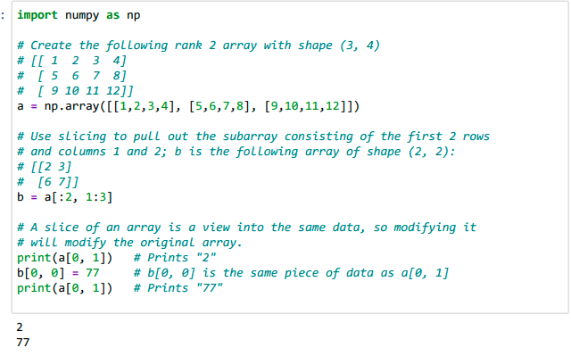
Array indexing Numpy - offers several ways to index into arrays.
Slicing

Slide 20
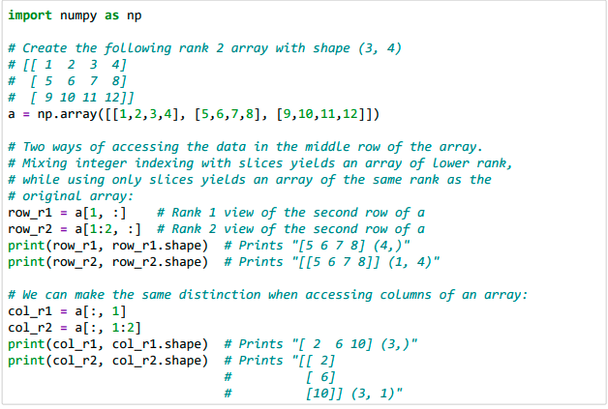
Array indexing Numpy
You can also mix integer indexing with slice indexing. However, doing so will yield an array of lower rank than the original array. Note that this is quite different from the way that MATLAB handles array slicing:

Slide 21
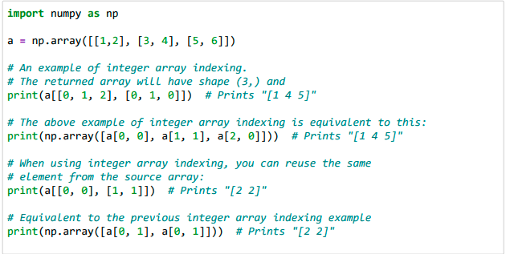
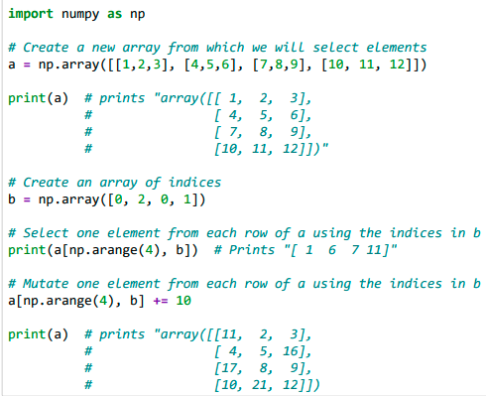
Integer array indexing

Slide 22
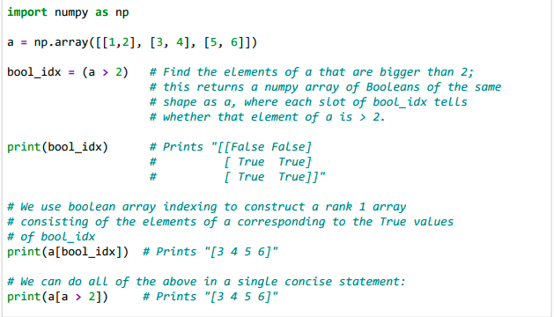
Boolean array indexing:

Slide 23
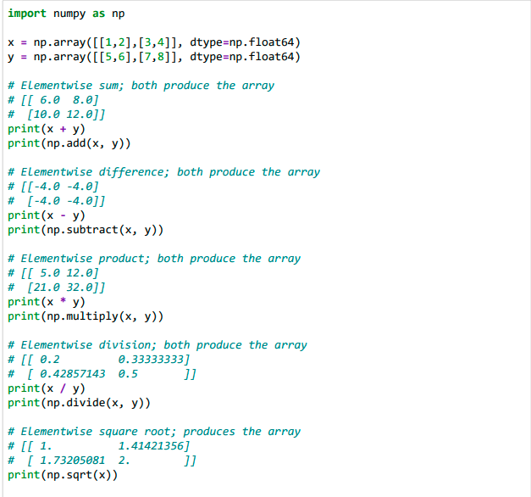
Array math
Basic mathematical functions operate elementwise on arrays, and are available both as operator overloads and as functions in the numpy module:

Slide 24
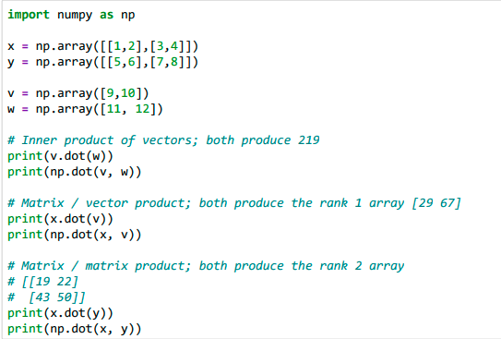
Array math
Note that unlike MATLAB, * is elementwise multiplication, not matrix multiplication. We instead use the dot function to compute inner products of vectors, to multiply a vector by a matrix, and to multiply matrices. dot is available both as a function in the numpy module and as an instance method of array objects:

Slide 25
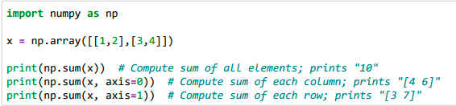
Array math
Numpy provides many useful functions for performing computations on arrays; one of the most useful is sum:

Slide 26
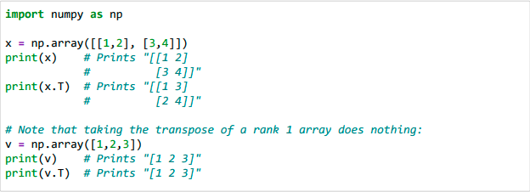
Array math
Apart from computing mathematical functions using arrays, we frequently need to reshape or otherwise manipulate data in arrays. The simplest example of this type of operation is transposing a matrix; to transpose a matrix, simply use the T attribute of an array object:

Slide 27
Reshape
import numpy as np
x = np.arange(10)
# x = [0, 1, 2, 3, 4, 5, 6, 7, 8, 9]
print(x) x = x.reshape((2, 5))
# x = [[0, 1 , 2, 3, 4], [5, 6, 7, 8, 9]]
print(x)

Slide 28
The Basics of NumPy Arrays
https://colab.research.google.com/github/jakevdp/PythonDataScienceHandbook/blob/master/notebooks/02
.02-The-Basics-Of-NumPy-Arrays.ipynb#scrollTo=OzbsSC7KBY3L

Slide 29
Aggregations: Min, Max, and Everything In Between
SECSION 3:

Slide 30
Summing the Values in an Array
As a quick example, consider computing the sum of all values in an array. Python itself can do this using the built-in sum function:
import numpy as np
L = np.random.random(100)
sum(L)

Slide 31
Summing the Values in an Array
However, because it executes the operation in compiled code, NumPy's version of the operation is computed much more quickly:
big_array = np.random.rand(1000000)
%timeit sum(big_array)
%timeit np.sum(big_array)
Notes:
Be careful, though: the sum function and the np.sum function are not identical, which can sometimes lead to confusion! In particular, their optional arguments have different meanings, and np.sum is aware of multiple array dimensions, as we will see in the following section.

Slide 32
Other aggregation functions
Function Name | NaN-safe Version | Description
np.sum | np.nansum | Compute sum of elements
np.prod | np.nanprod | Compute product of elements
np.mean | np.nanmean | Compute mean of elements
np.std | np.nanstd | Compute standard deviation
np.var | np.nanvar | Compute variance
np.min | np.nanmin | Find minimum value
np.max | np.nanmax | Find maximum value
np.argmin | np.nanargmin | Find index of minimum value
np.argmax | np.nanargmax | Find index of maximum value
np.median | np.nanmedian | Compute median of elements
np.percentile | np.nanpercentile | Compute rank-based statistics of elements
np.any | N/A | Evaluate whether any elements are true
np.all | N/A | Evaluate whether all elements are true

Slide 33
Average Height of US Presidents
import pandas as pd
data = pd.read_csv('data/president_heights.csv')
heights = np.array(data['height(cm)'])
print(heights)
print("Mean height: ", heights.mean())
print("Standard deviation:", heights.std())
print("Minimum height: ", heights.min())
print("Maximum height: ", heights.max())

Slide 34
Aggregations: Min, Max, and Everything In Between
https://colab.research.google.com/github/jakevdp/PythonDataScienceHandbook/blob/master/notebooks/02.04-Computation-on-arrays-aggregates.ipynb

Slide 35
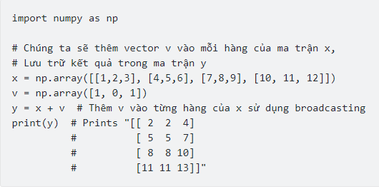
Matrix calculation with numpy
Numpy supports the computation of large, multidimensional arrays.
P + Q
P – Q
P.dot(Q)
numpy.linalg.inv(P)
P. transpose()

Slide 36
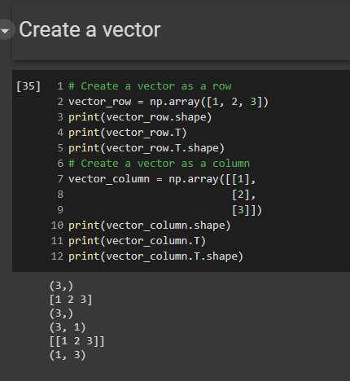
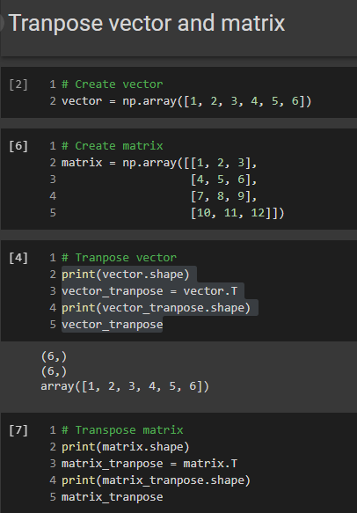
Example (Numpy_example)

Slide 37
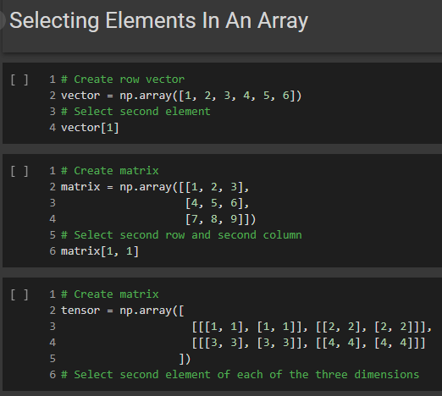
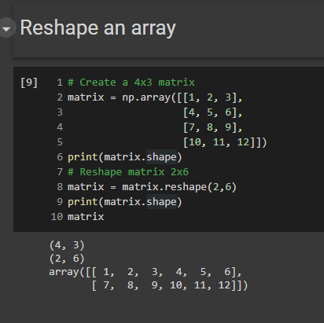
Example

Slide 38
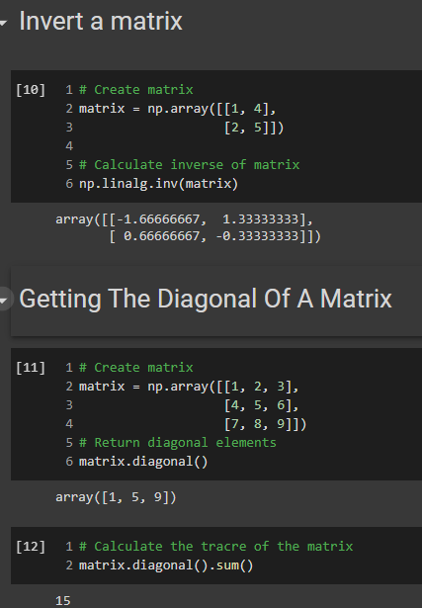
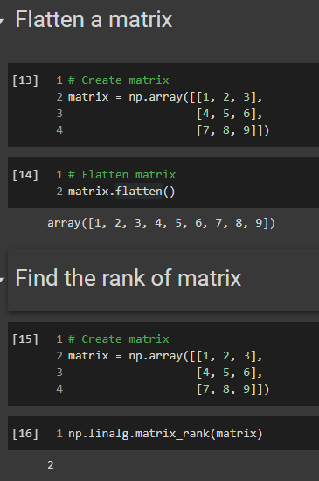
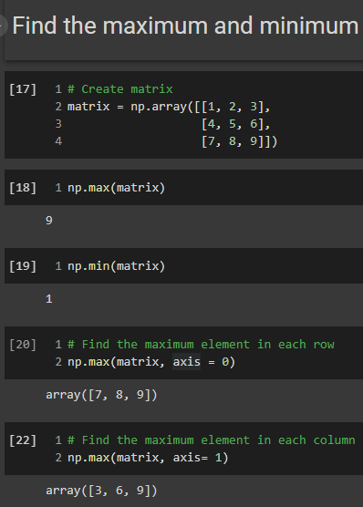
Example

Slide 39
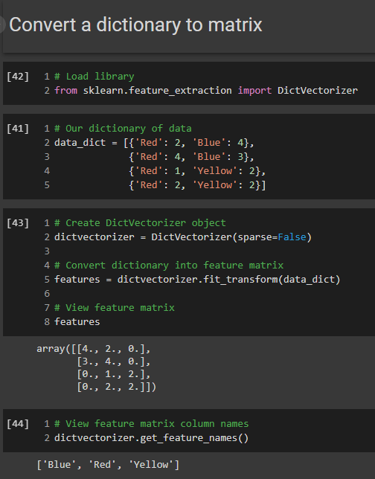
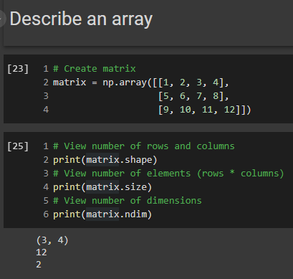
Example

Slide 40
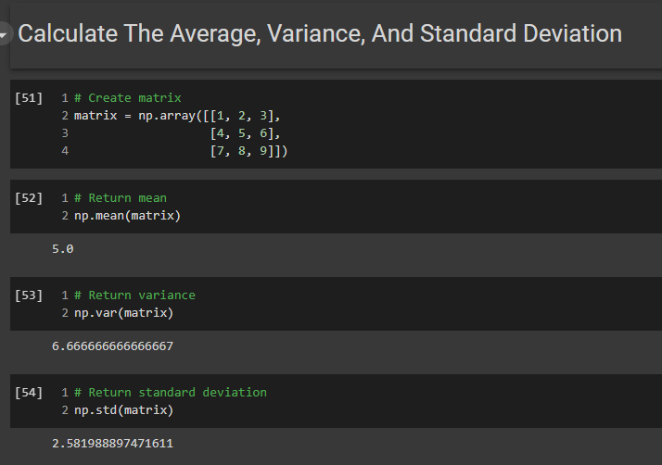
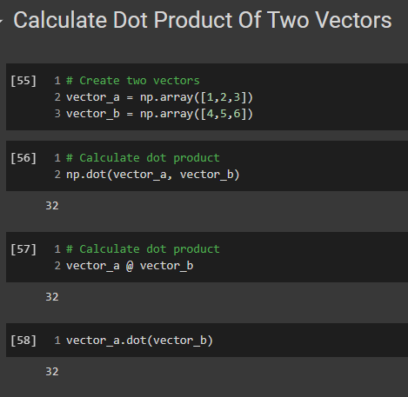
Example

Slide 41
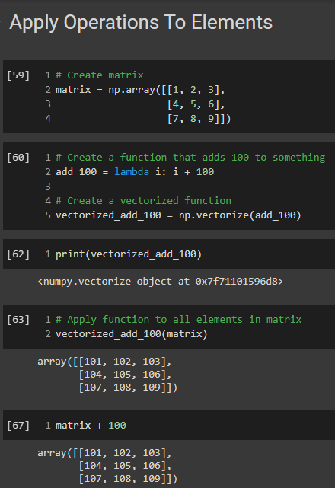
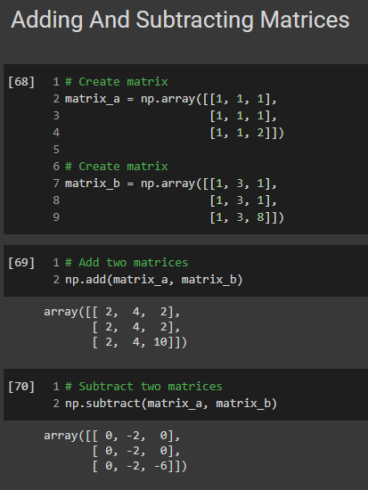
Example

Slide 42
Practice: 1. Create matrix P(mxm) and calculator P^n. 2. Calculate the inverse matrix of matrix P 3. Create matrix Q calculator P + Q, P – Q, PxQ (Note: choose the appropriate dimensions of the matrix Q)
SECSION 4:

Slide 43
Bài tập cơ bản
Lập trình python cơ bản: https://www.youtube.com/watch?v=NZj6LI5a9vc&list=PL33lvabfss1xczCv2BA0SaNJHu_VXsFtg
Viết chương trình xuất ra màn hình hình vuông đặc kí tự "*" có cạnh bằng a (với a nhập từ bàn phím).
Viết chương trình nhập vào ba cạnh của một tam giác, tính và xuất ra diện tích của tam giác đó.
Viết chương trình tính n!! với n!! = 1.3.5...n nếu n lẻ, n!! = 2.4.6...n nếu n chẵn.
Viết chương trình giải phương trình bậc 2 với các hệ số nhập từ bàn phím (xét đầy đủ các trường hợp).
Viết chương trình tính số Fibonashi thứ n.
Cho mảng một chiều các số thực hãy tìm đoạn [a,b] sao cho đoạn này chứa tất cả các giá trị trong mảng (a,b: số nguyên). (Sử dụng numpy)

