Slide 1

MSPE
-

Slide 2

MAPE

Slide 3
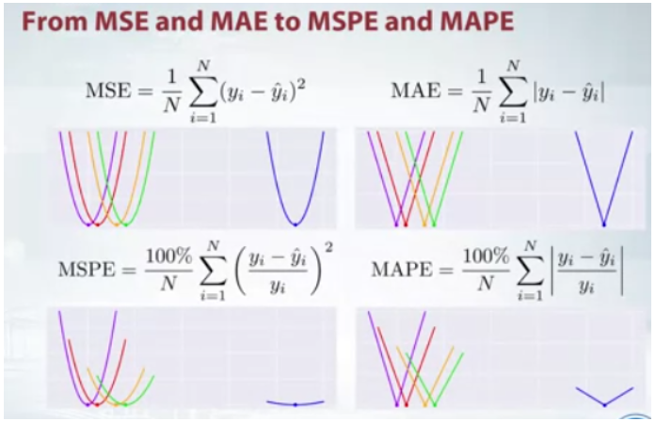

Slide 4
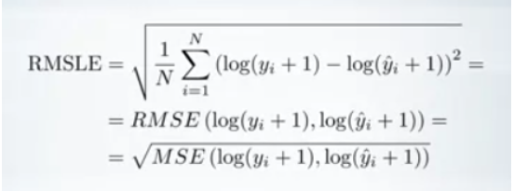
RMSLE

Slide 5

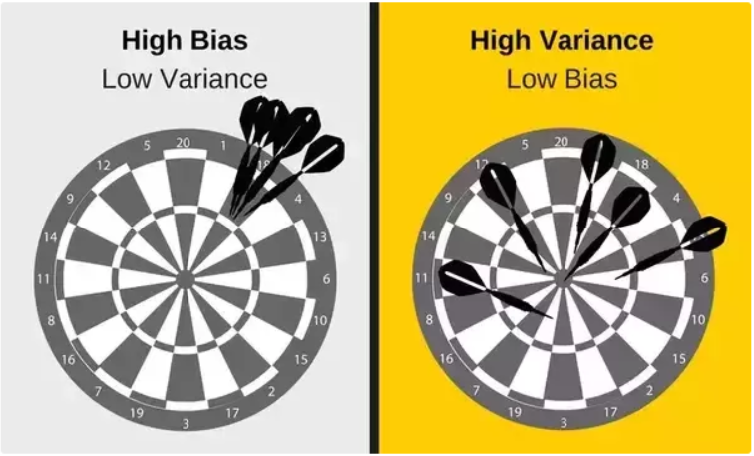



Bias-Variance Tradeoff
Bias :
Variance:

