Slide 1
Object- riented Software Design
HO CHI MINH CITY UNIVERSITY OF TECHNOLOGY AND EDUCATION
FACULTY FOR HIGH QUALITY TRAINING
NUTRITION MANAGE
SOFTWARE
LECTURER: HUYNH XUAN PHUNG

Slide 2
01
SUMMARY DOCUMENT

Slide 3
PREFACE
Application created to cater to the needs of those who want to tracking their nutrition to gain or lose weight
INTRODUCTION
Today, when society develops, the need to ensure nutrition for each individual in the family is more and more focused. From these needs, a variety of nutritional monitoring applications are created but do not meet the needs of users. We will develop a mobile application based on an android operating system. Tracking your nutrition has so many benefits, from helping to manage food intolerances to increasing energy, avoiding changes in mood, and fueling the rhythms of your day. Whatever your reasons for logging your meals, a good app can help.

Slide 4
USER REQUIMENT SPETIFICATION
Login
Signup
Unregister
Calculator
Schedule
Set the goal
Manage user information
Add data
Eliminate unwanted foods
Warn
Input information of food
Chance the user interface
Set up the security of the app
Schedule with dietitian

Slide 5
SYSTEM REQUIMENT SPETIFICATION
Functional Requirements
User: Login, set the goal, add data, manage info, …
The system: operates on the website basis, customers can be accessed through the account provided

Slide 6
SYSTEM REQUIMENT SPETIFICATION
Nonfunctional requirements
The lookup form is convenient, natural and intuitive.
Easy to use for even non- IT professionals.
User interface
User-friendly:
Easy operation
The function buttons are simply arranged. Convenient and easy to see
Functional windows can interact with each other, bringing efficiency to the user
Database is secure and easy to access
The system operates stably, reliably and responds immediately
Faster execution speed for looking up related information

Slide 7
02
USE CASE DIAGRAM

Slide 8
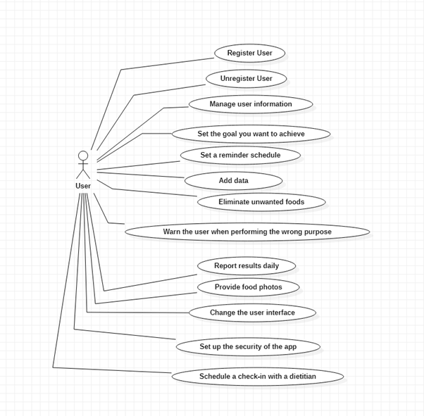
USE CASE DIAGRAM

Slide 9
USE CASE DESCRIPTION
Login: Open the project show registration activity to user, required enter data to registration, after registration the user moving to the application.
Register (sign up): After the first step, if a user is not registered in the application should click sign up button, then enter the required data, the system validates user input, and displays interface of that user.
Manage user information: After registration the user can modify his or her personal information
Set the goal you want to achieve: The user sets the goals he / she wants to achieve in the process
Set the reminder schedule: The user sets his / her time, schedule of activities, and meals. The system remind according to user set time
Add data: the user enters their activity data during the day
Provide food photo: After entering data, the system will calculate the user's kcal for the day
Warning: After entering data, the system will calculate whether the user has achieved or exceeded the initial target, if any, the system will notify the user.

Slide 10
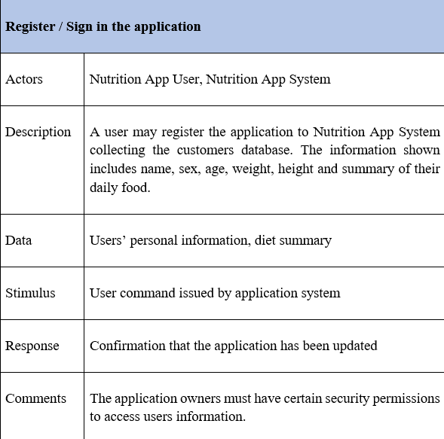
REGISTER / LOGIN

Slide 11
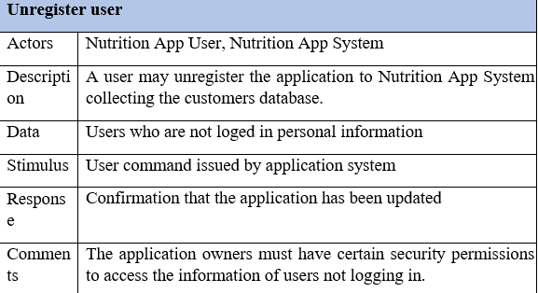
UNREGISTER

Slide 12
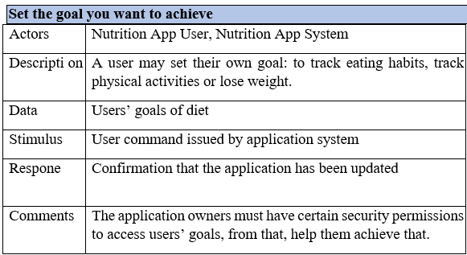
SET THE GOAL WANT TO ACHIEVE

Slide 13
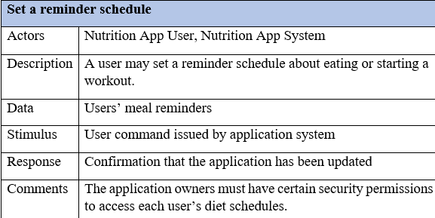
SET A REMIDER SCHEDULE

Slide 14
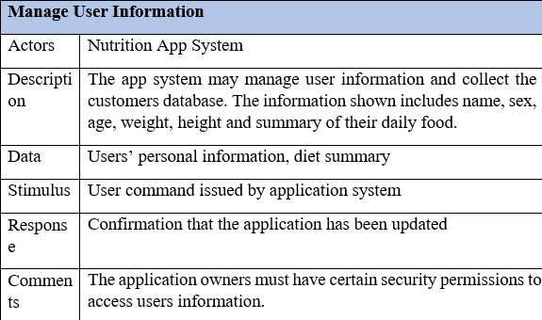
MANAGE INFORMATION

Slide 15
ADD DATA
Add data
Actors | User
Description | Users add food consumed and activities during the day, the system will calculate the total kcal intake and consumption in the day.
Data | The data will be picked up from the user
Stimulus | The interface to choose activities user do during the day
Response | The total kcal of each activity
Comments | List all the activities they do during the day. Show the correct activities

Slide 16
ELIMINATE UNWANTED FOODS
Eliminate unwantes foods
Actors | User, system
Description | Lists foods and activities the user has to eliminate during the process
Data | The list from the system
Stimulus | List of excluded activities and foods, not good for the user
Response | The list of things we should avoid
Comments | Do not eat and operate the things listed on the list

Slide 17
WARN THE USER WHEN PERFORMING THE WRONG PURPOSE
Warn the user when performing the wrong purpose
Actors | User, System
Description | If the amount of kcal is less than or exceeds the target, the system will notify the user
Data | A notification from the system
Stimulus | Notifications that remind users to eat and stay on schedule
Response | Notifications are sent when a user is eating and drinking not on schedule
Comments | Read the notice and comply with the request

Slide 18
INPUT INFORMATION OF FOOD
Input information of food
Actors | System
Description | Provide and synchronize images in the system and help improve user satisfaction, help users distinguish foods
Data | photos that the system supports
Respone | increase the accessibility of users and help the system become complete
Comments | the Images need regular updating and diversification of options

Slide 19
CHANGE THE USER INTERFACE
Change the user interface
Actors | System
Description | Creates diverse user options to drive downloads and optimize usage
Data | Pre-configured options in the app
Respone | Pre-configured options in the app

Slide 20
SET UP THE SECURITY OF THE APP
Set up the security of the app
Actors | system and user information
Description | it is an essential element of every app and helps increase the app's security to drive downloads
Data | passwords and login names of different users
Stimulus | user privacy
Respone | The result is to ensure the privacy of each user. If there is use of many different users and then need a password and username to use.
Comments | Recommended to use

Slide 21
SCHEDULE A CHECKIN WITH A DIETIAN
Schedule a check-in with a dietian
Actors | System, user , nutritionist
Description | As part of the system that helps to systematically maintain the food chain, improve the efficiency of health monitoring and understand user health.
Data | user information on contact information
Stimulus | is the give the a khuyên mang tính thuyết phục
Respone | The results help to improve nutritional cycle age and monitor health status
Comments | It is necessary to set up this feature to contribute to the correct implementation of the original purpose

Slide 22
LOGIN

Slide 23
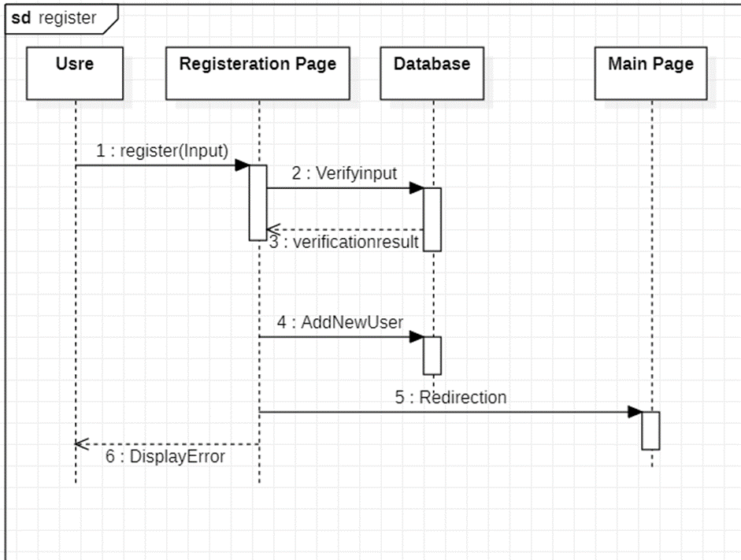
REGISTER

Slide 24
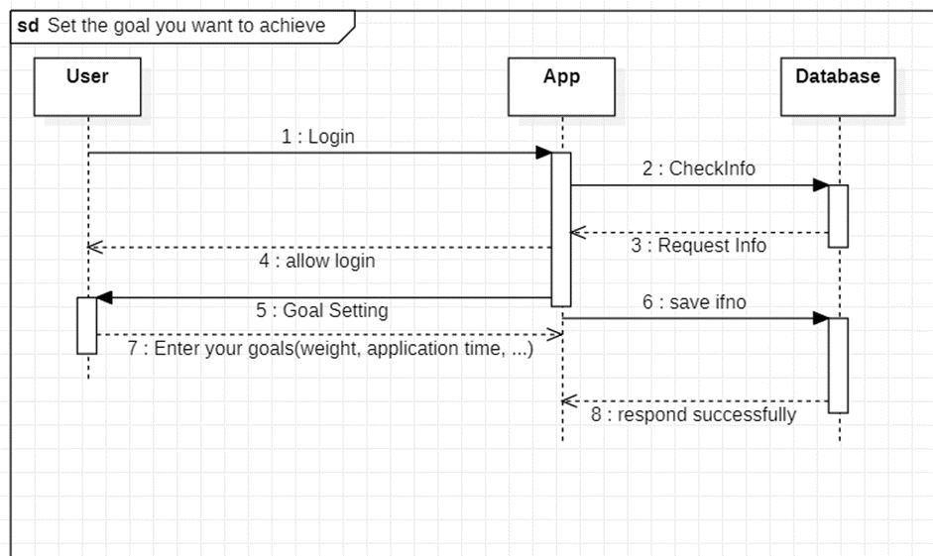
SET THE GOAL

Slide 25
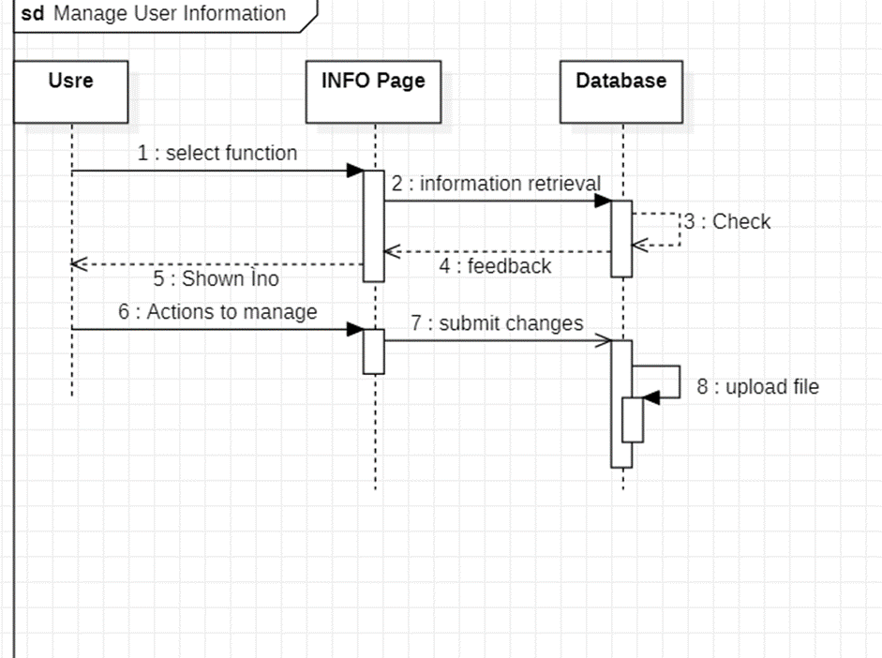
MANAGE USER INFORMATION

Slide 26
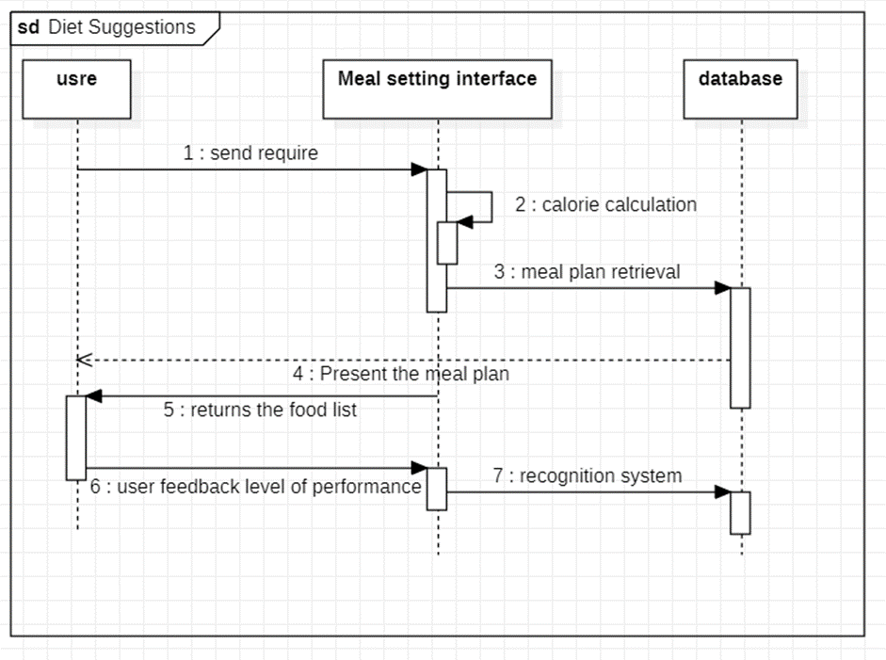
DIET SUGGESTIONS

Slide 27
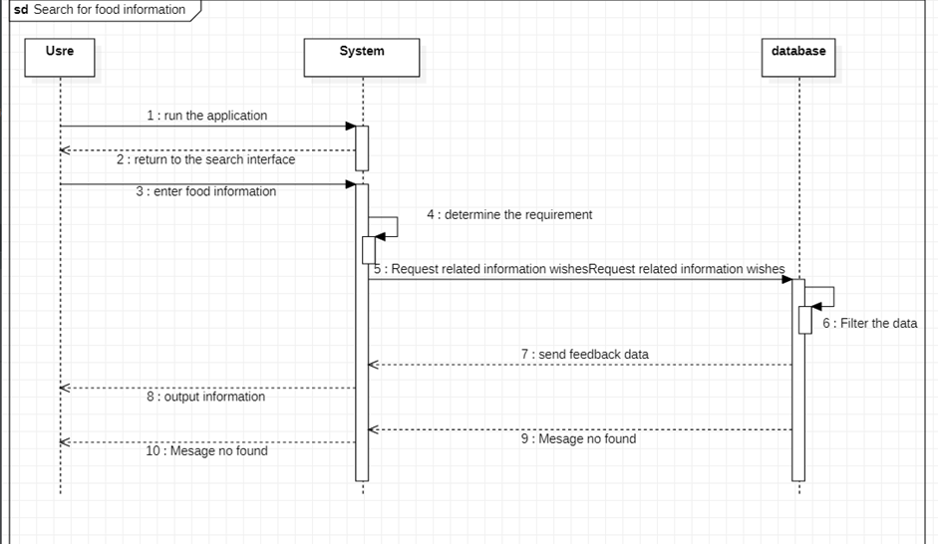
SEARCH FOOD

Slide 28
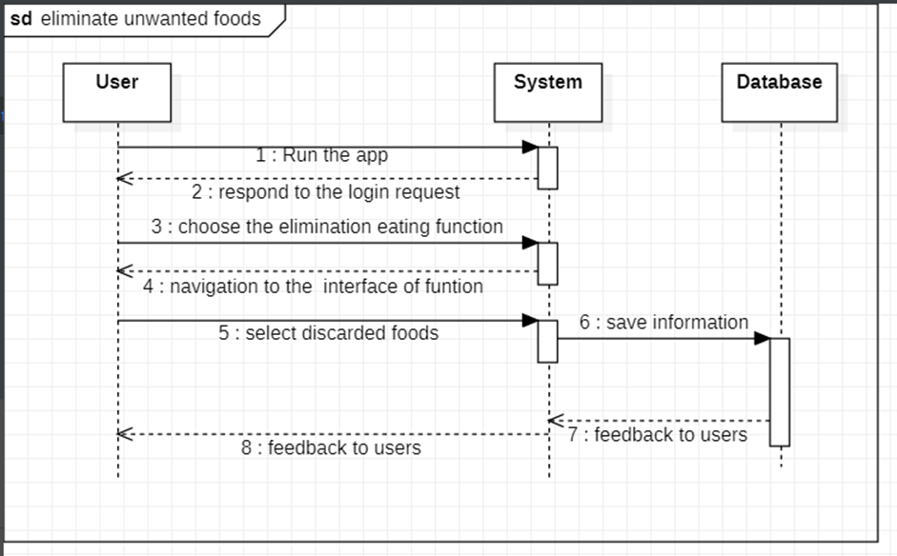
ELIMINATE UNWANTED FOOD

Slide 29
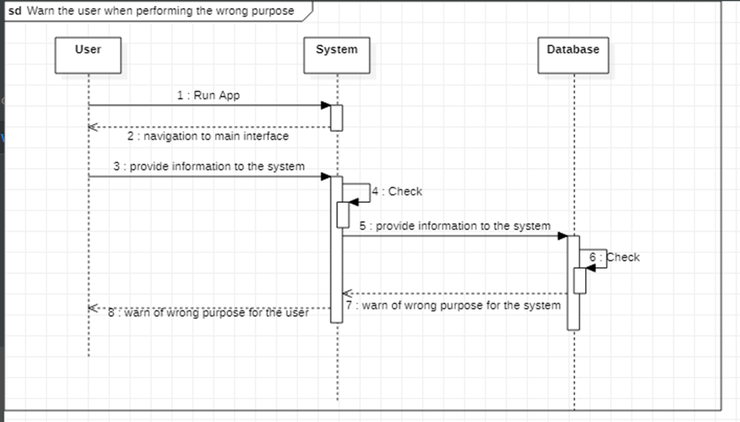
WARN

Slide 30
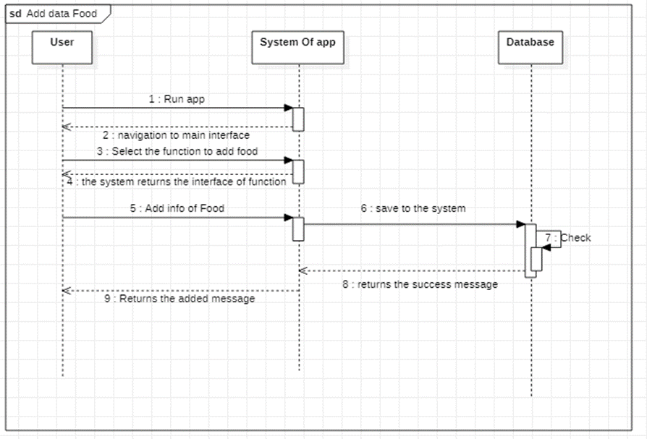
ADD DATA FOOD

Slide 31
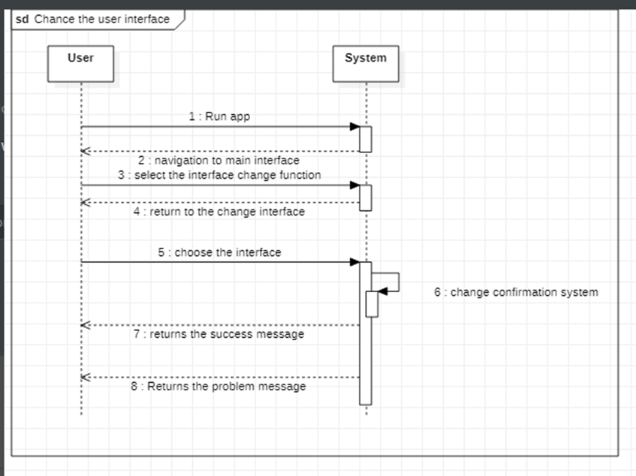
CHANGE USER INTERFACE

Slide 32
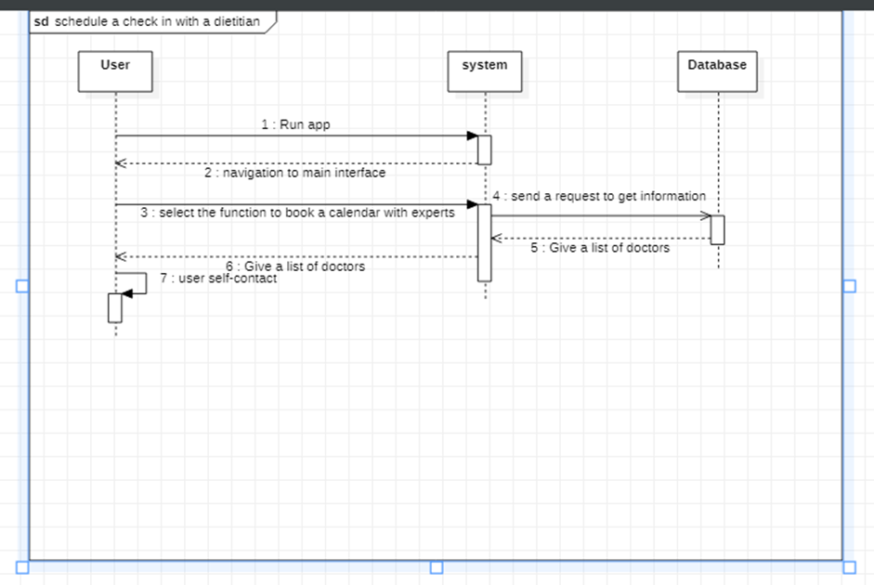
SCHEDULE WITH DIETITIAN

Slide 33
Decorator
Decorator is a structural pattern that allows adding new behaviors to objects dynamically by placing them inside special wrapper objects.
Apply Decorator in nutrition management software to give appropriate advice to users about the current weight of the user.
The Decorator pattern is a structural pattern that lets you attach additional functionalities to an object dynamically. In other words, the client has the freedom to create an object and then extend it by adding a variety of “features” to it.

Slide 34
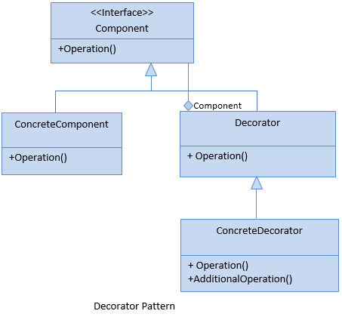
Decorator
The following class diagram shows us the Decorator Pattern's design:
Component: It defines the interface of the actual object that needs functionality to be added dynamically to the ConcreteComponents.
ConcreteComponent: The actual object in which the functionalities could be added dynamically.
Decorator: This defines the interface for all the dynamic functionalities that can be added to the ConcreteComponent.
ConcreteDecorator: All the functionalities that can be added to the ConcreteComponent. Each needed functionality will be one ConcreteDecorator class.

Slide 35
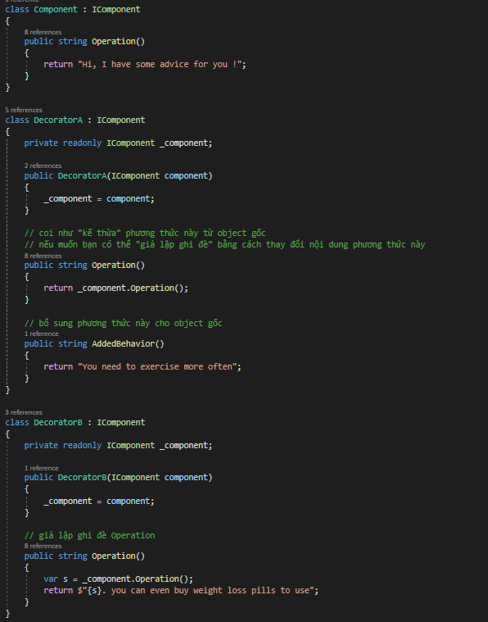
Decorator

Slide 36
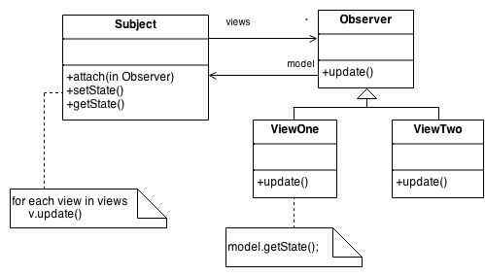
Observer
Usage examples: The Observer pattern is pretty common in C# code, especially in the GUI components. It provides a way to react to events happening in other objects without coupling to their classes.
Identification: The pattern can be recognized by subscription methods, that store objects in a list and by calls to the update method issued to objects in that list.

Slide 37
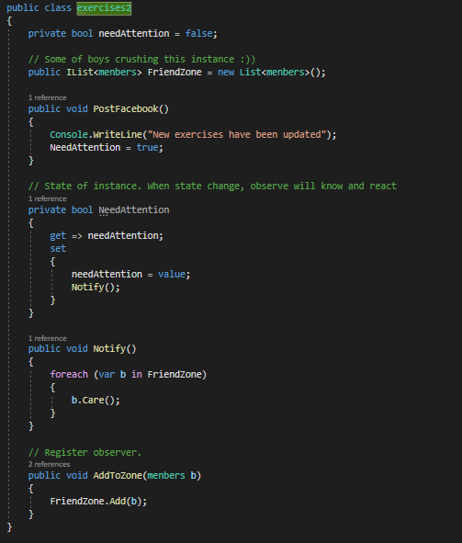
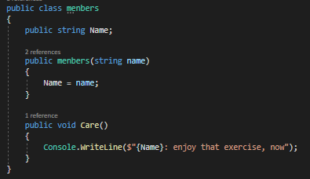
Observer

Slide 38
Factory
The function: Check the nutrition of meals
I choose this design pattern because it’s very useful when you need to provide a high level of flexibility for your code.
Factory methods can be recognized by creation methods, which create objects from concrete classes, but return them as objects of abstract type or interface.

Slide 39
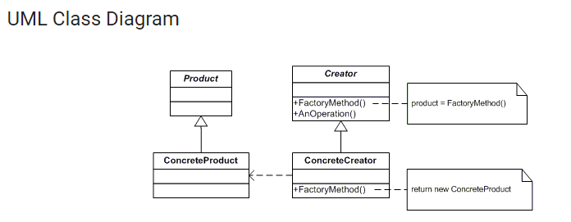
Factory

Slide 40
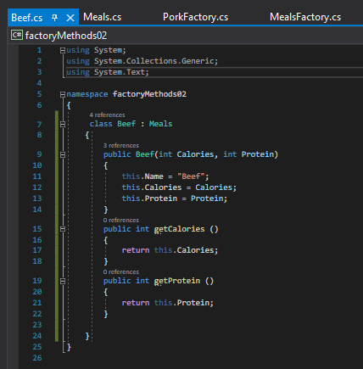
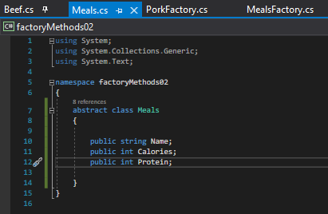
Factory

Slide 41
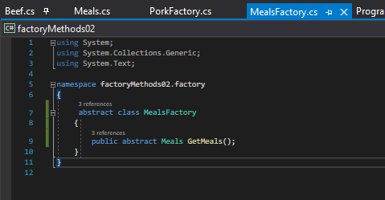
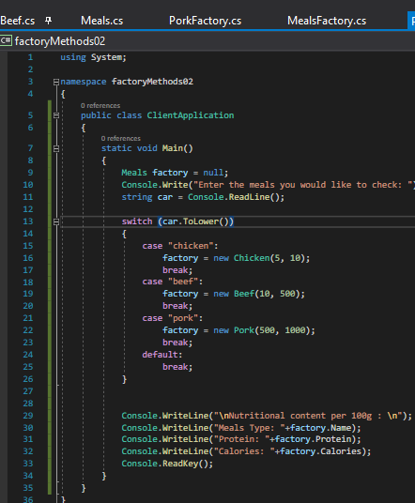
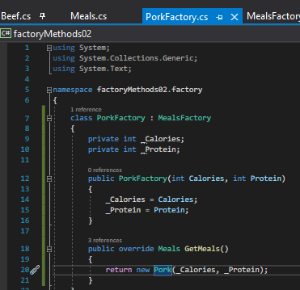
Factory

Slide 42
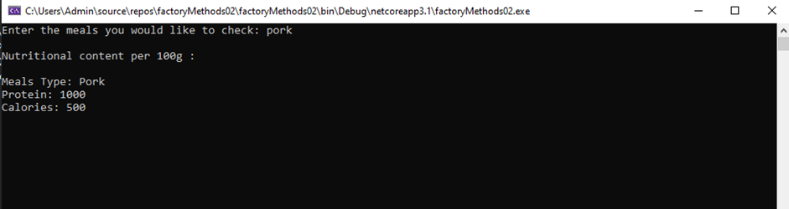
Factory
Result

Slide 43
Builder
The function: Register
I choose this design pattern because it’s especially useful when you need to create an object with lots of possible configuration options.
The Builder pattern can be recognized in a class, which has a single creation method and several methods to configure the resulting object. Builder methods often support chaining
For example,
(someBuilder->setValueA(1)->setValueB(2)->create()).

Slide 44
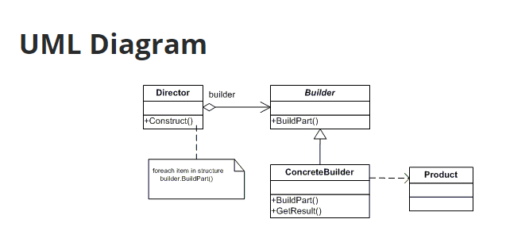
Builder

Slide 45
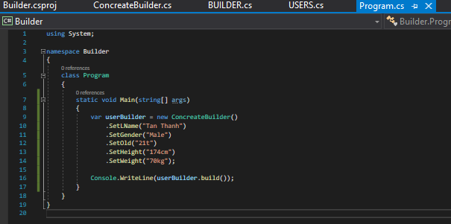
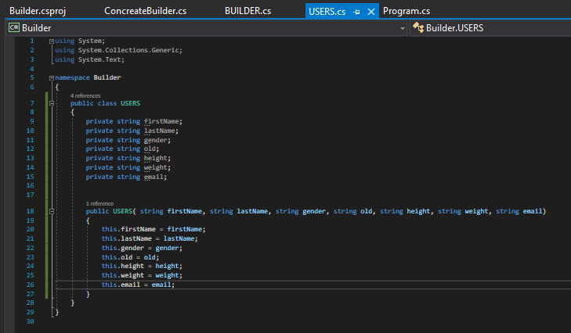
Builder

Slide 46
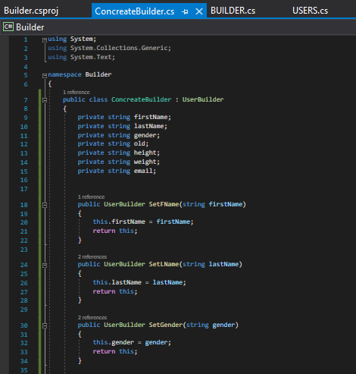
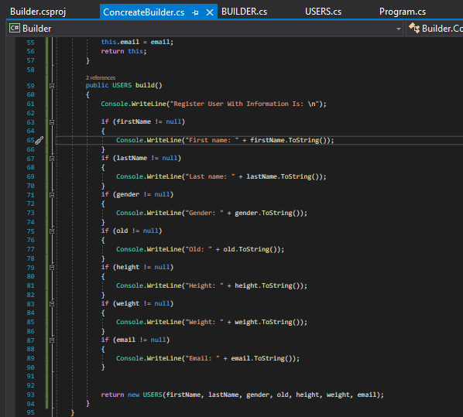
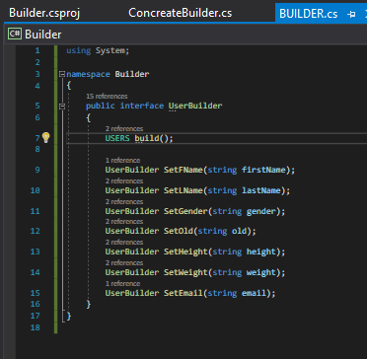
Builder

Slide 47
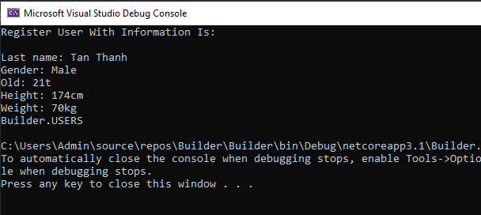
Builder
Result

Slide 48
Prototype
The function: Manage User Information
I choose this design pattern because this type of design provides a mechanism for instantiating an object by copying from an existing object instead of using the new operator.
The new object is a copy that can be completely similar or has some properties changed compared to the original object, we can freely change the data of this copy object without affecting the original object.

Slide 49
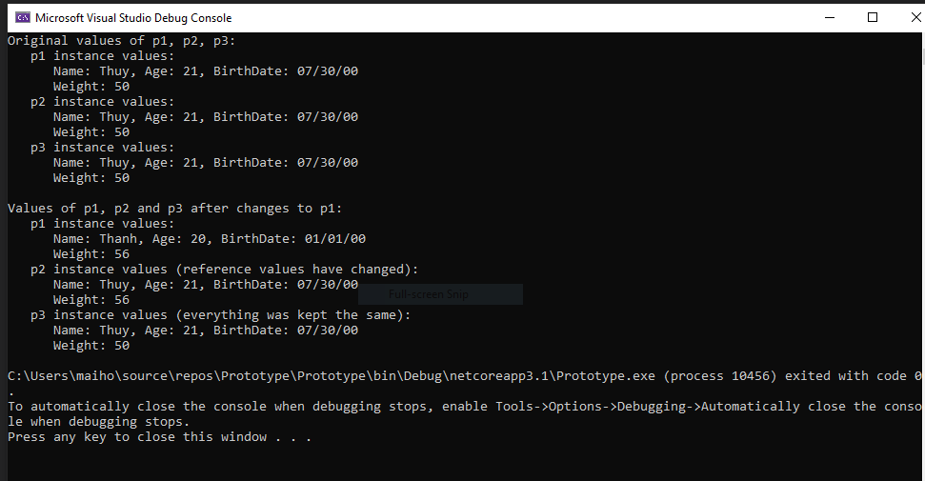
Prototype

Slide 50
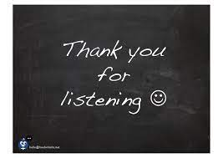
Please keep this slide for attribution

