Slide 1
COSMETICS ANALYTICS · TABLEAU DASHBOARD
Cosmetic Insights
Navigating Cosmetics Trends and Consumer Behavior with Tableau
An interactive Tableau dashboard analyzing product data across 116 brands and 1,472 products in the skincare and cosmetics space — uncovering trends in pricing, category distribution, and skin-type suitability.
116
1,472
5
BRANDS
PRODUCTS
SKIN TYPES
Shafiya Shaik (Team Lead) · Varsha Vanganuru · Afreen Shaikh · Shaik Safa · Syed Azmeera Begum

Slide 2
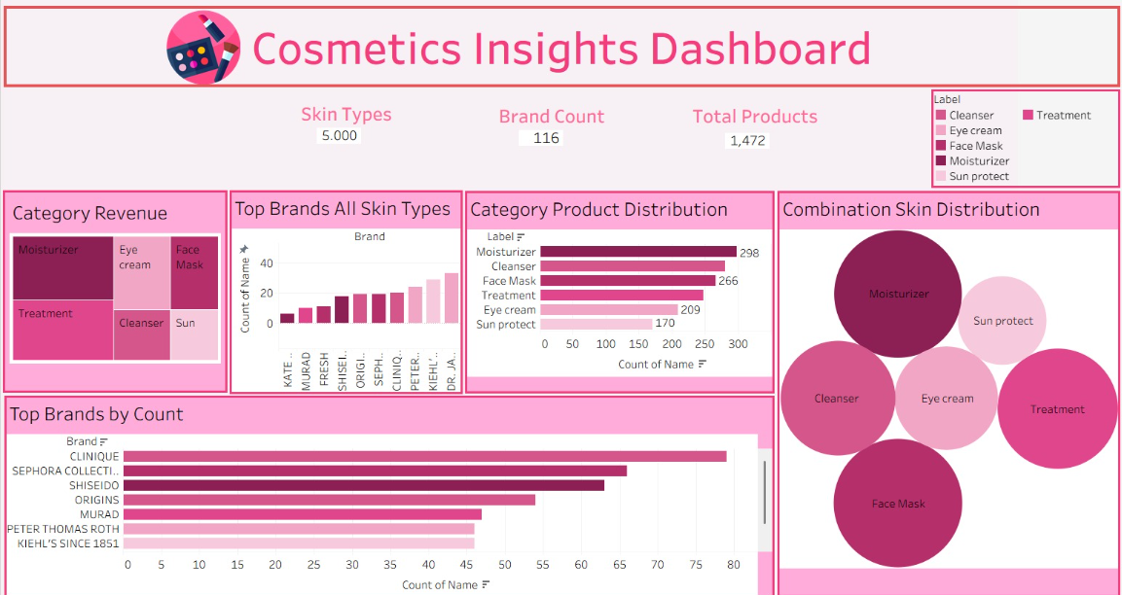
Project Overview
The cosmetics industry is one of the fastest-growing and most competitive sectors, shaped by changing consumer preferences, diverse skin types, brand innovation, and evolving pricing strategies. As demand for personalized beauty products grows, companies increasingly rely on data-driven insights to understand market trends, consumer behavior, and product performance.
This project analyzes a cosmetics dataset — covering brand, product category, price, rank, and skin-type suitability — to surface actionable insights for brand performance, pricing patterns, product distribution, and skin-type coverage.
116
1,472
5
BRANDS
PRODUCTS
SKIN TYPES
Dashboard Preview

Slide 3





Dashboard Highlights
Five coordinated views turning raw product data into brand and category insight
Category Revenue
Top Brands (All Skin Types)
Category Product Distribution
Distribution across Moisturizer, Treatment, Eye Cream, Face Mask, Cleanser, and Sun Protect.
Ranked bar chart of leading brands — KATE, MUSAQ, SHISEI, DIOR, SEPH, PETER, KIEHL, DR. JA, and more.
Horizontal bar breakdown by product label across all six categories.
Top Brands by Count
Combination Skin Distribution
Highest product-count brands — Clinique, Sephora Collection, Shiseido, Origins, Murad, Peter Thomas Roth, Kiehl's.
Packed bubble chart visualizing product spread across categories for combination skin type.

Slide 4

Design Approach
Turning raw data into a polished, on-brand deliverable
Consistent Color Encoding
“Building this dashboard reinforced how much design decisions matter in making a dashboard genuinely usable.”
Each product category maps to the same color across every chart, enabling analysis at a glance.
Clean KPI Summary Layer
Quick, at-a-glance insights presented before diving into detail.
Thoughtful Layout Hierarchy
Guides the viewer from high-level metrics down to granular breakdowns.
Cohesive Visual Theme
A pink/magenta palette ties the dashboard together as a polished, on-brand deliverable.

Slide 5
Use Case Scenarios
How the dashboard supports real business decisions
01
02
03
Monitoring Consumer Preferences
Addressing Product Concerns
Predictive Analysis & Product Innovation
Detect shifts in interest toward certain products or ingredients, assess impact, and adapt product offerings, promotions, or personalized recommendations in near real time.
Quickly investigate the prevalence and demographic impact of product-related issues, supporting quality control, recalls, and transparent consumer communication.
Use historical data and predictive indicators to anticipate emerging trends, guide new product development, and refine formulations and marketing strategy.

Slide 6

Dataset & Tools
DATASET ATTRIBUTES
Attribute | Description
Brand | Cosmetics brand name
Category | Moisturizer, Cleanser, Face Mask, Treatment, Eye Cream, Sun Protect
Price | Product price
Rank | Product ranking
Skin Type | Dry, Oily, Combination, Normal, Sensitive
Tools & Skills
Tool: Tableau Public
Skills: Data Analysis, Dashboard Design, Data Visualization, Data Preprocessing
8
14
8
EPICS
TASKS
SUBTASKS
Team
Shafiya Shaik — Team Lead
Varsha Vanganuru, Afreen Shaikh, Shaik Safa, Syed Azmeera Begum

Slide 7
Key Takeaway
Building this dashboard reinforced how much design decisions — layout structure, color consistency, and visual hierarchy — matter in making a dashboard genuinely usable, not just visually appealing.
Open to feedback and suggestions from the data visualization community.
#Tableau #DataVisualization #DataAnalytics #DashboardDesign #DataStorytelling

