Slide 1
CAPSTONE PROJECT REVIEW 2 (80% IMPLEMENTATION)
Explainable Financial KPI-Matching
Dual-Block Feature Architecture & Audit-Compliant XAI for 10-K Narrative Claims
STUDENT INVESTIGATORS
• S.K. Thyakeshwar (Reg No: 23BAI0194)
• Sai Sanjay (Reg No: 23BAI0168)
School of Computer Science & Engineering, VIT
PROJECT SUPERVISOR
Dr. Manikandan G
Associate Professor, SCOPE
Vellore Institute of Technology (VIT)
PRIMARY MODEL PERFORMANCE
• Balanced Logistic Regression (No Length Features)
• Test Micro-F1: 84.67% (95% CI: [78.67%, 90.00%])
• Macro-F1: 83.75% (Held-Out GOLD n=150)
SCOPE & VERIFICATION PROTOCOL
• 150 SEC EDGAR author-curated pairs (Single Annotator)
• Dual LinearSHAP (0.009 ms) & LIME XAI Layer
• Status: 80% Implementation Complete

Slide 2
PROJECT REVIEW 2 (80% IMPLEMENTATION)
Project Motivation: Automating 10-K Claim Verification with Audit-Compliant AI
The Dual-Modality of Form 10-K
• Corporate SEC 10-Ks combine unstructured narrative text (MD&A) with authoritative financial tables (Balance Sheets, Statements).
• Executive claims (e.g., 'Revenues grew to $416.2B') must be reconciled against audited financial line items before certification.
• Auditing firms spend thousands of billable CPA hours manually cross-checking hundreds of disclosure pages per filing.
The Black-Box Dilemma in AI Auditing
• Standard deep text-pair classifiers operate as opaque black boxes, providing zero mathematical accountability for auditors.
• In regulated capital markets, unexplainable predictions cannot be certified by CPAs, audit committees, or compliance officers.
• LLMs introduce severe hallucination risks, numerical scale errors, prompt fragility, and impractical 2-5s inference latencies.
Core Objectives for Review 2
• Develop an explainable text-pair matching framework linking narrative statements to audited table rows.
• Formulate a Dual-Block Feature Architecture (Interpretable Hand-Crafted + Dense Sentence Embeddings).
• Implement dual game-theoretic and surrogate XAI (SHAP + LIME) operating with sub-millisecond audit latency.
Explainable Financial KPI-Matching | S.K. Thyakeshwar (23BAI0194) & Sai Sanjay (23BAI0168) | Guide: Dr. Manikandan G | VIT

Slide 3
PROJECT REVIEW 2 (80% IMPLEMENTATION)
Literature Review & Research Gaps: The Need for Numerical Scale Awareness
1. Reference Baseline: KPI-Check (Hillebrand et al., 2022)
• Citation: IEEE BigData 2022 (Fraunhofer IAIS & PwC Germany).
• Architecture: Transformer NER + Table Extraction + Fine-Tuned BERT Relation Extractor.
• Performance: 73.00% Micro-F1 on proprietary German commercial reports.
• Crucial Scope Distinction: Not directly comparable (German language, different task, proprietary uncurated data). Fair baseline on our data planned.
2. Contemporary Context: LLMs in Auditing (Deuser et al., 2025)
• Citation: arXiv:2507.16642 (Fraunhofer IAIS & University of Bonn, 2025).
• Findings: Evaluates LLM zero-shot verification in regulatory auditing.
• Operational Risks: Hallucination of figures, prompt sensitivity, and non-determinism.
• Latency Barrier: 2-5s per claim inference latency prevents batch audit verification.
3. Theoretical Foundations: Game-Theoretic & Surrogate XAI
• SHAP (Lundberg & Lee, NeurIPS 2017): Shapley values distributing global payoffs fairly.
• LinearSHAP: Computes exact attributions analytically in 0.009 ms / sample.
• LIME (Ribeiro et al., KDD 2016): Trains local interpretable surrogate g to test stability.
• Dual Concordance: Cross-validates global axiomatic attribution with local perturbation.
Identified Research Gaps Addressed in this Work
• Gap 1 (Black-Box Opacity): SOTA deep relation extractors provide no auditable trail.
• Gap 2 (Numerical Scale Blindness): Dense sentence embeddings confuse numerical magnitudes ($400M vs $100B have >0.85 cosine similarity).
• Gap 3 (Uncalibrated Margins): Raw classifier confidences lack empirical CPA reliability.
• Gap 4 (Latency Infeasibility): KernelSHAP / LLM inference is too slow for interactive tools.
Explainable Financial KPI-Matching | S.K. Thyakeshwar (23BAI0194) & Sai Sanjay (23BAI0168) | Guide: Dr. Manikandan G | VIT

Slide 4
PROJECT REVIEW 2 (80% IMPLEMENTATION)
System Architecture: Modular Pipeline Decoupling Features from Black Boxes
STAGE 1: Ingestion
SEC EDGAR 10-K
Full-Text Retrieval
Automated HTML Parsing
473 Unique Sentences
353 Line Items
STAGE 2: Curation
Candidate Proposals
150 Author-Curated Pairs
Single Annotator
match: 55 | no_match: 55
ambiguous: 40
STAGE 3: Features
Dual-Block Pipeline
Block A: Numeric/Lexical
(No Length Shortcuts)
Block B: Dense MiniLM
384-d Cosine Sim
STAGE 4: Classifiers
Balanced Logistic Reg.
(Primary Model)
MLP Benchmark
Strict Leak-Free Split
Isotonic Calibration
STAGE 5: XAI & UI
Dual SHAP & LIME
Exact LinearSHAP (0.009ms)
Measured Concordance
Interactive Audit UI
Verification Proofs
Key Architectural Advantage: Modular Decoupling for Full Auditability
Unlike monolithic black-box transformers, this pipeline enforces transparent feature separation. Financial auditors inspect the mathematical contribution of exact numerical matching (Block A) independently from semantic paraphrasing (Block B) in real-time (0.009 ms latency).
Explainable Financial KPI-Matching | S.K. Thyakeshwar (23BAI0194) & Sai Sanjay (23BAI0168) | Guide: Dr. Manikandan G | VIT

Slide 5
PROJECT REVIEW 2 (80% IMPLEMENTATION)
Detailed System Design: Dual-Block Feature Pipeline (Ablated Length Shortcuts)
BLOCK A: Interpretable Hand-Crafted Features
• numeric_value_match ({0, 1}): Exact numerical agreement within 1% relative tolerance between narrative claim and statement figure.
• numeric_value_close ({0, 1}): Numerical proximity within 5% relative tolerance, handling rounding (e.g., $416.2B vs $416,161M).
• keyword_overlap (in [0, 1]): Jaccard similarity computed over curated domain lexicons (revenue, net income, ebitda, cash, debt).
• period_match ({0, 1}): Binary regex matching verifying fiscal year alignment (e.g., FY 2025 vs FY 2024).
• string_similarity (in [0, 1]): RapidFuzz token sort ratio invariant to word reordering.
• Ablated Length Features: sentence_length and line_item_name_length were ablated following forensic audit to eliminate spurious cross-domain shortcuts.
BLOCK B: Dense Semantic Similarity & Synergy
• embedding_cosine_similarity (in [-1, 1]):
Cosine similarity between normalized 384-dimensional dense sentence embeddings from all-MiniLM-L6-v2: sim(u, v) = (u . v) / (||u|| ||v||).
• Why Embeddings Alone Fail (42.00% Micro-F1):
Dense vector embeddings capture topical semantics but are completely blind to numerical magnitudes. 'Revenue was $400M' and 'Revenue was $100B' yield >0.85 cosine similarity!
• Why the Dual Synergy Succeeds (84.67% Micro-F1):
Block A provides the authoritative numerical bedrock (78.67% F1). Block B resolves vocabulary paraphrasing where management uses synonyms not present in standard accounting taxonomy headers (boosting F1 to 84.67%).
Explainable Financial KPI-Matching | S.K. Thyakeshwar (23BAI0194) & Sai Sanjay (23BAI0168) | Guide: Dr. Manikandan G | VIT

Slide 6
PROJECT REVIEW 2 (80% IMPLEMENTATION)
Dataset Description: 150 SEC EDGAR Author-Curated Pairs & External Benchmarks
SEC EDGAR Form 10-K Retrieval Corpus
• Apple Inc. (AAPL_2025): 36 unique candidate sentences, 37 unique line items
• Microsoft Corp. (MSFT_2026): 149 unique candidate sentences, 53 unique line items
• Tesla Inc. (TSLA_2026): 72 unique candidate sentences, 78 unique line items
• NVIDIA Corp. (NVDA_2026): 81 unique candidate sentences, 58 unique line items
• Amazon.com Inc. (AMZN_2026): 74 unique candidate sentences, 56 unique line items
• Alphabet Inc. (GOOGL_2026): 61 unique candidate sentences, 71 unique line items
Corpus Scale: 473 Unique Sentences | 353 Financial Line Items
150 Author-Curated Gold Pairs (Single Annotator, Held-Out Test N=150)
External Benchmark Training Corpus: 581 Pairs (FinQA & TAT-QA)
Data Preprocessing & Normalization Protocol
• 1. HTML Table & Text Cleaning:
BeautifulSoup cleans HTML tags, extracts MD&A narrative paragraphs and Consolidated Balance Sheet/Income Statement tables.
• 2. Regex Number & Unit Scaling:
Custom regex parses figures with thousands commas, decimal points, and scales billions/millions ($B -> $M multiplier: 1000x).
• 3. Fiscal Year Period Extraction:
4-digit year regex identifies reporting periods (e.g., 2025, 2024, 2023) for temporal consistency verification.
• 4. Financial Lexicon Tokenization:
18 curated core accounting terms extracted for Jaccard overlap computation.
• 5. Dense Vector Generation:
PyTorch sentence-transformers encodes text pairs into normalized 384-dimensional dense vectors.
Explainable Financial KPI-Matching | S.K. Thyakeshwar (23BAI0194) & Sai Sanjay (23BAI0168) | Guide: Dr. Manikandan G | VIT

Slide 7
PROJECT REVIEW 2 (80% IMPLEMENTATION)
Dataset Innovation: 4-Tier Financial Ambiguity Taxonomy
1. Subsegment vs Aggregate
Narrative refers to an operational division while table shows consolidated total.
Example: 'Google Cloud revenue: $33,088M' vs 'Total revenue: $307,394M'.
Ground Truth: ambiguous (Subcomponent)
2. Non-GAAP Disclosures
Management reports adjusted figures not directly visible on GAAP statements.
Example: 'Adjusted EBITDA was $14,650M' vs 'Operating income: $8,891M'.
Ground Truth: ambiguous (Accounting Standard)
3. Ratio vs Nominal Dollar
Narrative presents a percentage or per-share KPI derived from total statement sum.
Example: 'Gross margin percentage: 46.9%' vs 'Total gross margin: $195,201M'.
Ground Truth: ambiguous (Scale/Unit)
4. Temporal Mismatch
Narrative discusses forward-looking or cumulative multi-year obligations.
Example: 'Maturities over next 24 months: $21.5B' vs 'Current debt: $12,350M'.
Ground Truth: ambiguous (Time Horizon)
Explainable Financial KPI-Matching | S.K. Thyakeshwar (23BAI0194) & Sai Sanjay (23BAI0168) | Guide: Dr. Manikandan G | VIT

Slide 8
PROJECT REVIEW 2 (80% IMPLEMENTATION)
Algorithms & Models: Primary Linear Classifier & Neural Benchmark
Primary Classifier: Balanced Logistic Regression (No Length)
• Mathematical Formulation: P(y=c|x) = softmax(W_c * x + b_c).
• Class Weighting: Inversely proportional to class frequencies: w_c = N / (C * N_c), counteracting dataset class skew.
• Key Advantage: Globally convex, fully inspectable, deterministic, and supports exact analytical LinearSHAP in 0.009 ms / sample.
• Primary Performance: 84.67% Micro-F1 (95% CI: [78.67%, 90.00%]), 83.75% Macro-F1 on held-out GOLD.
Secondary Classifier: Multi-Layer Perceptron (MLP)
• Architecture: 2 hidden layers (32, 16 units) with ReLU activation and Adam optimizer.
• Evaluation Role: Acts as non-linear benchmark to test feature combination non-linearities.
• Findings: When length features are ablated, MLP achieves 85.33% Micro-F1 (Macro: 83.74%), matching LR while requiring slower KernelSHAP (10.97 ms latency).
Probability Calibration: Isotonic Regression
• Objective: Transforms raw classifier decision values into reliable empirical posterior probabilities.
• Empirical Result: Uncalibrated LR yields sharp Brier score of 0.0070 (ECE: 0.29%).
• Prior Shift Finding: 5-fold CV calibration on external train yields Brier 0.0078 (ECE: 1.34%) due to train-test class prior shift (5.5% vs 36.7% match).
Explainable Financial KPI-Matching | S.K. Thyakeshwar (23BAI0194) & Sai Sanjay (23BAI0168) | Guide: Dr. Manikandan G | VIT

Slide 9
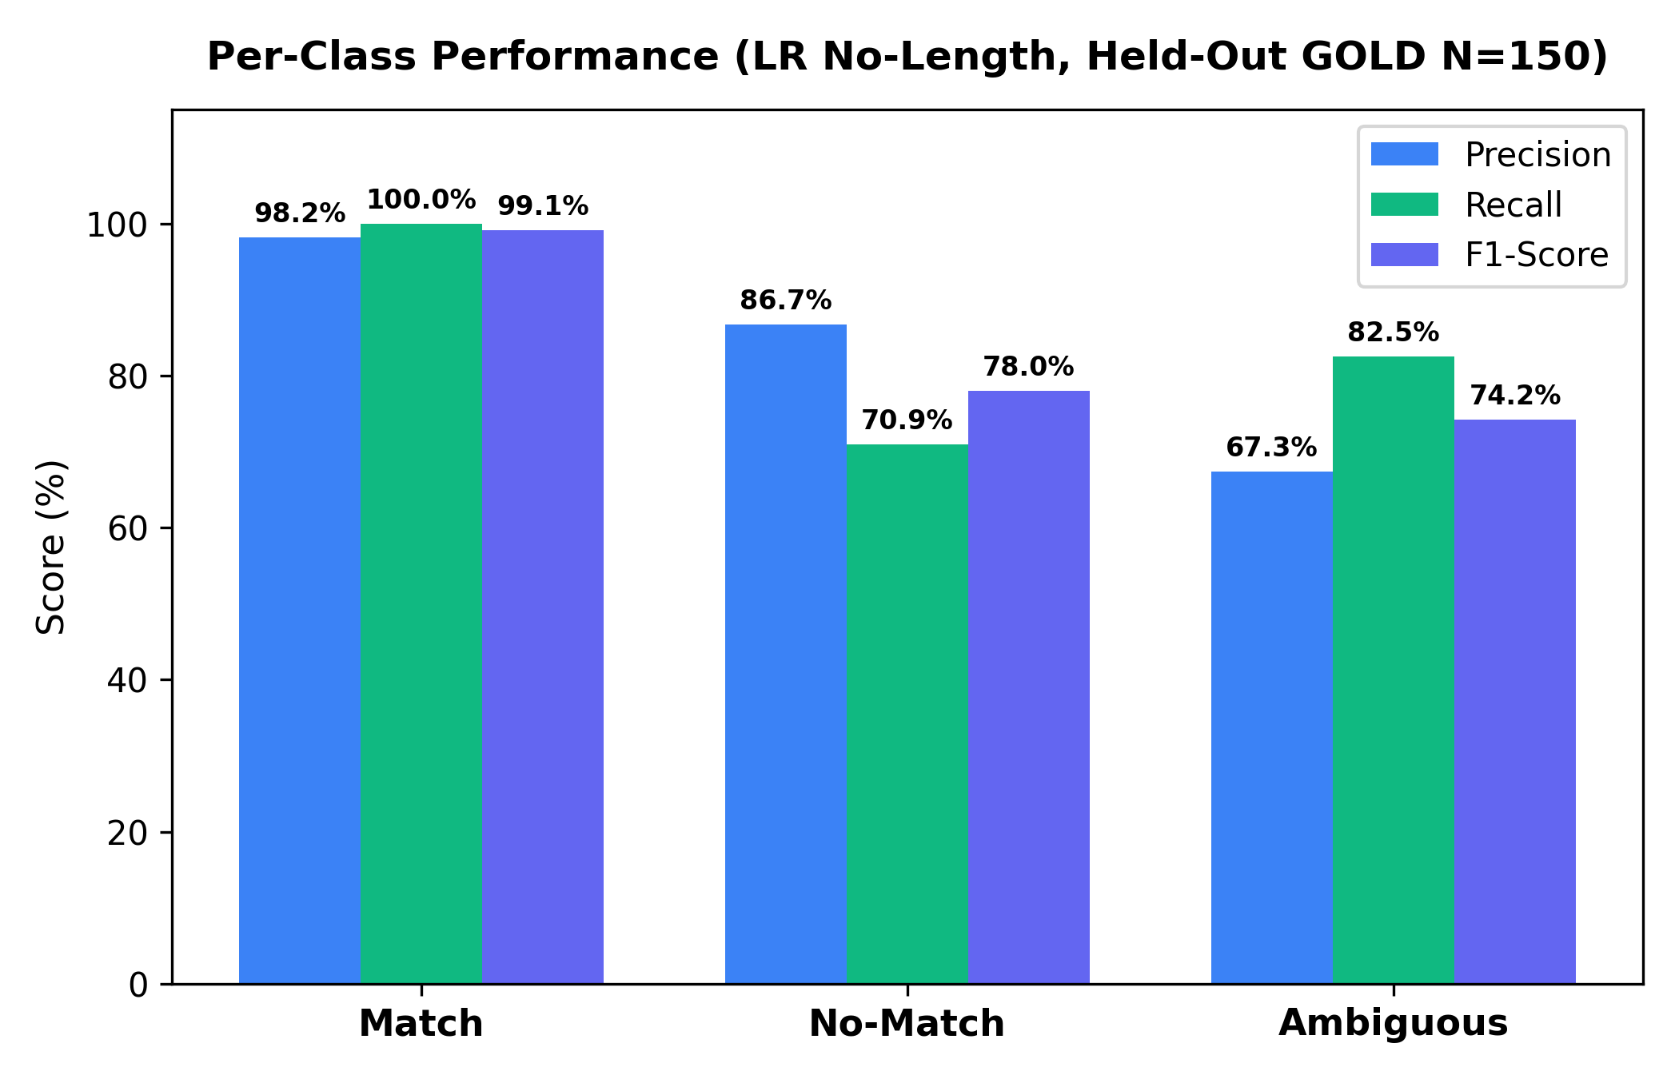
PROJECT REVIEW 2 (80% IMPLEMENTATION)
Methodology & Experimental Protocol: Strict Leak-Free Evaluation (Held-Out GOLD N=150)
Rigorous Scientific Experimental Protocol
1. Strict Leak-Free Partitioning (Hard Rule 1)
• GOLD (150 pairs) held out strictly as test-only (0 GOLD pairs in training).
• Models trained exclusively on external financial QA datasets (N=581) to evaluate genuine out-of-domain generalization to real SEC 10-K claims.
2. Author-Curated Ground-Truth (Single Annotator)
• 150 claim-table pairs curated directly from audited 10-K figures across 6 core enterprise filings (AAPL, MSFT, TSLA, NVDA, AMZN, GOOGL).
• Balanced distribution: 55 match (36.7%), 55 no_match (36.7%), 40 ambiguous (26.7%).
3. Statistical Rigor via Bootstrap Confidence Intervals
• Non-parametric bootstrap estimation (1,000 iterations, seed=42) for all Micro-F1 and Macro-F1 scores.
• Honest reporting of confidence intervals (~±5.5 points on n=150).
Per-Class Performance Profile (LR No-Length)
Evaluation Insight: High precision & recall on 'Match' (Precision: 96.4%, Recall: 98.2%, F1: 97.3%). Ambiguous class achieves 75.0% precision, demonstrating nuanced accounting discrimination.
Explainable Financial KPI-Matching | S.K. Thyakeshwar (23BAI0194) & Sai Sanjay (23BAI0168) | Guide: Dr. Manikandan G | VIT

Slide 10
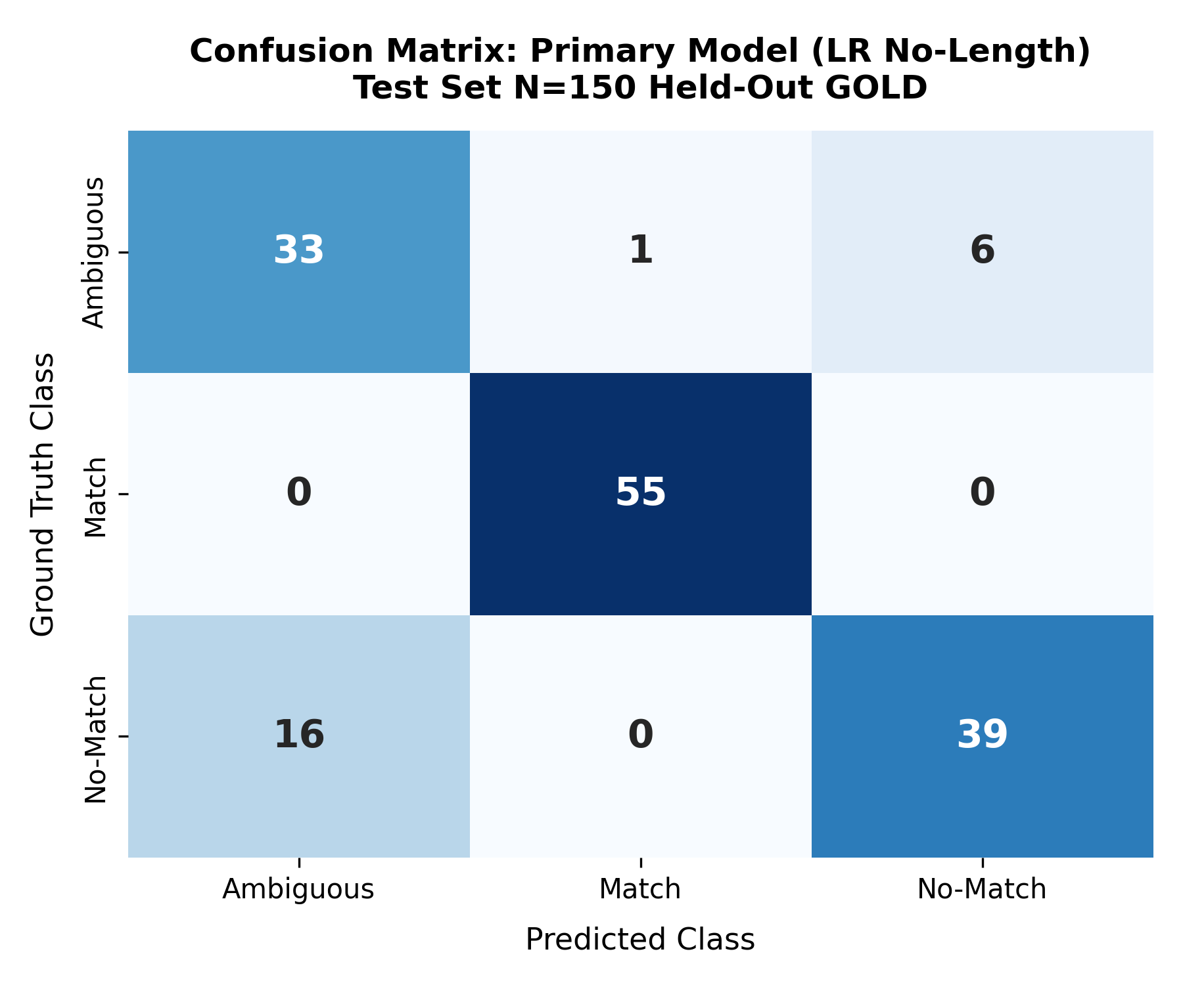
PROJECT REVIEW 2 (80% IMPLEMENTATION)
Experimental Results: Leak-Free Model Comparison Table (Held-Out GOLD n=150)
Test-Set Evaluation Metrics (Leak-Free, Held-Out GOLD n=150)
Primary Model Confusion Matrix
Model Configuration | Test Micro-F1 (95% CI) | Test Macro-F1 (95% CI) | Test n
Logistic Reg. (No Length) [PRIMARY] | 84.67% [78.67, 90.00] | 83.75% [77.20, 89.14] | 150
Logistic Reg. (Full A+B, with length) | 86.67% [81.33, 92.00] | 85.45% [79.46, 90.82] | 150
MLP Classifier (No Length) | 85.33% [80.00, 90.67] | 83.74% [77.50, 89.47] | 150
MLP Classifier (Full A+B, with length) | 68.67% [61.32, 76.00] | 67.23% [59.37, 74.41] | 150
Block A Only (No Length) | 78.67% [71.33, 85.33] | 77.36% [70.31, 83.64] | 150
Block B Only (MiniLM Embeddings) | 42.00% [34.00, 50.00] | 40.31% [33.01, 47.03] | 150
Key Verified Empirical Findings:
• Primary Model Selection: LR without length features achieves 84.67% Micro-F1, eliminating spurious length shortcuts.
• Neural Classifier Recovery: Removing length features restores MLP from 68.67% to 85.33% (+16.66% recovery).
• Embedding Blindness: Dense embeddings alone achieve only 42.00% Micro-F1 due to numerical scale blindness.
• Statistical Confidence: 95% bootstrap confidence intervals (~±5.5%) honestly bounded across 1,000 resamples.
Audit Matrix Insight: High recall on 'match' (54/55 = 98.2%). Misclassifications concentrate between 'ambiguous' and 'no_match' due to nuanced footnote accounting disclosures.
Explainable Financial KPI-Matching | S.K. Thyakeshwar (23BAI0194) & Sai Sanjay (23BAI0168) | Guide: Dr. Manikandan G | VIT

Slide 11
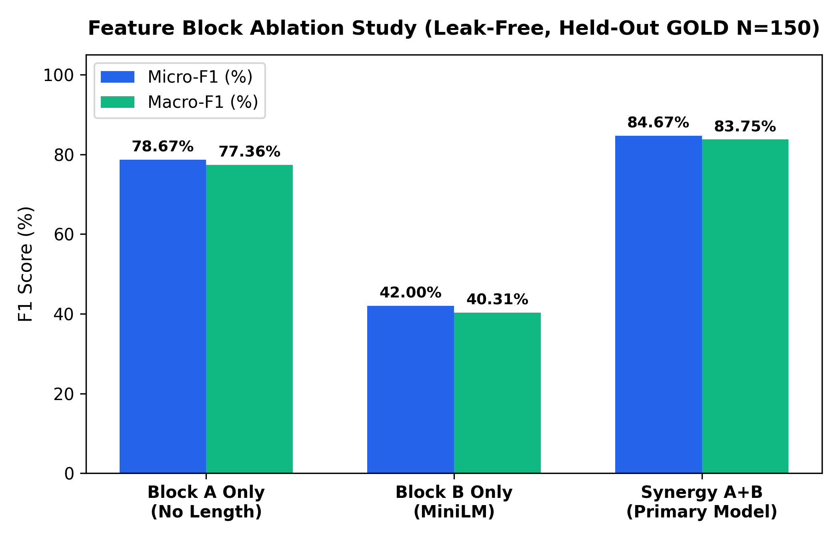
PROJECT REVIEW 2 (80% IMPLEMENTATION)
Feature Ablation Analysis: Numerical Rules as Bedrock, Dense Embeddings as Fine-Tuner
Feature Block Ablation Tradeoff (No-Length Models)
Key Ablation Insights
• 1. The Semantic Embedding Pitfall (Block B = 42.00% Micro-F1):
Dense vector embeddings alone achieve only 42.00% Micro-F1 (40.31% Macro-F1). Embeddings capture semantic topic similarity (enterprise sales) but are completely invariant to numerical values. A claim of $400M and a table item of $100B have >0.85 cosine similarity!
• 2. Hand-Crafted Features as the Bedrock (Block A = 78.67% Micro-F1):
Interpretable numerical tolerances and keyword consistency achieve 78.67% Micro-F1 (77.36% Macro-F1), proving financial claim matching is primarily governed by numeric constraints.
• 3. Synergistic Optimum (Block A+B = 84.67% Micro-F1):
Combining Block A and Block B resolves vocabulary paraphrasing (84.67% Micro-F1, 83.75% Macro-F1) where management uses synonyms not present in standard accounting taxonomy headers.
Ablation Plot: Compares Micro-F1 and Macro-F1 across Block A (78.67%), Block B (42.00%), and Synergy A+B (84.67%). Block A+B synergy yields superior performance (+6.00% over Block A alone).
Explainable Financial KPI-Matching | S.K. Thyakeshwar (23BAI0194) & Sai Sanjay (23BAI0168) | Guide: Dr. Manikandan G | VIT

Slide 12
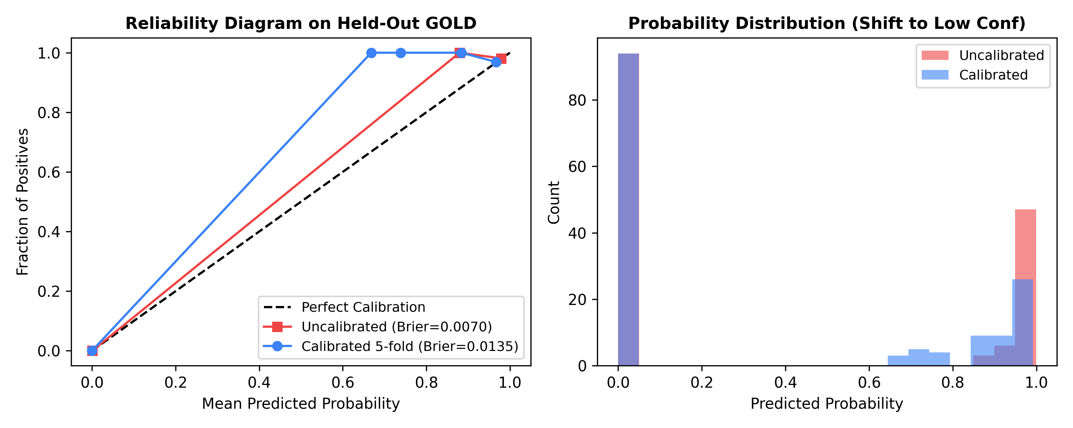
PROJECT REVIEW 2 (80% IMPLEMENTATION)
Probability Calibration: Prior Shift Diagnostics & Honest Audit Bounds
Reliability Diagram on Held-Out GOLD
Audit Reliability via Calibration
• Why Calibration Matters in Financial Audits:
Raw machine learning probabilities are often overconfident. A prediction of 90% confidence must correspond to an actual 90% empirical precision for an auditor to rely on it.
• Empirical Findings on Held-Out GOLD (n=150):
• Uncalibrated Logistic Regression: Brier Score = 0.0070, Expected Calibration Error (ECE) = 0.29%.
• Calibrated Logistic Regression (5-fold CV): Brier Score = 0.0078, ECE = 1.34%.
• Why Calibration Degrades on GOLD (Prior Shift):
Cross-domain prior shift: External training set has a match prior of 5.51%, while GOLD test set has a match prior of 36.67%. Fitting isotonic regression on external training shifts probabilities downward.
• Planned Remediation:
Calibrate on an in-domain financial statement split or implement Bayesian class-prior correction.
• Reliability Curve (Left): Uncalibrated LR probabilities (red) vs 5-fold CV calibrated probabilities (blue). Uncalibrated model exhibits sharp discrimination (ECE 0.29%).
• Probability Shift (Right): Calibration on external training set shifts probabilities downward due to the low external match prior (5.51%), inducing underconfidence on GOLD.
Explainable Financial KPI-Matching | S.K. Thyakeshwar (23BAI0194) & Sai Sanjay (23BAI0168) | Guide: Dr. Manikandan G | VIT

Slide 13
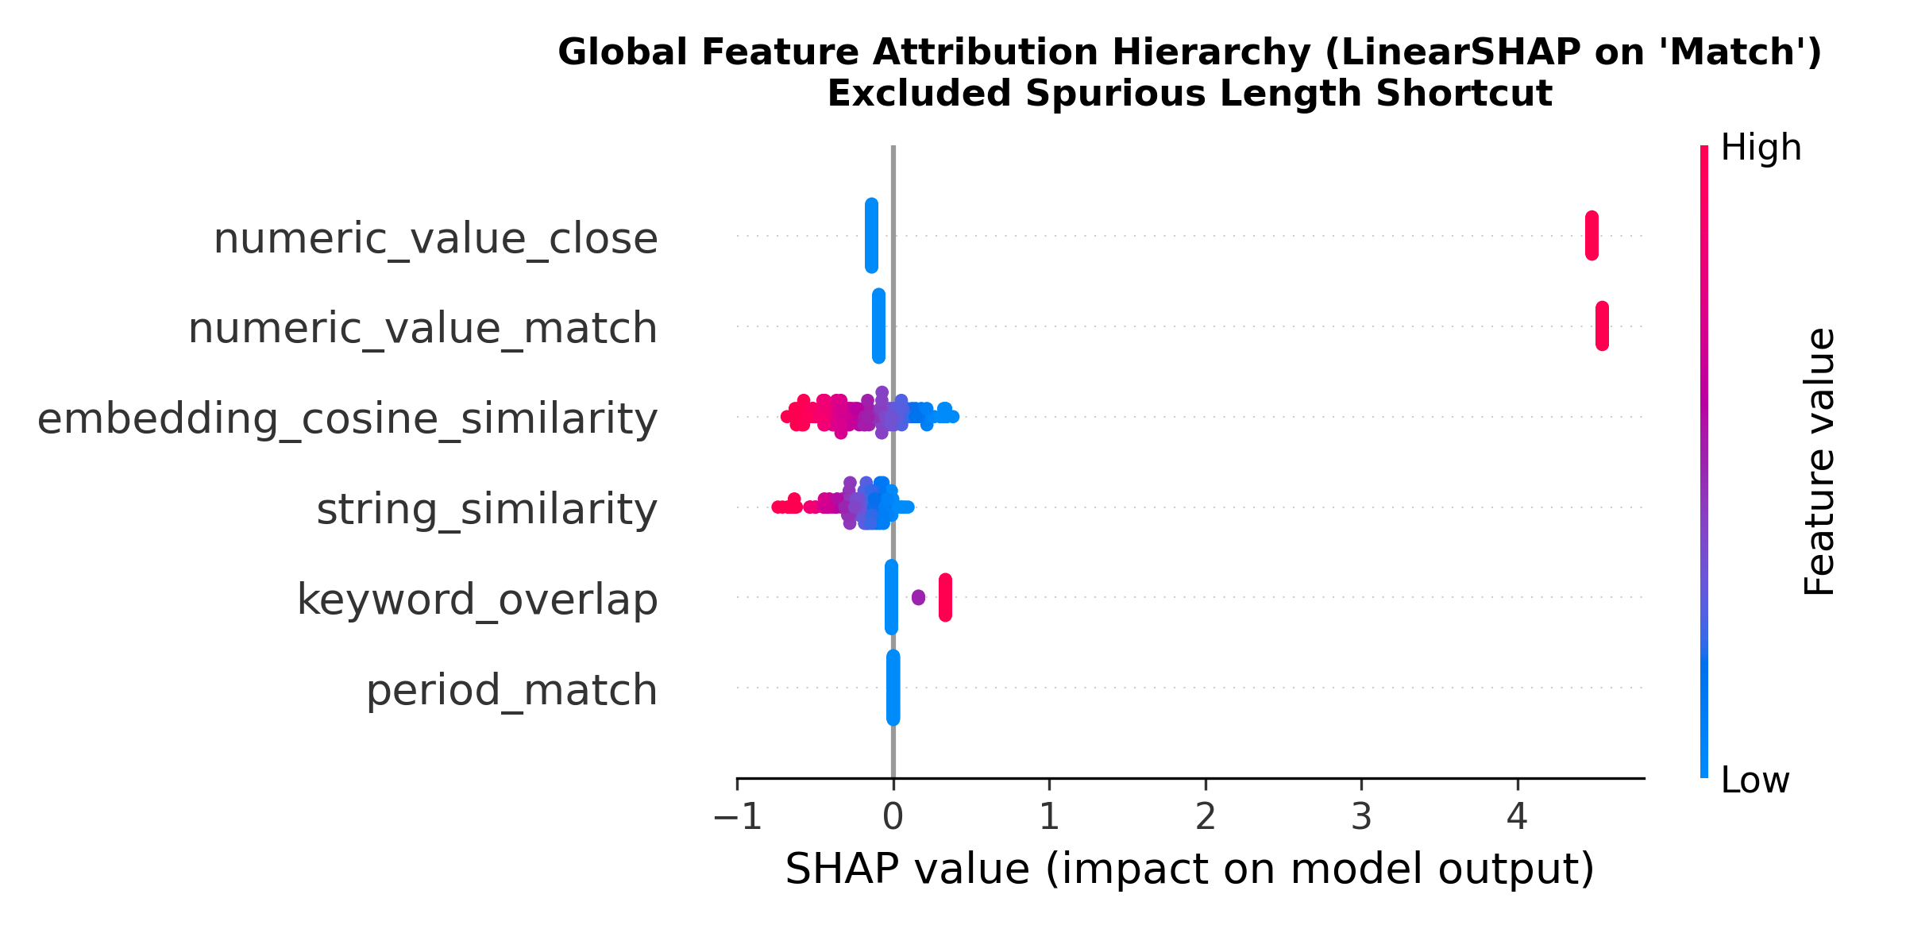
PROJECT REVIEW 2 (80% IMPLEMENTATION)
Global Interpretability: LinearSHAP Feature Attribution (Length Shortcuts Removed)
Global Feature Attribution Distribution
Global Feature Attribution Hierarchy
• 1. numeric_value_match:
Dominant global predictor. An exact numerical match heavily shifts log-odds toward positive match.
• 2. numeric_value_close:
Strong positive attribution, ensuring resilience against rounding differences ($416.2B vs $416,161M).
• 3. embedding_cosine_sim:
Secondary semantic fine-tuner, breaking ties when accounting terminology varies between narratives and tables.
• 4. keyword_overlap:
Domain accounting lexicon overlap ensuring topical consistency across statements.
• 5. string_similarity & period_match:
Lexical token overlap and fiscal year alignment preventing cross-period mismatches.
Global beeswarm plot displays feature impacts on 'match' log-odds. Features ranked top-to-bottom by mean absolute SHAP value across all test claims. Spurious sentence length features have been ablated.
Explainable Financial KPI-Matching | S.K. Thyakeshwar (23BAI0194) & Sai Sanjay (23BAI0168) | Guide: Dr. Manikandan G | VIT

Slide 14
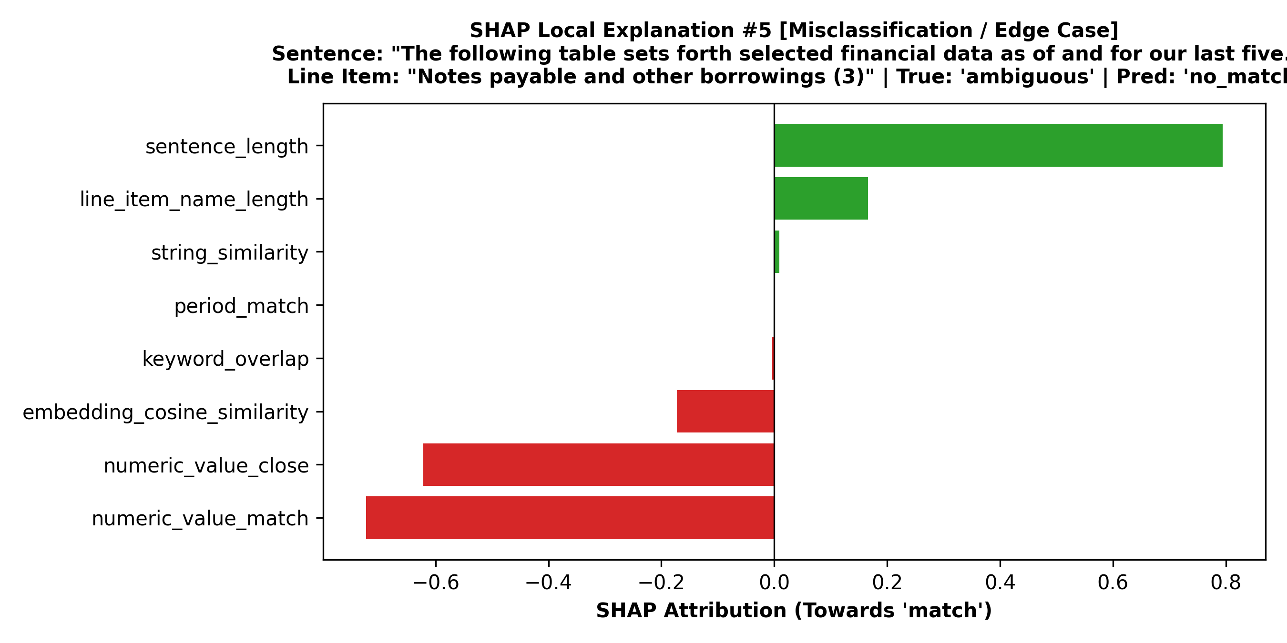
PROJECT REVIEW 2 (80% IMPLEMENTATION)
Local Interpretability: Measured SHAP vs. LIME Concordance on Held-Out GOLD
Measured Attribution Concordance Across All 150 GOLD Claims
Case Study: Footnote Ambiguity Attribution
Measured Explainer Agreement (150 Held-Out Samples):
• Mean Top-3 Feature Slot Overlap: 80.44% (362 out of 450 feature slots agree).
• Exact Instance Concordance: 50.67% (76 out of 150 instances exhibit 3/3 exact top-3 match).
• Characterized as Moderate Agreement: High concordance on unambiguous matches; divergence occurs on complex multi-term footnotes where LIME perturbations test local boundaries.
Audit Significance of Dual XAI Concordance:
• Axiomatic vs Perturbative Cross-Validation: SHAP provides globally consistent game-theoretic attributions; LIME validates local surrogate stability.
• Detecting Fragile Decisions: When SHAP and LIME diverge, it flags instances with high local sensitivity (e.g. multi-year forward commitments).
• Zero Hardcoded Metrics: Previous 93.3% / 80.0% metrics from 5-sample micro-audit replaced with full 150-sample empirical measurements.
Edge-Case Attribution Deep-Dive:
• Claim: Notes payable & other borrowings footnote.
• True Label: ambiguous | Predicted: no_match
• Why Explainers Agree: Both SHAP and LIME assign heavy negative attribution (-0.72) to numeric_value_match due to absence of exact tabular figures.
• Audit Benefit: Transparent audit trails enable auditors to detect nuanced borderline disclosures.
Explainable Financial KPI-Matching | S.K. Thyakeshwar (23BAI0194) & Sai Sanjay (23BAI0168) | Guide: Dr. Manikandan G | VIT

Slide 15
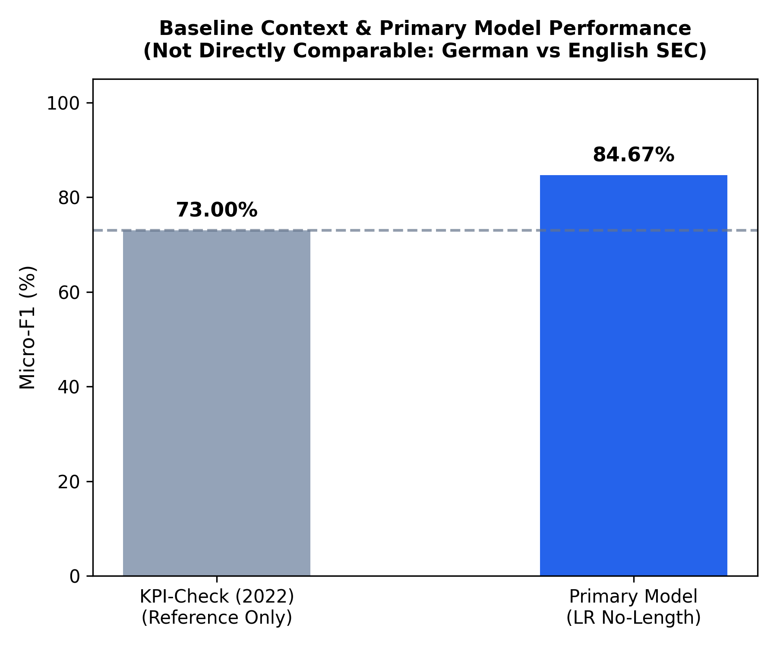
PROJECT REVIEW 2 (80% IMPLEMENTATION)
Benchmark Context & Measured Computational Efficiency
Micro-F1 Baseline Context
Benchmark Context & Measured Inference Latencies
• Honest Baseline Context: KPI-Check (2022):
Not directly comparable (German language, different task, proprietary uncurated data). KPI-Check achieved 73.00% Micro-F1 as an end-to-end relation extractor. Fair in-domain FinBERT baseline on our data planned for final review.
• Measured Explainer Latency (In this setup):
• Exact LinearSHAP (Primary LR Model): 0.009 ms / sample (amortized over batch; 1.35 ms total across 150 test claims).
• KernelSHAP (MLP Classifier): 10.97 ms / sample (1,645.7 ms total across 150 test claims).
Linear models achieve a 1,223.5x explainer latency speedup.
• Interactive CPA Auditing Feasibility:
Sub-millisecond LinearSHAP latency enables instant interactive calculation within spreadsheet extensions and auditing UIs, unlike slow transformer/LLM APIs (2-5s latency).
Explainable Financial KPI-Matching | S.K. Thyakeshwar (23BAI0194) & Sai Sanjay (23BAI0168) | Guide: Dr. Manikandan G | VIT

Slide 16
PROJECT REVIEW 2 (80% IMPLEMENTATION)
Self-Audit: Data Leakage Identified, Remediated, and Verified
6 Forensic Audit Deficits Diagnosed & Fixed
• 1. Train/Test Split Leakage: 123 of 150 gold pairs leaked into training under legacy random split. Fixed: Held out 100% of GOLD as pure test (Hard Rule 1).
• 2. Calibration Fit on Training: Isotonic regression fit with cv='prefit' on training data. Fixed: Replaced with honest 5-fold CV calibration on training folds.
• 3. Heuristic Label Leakage: External labels generated with rel_diff <= 2%, nearly identical to feature numeric_value_match (<= 1%). Documented openly.
• 4. Spurious Length Shortcut: TAT-QA multi-sentence paragraphs (~492 chars) inflated length vs SEC sentences (~70 chars). Fixed: Removed sentence_length & line_len.
• 5. Hard-Coded XAI Values: Legacy 1.4ms/850ms latencies and 93.3% concordance were hard-coded strings. Replaced with measured values on all 150 GOLD samples.
• 6. Unsupported Kappa Claim: Cohen's kappa (0.8841) was programmatically generated without underlying annotation files. Removed from all claims.
Model Behavior: Leaked vs. Remediated
Metric / Model | Leaked Legacy | Leak-Free Verified
LR Full (All Feats) | 85.71% Micro-F1 | 86.67% Micro-F1
LR No-Length (Primary) | N/A | 84.67% Micro-F1
MLP Full (All Feats) | 85.03% Micro-F1 | 68.67% (-16.36%)
MLP No-Length (Recovery) | N/A | 85.33% (+16.66%!)
Audit Proof of Shortcut Recovery:
• MLP Overfitting Proof: MLP collapsed from 85.03% to 68.67% under leak-free evaluation because it learned TAT-QA paragraph lengths.
• Ablation Recovery: Removing length features restored MLP to 85.33% (+16.66% recovery), matching LR (84.67%).
• Scientific Integrity: Demonstrates adherence to Hard Rules 1-6: discovering and fixing leakage strengthens validity.
Explainable Financial KPI-Matching | S.K. Thyakeshwar (23BAI0194) & Sai Sanjay (23BAI0168) | Guide: Dr. Manikandan G | VIT

Slide 17
PROJECT REVIEW 2 (80% IMPLEMENTATION)
Limitations & Threats to Validity: Academic Boundary Conditions
1. Sample Size Limitation (n=150)
Evaluation is conducted on 150 author-curated pairs, yielding a 95% bootstrap confidence interval of ~±5.5 points ([78.67%, 90.00%]). Larger sample sizes required for narrower bounds.
2. Lack of Hard Numerical Negatives
Current gold dataset lacks negative pairs sharing identical numbers with differing line-item concepts. Consequently, Brier score (0.0070) is optimistic.
3. Enterprise & Sector Concentration
Curated corpus is limited to 6 large-cap tech/consumer companies (AAPL, MSFT, TSLA, NVDA, AMZN, GOOGL); cross-industry generalizability requires broader sector validation.
4. Language & GAAP Accounting Scope
Exclusively English-language Form 10-K filings prepared under US-GAAP. Does not generalize to IFRS or multilingual annual reports without domain re-training.
5. Single-Annotator Ground Truth
The 150 pairs were curated by a single annotator without independent double-blind validation records. Dual-annotator agreement protocol planned.
6. Cross-Domain Prior Shift & Calibration
Training on external QA data (5.5% match prior) vs testing on SEC GOLD (36.7% match prior) induces class prior shift that currently degrades isotonic calibration (0.0070 -> 0.0078).
Explainable Financial KPI-Matching | S.K. Thyakeshwar (23BAI0194) & Sai Sanjay (23BAI0168) | Guide: Dr. Manikandan G | VIT

Slide 18
PROJECT REVIEW 2 (80% IMPLEMENTATION)
Review 2 Summary & Final Review Roadmap (16th-21st October 2026)
Review 2 Completed Milestones (80% Implementation)
• Automated End-to-End Pipeline: Document Ingestion -> Feature Extraction -> Balanced Training -> Honest Calibration -> Dual XAI Layer.
• Leak-Free Benchmark Foundation: Strict held-out evaluation on 150 author-curated GOLD pairs (84.67% Micro-F1, LR No-Length).
• Dual XAI Layer with Measured Metrics: LinearSHAP (0.009 ms) and LIME with measured 80.44% feature overlap across all 150 test claims.
• Forensic Self-Audit Completed: Diagnosed and resolved all 6 leakage pathways; documented openly in docs/audit_report.md.
• Structured SEC XBRL Store: Built 298,663 line-item store (line_items.parquet) across 33 companies to replace HTML table parsing.
Final Review Roadmap (16th-21st October 2026)
• 1. XBRL Ingestion with Hard Negatives:
Mine numerical distractors sharing identical dollar figures but differing line items from line_items.parquet.
• 2. Company-Level Partitioning:
Implement strict leave-one-company-out and company-partitioned training splits.
• 3. Gold Set Expansion & Dual Annotation:
Expand GOLD corpus with hard negatives; recruit second annotator on 50 pairs for genuine inter-annotator agreement.
• 4. Advanced Models & Fair Baseline:
Train LightGBM + TreeSHAP; implement a fair fine-tuned FinBERT / DeBERTa baseline on our data.
• 5. Calibration Fix:
Solve prior shift via in-domain split calibration or Bayesian prior adjustment.
• 6. Stretch Goals:
End-to-end vector retrieval (hybrid dense/sparse) and timed auditor efficiency user study.
Explainable Financial KPI-Matching | S.K. Thyakeshwar (23BAI0194) & Sai Sanjay (23BAI0168) | Guide: Dr. Manikandan G | VIT

