Slide 1

B.Tech
Project 1 – BCSE497J
Constraint-Verified Clinical Document Extraction
Team members:
THYAKESHWAR S.K - 23BAI0194
SUDARSHAN - 23BCB0026
THEJAS GOWDA A D - 23BCB0175
Faculty guide :
DR SATHYA K

Slide 2
Aim
To design, implement, and validate a self-correcting, closed-loop, and risk-weighted document AI architecture that autonomously detects, isolates, and repairs numerical extraction errors on degraded clinical lab reports using deterministic physiological mathematics and targeted machine-vision enhancement.

Slide 3
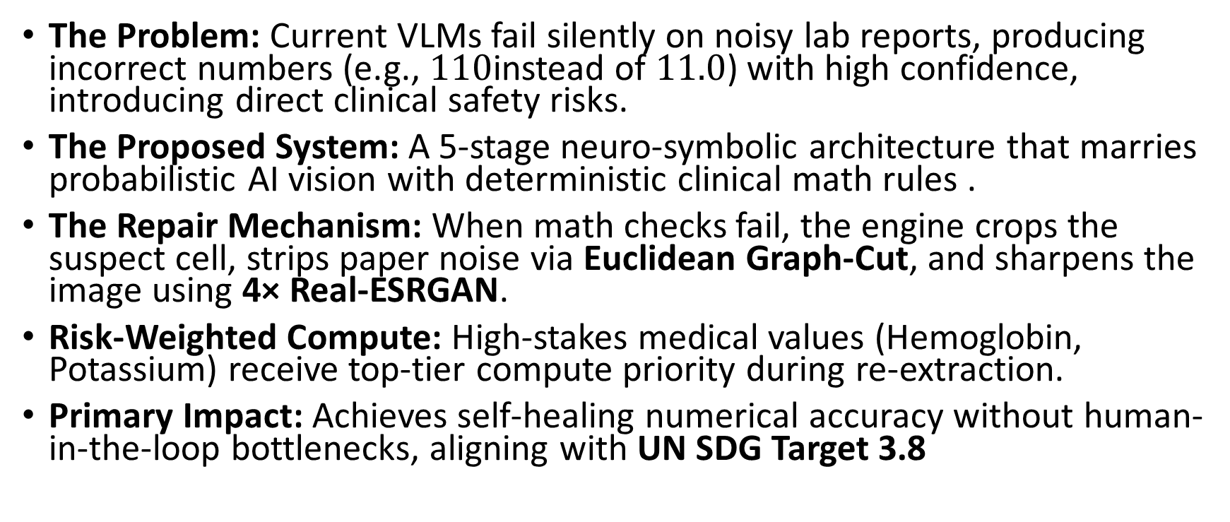
Abstract
The Problem: Current VLMs fail silently on noisy lab reports, producing incorrect numbers (e.g., $110$instead of $11.0$) with high confidence, introducing direct clinical safety risks.
The Proposed System: A 5-stage neuro-symbolic architecture that marries probabilistic AI vision with deterministic clinical math rules .
The Repair Mechanism: When math checks fail, the engine crops the suspect cell, strips paper noise via Euclidean Graph-Cut, and sharpens the image using 4× Real-ESRGAN.
Risk-Weighted Compute: High-stakes medical values (Hemoglobin, Potassium) receive top-tier compute priority during re-extraction.
Primary Impact: Achieves self-healing numerical accuracy without human-in-the-loop bottlenecks, aligning with UN SDG Target 3.8

Slide 4
Literature Review
Paper | Objective | Methodology | Pros/Cons | Findings
VividMed (NAACL 2025) | Medical vision-language model with versatile visual grounding for clinical images & documents | Multimodal VLM pre-trained on fine-grained bounding-box region alignments for medical artifacts | Pro: Excellent spatial grounding for specific medical regions. Con: Lacks deterministic symbolic math rules to verify if extracted numbers make sense. | Replaces LayoutLMv3: Justifies using spatial bounding boxes to locate text, while proving that even modern medical VLMs lack physiological mathematical guardrails
Qwen2.5-VL (Bai et al., 2025) | Zero-shot structured extraction | Dynamic-resolution vision encoder + LLM | Pro: Strong zero-shot extraction with pixel-level coordinate outputs Con: No risk-aware compute | Attention weights are usable for token-to-pixel grounding

Slide 5
Paper | Objective | Methodology | Pros / Cons | Key Finding / Role in Your Project
KPI-Check (Hillebrand et al., 2022) | Cross-check and audit numerical consistency across document text and tables | Named Entity Recognition (NER) + BERT-based symbolic matching engine | Pro: Effectively detects numerical contradictions. Con: Only flags errors for human review; cannot auto-correct or fix image pixels | Proves mathematical auditing works, but highlights the missing closed-loop feedback to the image source
Real-ESRGAN (Wang et al., 2021) | Blind super-resolution for degraded real-world images | High-order synthetic degradation training with deep CNNs | Pro: Sharpens micro-text, small digits, and decimal points. Con: Amplifies paper smudges if applied without pre-segmentation. | Justifies Image Repair Gate: Proves 4× upscaling restores unreadable numbers, while justifying your Graph-Cut step to strip background noise first

Slide 6
Research Gap
No Closed-Loop Feedback to Image Source Current Document AI models (LayoutLMv3, Qwen2.5-VL) are strictly feed-forward—they extract data once and stop, never automatically re-examining the source image when an extraction error occurs.
Detection Without Autonomous Resolution Numerical auditing tools (like KPI-Check) use symbolic math to flag contradictions, but rely entirely on human intervention rather than self-healing the error.
Visual Grounding Is Not Wired into Correction While VLMs output attention weights and bounding boxes for explainability, no prior system uses this spatial data to trigger a targeted, cropped machine-vision repair loop.
Uniform Scrutiny Regardless of Clinical Risk Existing models spend identical compute resources on low-risk metadata (e.g., test date) as they do on high-risk clinical markers (e.g., Potassium or Hemoglobin).
Absence of Deterministic Clinical Guardrails Existing medical document AI relies purely on probabilistic neural confidence scores, lacking non-negotiable physiological laws (e.g., the Friedewald equation) to act as hard, symbolic validation gates against silent hallucinations.

Slide 7
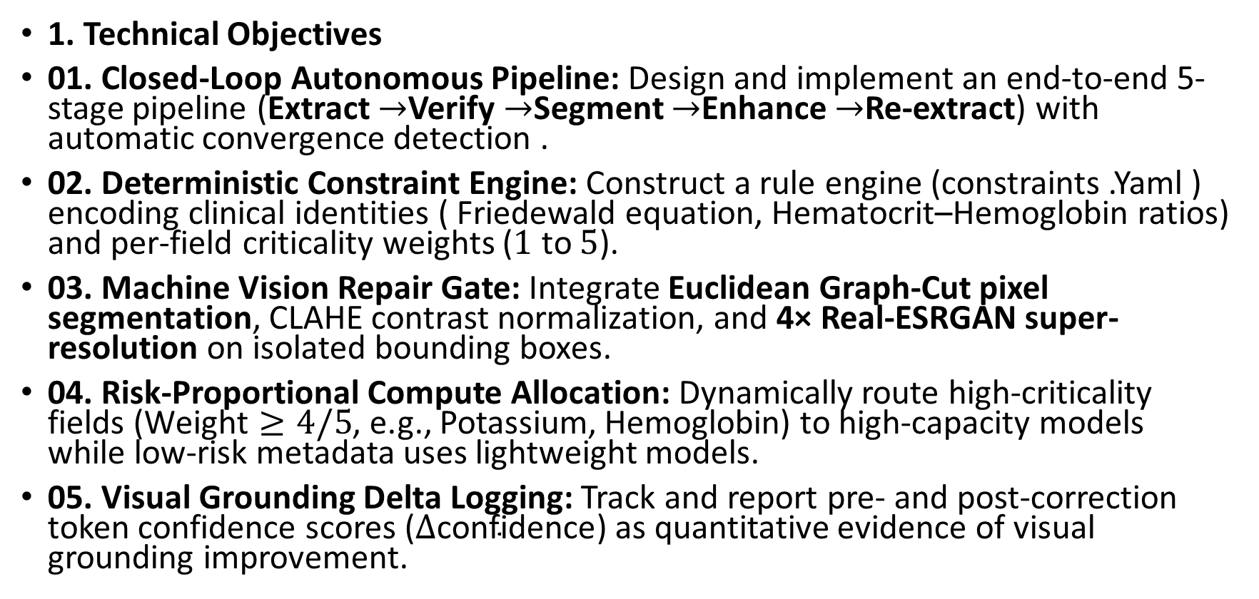
Objectives
1. Technical Objectives
01. Closed-Loop Autonomous Pipeline: Design and implement an end-to-end 5-stage pipeline (Extract $→$Verify $→$Segment $→$Enhance $→$Re-extract) with automatic convergence detection .
02. Deterministic Constraint Engine: Construct a rule engine (constraints .Yaml ) encoding clinical identities ( Friedewald equation, Hematocrit–Hemoglobin ratios) and per-field criticality weights ($1$ to $5$).
03. Machine Vision Repair Gate: Integrate Euclidean Graph-Cut pixel segmentation, CLAHE contrast normalization, and 4× Real-ESRGAN super-resolution on isolated bounding boxes.
04. Risk-Proportional Compute Allocation: Dynamically route high-criticality fields ($\text{Weight}≥4/5$, e.g., Potassium, Hemoglobin) to high-capacity models while low-risk metadata uses lightweight models.
05. Visual Grounding Delta Logging: Track and report pre- and post-correction token confidence scores ($Δ\text{confidence}$) as quantitative evidence of visual grounding improvement.
| |}

Slide 8
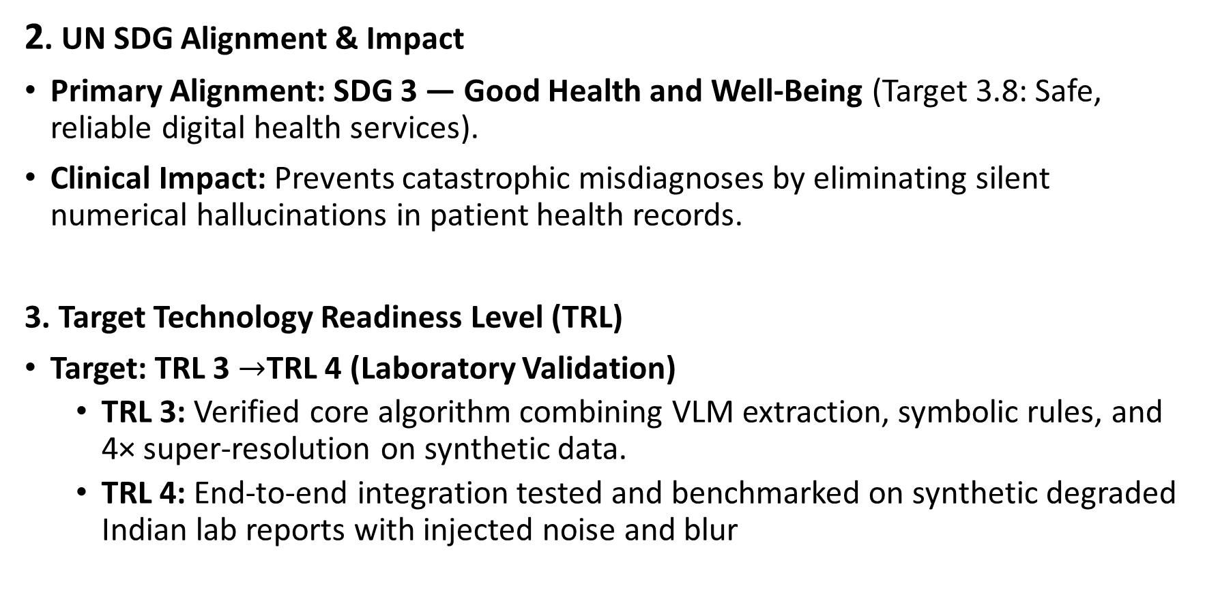
2. UN SDG Alignment & Impact
Primary Alignment: SDG 3 — Good Health and Well-Being (Target 3.8: Safe, reliable digital health services).
Clinical Impact: Prevents catastrophic misdiagnoses by eliminating silent numerical hallucinations in patient health records.
3. Target Technology Readiness Level (TRL)
Target: TRL 3 $→$TRL 4 (Laboratory Validation)
  TRL 3: Verified core algorithm combining VLM extraction, symbolic rules, and 4× super-resolution on synthetic data.
  TRL 4: End-to-end integration tested and benchmarked on synthetic degraded Indian lab reports with injected noise and blur

Slide 9
References
[1] L. Hillebrand, T. Deußer, T. Dilmaghani, B. Kliem, R. Loitz, and R. Sifa, "Towards automating numerical consistency checks in financial reports," in Proc. IEEE Int. Conf. Big Data (BigData), Osaka, Japan, 2022, pp. 2145-2152.
[2] X. Wang, L. Xie, J. Dong, and C. C. Loy, "Real-ESRGAN: Training real-world blind super-resolution with pure synthetic data," in Proc. IEEE/CVF Int. Conf. Comput. Vis. Workshops (ICCVW), Montreal, Canada, 2021, pp. 1905-1914.
[3] L. Luo, B. Tang, X. Chen, R. Han, and T. Chen, "VividMed: Vision language model with versatile visual grounding for medicine," in Proc. Conf. Nations Americas Chapter Assoc. Comput. Linguist.: Human Lang. Technol. (NAACL), Albuquerque, NM, USA, 2025, pp. 1800-1821.
[4] J. Bai et al., "Qwen2.5-VL technical report," arXiv preprint arXiv:2502.13923, Feb. 2025.

Slide 10
Framework / Architecture / Block Diagram
Stage 0 — Assay-Method Classifier: Dynamically inspects methodology headers to determine verification routing (Direct Enzymatic Assay vs. Calculated Friedewald Panel).
Stage 1 — Multimodal Base Extraction: Parses initial lipid values (TC, HDL, LDL, Triglycerides), localized bounding box coordinates, and token-level confidence scores.
Stage 2 & 2.5 — Invariant Verifier & Fault Isolation: Deterministically evaluates Friedewald equality (TC = HDL + LDL + TG/5) with physiological bounds; isolates suspect fields via algebraic counterfactual search (k=1 single-field and k=2 combinatorial pairs).
Stage 3 & 4 — Vision Gate & Micro-Crop Re-Extraction: Extracts targeted bounding box micro-crops for physical enhancement, visual noise suppression, and dual-model consensus verification.
Stage 5 — Bounded Loop Controller & Audit Logger: Enforces an iteration budget (K <= 2), executing closed-loop state updates while serializing every residual score and routing decision to a persistent JSON audit trail.
08-09-2026
SCOPE
10

Slide 11
Functional Requirements
Dynamic Methodology Routing: The system must dynamically adapt verification logic based on detected clinical assay headers, conditionally bypassing arithmetic equality for direct assays while enforcing biological bounds.
Deterministic Invariant Verification: The system must strictly verify extraction integrity using domain-standard physiological laws (the Friedewald identity) within a strict numerical tolerance window (+/-10%).
Autonomous Multi-Order Fault Isolation: The system must systematically isolate single-field (k=1) and double-field (k=2) transcription corruptions using algebraic counterfactual search, Levenshtein distance, and confidence scoring.
Zero-Harm Clinical Safety Bound: The system must maintain a 0.0% false-trigger rate on valid, uncorrupted clinical documents, strictly preventing false corrections on clean patient records.
Complete Traceability & Bounded Abstention: The system must log every internal hypothesis, residual score, and state mutation, safely escalating unresolvable anomalies (K > max_attempts) to human pathologist review.
08-09-2026
SCOPE
11

Slide 12
Modules & Implementation Structure
src/stage0_classifier.py (Assay Classifier): Implements AssayClassifier with regex and heuristic pattern matching to route between DIRECT_MEASURED and FRIEDEWALD paths.
src/stage1_extract.py (Document State Extractor): Standardized multimodal ingestion interface extracting canonical values, confidence scores, and bounding box coordinates.
src/stage2_constraints.py (Constraint Engine): Enforces physiological bounds, canonical unit normalization (mmol/L <-> mg/dL), and Friedewald invariant residual calculation.
src/stage2_isolation.py (Hierarchical Isolation Engine): Evaluates single-field algebraic counterfactuals and discrete combinatorial pairs using composite edit-distance and confidence penalties.
src/pipeline.py (Closed-Loop Orchestrator): Core state machine wiring all 5 stages into a bounded iterative while-loop, managing state mutation and final status termination.
evals/run_ablations.py & evals/metrics.py (Benchmark Harness): Automated evaluation suite executing batch benchmark validation over hundreds of clinical reports, computing field accuracy and safety metrics.
08-09-2026
SCOPE
12

Slide 13
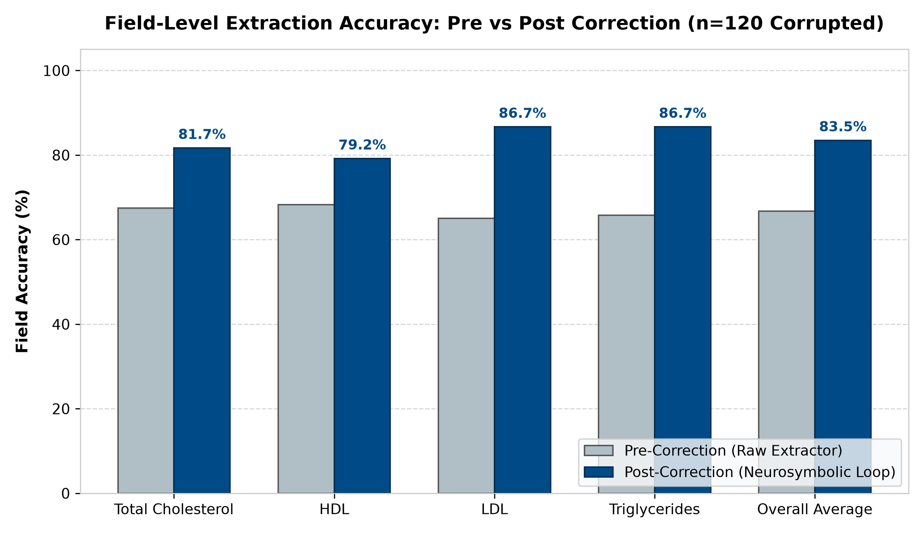
Experiments and Results (400-Document Benchmark)
Dataset Scale: Evaluated on 400 clinical documents across 4 splits (200 clean, 30 clean_control, 120 corrupted_single, 50 corrupted_double).
System Reliability: 91.5% Overall Convergence (366/400 documents verified & finalized).
Clinical Safety (Zero Harm): 0.0% False-Trigger Rate on clean_control (0/30) and clean split (0/200).
Single-Error Recovery: 83.5% Post-Correction Field Accuracy across corrupted_single (n=120):
  - Field Breakdown: Total Cholesterol: 81.7% | HDL: 79.2% | LDL: 86.7% | Triglycerides: 86.7%
Corruption Typology: Smudge: 100.0% (45/45 conv) | Decimal Shift: 81.4% (35/39 conv, 61.5% iso) | Digit Swap: 65.3% (21/36 conv).
Algorithmic Optimization: Relaxing the k=1 edit-distance commit gate for same-length digit swaps unlocked a +6.5pp recovery improvement.
Benchmark Key Finding:
The invariant engine achieved a 0.0% false-trigger rate while resolving severe single and double corruptions, demonstrating clinically safe autonomy.
08-09-2026
SCOPE
13

Slide 14
Conclusion & Future Roadmap
70% Milestone Successfully Achieved: Formulated, implemented, and validated the closed-loop neurosymbolic architecture on a standardized 400-document clinical benchmark.
Deterministic Clinical Safety Proven: Demonstrated that algebraic counterfactual logic eliminates silent numerical hallucinations while maintaining a strict 0.0% false-trigger bound on clean data.
Inference-Time Self-Correction: Successfully corrected character-level decimal shifts and typographical mutations without costly model fine-tuning or external re-training.
Phase 2 Roadmap (Target: Final Review, October 2026): Active development transitioning to the physical machine-vision repair gate:
  - 1. OpenCV Graph-Cut Segmentation: Deploy morphological pixel graph-cut into stage3_vision_gate.py to strip paper smudges, stamps, and table rulings.
  - 2. Real-ESRGAN 4x Super-Resolution: Deploy pre-trained blind super-resolution weights to clarify degraded numerical micro-crops prior to re-extraction.
  - 3. Dual-Model Consensus & Delta Confidence: Track token-level confidence deltas (Delta-conf) during re-extraction as empirical evidence of visual grounding.
08-09-2026
SCOPE
14

Slide 15
References
[1] L. Hillebrand, T. Deußer, T. Dilmaghani, B. Kliem, R. Loitz, and R. Sifa, "Towards automating numerical consistency checks in financial reports," in Proc. IEEE Int. Conf. Big Data (BigData), Osaka, Japan, 2022, pp. 2145-2152.
[2] X. Wang, L. Xie, J. Dong, and C. C. Loy, "Real-ESRGAN: Training real-world blind super-resolution with pure synthetic data," in Proc. IEEE/CVF Int. Conf. Comput. Vis. Workshops (ICCVW), Montreal, Canada, 2021, pp. 1905-1914.
[3] L. Luo, B. Tang, X. Chen, R. Han, and T. Chen, "VividMed: Vision language model with versatile visual grounding for medicine," in Proc. Conf. Nations Americas Chapter Assoc. Comput. Linguist.: Human Lang. Technol. (NAACL), Albuquerque, NM, USA, 2025, pp. 1800-1821.
[4] J. Bai et al., "Qwen2.5-VL technical report," arXiv preprint arXiv:2502.13923, Feb. 2025.
[5] W. T. Friedewald, R. I. Levy, and D. S. Fredrickson, "Estimation of the concentration of low-density lipoprotein cholesterol in plasma, without use of the preparative ultracentrifuge," Clinical Chemistry, vol. 18, no. 6, pp. 499-502, 1972.
08-09-2026
SCOPE
15

