Slide 1
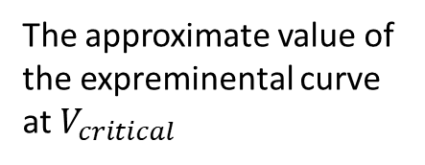

Scaling
Note: For better quality, double click the figure to open pdf.
Normalizing the experimental measurements by the critical voltage corresponding to the normal and quantum tunneling regime transition point.
The approximate value of the expreminental curve at $V_{critical}$
$V_{critical}$ - Normalization value $Π_{0}^{−1}$
Particle Number | V_critical 1 (original from Shahal) | Exp. Curve value | V critical 2 (from us first iteration) | Exp. Curve value | V critical 3 (from us second iteration) | Exp. Curve value | V critical 4 („eyeballed it”) | Exp. Curve Value
1 | 104 | 13.05 | 104 | 13.05 | 114 | 7.18 | 110 | 9
3 | 280 | 9.2 | 360 | 1.327 | 368 | 0.8752 | 322.5 | 4
5 | 560 | 9.067 | 720 | 0.682 | 711 | 0.917 | 640 | 3.5
7 | 850 | 8.2 | 1020 | 0.51 | 1031 | 0.482 | 935 | 3.5
The scales are not adjusted to match the theoretical figure.

Slide 2
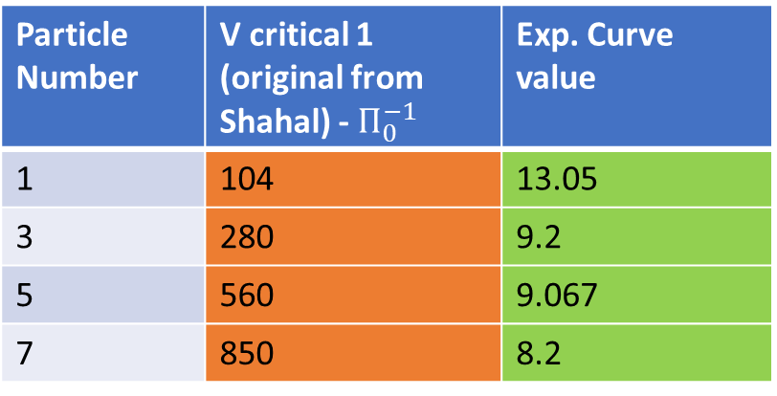
Critical points as described by Shahal’s original ppt
Particle Number | V critical 1 (original from Shahal) - $Π_{0}^{−1}$ | Exp. Curve value
1 | 104 | 13.05
3 | 280 | 9.2
5 | 560 | 9.067
7 | 850 | 8.2
For better visibility I erased the electron numbers and added a vertical line at 1.

Slide 3
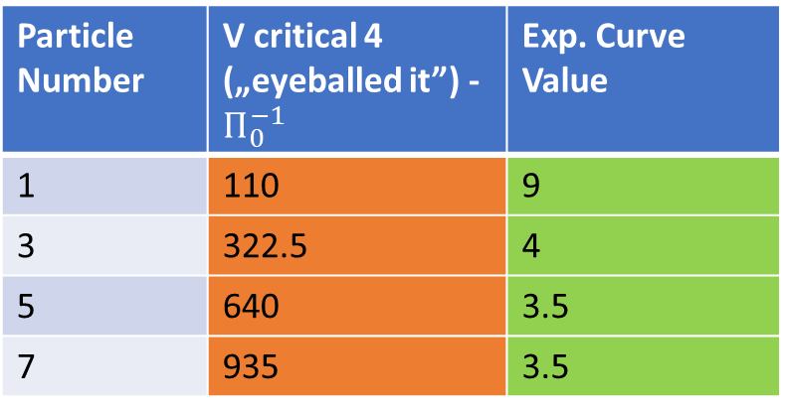
Particle Number | V critical 4 („eyeballed it”) - $Π_{0}^{−1}$ | Exp. Curve Value
1 | 110 | 9
3 | 322.5 | 4
5 | 640 | 3.5
7 | 935 | 3.5
Critical points extracted without fitting, only by visual examination
For better visibility I erased the electron numbers and added a vertical line at 10^0.

Slide 4
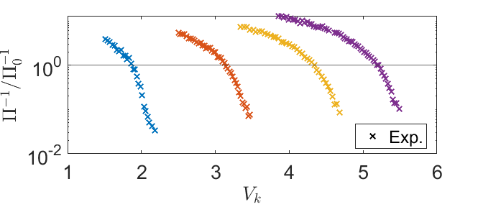

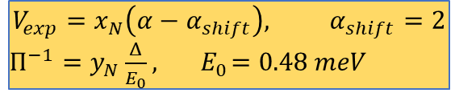
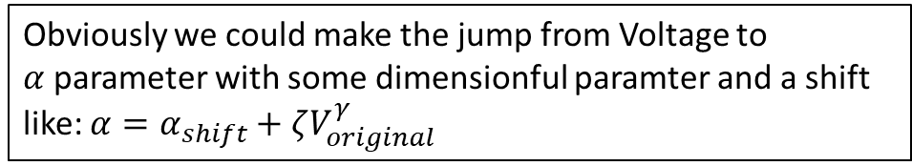
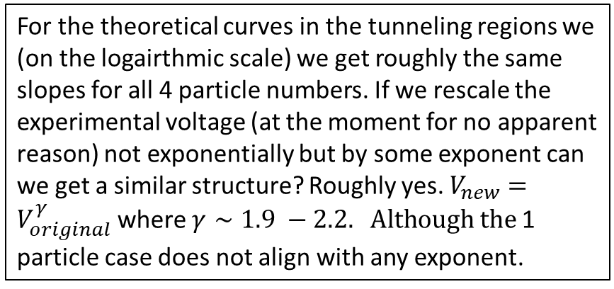
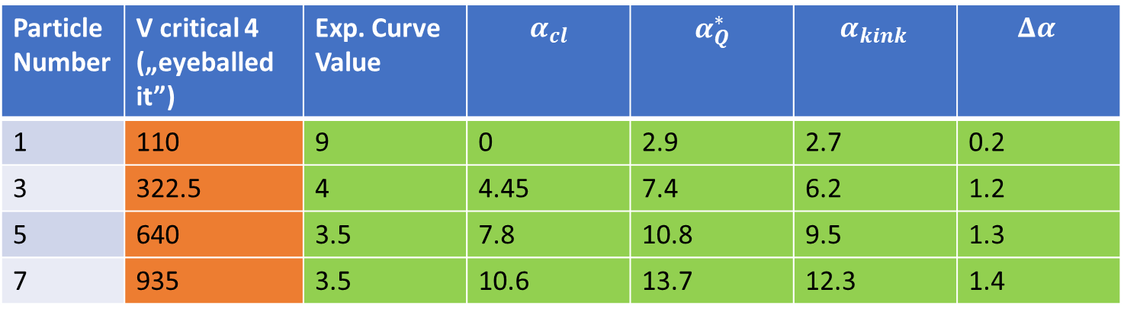
$$V_{exp}=x_{N}\left(α−α_{shift}\right), α_{shift}=2$$
$Π^{−1}=y_{N}\frac{Δ}{E_{0}}, { E}_{0}=0.48 meV$
Taking the „Eyeballed” V critical values, using the scaling, we can reverse enginier the $α_{kink}$values .
Particle Number | V critical 4 („eyeballed it”) | Exp. Curve Value | $$α_{cl}$$ | $$α_{Q}^{∗}$$ | $$α_{kink }$$ | $${Δα}_{ }$$
1 | 110 | 9 | 0 | 2.9 | 2.7 | 0.2
3 | 322.5 | 4 | 4.45 | 7.4 | 6.2 | 1.2
5 | 640 | 3.5 | 7.8 | 10.8 | 9.5 | 1.3
7 | 935 | 3.5 | 10.6 | 13.7 | 12.3 | 1.4
For the theoretical curves in the tunneling regions we (on the logairthmic scale) we get roughly the same slopes for all 4 particle numbers. If we rescale the experimental voltage (at the moment for no apparent reason) not exponentially but by some exponent can we get a similar structure? Roughly yes. $V_{new}=V_{original}^{γ}$ where $γ∼1.9 −2.2. Although the$1 particle case does not align with any exponent.
$$γ$$
Obviously we could make the jump from Voltage to $α$parameter with some dimensionful paramter and a shift like: $α=α_{shift}+ζV_{original}^{γ}$

Slide 5
New Scaling from Shshal’s „Universal Scaling”
Note: For better quality, double click the figure to open pdf.

Slide 6
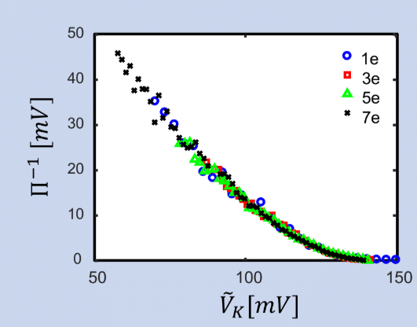
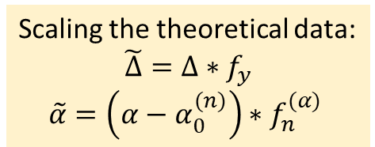

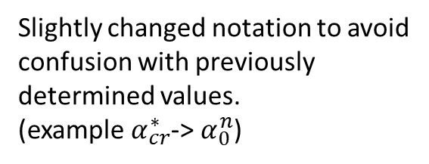
Idea: Scale together the experimental curves, then scale together the theory curves, then with one conversion factor from tunnel splitting to polarization see if theres a connection.
Slightly changed notation to avoid confusion with previously determined values.
(example $α_{cr}^{∗}$-> $α_{0}^{n}$)
Scaling the theoretical data:
$$\tilde{Δ}=Δ∗f_{y}$$
$$\tilde{α}=\left(α−α_{0}^{(n)}\right)∗f_{n}^{(α)}$$
Scaling the experimental data on the x axis:
(y axis remains unchanged)
$${\tilde{V}}_{k}={(V}_{k}−V_{0}^{\left(n\right)})f_{n}$$
Particle number dependent scaling factor
Parameter of the quadratic potential term
Particle number dependent scaling factor
Voltage on the pot. barrier
Critical voltage corresponding to the quantum tunneling regime transition point (we use Shahal’s values)
Critical alpha value corresponding to the quantum tunneling regime transition point

Slide 7
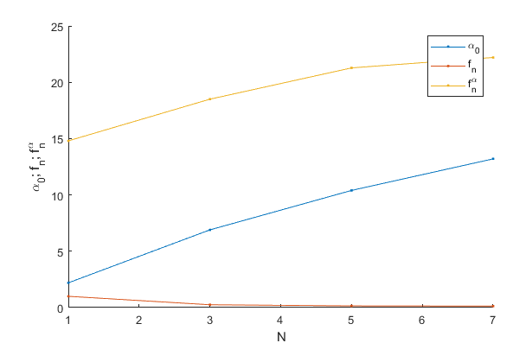
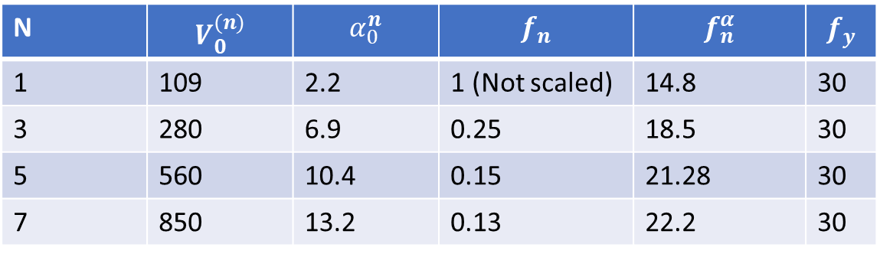


N | $$V_{0}^{(n)}$$ | $$α_{0}^{n}$$ | $$f_{n}$$ | $$f_{n}^{α}$$ | $$f_{y}$$
1 | 109 | 2.2 | 1 (Not scaled) | 14.8 | 30
3 | 280 | 6.9 | 0.25 | 18.5 | 30
5 | 560 | 10.4 | 0.15 | 21.28 | 30
7 | 850 | 13.2 | 0.13 | 22.2 | 30
f_y depends on the normalization we used for the experimental data.
$${\tilde{V}}_{k}={(V}_{k}−V_{0}^{\left(n\right)})f_{n}$$
$$\tilde{Δ}=Δ∗f_{y}$$
$$\tilde{α}=\left(α−α_{0}^{(n)}\right)∗f_{n}^{(α)}$$

Slide 8
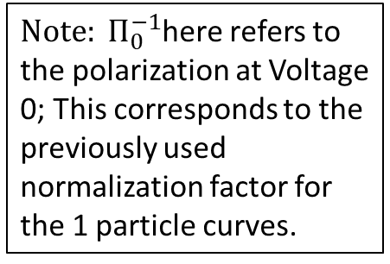
With appropriate critical alpha value choice the curves fit together rather nicely
${Note: Π}_{0}^{−1}$here refers to the polarization at Voltage 0; This corresponds to the previously used normalization factor for the 1 particle curves.

Slide 9
We might want to trim the data above 30 or 40 in this case, here I just wanted to show the whole experimental data.
Note: For better quality, double click the figure to open pdf.

Slide 10
Previously discarded slides ahead

Slide 11
Particle Number | V critical 2 (from us first iteration) | Exp. Curve value
1 | 104 | 13.05
3 | 360 | 1.327
5 | 720 | 0.682
7 | 1020 | 0.51
For better visibility I erased the electron numbers and added a vertical line at 1.

Slide 12
Particle Number | V critical 3 (from us second iteration) | Exp. Curve value
1 | 114 | 7.18
3 | 368 | 0.8752
5 | 711 | 0.917
7 | 1031 | 0.482
For better visibility I erased the electron numbers and added a vertical line at 1.

