Slide 1
In San Francisco, Making a living From Your Billionaire Neighbor’s Trash
--The new York times
April 7, 2019
Presented by 田昊宇 –社院1802 （sociology 1802）

Slide 2
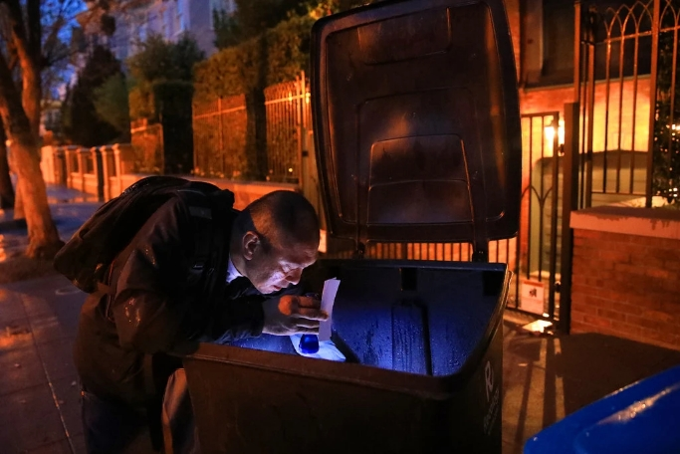
Jake Orta searched through a trash bin outside Mark Zuckerberg’s home in San Francisco

Slide 3
There’s a child’s pink bicycle helmet that Mr. Orta dug out from the garbage bin across the street from Mr. Zuckerberg’s house. And a vacuum cleaner, a hair dryer, a coffee machine — all in working condition — and a pile of clothes that he carried home in a Whole Foods paper bag retrieved from Mr. Zuckerberg’s bin.
--ny times

Slide 4
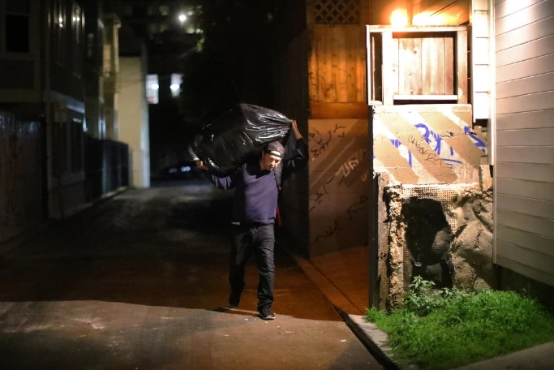
Mr. Orta is part of an underground economy of people who work the sidewalks in front of multimillion-dollar homes, rummaging for things they can sell.

Slide 5
One man’s trash is another man’s treasure.
--one of Mr. Orta’s trash-picking colleagues

Slide 6
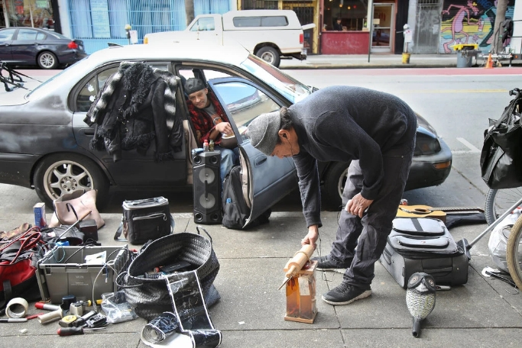
Mr. Orta, right, selling some of the items he found. His goal is to earn around $30 to $40 a day from his discoveries

Slide 7
We have a lot of trash of convenience, You’ve got more and more tech people here and this city is moving faster and faster. These people have short attention spans. Some discard items that ought to be repurposed through a thrift shop
--Mr. Reed, the spokesman for Recology.

Slide 8
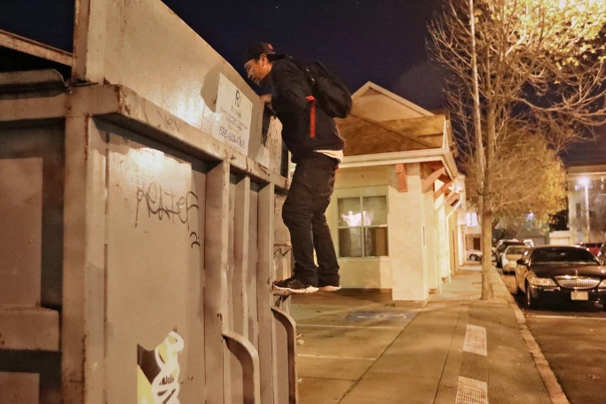
“It just amazes me what people throw away,” Mr. Orta said.

Slide 9
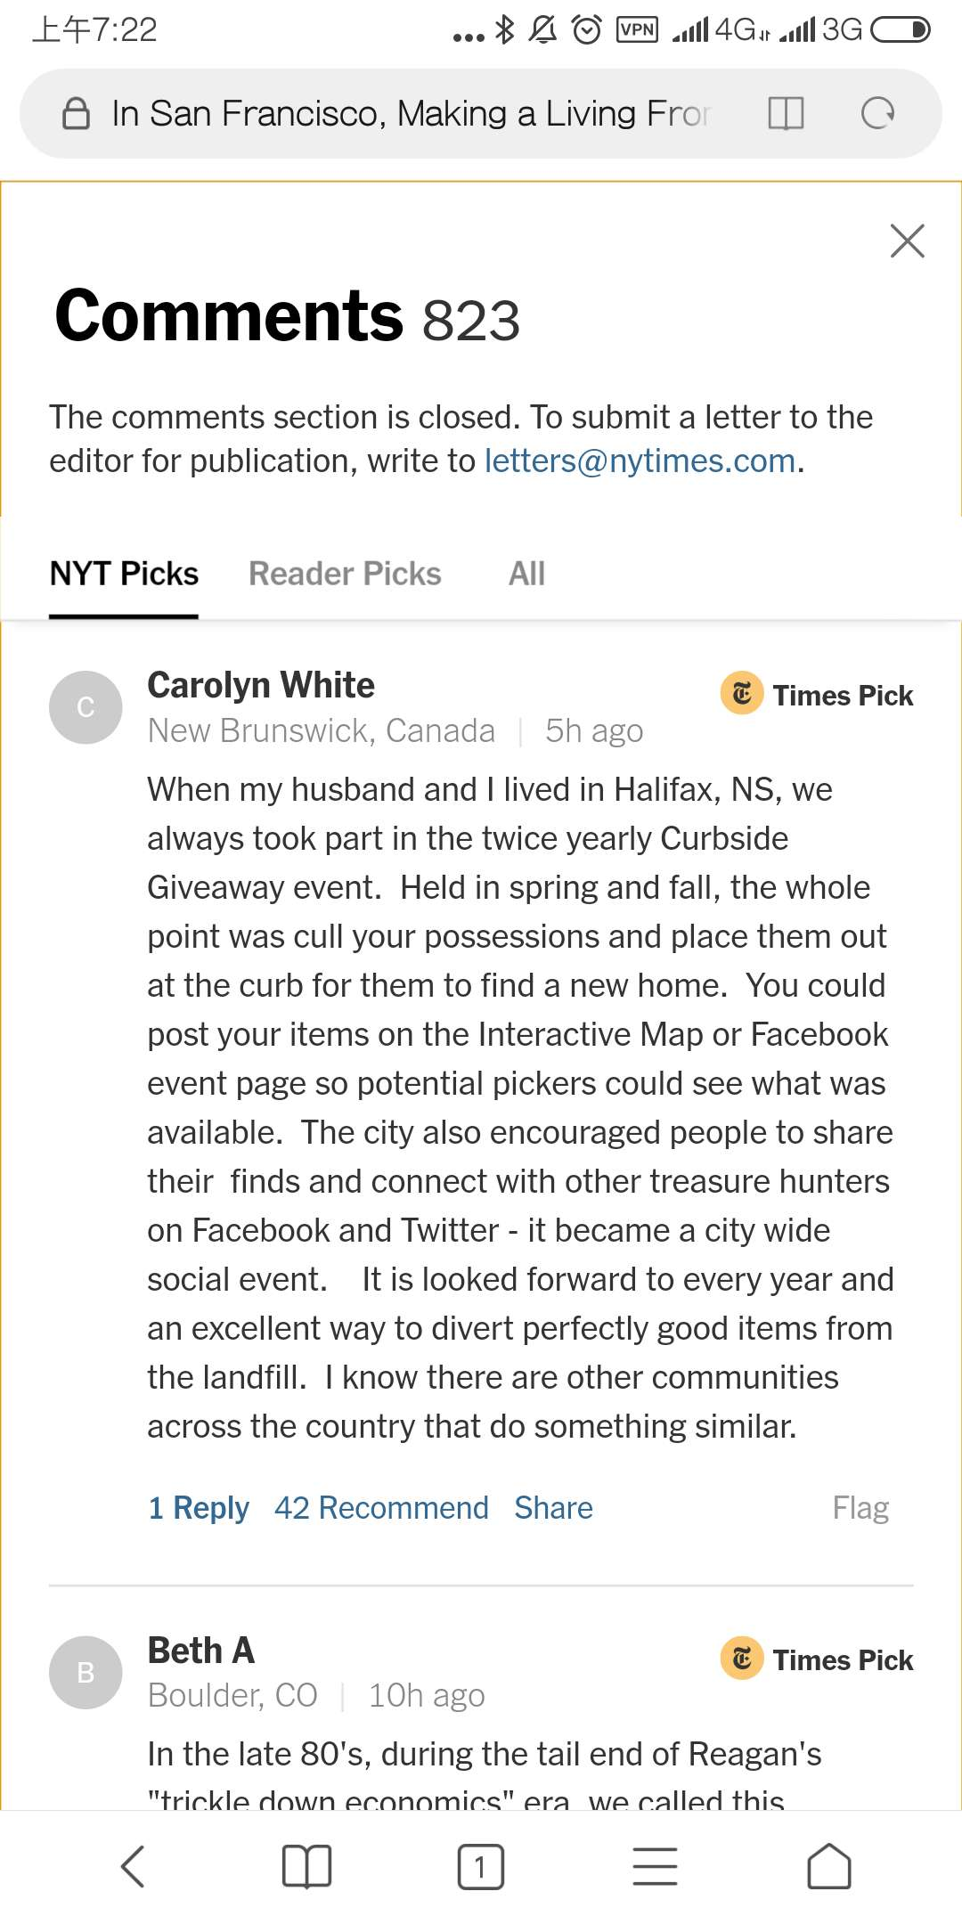
Comments from www.nytimes.com
NYK Picks #1 - Carolyn White
Curbside Giveaway event
cull your possessions and place them out at the curb
Facebook post for potential pickers
City encouragement – city wide social event
Other communities across the country

Slide 10
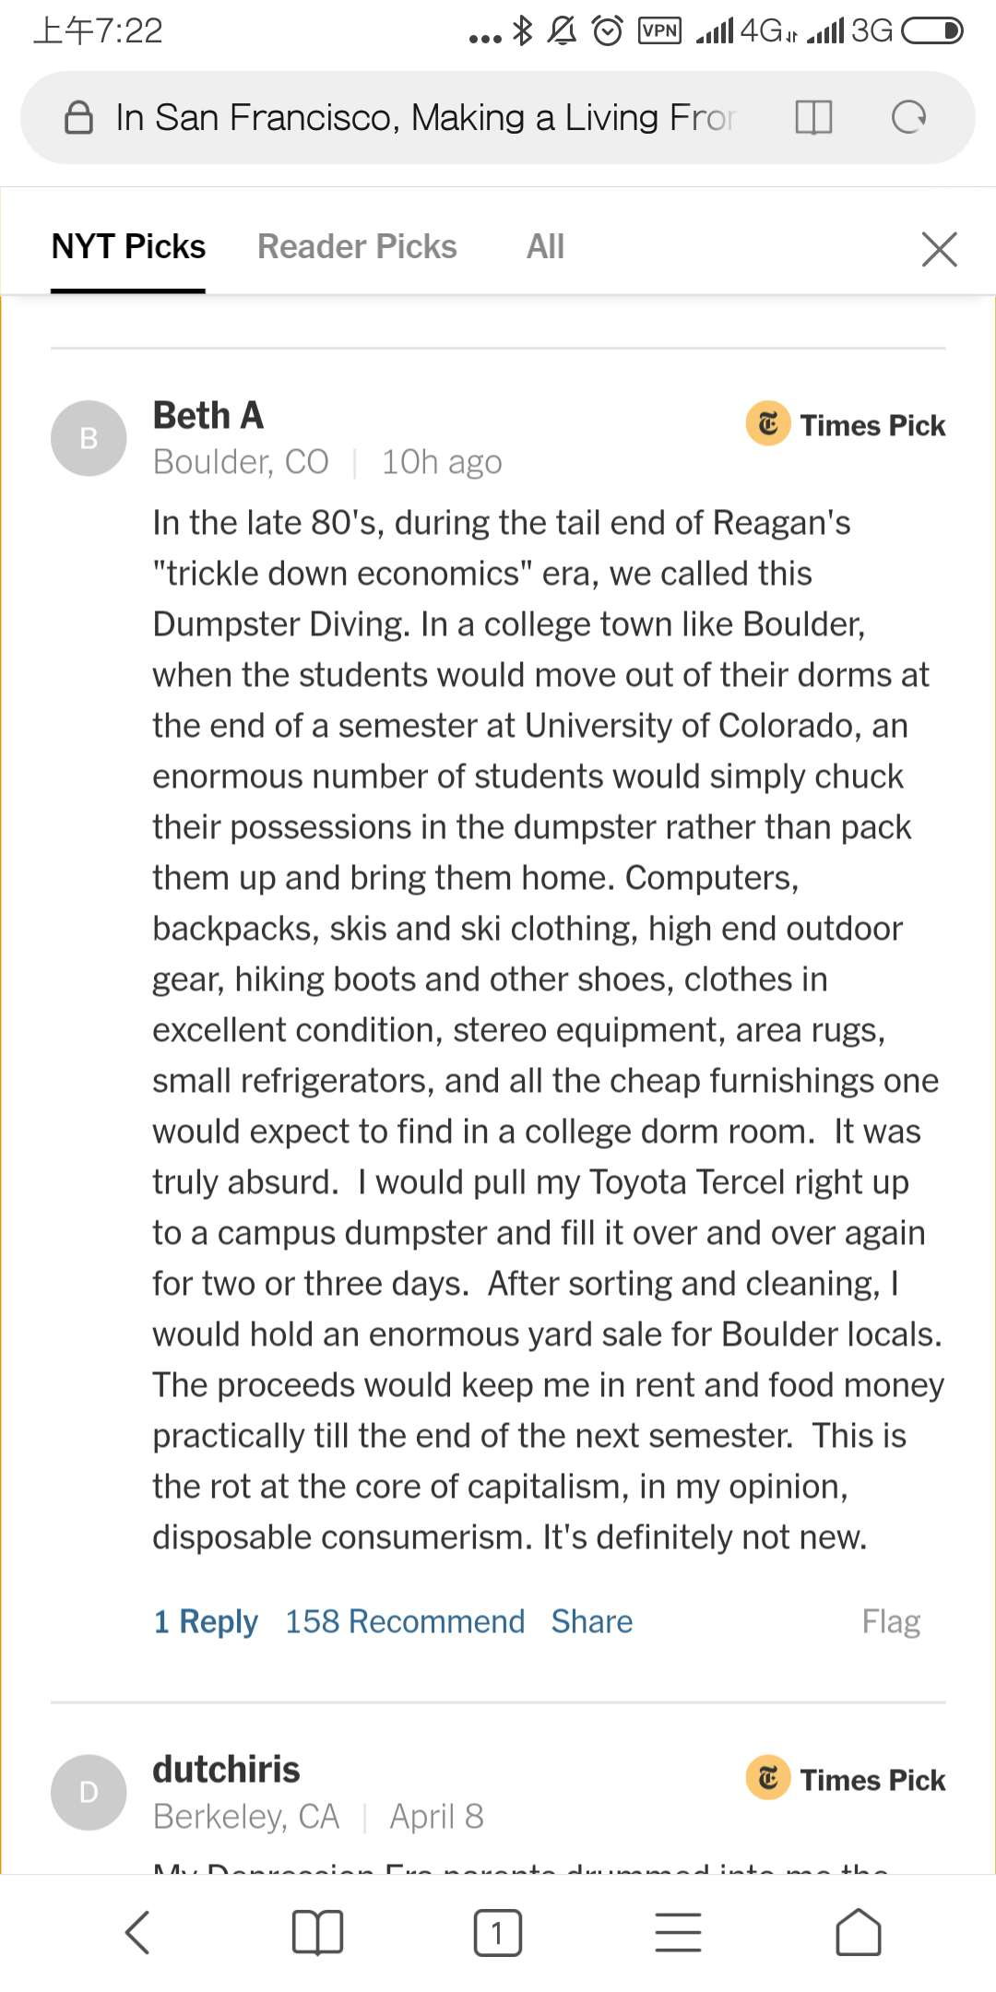
Comments from www.nytimes.com
NYK Picks #2 – Beth A
Dumpster Diving
80’s, the tail of Reagan’s “trickle down economics”
Students moving out of dormitory
Chuck their possessions in the dumpster
Sorting – cleaning – yard sale for locals
Rent and food money till next semester

Slide 11
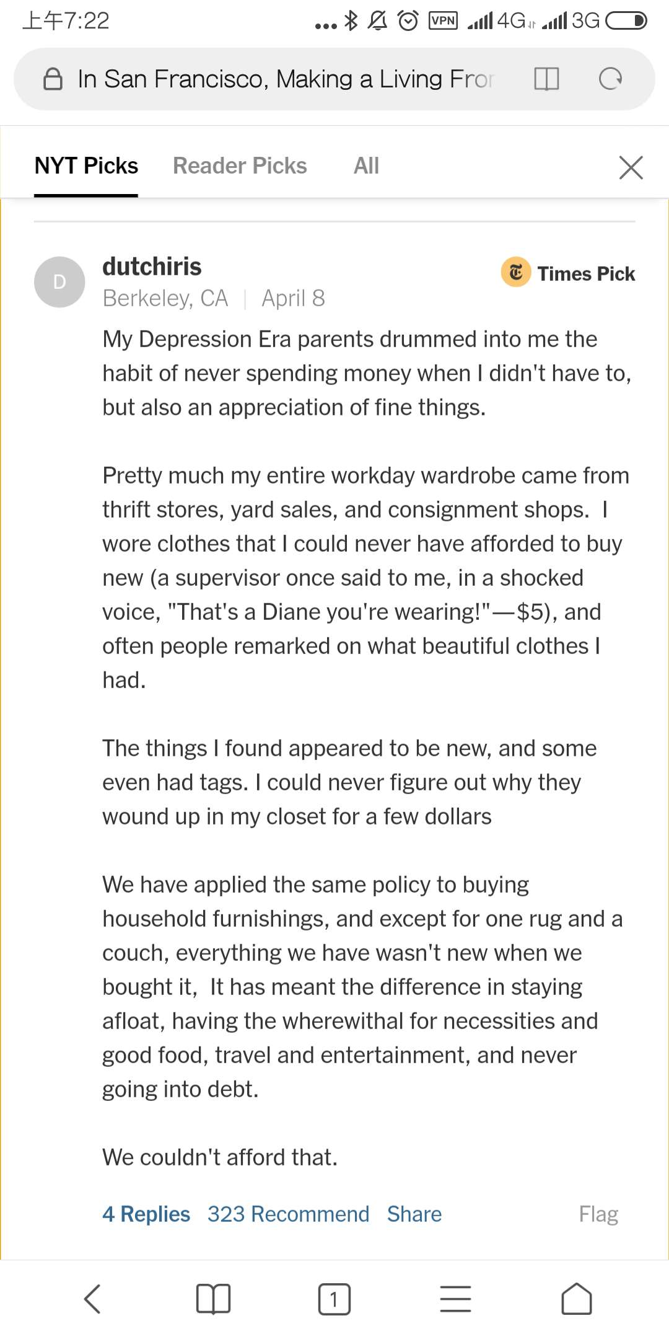
Comments from www.nytimes.com
NYK Picks #2 – dutchiris
Depression Era parents
Never spending money when don’t have to
Appreciation of fine things
Buy “not new” things
Thrift stores, yard sales, consignment shops
Appeared to be new, even had tags
Couldn’t afford that
Having the wherewithal for necessities and good food, travel and evertainment
Never going into debt

Slide 12
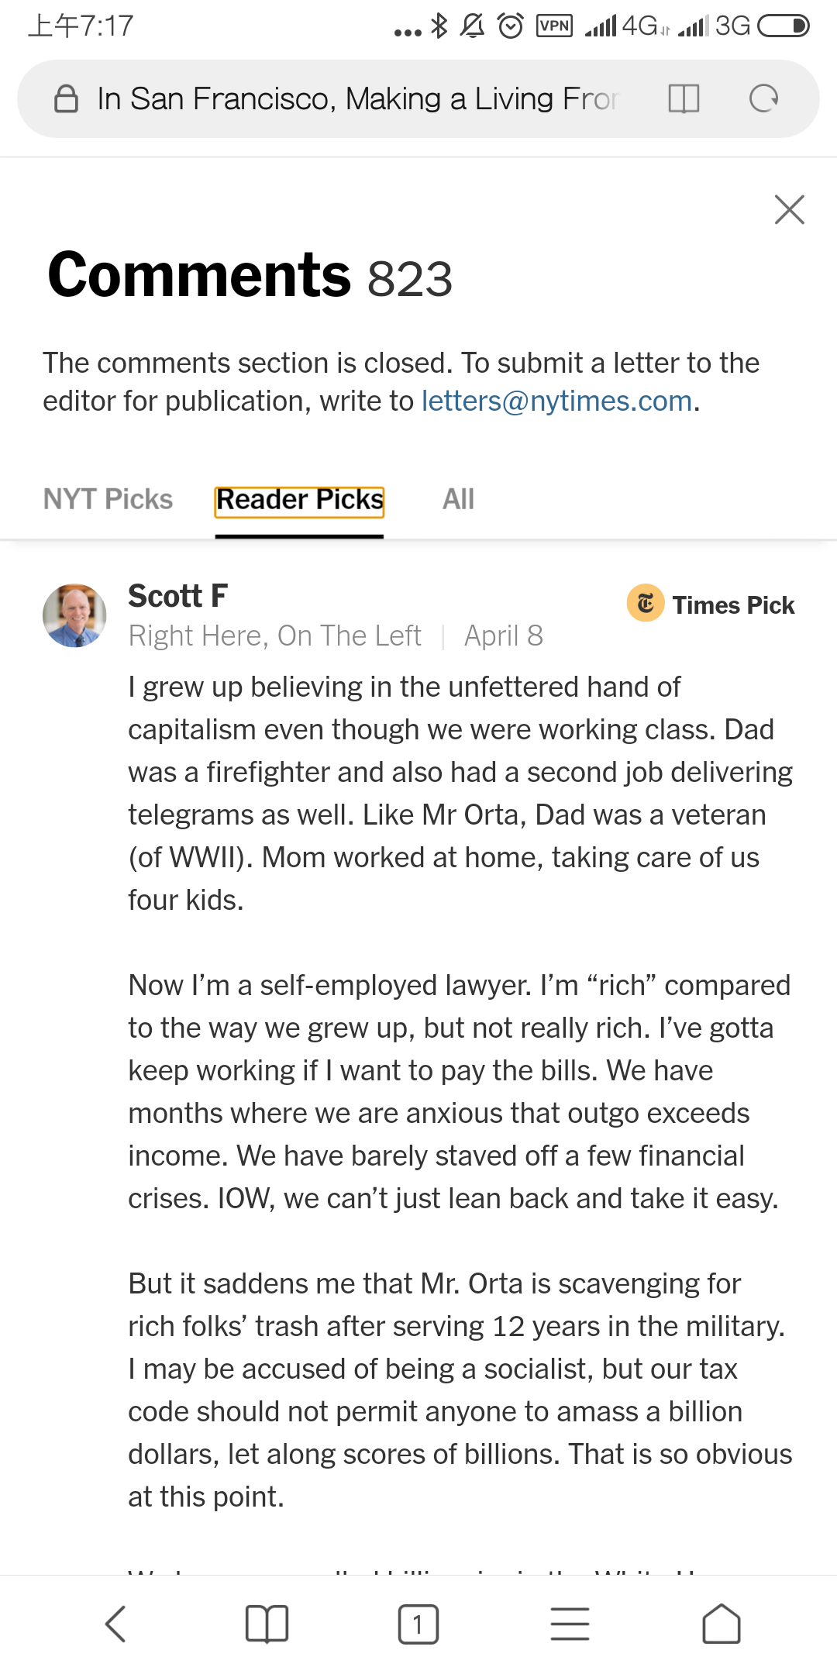
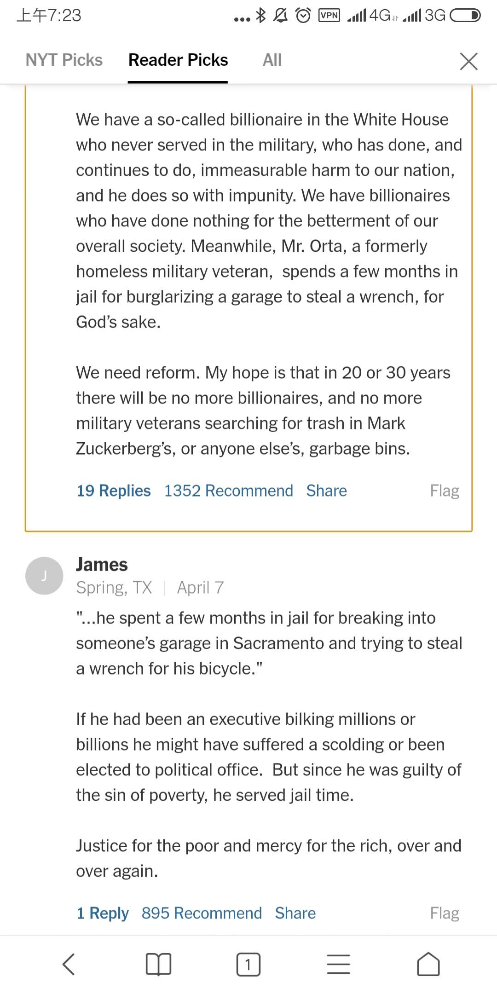
Comments from www.nytimes.com
Reader Picks #1 – Scott F
Self-employed lawyer
We need reform - our tax code should not permit anyone to amass a billion dollars
We have a so-called billionaire in the White House who never served in the military, who has done, and continues to do, immeasurable harm to our nation, and he does so with impunity. We have billionaires who have done nothing for the betterment of our overall society. Meanwhile, Mr. Orta, a formerly homeless military veteran, spends a few months in jail for burglarizing a garage to steal a wrench, for God’s sake.

Slide 13
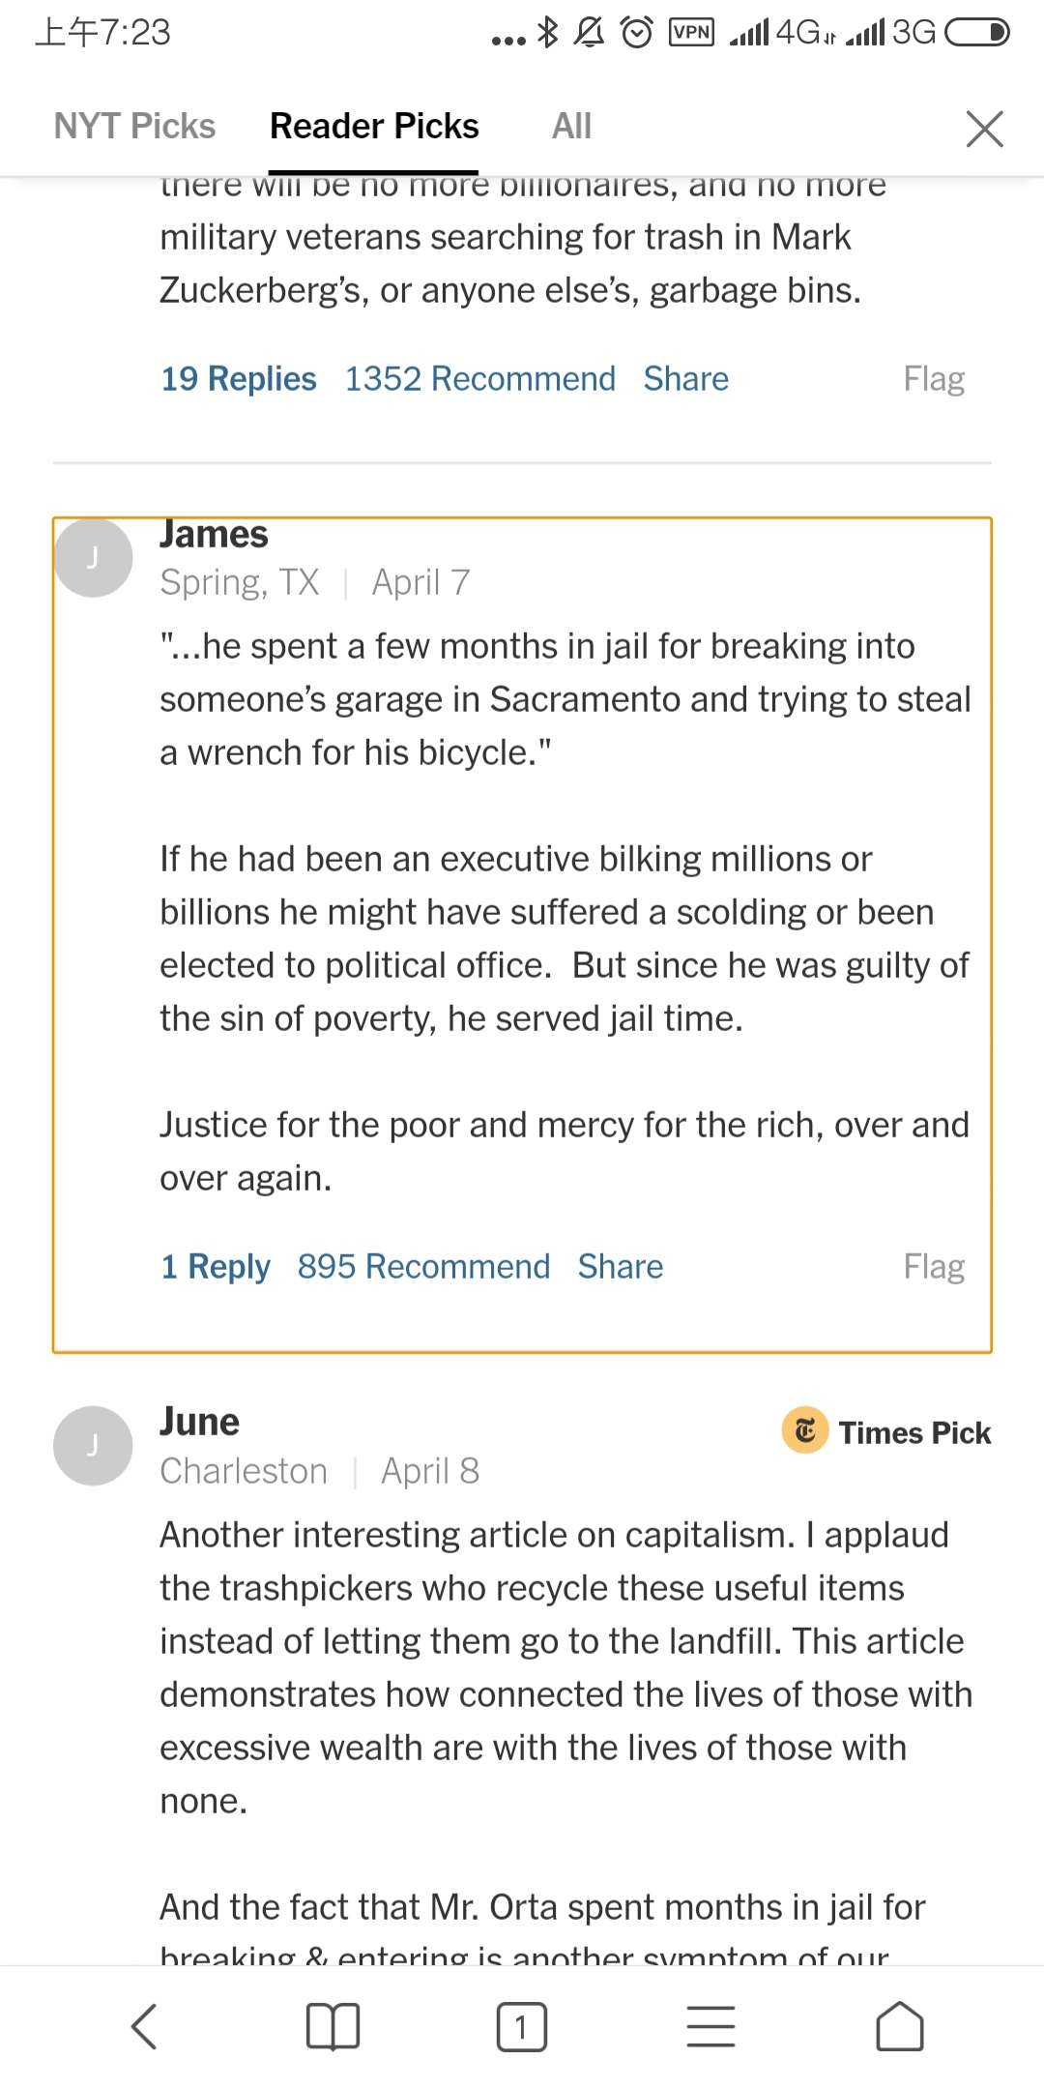
Comments from www.nytimes.com
Reader Picks #2 – James
“...he spent a few months in jail for breaking into someone’s garage in Sacramento and trying to steal a wrench for his bicycle.”
If he had been an executive bilking millions or billions he might have suffered a scolding or been elected to political office. But since he was guilty of the sin of poverty, he served jail time.
Justice for the poor and mercy for the rich, over and over again.

Slide 14
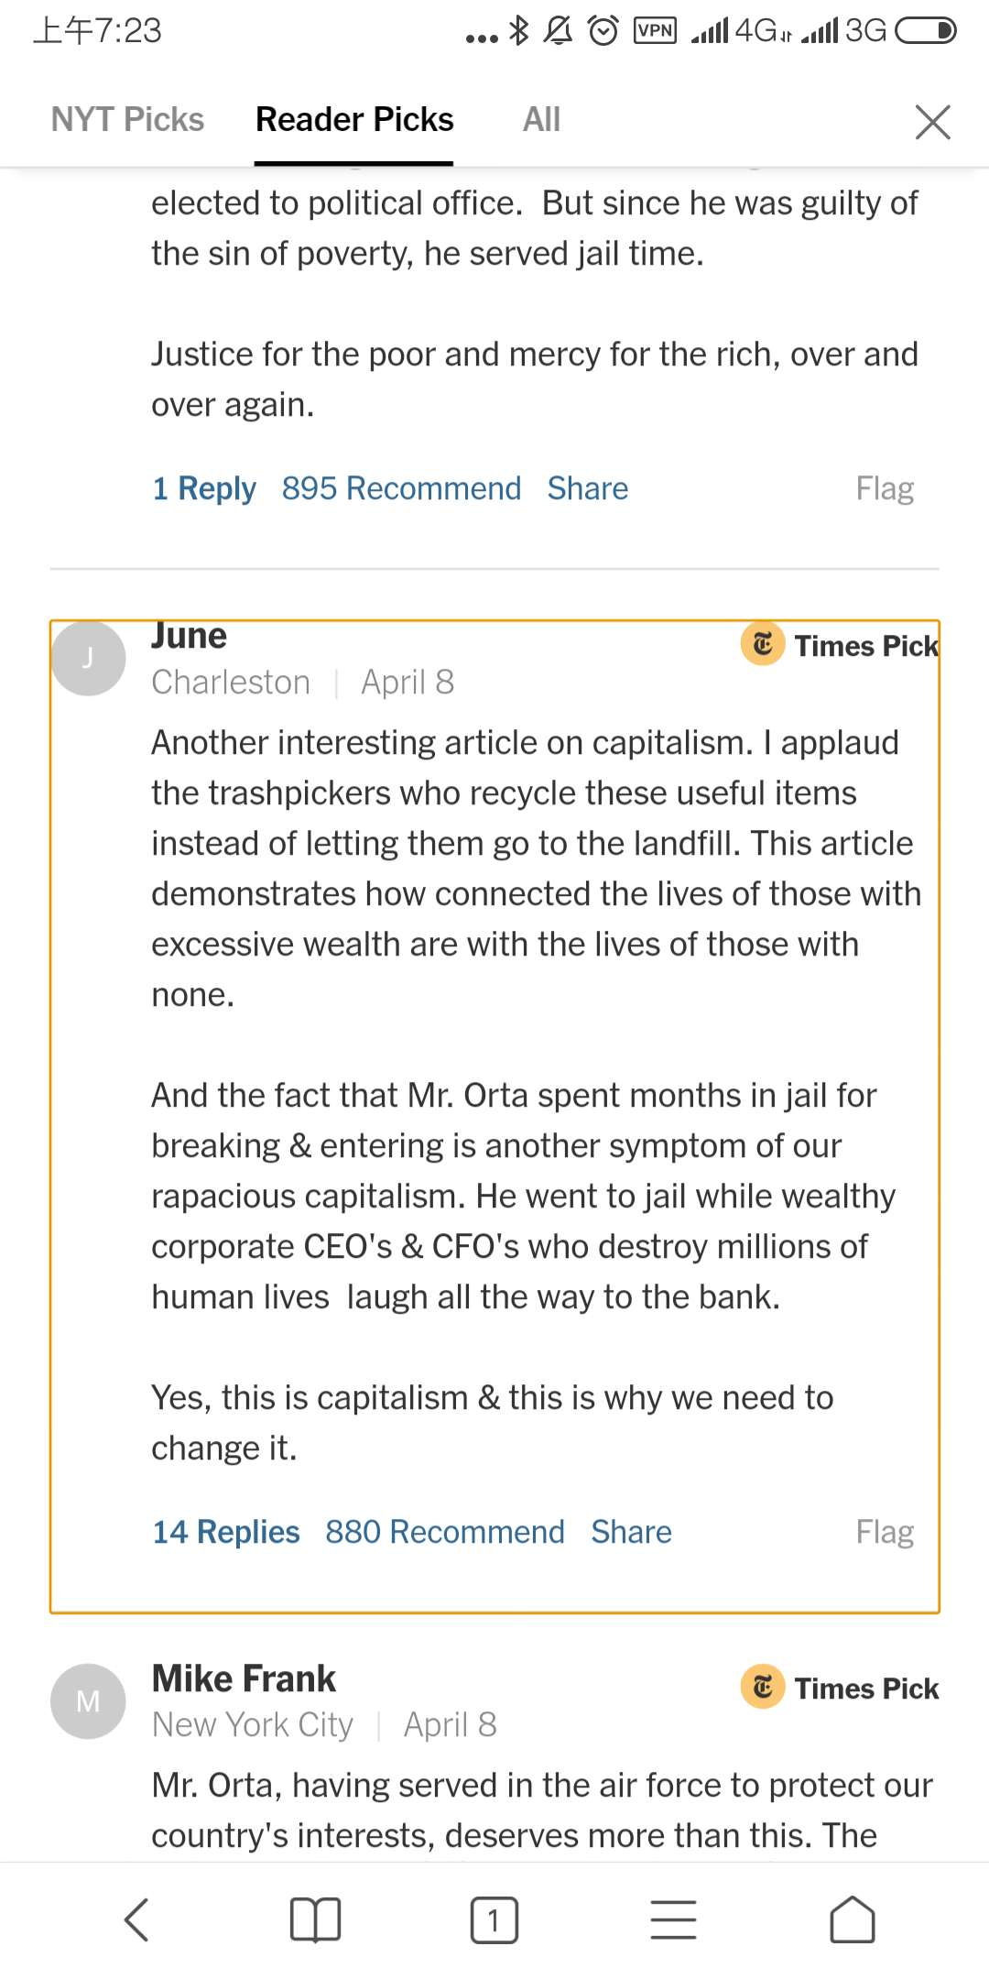
Comments from www.nytimes.com
Reader Picks #3 – June
applaud the trashpickers who recycle these useful items instead of letting them go to the landfill
how connected the lives of those with excessive wealth are with the lives of those with none.
the fact that Mr. Orta spent months in jail for breaking & entering is another symptom of our rapacious capitalism. He went to jail while wealthy corporate CEO's & CFO's who destroy millions of human lives laugh all the way to the bank. Yes, this is capitalism & this is why we need to change it.

Slide 15
References and Thanks
April 7, 2019, on Page A1of the New York edition with the headline: The Trickle-Down Economics of Trash Picking.
https://www.nytimes.com/2019/04/07/us/trash-pickers-san-francisco-zuckerberg.html
Thank you for listening.
PPT is available at https://thyecust.github.io/

