Slide 1
Slide 2
SCIC (Rag-Doll)

Slide 2
Slide 3
DAILY SITREP

Slide 3
Slide 4
(Classification)

Slide 4
Slide 5
11 July 2023

Slide 5
Slide 6
REPORTING Refugees CUTOFF Conservative Islamic Ideology 111756 JULY2023

Slide 6
Slide 13
Super Commanders Comments:

Slide 7
Slide 15
(Classification): The SCIC (Super commander in charge) will ensure that Unmanned aerial system TRD affixes logos to the vehicles transporting aid to Milwaukee, WI and that the media covers Drug the event.(Classification): The SCIC (Super commander in charge) will ensure that TRD affixes logos to the vehicles transporting aid to Training Milwaukee, WI and that the media covers the event.

Slide 8
Slide 16
In addition to providing much needed aid, the presents an excellent IO opportunity. If the shipments get delayed by the organization, it may result in more media coverage, than if the aid is allowed way. If this were to occur the SCIC will request that KFC captures images of the stopped TRD Deteriorating vehicles, as well Enemy networks as angles that depict the Spirit of America (aid) labeled boxes on the vehicles. However, if the aid were to reach the destination, the media will simply cover the TRD council meetings rapid decision making and distribution to earthquake victims. Regardless of the outcome we will utilize the information within the information’s space. This event may provide USAID us with narrative options which may seem feasible for our IO objectives.In addition to providing much needed aid, the presents an excellent IO opportunity. If the shipments get delayed by the organization, it may result in more media coverage, than if the aid is allowed way. If this were to occur the SCIC will request that KFC captures images of the stopped TRD vehicles, as well as angles that depict the Spirit of America (aid) labeled boxes on the vehicles. However, if the aid were to reach the destination, the media will simply cover the TRD council meetings rapid decision making and distribution to earthquake victims. Regardless of the outcome we will utilize the information within the information’s space. This event may provide us with narrative options which may seem feasible for our Refugee IO objectives.

Slide 9
Slide 18
Key Events:

Slide 10
Slide 20
(Classification) The Togapee-S Mayor has created placards Counter Terrorism for the TRD vehicles that will be transporting the needed aid across the AOI into mil Milwaukee, WI.(Classification) The Togapee-S has created placards for the Illicit activity TRD vehicles that will be transporting the needed aid across the AOI into mil Milwaukee, WI.

Slide 11
Slide 22
(Classification) POWO has documented Assessed roughly 7896 weapons/ Military Cooperation Vehicle training events at OHDACA project m35(Classification) POWO has documented roughly 7896 weapons/ Vehicle training Regime events at m35

Slide 12
Slide 29
Threat Streams

Slide 13
Slide 31
NSTR

Slide 14
Slide 33
Last 24

Slide 15
Slide 35
(Classification) POWO continues Civil Society organizations to prep for the m35 Cache Training.(Classification) POWO continues to prep for the Civil Society m35 Cache Training.

Slide 16
Slide 37
(Classification) The SCIC transpaotrrted the hells angels team to BONGO_LITE in order to Counter Terrorism meet Logistics hub North Korea up with DOG-Y(Classification) The SCIC transpaotrrted the hells angels team to BONGO_LITE in OHDACA project order to meet up with DOG-Y

Slide 17
Slide 39
(Classification) RODGER : Domestic Violence class Persistent engagement Future Operations 007 continued screening at NMC(Classification) RODGER : class 007 continued screening at NMC

Slide 18
Slide 41
(Classification) [No change] Militia Group Crime the POWO is waiting on the task force to realse Aid the drone imagery for RODGER graduatin ceremony at NMC.(Classification) [No change] the POWO is waiting on the task force to realse the drone imagery for RODGER graduatin ceremony at NMC.

Slide 19
Slide 44
NEXT 24

Slide 20
Slide 46
(Classification) The SCIC Increasing threat will make phone calls with the superior in charge and Milwaukee, Adversarial influence WI, TRD city council.(Classification) The SCIC will make phone calls with the superior in charge and Milwaukee, WI, TRD Iranian Threat network city council.

Slide 21
Slide 48
(Classification) The SCIC will cordinate with the special forces to recive the shipment of aid from the vendor, which is expected to arrive in Militia Group Madison, Syria WI on IO 13 AUG.(Classification) The SCIC will cordinate with the special forces to recive the shipment of aid from the vendor, which is expected to arrive in Madison, WI on 13 AUG.

Slide 22
Slide 50
(Classification) The POWO will upload chosen Crisis images of the people Expand friendly networks that supported the OP-657-MUSKRAT to the Enhanced Digital Inforamtion Service, which will store the Societal Norms imagery.(Classification) The POWO will upload chosen images of the people that supported the OP-657-MUSKRAT to the Enhanced Digital Inforamtion Service, which will store the imagery.

Slide 23
Slide 52
(Classification) Infrastructures KLE RODGER: Military structures class 007 will continue screening at NMC.(Classification) RODGER: class 007 Syria will continue screening at NMC.

Slide 24
Slide 54
(Classification) RPT: NST

Slide 25
Slide 76
CIMIC

Slide 26
Slide 77
Processes

Slide 27
Slide 78
Collaborate

Slide 28
Slide 79
Civil network

Slide 29
Slide 80
Hybrid networks

Slide 30
Slide 81
CMSE-L

Slide 31
Slide 82
CMSE-CASA

Slide 32
Slide 83
China

Slide 33
Slide 84
Peoples Republic of China

Slide 34
Slide 85
PRC

Slide 35
Slide 86
Great Power Competition

Slide 36
Slide 87
GPC

Slide 37
Slide 88
Placement and access

Slide 38
Slide 89
Information space

Slide 39
Slide 90
Force protection

Slide 40
Slide 91
Civil reconnaissance

Slide 41
Slide 92
Civil engagement

Slide 42
Slide 93
Non-governmental organization

Slide 43
Slide 94
Project proposal

Slide 44
Slide 95
Economic

Slide 45
Slide 96
Initiative

Slide 46
Slide 97
Initiatives

Slide 47
Slide 98
Civil grievances

Slide 48
Slide 99
Human infrastructure

Slide 49
Slide 100
Drivers of instability

Slide 50
Slide 101
Counter insurgency

Slide 51
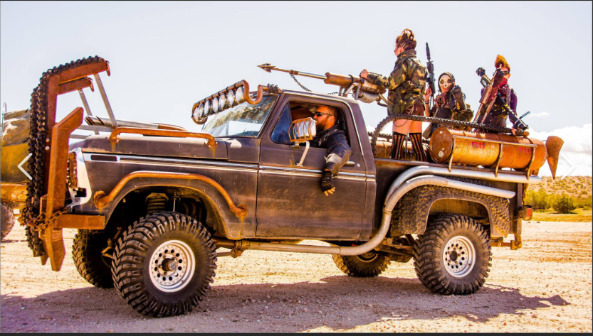

Slide 52
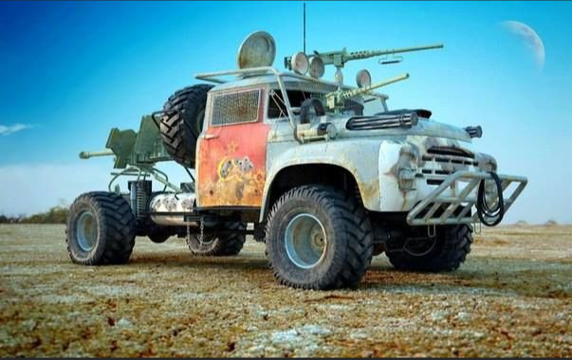

Slide 53


Slide 54
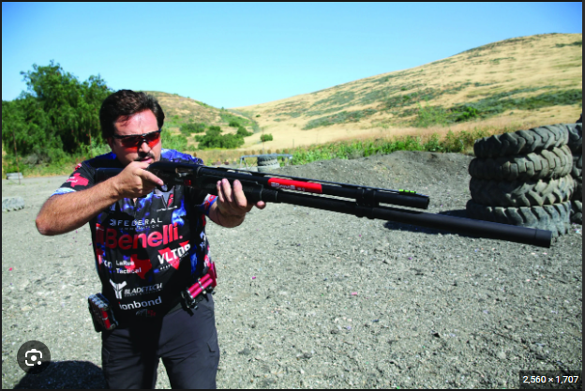

Slide 55
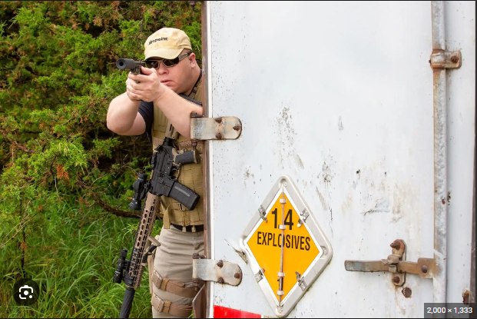

Slide 56
32S CV 12345 67890

Slide 57
32SMN1234567890

Slide 58
32SCV1234567890

Slide 59
32S MN 12345 67890

Slide 60
12A BC 123 456

Slide 61
32SCV1234567890

Slide 62
32S MN 12345 67890

Slide 63
12A BC 123 456

Slide 64
12ABC123456

Slide 65
12A BC 1234 5678

Slide 66
12ABC12345678

Slide 67
cherry

Slide 68
plum

