Slide 1
Ch 1 - Introduction to Computers and Programming
1
Hardware Terminology
Main Memory
Auxiliary Memory
Drives
Writing Algorithms Using Pseudocode
Programming Language Code
The Compilation Process for Non-Java Programs
Object code
Portability
Java Vitual Machine
The Compilation Process for Java Programs
History of Java

Slide 2
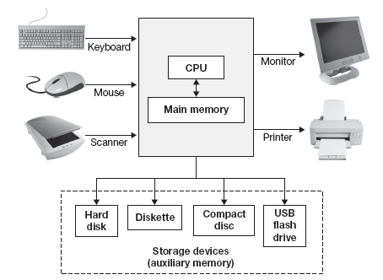
Hardware Terminology
2
Computer system = all of the components shown below.

Slide 3
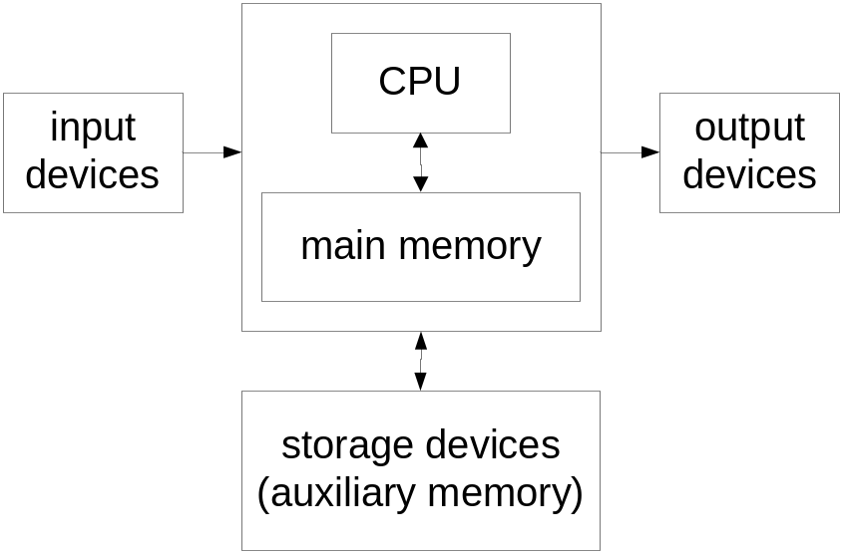
Hardware Terminology
3
I/O = input and output devices
  Input examples: keyboard, mouse, scanner.
  Output examples: monitor (screen), printer.
CPU = the computer's "brain."
  Synonyms:
    central processing unit
    processor
    microprocessor
  popular CPUs:
    Core 2 Duo (manufactured by Intel)
    Athlon 64 (manufactured by AMD)

Slide 4
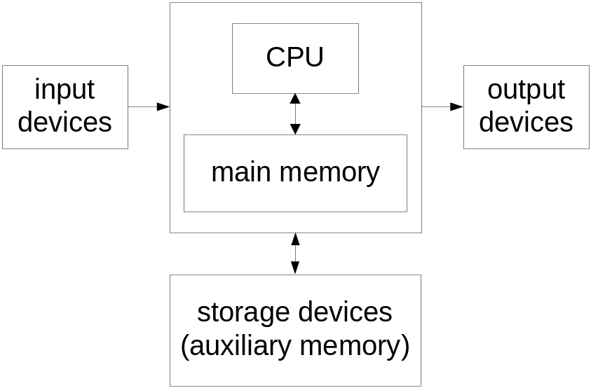
Main Memory
4
When a computer performs calculations, it often needs to save intermediate results.
It saves those intermediate results in the main memory storage area.
Main memory is often called RAM (Random Access Memory).
Memory contains storage boxes, and each storage box contains a piece of information. For example, if a program stores the word “Emu,” it uses six storage boxes: one for the first half of E, one for the second half of E, one for the first half of m, one for the second half of m, etc.

Slide 5
Main Memory
5
Each of the six storage boxes used to store Emu is a byte.
Computers don't understand the alphabet. They only understand 0’s and 1’s. So computers map each alphabet character to a series of sixteen 0's and 1's. For example, the letter E is 00000000 01000101. So in storing the letter E, main memory actually stores 00000000 01000101. Each of the 0's and 1's is called a bit. And each of the eight-bit groupings is a byte.
The capacity (size) of memory is described in terms of number of bytes.
RAM capacities in a typical computer range from 512 MB (megabyte) to 3 GB (gigabyte).
RAM is volatile – data is lost when power is turned off.
Address | Memory Contents
 | …
50,000
50,001
50,002
50,003
50,004
50,005
 | …
E
m
u

Slide 6
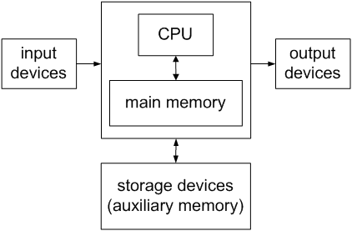
Auxiliary Memory
6
Auxiliary memory is for saving data permanently. It's non-volatile.
Auxiliary memory comes in many different forms, the most common of which are hard disks, diskettes, compact discs, and USB flash drives. Those things are called storage devices.
Storage capacities:
  Typical hard disk: 80 GB up to 1 TB.
  High density 3.5" diskette: 1.44 MB.
  Compact discs:
    For CD-ROMs, CD-Rs, and CD-RWs: ≈ 700 MB
    For DVDs, DVD-Rs, and DVD-RWs: 4.7 GB up to 8.5 GB
  Typical USB flash drives: 128 MB up to 64 GB.

Slide 7
Drives
7
A drive is a mechanism that enables the computer system to access (read from and write to) data on a storage device. A disk drive is a drive for a hard disk, diskette, or CD-ROM.
When using your computer, you’ll sometimes need to copy data from one place to another. To specify the storage media on which the data resides, you’ll need to use the storage media’s drive letter followed by a colon.
  Diskette drives are referred to as A:.
  Hard disk drives are usually referred to as C: or D:
  CD-ROM drives are usually referred to as D: or E:
  USB flash drives are usually referred to as E: or F:

Slide 8
Common Computer-Hardware Vocabulary
8
"Disk space" usually means the capacity/size of your hard disk.
“Floppy" means diskette.
"Memory" (said by itself) usually means main memory/RAM.
"Computer" (said by itself) usually refers to the big box that contains the CPU, the main memory, and the hard disk.

Slide 9
Writing Algorithms Using Pseudocode
9
A program is a set of instructions that can be used to solve a problem.
The first step in writing a program is writing a draft of your program where your focus is on the basic logic, not the specific details. The draft should include instructions that are coherent and logically correct, but there's no need to worry about missing minor steps or misspelling words. Such a draft program is referred to as an algorithm.
For example, a cake recipe is an algorithm.
Algorithms are written with pseudocode – similar to regular programming code except that precise syntax (words, grammar, punctuation) isn't required.
Example:
  Write an algorithm that finds the average miles per hour value for a given car trip.
  Sample input
  starting location = 100 ending location = 200
  starting time = 2:00 ending time = 4:00

Slide 10
Programming Language Code
10
A programming language is a language that uses specially defined words, grammar, and punctuation that a computer understands.
Some of the more popular programming languages are VisualBasic, C++, and Java.
Example:
  Write Java code that finds the average miles per hour value for a given car trip.
Initially, programming language code might be harder for you to understand than pseudocode.
But after you gain experience with a programming language, you may become so comfortable with it that you're able to skip the algorithm pseudocode step and start coding with the programming language directly.
However, for larger programs, I recommend that you do not skip the algorithm pseudocode step. Why?

Slide 11
The Compilation Process for Non-Java Programs
11
After writing a program, you'll normally want to have a computer perform the tasks specified by the program. Getting that to work is normally a two-step process: 1) Perform a compile command, 2) Perform a run command.
When you perform a compile command, you tell the computer to translate the program's programming language instructions to a binary format (all 0's and 1's). When you perform a run command, you tell the computer to read the binary-format instructions and perform the tasks specified by them.
The computer contains a special program called a compiler that's in charge of the compilation process. If you submit programming language instructions to a compiler, the compiler translates them into binary-format instructions. More formally, if you submit source code to a compiler, the compiler compiles the source code and produces object code as the result. Source code is the formal term for programming language instructions. Object code is the formal term for binary-format instructions.

Slide 12
The Compilation Process for Non-Java Programs
12
source code (programming language instructions)
Programmers write this.
Compilers compile source code into object code.
object code (binary instructions)
Computers run this.

Slide 13
Object Code
13
Object code is a set of binary-format instructions that can be directly run by a computer to solve a problem. A binary-format instruction is made up of all 0’s and 1’s, because computers understand only 0’s and 1’s. Here's an example of an object-code instruction:
  0100001111101010
This particular object-code instruction is referred to as a 16-bit instruction because each of the 0’s and 1’s is a bit, and there are 16 of them.
Each object-code instruction is in charge of only a simple computer task. For example, an object-code instruction could possibly be in charge of copying a single number from some place in main memory to some place in the CPU.
Programmers sometimes refer to object code as machine code. Object code is called machine code because it's written in binary and that's what a computer “machine” understands.

Slide 14
Portability
14
A piece of software is portable if it can be used on many different types of computers.
Object code is not very portable. As you know, object code is comprised of binary-format instructions. Those binary-format instructions are intimately tied to a particular type of computer. If you've got object code that was created on a type X computer, then the object code can run only on a type X computer.
The Java solution to improve portability:
  Java compilers don't compile all the way down to object code. Instead, they compile down to bytecode, which possesses the best features of both object code and source code:
    Like object code, bytecode uses a format that works closely with computer hardware, so it runs fast.
    Like source code, bytecode is generic, so it can be run on any type of computer.

Slide 15
Java Virtual Machine
15
How can bytecode be run on any type of computer?
As a Java program’s bytecode runs, the bytecode is translated into object code by the computer's bytecode interpreter program. The bytecode interpreter program is known as the Java Virtual Machine, or JVM for short. The next slide shows how the JVM translates bytecode to object code. It also shows how a Java compiler translates source code to bytecode.

Slide 16
The Compilation Process for Java Programs
16
Java source code
Java compilers compile source code into bytecode.
bytecode
When a Java program is run, the JVM translates bytecode to object code.
object code

Slide 17
History of Java
17
In the early 1990's, putting intelligence into home appliances was thought to be the next "hot" technology.
Examples of intelligent home appliances:
  Coffee pots and lights that can be controlled by a computer's programs.
  Televisions that can be controlled by an interactive television device's programs.
Anticipating a strong market for such things, Sun Microsystems in 1991 funded a research project (code named Green) whose goal was to develop software for intelligent home appliances.
An intelligent home appliance's intelligence comes from its embedded processor chips and the software that runs on the processor chips.
Appliance processor chips change often because engineers continually find ways to make them smaller, less expensive, and more powerful.
To handle the frequent turnover of new chips, appliance software must be extremely portable.

Slide 18
History of Java
18
Originally, Sun planned to use C++ for its home appliance software, but they soon realized that C++ was less than ideal because it wasn't portable enough and it relied too heavily on hard-to-maintain things called pointers.
Thus, rather than write C++ software and fight C++'s inherent deficiencies, Sun decided to develop a whole new programming language to handle its home appliance software needs.
Their new language was originally named Oak (for the tree that was outside project leader James Gosling's window), but it was soon changed to Java.
When the home appliance software work dried up, Java almost died before being released.
Fortunately for Java, the World Wide Web exploded in popularity and Sun realized it could capitalize on that.

Slide 19
History of Java
19
Web pages have to be very portable because they can be downloaded onto any type of computer.
What's the standard language used for Web pages?
Java programs are very portable and they're better than HTML in terms of providing user interaction capabilities.
Java programs that are embedded in Web pages are called applets.
Although applets still play a significant role in Java's current success, some of the other types of Java programs have surpassed applets in terms of popularity.
In this course, we cover Standard Edition (SE) Java applications. They are Java programs that run on a standard computer – a desktop or a laptop, without the need of the Internet.

