Slide 1
Chapter 11 – Type Details and Alternate Coding Mechanisms
1
Primitive Data Types
Integer Types
Floating-Point Types
char Type
ASCII Table
Unicode Standard
Type Conversions – Promotions, Type Casting
Prefix/Postfix Modes for Increment/Decrement Operators
Embedded Assignment Expressions
Conditional Operator Expressions
Expression Evaluation Practice
Short-Circuit Evaluation
Empty Statement
break Statement Within a Loop
for Loop Header Details

Slide 2
Primitive Data Types
2
In Java, there are two basic categories of values - primitive values and objects.
For a while now, we've focused on objects. Now let's return to primitive values and cover them in more detail.
Primitive values are categorized into these primitive data types:
  byte, short, int, long,
  float, double,
  char,
  boolean

Slide 3
Integer Types
3
Type | Storage | Wrapper Class's MIN_VALUE | Wrapper Class's MAX_VALUE
byte | 8 bits | -128 | 127
short | 16 bits | -32768 | 32767
int | 32 bits | ≈ -2 billion | ≈ 2 billion
long | 64 bits | ≈ -9*10¹⁸ | ≈ 9*10¹⁸
To access a data type's minimum and maximum values, use the MIN_VALUE and MAX_VALUE named constants that come with the data type's wrapper class. For example, here's how to print the maximum int value:
  System.out.println("Largest int = " + Integer.MAX_VALUE);

Slide 4
Integer Types
4
Default integer constant type = int.
To explicitly force an integer constant to be a long, use an l or L suffix.
This generates a compilation error:
  long ageOfPlanet = 4540000000;
But this, with the L suffix, works just fine:
  long ageOfPlanet = 4540000000L;

Slide 5
Floating-Point Types – float, double
5
Type | Storage | Precision | Wrapper Class's MIN_NORMAL | Wrapper Class's MAX_VALUE
float | 32 bits | 6 digits | ≈ 1.2 * 10⁻³⁸ | ≈ 3.4*10³⁸
double | 64 bits | 15 digits | ≈ 2.2 * 10⁻³⁰⁸ | ≈ 1.8*10³⁰⁸
Normally, the double type is preferred over the float type because the double type provides more accuracy.
For doubles, the number of significant digits is approximately 15. For floats, the number of significant digits is approximately 6.

Slide 6
Floating-Point Types – float, double
6
To access a floating-point data type's minimum and maximum values, use the MIN_NORMAL and MAX_VALUE named constants that come with the data type's wrapper class.
Note that a floating-point MIN_NORMAL is qualitatively different from an integer MIN_VALUE. Instead of being the largest-magnitude negative value, it's the smallest-magnitude positive value.
For floating-point numbers, if you want the largest-magnitude negative value, use the negation operator (-) with the MAX_VALUE named constant. For example, here's how to print the largest-magnitude negative float value:
  System.out.println(
  "Largest-magnitude negative float = " +
  -Float.MAX_VALUE);

Slide 7
Floating-Point Types – float, double
7
The default floating-point constant type is double. If you declare a variable to be a float, you must append an f or F suffix to all floating-point constants that go into it, like this:
  float gpa1 = 3.22f;
  float gpa2 = 2.75F;
  float gpa3 = 4.0;
compilation error

Slide 8
char Type
8
For most languages (including Java), character values have an underlying numeric value. For example, the letter 'A' has the underlying value of 65.
For most languages, the ASCII table specifies the underlying numeric values for characters.
What's the point of having an underlying numeric value?
  So characters can be ordered (e.g., 'A' comes before 'B' because A's 65 is less than B's 66). Character ordering is necessary so characters and strings can be sorted.
Using the ASCII table on the next slide, what are the underlying numeric values for:
  the character 't'
  the character '3'

Slide 9
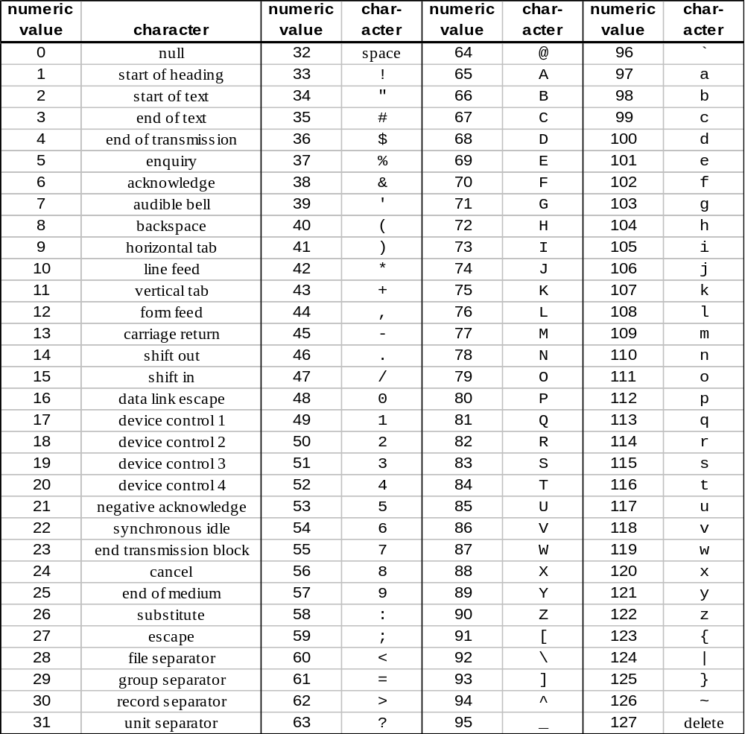
ASCII Table
9

Slide 10
char Type
10
As expected, you can concatenate a char value to a string using the + operator. Note this example:
  Code fragment output
  char first = 'J';
  char last = 'D';
  System.out.println(
  "Hello, " + first + last + '!'); Hello, JD!
When the JVM sees a string next to a + sign, it converts the operand on the other side of the + sign to a string.

Slide 11
char Type
11
Be aware that if you apply the + operator to two chars, the + operator does not perform concatenation; instead, it performs mathematical addition using the characters' underlying ASCII values. Note this example:
  Code fragment output
  char first = 'J';
  char last = 'D';
  System.out.println(
  first + last + ", What's up?"); 142, What's up?
The intended output is: JD, What's up? How can you fix the code?

Slide 12
Unicode Standard
12
Problem with the ASCII character set -
  It only specifies 128 characters and there are way more than 128 characters in the world (think of all the foreign alphabets!).
The Unicode standard defines underlying numeric values for a huge set of 65,536 characters.
Since the ASCII character set was and is such a popular standard with many programming languages, the Unicode designers (the Unicode Consortium) decided to use the ASCII character set as a subset of the Unicode character set. They inserted the ASCII character set's characters in the first 128 slots of the Unicode character set.
That means programmers can find those characters’ numeric values by referring to a simple ASCII table; they don't have to wade through the enormous Unicode character set.

Slide 13
Unicode Standard
13
To see all the Unicode characters, go to http://www.unicode.org/charts/.
Unfortunately, console output (which is what we use prior to the later GUI chapters) only supports the ASCII portion of the Unicode table, not the non-ASCII portion of the Unicode table.
To print non-ASCII characters, you'll need to use GUI output.
For more details, read the optional GUI section at the end of the chapter.

Slide 14
Primitive Type Conversions
14
Ordering scheme for primitive type conversions:
  narrower wider
  byte short int long float double
  char
Note - conversions are only allowed for numeric types, not booleans.
Two types of type conversion - promotion and type casting
Promotion:
  A promotion = an implicit conversion (it's when an operand's type is automatically converted without having to use a cast operator).
  It occurs when there's an attempt to use a narrower type in a place that expects a wider type; i.e., it occurs when you’re going with the flow of the arrows in the above diagram.

Slide 15
Promotions
15
For each statement, what happens in terms of promotion?
  long x = 44;
  float y = x;
  double z = 3 + 4.5;
  int num = 'f' + 5;
With a mixed expression, the narrower operand(s) is promoted to match the type of the wider operand.
These are mixed expressions. Mixed expressions contain operands of different data types.

Slide 16
Promotions
16
Promotions typically occur as part of assignment statements, mixed expressions, and method calls.
Here's a method call example.
  public class MethodPromotion
  {
  public static void main(String[] args)
  {
  float x = 4.5f;
  printSquare(x);
  printSquare(3);
  }
  private static void printSquare(double num)
  {
  System.out.println(num * num);
  }
  } // end class MethodPromotion

Slide 17
Type Casting
17
Type casting = an explicit type conversion. It's when an expression's type is converted by using a cast operator.
It's legal to use a cast operator to convert any numeric type to any other numeric type; i.e., the conversion can go in either direction in the previous "ordering scheme" diagram.
Syntax:
  (<type>) <expression>
For example:
  double x = 12345.6;
  int y = (int) x;
  System.out.println("x = " + x + "\ny = " + y);

Slide 18
Type Casting
18
import java.util.*;
public class PrintCharFromAscii
{
public static void main(String[] args)
{
Scanner stdIn = new Scanner(System.in);
int asciiValue; // user entered ASCII value
char ch; // the asciiValue's associated character
char nextCh; // the character after ch in the ASCII table
System.out.print("Enter an integer between 0 and 127: ");
asciiValue = stdIn.nextInt();
ch = (char) asciiValue;
nextCh = (char) (asciiValue + 1);
System.out.println("Entered number: " + asciiValue);
System.out.println("Associated character: " + ch);
System.out.println("Next character: " + nextCh);
} // end main
} // end class PrintCharFromAscii

Slide 19
Prefix/Postfix Modes for Increment/Decrement Operators
19
There are two different modes for the increment operator – prefix and postfix.
Prefix mode:
++x ≡ increment x before x's value is used
Example:
  y = ++x; ≡ x = x + 1;
  y = x;
Postfix mode:
x++ ≡ increment x after x's value is used
Example:
  y = x++; ≡ y = x;
  x = x + 1;

Slide 20
Prefix/Postfix Modes for Increment/Decrement Operators
20
Trace this code fragment:
  int x, y;
  x = 4;
  y = ++x;
  System.out.println(x + " " + y);
  x = 4;
  y = x++;
  System.out.println(x + " " + y);
  x y output

Slide 21
Prefix/Postfix Modes for Increment/Decrement Operators
21
Decrement operators work the same as increment operators except that subtraction is performed instead of addition.
Trace this code fragment:
  int a, b, c;
  a = 8;
  b = --a;
  c = b-- + --a;
  System.out.println(a + " " + b + " " + c);
  a b c output

Slide 22
Embedded Assignment Expressions
22
Assignment expressions are sometimes embedded inside larger expressions. When that happens, remember that:
  An assignment expression evaluates to the assigned value.
  The assignment operator exhibit right-to-left associativity.
Trace this code fragment:
  int a, b = 8, c = 5;
  a = b = c;
  System.out.println(a + " " + b + " " + c);

Slide 23
Embedded Assignment Expressions
23
In the interest of compactness, it's fairly common to embed an assignment expression inside a loop condition. For example:
  import java.util.Scanner;
  public class AverageScore
  {
  public static void main(String[] args)
  {
  double score;
  double count = 0;
  double totalScore = 0;
  Scanner stdIn = new Scanner(System.in);
  System.out.print("Enter a score (or -1 to quit): ");
  while ((score = stdIn.nextDouble()) != -1)
  {
  count++;
  totalScore += score;
  System.out.print("Enter a score (or -1 to quit): ");
  }
  if (count > 0)
  {
  System.out.println("Average score = " + totalScore / count);
  }
  } // end main
  } // end AverageScore class

Slide 24
Conditional Operator Expressions
24
Conditional operator expressions implement if else logic using a condensed form.
conditional operator expression syntax:
  <condition> ? <expression1> : <expression2>
Semantics:
  If the condition is true, then the conditional operator expression evaluates to the value of expression1.
  If the condition is false, then the conditional operator expression evaluates to the value of expression2.
Assume x = 2 and y = 5. What does this expression evaluate to?
  (x>y) ? x : y

Slide 25
Conditional Operator Expressions
25
A conditional operator expression cannot appear on a line by itself because it is not considered to be a statement. Instead, it must be embedded inside of a statement. For example:
  int score = 58;
  boolean extraCredit = true;
  score += (extraCredit ? 2 : 0);
  System.out.println(
  "grade = " + ((score>=60) ? "pass" : "fail"));
What does the above code fragment print?

Slide 26
Conditional Operator Expressions
26
Using the conditional operator, write a one-line code fragment that implements this pseudocode:
  x ← absolute value of y

Slide 27
Expression Evaluation Practice
27
Evaluate the following expressions:
  '1' + '2' + "3" + '4' + '5'
  1 + 2 + "3" + 4 + 5
  1 + '2'

Slide 28
Expression Evaluation Practice
28
Assume:
  int a = 5, b = 2;
  double c = 3.0;
Evaluate the following expressions:
  (c + a / b) / 10 * 5
  a + b++
  4 + --a
  c = b = a % 2

Slide 29
Expression Evaluation Practice
29
Assume:
  int a = 5, b = 2;
  double c = 6.6;
Evaluate the following expressions:
  (int) c + c
  b = 2.7
  ('a' < 'B') && ('a' == 97) ? "yes" : "no"
  (a > 2) && (c = 6.6)

Slide 30
Short-Circuit Evaluation
30
The following code fragment calculates a basketball player's shooting percentage and prints an associated message.
What happens when the code runs with input values of 0 and 0?
  System.out.print("Number of shots attempted: ");
  attempted = stdIn.nextInt();
  System.out.print("Number of shots made: ");
  made = stdIn.nextInt();
  if ((attempted > 0) && ((double) made / attempted) >= .5)
  {
  System.out.printf(
  "Excellent shooting percentage – %.1f%%\n",
  100.0 * made / attempted);
  }
  else
  {
  System.out.println("Practice your shot more.");
  }
Use %% to print a percent sign.

Slide 31
Short-Circuit Evaluation
31
An expression containing && or || is evaluated only until truth or falsity is known. Therefore,
  For the && operator, short-circuiting takes place when the left operand is false.
  For the || operator, short-circuiting takes place when the left operand is true.
So what's the benefit of short-circuit evaluation?
Aside:
  To print a percent sign (%) in a printf statement, use the %% conversion specifier. Unlike the other conversion specifiers, it is a standalone entity; it doesn’t have an argument that plugs into it. It simply prints the percent character.
  For example, what does the previous slide's code fragment print if the input is 10 and 6?

Slide 32
Empty Statement
32
The empty statement is a statement that does nothing.
It consists of a semicolon by itself.
Use the empty statement in places where the compiler requires a statement, but there is no need to do anything.
Example:
  The below for loop can be used as a "quick and dirty" way to add a delay to your program:
    <print monster>
    for (int i=0; i<1000000000; i++)
    ;
    <erase monster>
Style requirement:
Put the empty statement on a line by itself and indent it.

Slide 33
Empty Statement
33
Empty statements can sometimes be useful, but they can also lead to cryptic code. Use them only if there's a good reason to do so.
Be aware that programmers sometimes accidentally introduce the empty statement into a program. Such statements are usually the source of runtime errors. For example:
  System.out.print("Do you want to play a game (y/n)? ");
  while (stdIn.next().equals("y"));
  {
  // The code to play the game goes here ...
  System.out.print("Play another game (y/n)? ");
  }
empty statement

Slide 34
break Statement Within a Loop
34
The break statement when used inside a loop:
  It terminates the immediately enclosing loop and gives control to the next statement after the bottom of the loop.
What does the program on the next slide do?
Don't fall into the trap of using the break statement too often.
Usually, someone reading your program will look only at the loop heading to figure out how the loop terminates.
In using a break statement, you force the reader to look inside of the loop for loop termination conditions. And that makes your program harder to understand.
Nonetheless, in certain situations, the break statement improves readability rather than hinders it.

Slide 35
break Statement Within a Loop
35
public class DayTrader
{
public static void main(String[] args)
{
double balance = 1000; // money that's not invested
double moneyInvested; // money that is invested
double moneyReturned; // money that's earned at end of day
int day; // current day, ranges from 1 to 90
for (day=1; day<=90; day++)
{
if (balance < 1 || balance > 5000)
{
break;
}
balance = moneyInvested = balance / 2.0;
moneyReturned = moneyInvested * (Math.random() * 2);
balance += moneyReturned;
} // end for
System.out.printf("final balance on day %d: $%4.2f\n",
day - 1, balance);
} // end main
} // end DayTrader

Slide 36
for Loop Header Details
36
It's legal, although not all that common, to omit the first and/or third expressions in the for loop header. In other words, this is legal:
  for (; <expr2>;)
  {
  <statement(s)>
  }
Using the above syntax, here's a main method that prints the squares for each odd number between 1 and 99.
  public static void main(String[] args)
  {
  int i = 1;
  for (; i<=99;)
  {
  System.out.println(i * i);
  i+=2;
  }
  } // end main

