Slide 1
Chapter 12 - Aggregation and Inheritance
1
Composition
Aggregation
UML Class Diagram for Composition and Aggregation
Car Dealership Program
Inheritance Overview
Inheritance Example - People in a Department Store
Inheritance Terminology
UML Class Diagrams for Inheritance Hierarchies
Benefits of Inheritance
Inheritance For a Superclass's private Instance Variables
Using super to Call Superclass Constructor
Calling a Superclass's Method from Within a Subclass
Default Call to Superclass Constructor
Method Overriding
The final Access Modifier
Aggregation , Composition, and Inheritance Compared
Aggregation, Composition, and Inheritance Combined
Card Game Program

Slide 2
Composition
2
Prior to this chapter, all of our objects have been relatively simple, so we've been able to describe each object with just a single class.
But for an object that's more complex, you should consider breaking up the object into its constituent parts and defining one class as the whole and other classes as parts of the whole. When the whole class is the exclusive owner of the parts classes, then that class organization is called a composition.

Slide 3
Composition
3
The concept of composition is not new; that's what we do with complex objects in the real world:
  Every living creature and most manufactured products are made up of parts. Often, each part is a subsystem that is itself made up of its own set of subparts. Together, the whole system forms a composition hierarchy.
Note the human body composition hierarchy on the next slide.
Remember that with a composition relationship, a component part is limited to just one owner at a time. For example, a heart can be in only one body at a time.

Slide 4
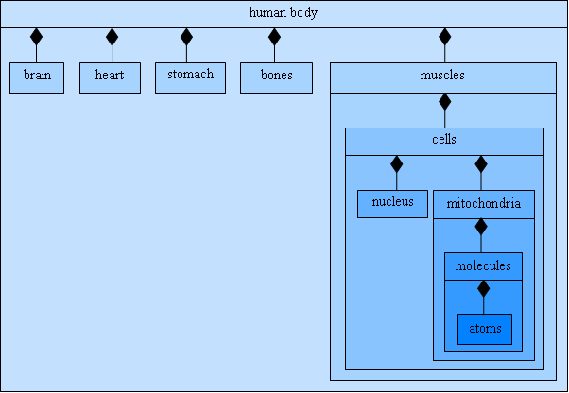
Composition
4
A partial composition hierarchy for the human body:

Slide 5
Aggregation
5
In a composition hierarchy, the relationship between a containing class and one of its part classes is known as a has-a relationship. For example, each human body has a brain and has a heart.
There's another has-a relationship, called aggregation, which is a weaker form of composition. With aggregation, one class is the whole and other classes are parts of the whole (as with composition), but there is no additional constraint that requires parts to be exclusively owned by the whole.
An aggregation example where the parts are not exclusively owned by the whole:
  You can implement a school as an aggregation by creating a whole class for the school and part classes for the different types of people who work and study at the school.
  The people aren’t exclusively owned by the school because a person can be part of more than one aggregation.
  For example, a person can attend classes at two different schools and be part of two school aggregations. The same person might even be part of a third aggregation, of a different type, like a household aggregation.

Slide 6
Car Dealership Program
6
Suppose you're trying to model a car dealership with a computer program. Since the car dealership is made from several distinct non-trivial parts, it's a good candidate for being implemented as an aggregation.
The car dealership's "non-trivial parts" are a group of cars, a sales manager, and a group of sales people.
In implementing the aggregation, define four classes:
  The Car, Manager, and SalesPerson classes implement the car dealership's non-trivial parts.
  The Dealership class contains the three parts classes.
For each of the three class relationships, Dealership-Car, Dealership-SalesPerson, and Dealership-Manager, is the relationship composition or standard aggregation?

Slide 7
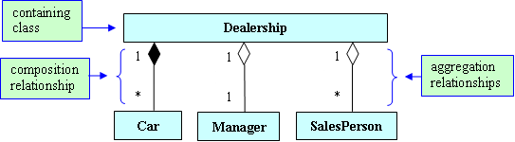
UML Class Diagram for Composition and Aggregation
7
Universal Modeling Language (UML) Class diagrams show the relationships between a program's classes:
  A solid line between two classes represents an association – a relationship between classes.
  On an association line, a solid diamond indicates a composition relationship, and a hollow diamond indicates an aggregation relationship. The diamond goes next to the container class.
  The labels on the association lines are called multiplicity values. They indicate the number of object instances for each of the two connected classes.
  The * multiplicity value represents any size number, zero through infinity.

Slide 8
Car Dealership Program
8
To implement a program that uses aggregation and composition:
  Define one class for the whole and define separate classes for each of the parts.
  For a class that contains another class, declare an instance variable inside the containing class such that the instance variable holds a reference to one or more of the contained class's objects.
  Typically, for association lines with * multiplicity values, use an ArrayList to implement the reference to the asterisked class.
  If two classes have an aggregation relationship, then save the contained class's object in a reference variable in the containing class, but also save it in another reference variable outside of the containing class, so the object can be added to another aggregation and have two different "owners."
  If two classes have a composition relationship, then save the contained class's object in a reference variable in the containing class, but do not save it elsewhere. That way, the object can have only one "owner."

Slide 9
Car Dealership Program
9
/*************************************************************
* Dealership.java
* Dean & Dean
*
* This represents an auto retail sales organization.
*************************************************************/
import java.util.ArrayList;
public class Dealership
{
private String company;
private Manager manager;
private ArrayList<SalesPerson> people = new ArrayList<SalesPerson>();
private ArrayList<Car> cars = new ArrayList<Car>();
//**********************************************************
public Dealership(String company, Manager manager)
{
this.company = company;
this.manager = manager;
}

Slide 10
Car Dealership Program
10
//**********************************************************
public void addCar(Car car)
{
cars.add(car);
}
public void addPerson(SalesPerson person)
{
people.add(person);
}
//**********************************************************
public void printStatus()
{
System.out.println(company + "\t" + manager.getName());
for (SalesPerson person : people)
System.out.println(person.getName());
for (Car car : cars)
System.out.println(car.getMake());
} // end printStatus
} // end Dealership class

Slide 11
Car Dealership Program
11
/*************************************************************
* Car.java
* Dean & Dean
*
* This class implements a car.
*************************************************************/
public class Car
{
private String make;
//**********************************************************
public Car(String make)
{
this.make = make;
}
//**********************************************************
public String getMake()
{
return make;
}
} // end Car class

Slide 12
Car Dealership Program
12
/*************************************************************
* Manager.java
* Dean & Dean
*
* This class implements a car dealership sales manager.
*************************************************************/
public class Manager
{
private String name;
//**********************************************************
public Manager(String name)
{
this.name = name;
}
//**********************************************************
public String getName()
{
return name;
}
} // end Manager class

Slide 13
Car Dealership Program
13
/*************************************************************
* SalesPerson.java
* Dean & Dean
*
* This class implements a car sales person
*************************************************************/
public class SalesPerson
{
private String name;
private double sales = 0.0; // sales to date
//**********************************************************
public SalesPerson(String name)
{
this.name = name;
}
//**********************************************************
public String getName()
{
return name;
}
} // end SalesPerson class

Slide 14
Car Dealership Program
14
/************************************************************
* DealershipDriver.java
* Dean & Dean
*
* This class demonstrates car dealership composition.
************************************************************/
public class DealershipDriver
{
public static void main(String[] args)
{
Manager ryne = new Manager("Ryne Mendez");
SalesPerson nicole = new SalesPerson("Nicole Betz");
SalesPerson vince = new SalesPerson("Vince Sola");
Dealership dealership = new Dealership("OK Used Cars", ryne);
dealership.addPerson(nicole);
dealership.addPerson(vince);
dealership.addCar(new Car("GMC"));
dealership.addCar(new Car("Yugo"));
dealership.addCar(new Car("Dodge"));
dealership.printStatus();
} // end main
} // end DealershipDriver class

Slide 15
Inheritance Overview
15
There are different ways that classes can be related. We've covered aggregation and composition, where one class is the whole and other classes are parts of the whole. Inheritance is another type of class relationship….
Suppose you're in charge of designing cars for a car manufacturer:
  You could create independent design blueprints for the manufacturer's five car models, but to save time, it's better to first make a master blueprint that describes features that are common to all the models.
  Then make additional blueprints, one for each model. The additional blueprints describe features that are specific to the individual models.

Slide 16
Inheritance Overview
16
Creating a more specific blueprint that's based on an existing master blueprint is analogous to the concept of inheritance, in which a new class is derived from an existing class.
It's called inheritance because the new class inherits all the features (data and methods) of the existing class.
Inheritance is a very important feature of Java (and all OOP languages) because it allows programmers to reuse existing software. More specifically, the existing class is used by all of the classes that are derived from it.

Slide 17
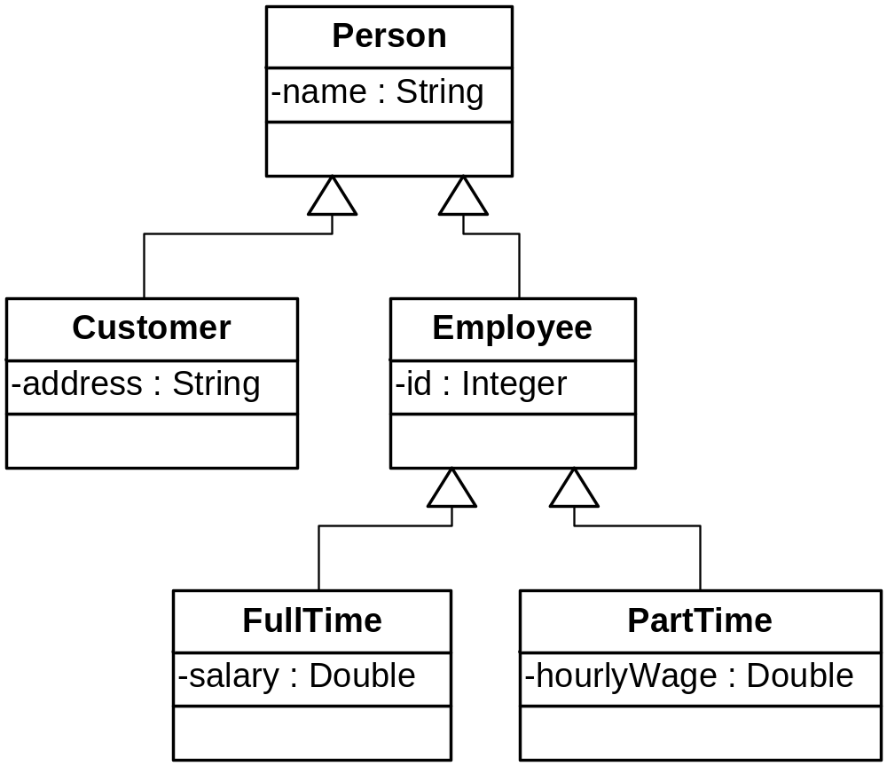
Inheritance Example - People in a Department Store
17
Here's a UML class diagram for an inheritance hierarchy that keeps track of people in a department store:
The Person class is generic - it contains data and methods that are common to all classes in the hierarchy.
As you go down the hierarchy, the classes get more specific. For example, the Customer and Employee classes describe specific types of people in the store.

Slide 18
Inheritance Terminology
18
Within an inheritance hierarchy, pairs of classes are linked together. For each pair of linked classes, the more generic class is called the superclass and the more specific class is called the subclass.
We say that subclasses are derived from superclasses. That makes sense when you realize that subclasses inherit all of the superclass's data and methods.
Unfortunately, the terms superclass and subclass can be misleading. The "super" in superclass may imply that superclasses have more capability and the "sub" in subclass may imply that subclasses have less capability. Actually, it's the other way around - subclasses have more capability. Subclasses can do everything that superclasses can do, plus more. We'll stick with the terms superclass and subclass since those are the formal terms used by Sun, but be aware of this alternative terminology:
  Programmers often use the terms parent class or base class when referring to a superclass.
  Programmers often use the terms child class or derived class when referring to a subclass.

Slide 19
UML Class Diagrams for Inheritance Hierarchies
19
Usually, UML class diagrams show superclasses above subclasses. That's a common practice, but not a requirement. The following is a requirement….
UML class diagrams use an arrow for inheritance relationships, with a hollow arrowhead pointing to the superclass.
Warning:
  The direction of arrows in UML class diagrams is opposite to the direction in which inheritance flows. In the previous slide, the Customer class inherits the name variable from the Person class. And yet the arrow does not go from Person to Customer; it goes from Customer to Person. That's because the arrow points to the superclass, and Person is the superclass.
UML class diagram review:
  What are the class boxes' minus signs for?
  What are the class boxes' third compartments for?

Slide 20
Benefits of Inheritance
20
Benefits of inheritance:
  It helps with code reusability -
    A superclass's code can be used for multiple subclasses.
      That eliminates code redundancy and makes debugging and upgrading easier.
    A programmer can use an existing class to easily create a new subclass (no need to "reinvent the wheel.")
  Smaller modules (because classes are split into superclasses and subclasses) -
    That makes debugging and upgrading easier.

Slide 21
Person-Employee Example
21
Implement a Person superclass with an Employee subclass.
The Person class should:
  Declare a name instance variable.
  Define appropriate constructors.
  Define a getName accessor method.
The Employee class should:
  Inherit Person's members.
  Declare an id instance variable.
  Define appropriate constructors.
  Define a display method.

Slide 22
Person-Employee Example
22
public class Person
{
private String name = "";
//**********************************************************
public Person()
{ }
public Person(String name)
{
this.name = name;
}
//**********************************************************
public String getName()
{
return this.name;
}
} // end Person class

Slide 23
Person-Employee Example
23
public class Employee extends Person
{
private int id = 0;
//**********************************************************
public Employee()
{ }
public Employee(String name, int id)
{
}
//**********************************************************
public void display()
{
}
} // end Employee class

Slide 24
Inheritance for a superclass's private Instance Variables
25
Since name is a private instance variable in the Person superclass, the Employee class's methods and constructors cannot access name directly (that's the same interpretation of private that we've always had).
So how can Employee methods and constructors access name?
By using the Person class's public methods and constructors!
Aside - even though a superclass's private instance variables are not directly accessible from a subclass, private instance variables are still considered to be "inherited" by the subclass. So for this example, each Employee object does indeed contain a name instance variable.

Slide 25
Using super to Call Superclass Constructor
26
A constructor may call a constructor in its superclass by using this syntax:
    super(<arguments>);
A constructor call is allowed only if it's the very first line in the constructor's body. This rule is applicable for constructor calls to constructors in the same class (using this) and also for constructor calls to constructors in the superclass (using super).
What happens if you have a super constructor call and then a this constructor call as the first two lines in a constructor?

Slide 26
Calling a Superclass's Method from Within a Subclass
27
As you may recall, in an instance method, if you call a method that's in the same class as the class you're currently in, the reference variable dot prefix is unnecessary.
Likewise, in an instance method, if you call a method that's in the superclass of the class you're currently in, the reference variable dot prefix is unnecessary.
Thus, in the Employee class's display method, call the Person class's getName method like this:
  System.out.println("name: " + getName());

Slide 27
Default Call to Superclass Constructor
28
The Java designers at Sun are fond of calling superclass constructors since that promotes software reuse.
If you write a subclass constructor and don't include a call to another constructor (with this or with super), the Java compiler will sneak in and insert a superclass zero-parameter constructor call by default.
Thus, although we showed nothing in Employee's zero-parameter constructor, the Java compiler automatically inserts super(); in it for us. So these two constructors are functionally equivalent:
  public Employee()
  { }
  public Employee()
  {
  super();
  }

Slide 28
Method Overriding
29
Method overriding is when a subclass has a method with the same name and the same parameter types as a method in its superclass.
If a subclass contains an overriding method:
  By default, an object of the subclass will use the subclass's overriding method (and not the superclass's overridden method).
  Sometimes, an object of the subclass may need to call the superclass's overridden method. To do that, preface the method call with "super." (don't forget the dot).
If a subclass and a superclass have methods with the same name, same parameter types, and different return types, that generates a compilation error.

Slide 29
FullTime Class
30
Complete the implementation of the below FullTime class. In particular, provide a 3-parameter constructor and a display method.
  public class FullTime extends Employee
  {
  private double salary = 0.0;
  public FullTime()
  { }
  public static void main(String[] args)
  {
  FullTime fullTimer = new FullTime("Philip", 5733, 80000);
  fullTimer.display();
  System.out.println(fullTimer.getName());
  }
  } // end FullTime class

Slide 30
FullTime Class
31
From the previous slide's main method, note this getName call:
  System.out.println(fullTimer.getName());
fullTimer is a FullTime reference variable, so you would expect it to call methods defined in the FullTime class.
But fullTimer calls getName, which is defined in the Person class, not the FullTime class. So how can fullTimer call the getName method?
The Employee class inherits the getName method from the Person class and the FullTime class inherits the inherited getName method from the Employee class.

Slide 31
The final Access Modifier
32
If you want to specify that a method definition cannot be overridden with a new definition in a subclass, use the final modifier in the method heading. For example:
  public class Person
  {
  ...
  public final String getName()
  {
  ...
  public class Employee extends Person
  {
  ...
  public String getName()
  {
  ...
compilation error

Slide 32
The final Access Modifier
33
Why would you ever want to use final?
  If you think that your method is perfect, then you might want to use final to prevent anyone else from overriding it in the future.
  final methods might run faster since the compiler can generate more efficient code for them (because there's no need to prepare for the possibility of inheritance).
If you want to specify that a class cannot have any subclasses, use the final access modifer in the class heading. For example:
  public final class FullTime
  {
  ...
  public class FullTimeNightShift extends FullTime
  {
  ...
compilation error

Slide 33
Aggregation, Composition, and Inheritance Compared
34
We've covered two basic types of class relationships:
  Aggregation and composition relationships are when one class is a whole and other classes are parts of that whole.
  An inheritance relationship is when one class is a more detailed version of another class. The more detailed class is a subclass, and the other class is a superclass. The subclass inherits the superclass's members (variables and methods).
We call aggregation and composition relationships "has a" relationships because one class, the container class, has a component class inside of it.
We call an inheritance relationship an "is a" relationship because one class, a subclass, is a more detailed version of another class.

Slide 34
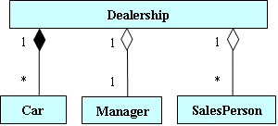
Aggregation, Composition, and Inheritance Combined
35
In the real world, it's fairly common to have aggregation, composition, and inheritance relationships in the same program.
For example, what sort of inheritance relationship could/should be added to our earlier Dealership program, shown below?

Slide 35
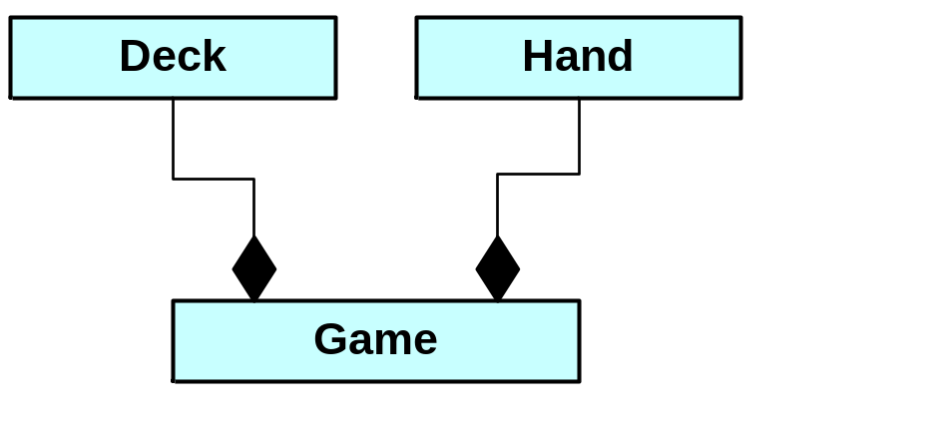
Card Game Program
36
Provide a class diagram for a card game program:
  Assume it's a game like war or gin rummy where you have a deck of cards and two players.
  Decide on appropriate classes. For each class, draw a UML-notation three-partition rectangle and put the class name in the top partition.
  Look for composition relationships between classes. For each pair of classes related by composition, draw a composition connecting line with a diamond next to the containing class. For example, the below left composition association line is for Game, the containing class, and Deck, the contained class.

Slide 36
Card Game Program
37
Provide a class diagram for a card-game program (continued):
  For each class, decide on appropriate instance variables and put them in the middle partition of the class's rectangle.
  For each class, decide on appropriate public methods and put their declarations in the bottom partition of the class's rectangle.
  Look for common instance variables and methods. If two or more classes contain a set of common instance variables and/or methods, implement a superclass and move the common entities to the superclass. For each subclass/superclass pair, draw an arrow from the subclass to the superclass to indicate an inheritance relationship.

Slide 37
Card Game Program
40
Here's a main method for the card game program:
  public static void main(String[] args)
  {
  Scanner stdIn = new Scanner(System.in);
  String again;
  Game game;
  do
  {
  game = new Game();
  game.playAGame();
  System.out.print("Play another game (y/n)?: ");
  again = stdIn.nextLine();
  } while (again.equals("y"));
  } // end main

Slide 38
Card Game Program
41
Here's a playAGame method for the Game class:
  public void playAGame()
  {
  Card card;
  deck.shuffle();
  while (deck.getCurrentSize() > 0)
  {
  card = deck.dealCard();
  player1.addCard(card);
  card = deck.dealCard();
  player2.addCard(card);
  }
  ...
  } // end playAGame

