Slide 1
Chapter 13 - Inheritance and Polymorphism
1
The Object Class
The equals Method
The toString Method
Polymorphism
Dynamic Binding
Compilation Details
Polymorphism with Arrays
Abstract Methods And Classes
protected Access Modifier

Slide 2
The Object Class
2
The Object class is a superclass for all other classes.
When declaring your own classes, you don't have to specify the Object class as a superclass - it's automatically a superclass.
I'm only covering two of Object's methods. The equals and toString methods are the most important Object methods.…

Slide 3
The equals Method
3
For classes that don't have their own equals method, if objects from those classes are compared with the equals method, they inherit and use the Object class's equals method.
The Object class's equals method returns true if the two reference variables that are being compared point to the same object; i.e., if the two reference variables contain the same address.

Slide 4
The equals Method
4
Assuming that the Car class does not have its own equals method, what does this code fragment print?
  Car car1 = new Car("Honda");
  Car car2 = car1;
  if ((car1.equals(car2) && (car1 == car2))
  {
  System.out.println("cars are equal - first time");
  }
  car2 = new Car("Honda");
  if ((car1.equals(car2) || (car1 == car2))
  {
  System.out.println("cars are equal - second time");
  }
Aside: the == operator works the same as the Object class's equals method; == returns true if the two reference variables point to the same object.

Slide 5
The equals Method
5
Usually, the Object class's equals method is not good enough. You'll usually want to compare the contents of two objects rather than just whether two reference variables point to the same object.
To do that, you'll need to have an equals method in the object's class definition that compares the contents of the two objects.

Slide 6
Defining Your Own equals Method
6
Write an equals method for a Car class. Use this skeleton:
  public class Car
  {
  private String make;
  private int year;
  private String color;
  <equals method goes here>
  } // end class Car
  public class CarDriver
  {
  public static void main(String[] args)
  {
  Car car1 = new Car();
  Car car2 = new Car();
  if (car1.equals(car2))
  {
  System.out.println("cars have identical features");
  }
  ...

Slide 7
The equals Method
7
Note that equals methods are built into lots of Java's API classes.
For example, the String class and the wrapper classes implement equals methods.
As you'd expect, those equals methods test whether the contents of the two compared objects are the same (not whether the addresses of the two compared objects are the same).
What does this code fragment print?
  String s1 = "hello", s2 = "he";
  s2 += "llo";
  if (s1 == s2)
  {
  System.out.println("\"==\" works");
  }
  if (s1.equals(s2))
  {
  System.out.println("\"equals\" works");
  }

Slide 8
The toString Method
8
The Object class's toString method returns a string that's a concatenation of the calling object's class name, an @ sign, and a sequence of digits and letters (called a hashcode).
Consider this code fragment:
  Object obj = new Object();
  System.out.println(obj.toString());
  Car car = new Car();
  System.out.println(car.toString());
Here's the output:
  java.lang.Object@601bb1
  Car@1ba34f2
If a class is stored in a package, toString prefixes the class name with the class's package.
The Object class is in the java.lang package.
hashcode

Slide 9
The toString Method
9
Retrieving the class name, an @ sign, and a hashcode is usually worthless, so you'll almost always want to avoid calling the Object class's toString method and instead call an overriding toString method.
In general, toString methods should return a string that describes the calling object's contents.
You'll find lots of overriding toString methods in the Java API classes.
  For example, the Date class's toString method returns a Date object's month, day, year, hour, and second values as a single concatenated string.
Since retrieving the contents of an object is such a common need, you should get in the habit of providing a toString method for most of your programmer-defined classes.
  Typically, your toString methods should simply concatenate the calling object's stored data and return the resulting string.
  Note that toString methods should not print the concatenated string value; they should just return it!!!

Slide 10
The toString Method
10
Write a toString method for a Car class. Use this skeleton:
  public class Car
  {
  private String make;
  private int year;
  private String color;
  ...
  <toString method goes here>
  } // end class Car
  public class CarDriver
  {
  public static void main(String[] args)
  {
  Car car = new Car("Honda", 1998, "silver");
  System.out.println(car);
  ...

Slide 11
The toString Method
11
The toString method is automatically called when a reference variable is an argument in a System.out.println or System.out.print call. For example:
  System.out.println(car);
The toString method is automatically called when a reference variable is concatenated (+ operator) to a string. For example:
  String carInfo = "Car data:\n" + car;
Note that you can also call an object's toString method using the standard method-call syntax. For example:
  car.toString();

Slide 12
The toString Method
12
Write a toString method for a Counter class. Use this skeleton:
  public class Counter
  {
  private int count;
  ...
  <toString method goes here>
  } // end class Counter
  public class CounterDriver
  {
  public static void main(String[] args)
  {
  Counter counter = new Counter(100);
  String message = "Current count = " + counter;
  ...

Slide 13
Wrapper Classes' toString Methods
14
All the primitive wrapper classes have toString methods that return a string representation of the given primitive value. For example:
  Integer.toString(22) : evaluates to string "22"
  Double.toString(123.45) : evaluates to string "123.45"

Slide 14
Polymorphism
15
Polymorphism is when different types of objects respond differently to the same method call.
To implement polymorphic behavior, declare a general type of reference variable that is able to refer to objects of different types.
To declare a "general type of reference variable," use a superclass. Later, we'll use a programmer-defined superclass. For now, we'll keep things simple and use the predefined Object superclass.
In the following Pets program, note how obj is declared to be an Object and note how the obj.toString() method call exhibits polymorphic behavior:
  If obj contains a Dog object, toString returns "Woof! Woof!"
  If obj contains a Cat object, toString returns "Meow! Meow!"

Slide 15
Polymorphism
16
import java.util.Scanner;
public class Pets
{
public static void main(String[] args)
{
Scanner stdIn = new Scanner(System.in);
Object obj;
System.out.print("Which type of pet do you prefer?\n" +
"Enter d for dogs or c for cats: ");
if (stdIn.next().equals("d"))
{
obj = new Dog();
}
else
{
obj = new Cat();
}
System.out.println(obj.toString());
System.out.println(obj);
} // end main
} // end Pets class
Declare obj as a generic Object.
Polymorphic method call.

Slide 16
Polymorphism
17
public class Dog
{
public String toString()
{
return "Woof! Woof!";
}
} // end Dog class
public class Cat
{
public String toString()
{
return "Meow! Meow!";
}
} // end Cat class

Slide 17
Dynamic Binding
18
Polymorphism is a concept. Dynamic binding is a description of how that concept is implemented.
More specifically, polymorphism is when different types of objects respond differently to the exact same method call. Dynamic binding is what the JVM does in order to match up a polymorphic method call with a particular method. We'll now describe how that "matching up" process works.
Just before the JVM executes a method call, it looks at the method call's calling object. More specifically, it looks at the type of the object that's been assigned into the calling object's reference variable. If the assigned object is from class X, the JVM binds class X's method to the method call. If the assigned object is from class Y, the JVM binds class Y's method to the method call. After the JVM binds the appropriate method to the method call, the JVM executes the bound method.

Slide 18
Dynamic Binding Compilation Details
19
If Dog implements a display method that prints "I'm a dog", would the following code work?
  Object obj = new Dog();
  obj.display();
Be aware of these compiler issues when dynamic binding takes place:
  When the compiler sees a method call, <reference-variable>.<method-name>(), it checks to see if the reference variable's class contains a method definition for the called method.
  Normally, when you assign an object into a reference variable, the object's class and the reference variable's class are the same. But note in the above example how an object of type Dog is assigned into a reference variable of type Object. Such assignments only work if the right side's class is a subclass of the left side's class.

Slide 19
Polymorphism with Arrays
20
The real usefulness of polymorphism comes when you have an array of generic reference variables and assign different types of objects to different elements in the array.
That allows you to step through the array and for each array element, you call a polymorphic method.
At runtime, the JVM uses dynamic binding to pick out the particular methods that apply to the different types of objects that are in the array.
To illustrate polymorphism with arrays, we present a payroll program that stores payroll data in an employees array….

Slide 20
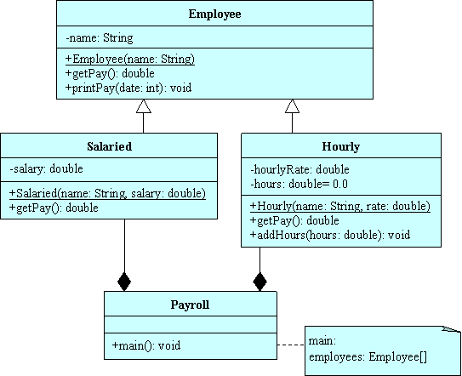
Polymorphism with Arrays
21
UML class diagram for the Payroll program:

Slide 21
Polymorphism with Arrays
22
public class Payroll
{
public static void main(String[] args)
{
Employee[] employees = new Employee[100];
int day; // day of week (Sun=0, Mon=1, ..., Sat=6)
Hourly hourly;
employees[0] = new Hourly("Aza", 25.00);
employees[1] = new Salaried("Ben", 48000);
employees[2] = new Hourly("Joby", 20.00);

Slide 22
Polymorphism with Arrays
23
// This driver arbitrarily assumes that the payroll's month
// starts on a Tuesday (day = 2) and contains 30 days.
day = 2;
for (int date=1; date<=30; date++)
{
day++; // change to the next day of the week
day %= 7; // causes day of week to cycle from 0-6 repeatedly
// Loop through all the employees
for (int i=0; i<employees.length && employees[i] != null; i++)
{

Slide 23
Polymorphism with Arrays
24
if (day > 0 && day < 6 && employees[i] instanceof Hourly)
{
hourly = (Hourly) employees[i];
hourly.addHours(8);
}
The instanceof operator returns true if the object at its left is an instance of the class at its right.
The cast operator is necessary because without it, you'd get a compilation error.
Why? Because we're attempting to assign a superclass object into a subclass reference variable (employees is defined with an Employee superclass type and hourly is defined with an Hourly subclass type).
If you want to assign a superclass object into a superclass reference variable, you can do it, but only if the "superclass object" really contains a subclass object and you include a cast operator.

Slide 24
Polymorphism with Arrays
25
// Print hourly employee paychecks on Fridays.
// Print salaried employee paychecks on 15th and 30th.
if ((day == 5 && employees[i] instanceof Hourly) ||
(date%15 == 0 && employees[i] instanceof Salaried))
{
employees[i].printPay(date);
}
} // end for i
} // end for date
} // end main
} // end class Payroll

Slide 25
Polymorphism with Arrays
26
public class Employee
{
private String name;
//*****************************************************
public Employee(String name)
{
this.name = name;
}
//*****************************************************
public void printPay(int date)
{
System.out.printf("%2d %10s: %8.2f\n", date, name, getPay());
} // end printPay
//*****************************************************
// This dummy method is needed to satisfy the compiler.
public double getPay()
{
System.out.println("error! in dummy");
return 0.0;
} // end getPay
} // end class Employee
polymorphic method call
This method never executes; it's provided to satisfy the compiler.

Slide 26
Polymorphism with Arrays
27
public class Salaried extends Employee
{
private double salary;
//***********************************************************
public Salaried(String name, double salary)
{
super(name);
this.salary = salary;
} // end constructor
//***********************************************************
public double getPay()
{
return this.salary / 24;
} // end getPay
} // end class Salaried

Slide 27
Polymorphism with Arrays
28
public class Hourly extends Employee
{
private double hourlyRate;
private double hours = 0.0;
//***********************************************************
public Hourly(String name, double rate)
{
super(name);
hourlyRate = rate;
} // end constructor
//***********************************************************
public double getPay()
{
double pay = hourlyRate * hours;
hours = 0.0;
return pay;
} // end getPay
//***********************************************************
public void addHours(double hours)
{
this.hours += hours;
} // end addHours
} // end class Hourly

Slide 28
abstract Methods and Classes
29
Declare a method to be abstract if the method's class is a superclass and the method is merely a "dummy" method for an overriding method(s) in a subclass(es).
Java requires that when you define a method to be abstract, you must:
  Use an abstract method heading instead of a method definition. An abstract method heading is the same as a standard method heading except that it includes the abstract modifier and a trailing semicolon.
  Define an overriding version of that method in each of the superclass's subclasses.
  Define the superclass to be abstract by using the abstract modifier.
In defining a class to be abstract, you're telling the compiler to not allow the class to be instantiated; i.e., if a program attempts to instantiate an abstract class, a compilation error is generated.

Slide 29
abstract Methods and Classes
30
public abstract class Employee
{
private String name;
public abstract double getPay();
//*****************************************************
public Employee(String name)
{
this.name = name;
}
//*****************************************************
public void printPay(int date)
{
System.out.printf("%2d %10s: %8.2f\n", date, name, getPay());
} // end printPay
} // end class Employee

Slide 30
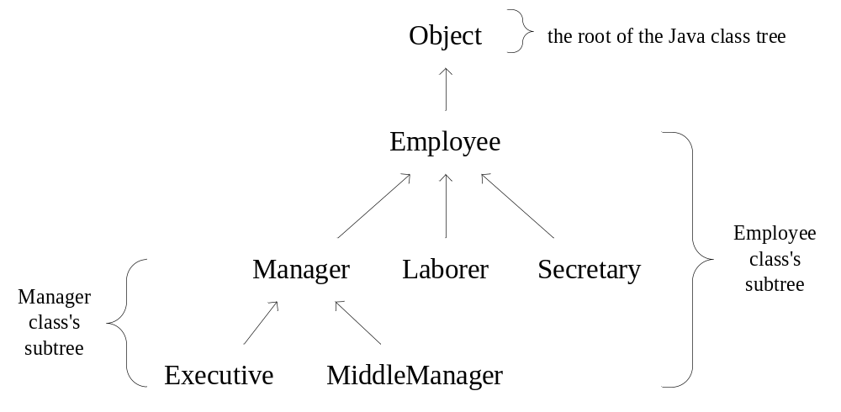
protected Access Modifier
31
The protected access modifier is in between the public and private modifiers in terms of how accessible something is.
protected members (instance variables, class variables, and methods) can only be accessed by classes within the subtree associated with the member's class.

Slide 31
protected Access Modifier
32
When to use the protected access modifier:
  When you want a member to be directly accessible from any class within its subtree of classes, but you don't want it to be accessible elsewhere.
Example:
  Suppose that the Employee class contains an employeeId instance variable and all of the descendant classes need to access it. To make access easier for the descendant classes, declare employeeId with the protected access modifier:
    protected int employeeId;
  Then, the descendant classes can access employeeId directly rather than having to use a getId() accessor method call.

