Slide 1
Chapter 15 – Files
1
I/O basics
File I/O Classes
File I/O Basic Operations
Text File Output
  PrintWriter
import Statement with a *
Text File Input
  Scanner, FileReader
HTML File Generator
Text Format Versus Binary Format
Binary I/O
  Output with: DataOutputStream, FileOutputStream
  Input with: DataInputStream, FileInputStream
Object I/O
  Output with: ObjectOutputStream, FileOutputStream
  Input with: ObjectInputStream, FileInputStream

Slide 2
I/O Basics
2
So far, all input has come from the keyboard and all output has been to the console window.
Keyboard and console input/output (I/O) is temporary, not permanent.
For permanent I/O, use files.
Benefit of reading input from a file:
  Allows input to be reused without having to re-enter the input via the keyboard.
Benefits of saving output to a file:
  Allows output to be re-viewed without having to rerun the program.
  Allows program chaining where the output of one program is used as the input for another program.

Slide 3
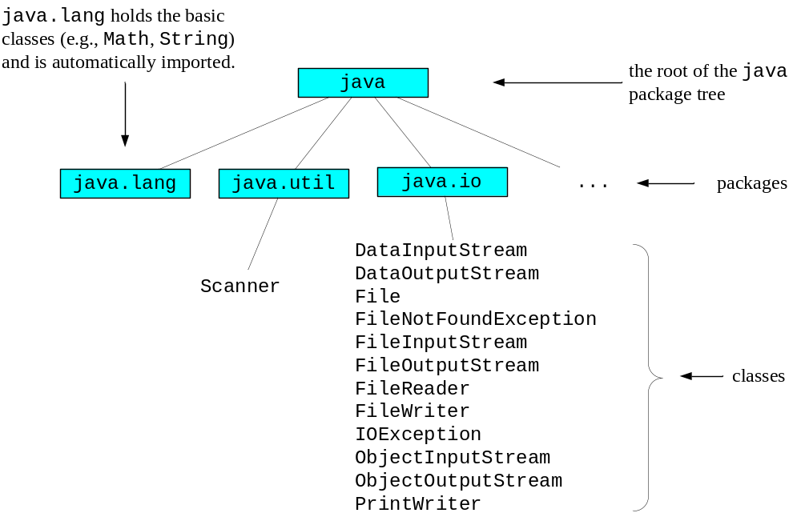
File I/O Classes
3
For programs that manipulate files, you'll need to use several pre-built classes from the Java API library.
The Java API is organized as a hierarchy of packages where each package contains a group of classes.
Here's the file I/O portion of the Java API library:

Slide 4
File I/O Classes
4
There are lots of classes that deal with file I/O, and there's overlap with some of those classes. In other words, some classes handle the same sort of file operation(s).
The book covers the file I/O classes that are the easiest to use. Here are the file I/O classes that the book covers:
  If you want to write text to a file, use the PrintWriter class.
  If you want to read text from a file, use the Scanner and FileReader classes.
  If you want to write objects to a file, use the ObjectOutputStream and FileOutputStream classes.
  If you want to read objects from a file, use the ObjectInputStream and FileInputStream classes.
When you write "text" to a file, you store the text as characters where each character is represented by its ASCII value.
When you write an object to a file, you store the object's instance variables in their native bytecode format, not as ASCII characters.

Slide 5
File I/O Basic Operations
5
There are four basic steps when performing file I/O:
  Import the appropriate classes.
    For input and output, import the java.io package.
    For input, also import the java.util.Scanner class.
  Open the file by instantiating the appropriate class(es).
  Write to or read from the file by calling the appropriate method.
    With output files, only write operations are allowed (not read operations).
    With input files, only read operations are allowed (not write operations).
  Close the file by calling the close method.

Slide 6
Text File Output
6
To open a text file for output:
  Instantiate the PrintWriter class like this:
    PrintWriter <reference-variable>;
    <reference-variable> = new PrintWriter(<filename>);
  The PrintWriter constructor throws a FileNotFoundException. To handle the exception, surround the constructor call in a try block, and add a FileNotFoundException catch block.
To write to the opened text file:
  Call the instantiated PrintWriter object's print and println methods. They're the same methods that handle output to a console window.
To close the opened text file:
  Call the instantiated PrintWriter object's close method like this:
    <PrintWriter-reference-variable>.close();

Slide 7
Text File Output
7
import java.util.Scanner;
import java.io.*;
public class WriteTextFile
{
public static void main(String[] args)
{
Scanner stdIn = new Scanner(System.in);
PrintWriter fileOut;
String text = "Hello, world!";
try
{
System.out.print("Enter filename: ");
fileOut = new PrintWriter(stdIn.nextLine());
fileOut.println(text);
fileOut.close();
}
catch (FileNotFoundException e)
{
System.out.println("Error: " + e.getMessage());
}
} // end main
} // end WriteTextFile class
open the file
write to the file
close the file
for the PrintWriter constructor call

Slide 8
Import Statement with a *
8
In the WriteTextFile program, note this import statement:
  import java.io.*;
That statement is necessary so that the program's PrintWriter and FileNotFoundException classes get imported (PrintWriter and FileNotFoundException are in the java.io package).
The * is a "wildcard." It represents all classes within the specified package. Using an * with the import statement causes all the classes in the specified package to be imported.
Benefit of using an * with the import statement:
  It leads to less code (particularly if you need to import more than one class from the same package).
Benefit of specifying the class name as part of the import statement:
  The code is self documenting (it's obvious which class you want to import).

Slide 9
Text File Output
9
By default, when opening a file with PrintWriter, the file's contents are deleted. Consequently, the file's first print statement causes output to be placed at the beginning of the empty file.
If you don't want to delete file's original contents:
  You can open a file in append mode by embedding a FileWriter object in a PrintWriter constructor call. That causes the file's print statements to insert text at the end of the file. Syntax:
    PrintWriter <reference-variable>;
    <reference-variable> = new PrintWriter(
    new FileWriter(<filename>, true));
    or …
2nd argument specifies append mode on/off

Slide 10
Text File Output
10
If you don't want to delete file's original contents:
  You can open a file as a random access file with the RandomAccessFile class. Random access allows a program to move freely within a file, writing and reading at specified positions. Syntax:
    RandomAccessFile <reference-variable>;
    <reference-variable> =
    new RandomAccessFile(<filename>, "rw"));
"rw" specifies read/write mode

Slide 11
Text File Input
11
To open a text file for input:
  Instantiate the Scanner and FileReader classes like this:
    Scanner <reference-variable>;
    <reference-variable> = new Scanner(new FileReader(<filename>));
  The FileReader constructor throws a FileNotFoundException. To handle the exception, surround the constructor call in a try block, and add a FileNotFoundException catch block.
To read from the opened text file:
  Call the instantiated Scanner object's "next" methods. They're the same methods that handle keyboard input with the Scanner class - nextLine , nextInt, nextDouble, etc.
To close the opened text file:
  Call the instantiated Scanner object's close method like this:
    <Scanner-reference-variable>.close();

Slide 12
Text File Input
12
import java.util.Scanner;
import java.io.*;
public class ReadTextFile
{
public static void main(String[] args)
{
Scanner stdIn = new Scanner(System.in);
Scanner fileIn;
try
{
System.out.print("Enter filename: ");
fileIn = new Scanner(new FileReader(stdIn.nextLine()));
while (fileIn.hasNextLine())
{
System.out.println(fileIn.nextLine());
}
fileIn.close();
}
catch (FileNotFoundException e)
{
System.out.println("Error: " + e.getMessage());
}
} // end main
} // end ReadTextFile class
open the file
read a line from the file and print it
close the file
for the FileReader constructor call

Slide 13
Text File Input
13
When you read from a Scanner object (using nextLine, nextInt, etc.), you read sequentially. That means your first read operation reads from the beginning of the file and subsequent read operations read from subsequent portions of the file. If you read through the entire file and then attempt to read past the end of the file, your program will crash (more specifically, it will throw a NoSuchElementException).
To prevent reading past the end of the file, call the Scanner class's hasNextLine method prior to reading from the file.
The hasNextLine method returns true if it's safe to read from the file (i.e., it returns true if the file "has a next line"). The hasNextLine method returns false otherwise.
Note this code fragment from the ReadTextFile program:
  while (fileIn.hasNextLine())
  {
  System.out.println(fileIn.nextLine());
  }

Slide 14
HTML File Generator
14
The upcoming program copies the contents of a user-specified file and pastes it into a newly generated HTML file.
Sample File (family.txt)
Our Family
We have a dog, Barkley. Barkley is a good dog. She sleeps a lot and digs up the grass. We feed her twice a day.
We have two kids, Jordan and Caiden. They're girls. They like to eat, cry, and play. We like them a lot.
Generated HTML File (family.html)
<html>
<head>
<title>Our Family</title>
</head>
<body>
<h1>Our Family</h1>
<p>
We have a dog, Barkley. Barkley is a good dog. She sleeps a lot and digs up the grass. We feed her twice a day.
<p>
We have two kids, Jordan and Caiden. They're girls. They like to eat, cry, and play. We like them a lot.
</body>
</html>

Slide 15
HTML File Generator
15
import java.util.Scanner;
import java.io.*;
public class HTMLGenerator
{
public static void main(String[] args)
{
Scanner stdIn = new Scanner(System.in);
String filenameIn; // original file's name
Scanner fileIn; // input file
int dotIndex; // position of dot within filename
String filenameOut; // HTML file's name
PrintWriter fileOut; // HTML file
String line; // a line from the input file
System.out.print("Enter file's name: ");
filenameIn = stdIn.nextLine();

Slide 16
HTML File Generator
16
try
{
fileIn = new Scanner(new FileReader(filenameIn));
dotIndex = filenameIn.lastIndexOf(".");
if (dotIndex == -1) // no dot found
{
filenameOut = filenameIn + ".html";
}
else // dot found
{
filenameOut =
filenameIn.substring(0, dotIndex) + ".html";
}
fileOut = new PrintWriter(filenameOut);
// First line is used for title and header elements.
line = fileIn.nextLine();
if (line == null)
{
System.out.println(filenameIn + " is empty.");
}

Slide 17
HTML File Generator
17
else
{
// Write starting HTML code.
fileOut.println("<html>");
fileOut.println("<head>");
fileOut.println("<title>" + line + "</title>");
fileOut.println("</head>");
fileOut.println("<body>");
fileOut.println("<h1>" + line + "</h1>");
while (fileIn.hasNextLine())
{
line = fileIn.nextLine();
// Blank lines generate p tags.
if (line.isEmpty())
{
fileOut.println("<p>");
} // end if

Slide 18
HTML File Generator
18
else
{
fileOut.println(line);
}
} // end while
// Write ending HTML code.
fileOut.println("</body>");
fileOut.println("</html>");
} // end else
fileIn.close();
fileOut.close();
} // end try
catch (IOException e)
{
System.out.println("Error: " + e.getMessage());
} // end catch
} // end main
} // end class HTMLGenerator

Slide 19
Text Format Versus Binary Format
19
Java can handle two types of file formats – text file format and binary file format.
Text file format:
  Text file data is stored using 8-bit ASCII values.
  Since the ASCII character set is a universal standard, text files can be viewed using standard text editors and they can be read by programs written in any language (not just Java).
  To facilitate reading and writing data one line at a time, text file data is organized using newline characters.
    When printing to a text file, Java uses a println method to specify that a newline is to be inserted at the end of the line.
    Likewise, when reading from a file, Java uses a nextLine method to specify that an entire line of characters is to be read in.

Slide 20
Text Format Versus Binary Format
20
Example data:
  Bob 2222
  Paul5555
How it's stored in a UNIX-created text file:
Text files created in a UNIX environment use only one character, \n, to represent a new line.
Text files created in a Windows environment use two characters, \r (carriage return) and \n (newline), to represent a new line, but Windows also reads UNIX-created lines.
B | o | b |  | 2 | 2 | 2 | 2 | \n | P
01000010 | 01101111 | 01100010 | 00100000 | 00110010 | 00110010 | 00110010 | 00110010 | 00001010 | 01010000
a | u | l | 5 | 5 | 5 | 5 | \n
01100001 | 01110101 | 01101100 | 00110101 | 00110101 | 00110101 | 00110101 | 00001010

Slide 21
Text Format Versus Binary Format
22
Binary file format:
  When writing values to a binary file, Java's native storage schemes are used.
  Binary files do not facilitate writing and reading data one line at a time. Specifically, binary files do not use println and readline methods to print an entire line or read an entire line, respectively. Instead, binary files use writeChar, readChar, writeInt, readInt, writeDouble, readDouble, etc. methods to write and read individual primitive-type variables.

Slide 22
Text Format Versus Binary Format
23
Example data:
  Bob2147483647
How it's stored in a binary file:
B |  | o |  | b |  | 2147483647
00000000 | 01000010 | 00000000 | 01101111 | 00000000 | 01100010 | 01111111 | 11111111 | 11111111 | 11111111

Slide 23
Text Format Versus Binary Format
24
Benefits of text format:
  Easy to view the file (because all standard text editors can display ASCII values).
  Text files can be read by programs written in any language (not just Java).
Benefits of binary format:
  Text format can only handle ASCII values, but binary format can handle all of the Unicode characters.
  Using binary format can lead to programs that run faster because when a program writes to or reads from a binary file, the data doesn't have to be converted. On the other hand, when a program writes to or reads from a text file, the data has to converted between Java native format and ASCII format.

Slide 24
Binary File Output
25
To open a binary file for primitive data output, instantiate a FileOutputStream object.
To transform primitive data types into bytes, instantiate a DataOutputStream object.
Example:
  DataOutputStream fileOut;
  ...
  fileOut =
  new DataOutputStream(
  new FileOutputStream(filename, true));
  ...
open file

Slide 25
Binary File Output
26
Output Example:
Write a doubleValues array to previously opened binary file with DataOutputStream’s writeDouble method, like this:
Other DataOutputStream methods:
  void writeInt(int i)
  void writeChar(int ch)
  void writeChars(String s)
for (int i=0; i<doubleValues.length; i++)
{
fileOut.writeDouble(doubleValues[i]);
}

Slide 26
Binary File Input
27
To open a binary file for primitive data input, instantiate a FileInputStream object.
To transform primitive data types into bytes, instantiate a DataInputStream object.
Example:
  DataInputStream fileIn;
  ...
  fileIn = new DataInputStream(
  new FileInputStream(filename));
  ...
open file

Slide 27
Binary File Input
28
Input Example:
Fill a doubleData array with data from previously opened binary file with DataInputStream’s readDouble method, like this:
  for (int i=0; i<doubleData.length; i++)
  {
  doubleData[i] = fileIn.readDouble();
  }
Other DataInputStream methods:
  int readInt()
  char readChar()

Slide 28
Object File I/O
29
Problem:
In OOP, most data is in object format, and the structure of objects is user-specified. So there is no universal format for storing objects in files, and each object’s variables must be stored separately using a format that is appropriate for that type of object. This makes writing or reading an object’s data to or from a file very tedious.
Solution:
  Automate this process with Java’s “serialization” service.
  To get this service, append the following to the heading of any class you want to use this service:
    implements Serializable
  The JVM handles all the details.

Slide 29
Object File I/O
30
Output:
  fileOut = new ObjectOutputStream(
  new FileOutputStream(filename));
  fileOut.writeObject(testObject);
  fileOut.close();
Input:
  fileIn = new ObjectInputStream(
  new FileInputStream(filename));
  testObject = (TestObject) fileIn.readObject();
  fileIn.close();
open file
open file

