Slide 1
Chapter 16
GUI Programming Basics
1
GUI Overview
Event-Driven Programming Basics
GUI Classes and Packages
A Simple Window Program
JFrame Class
Java Components
JLabel Component
JTextField Component
Component Listeners
Interfaces
Inner Classes
Anonymous Inner Classes
JButton Component
JOptionPane Dialog Box
Distinguishing Between Multiple Events
Using getActionCommand to Distinguish Between Multiple Events (optional)
Color

Slide 2
GUI Overview
2
GUI stands for Graphical User Interface.
  Graphical = picture objects (windows, buttons, menus, etc.)
  User = the person who uses the program.
  Interface = the manner in which the user interacts with the program.
Although companies still write text-based programs for internal use, most companies write GUI-based programs for programs that are to be used externally.

Slide 3
Event-Driven Programming Basics
3
GUI programs usually use event-driven programming techniques.
Basic idea behind event-driven programming:
  The program waits for events to occur and then it responds.
An event is a message that tells the program that something has happened. For example, if the user clicks a button, then an event is generated, and it tells the program that a particular button was clicked.
More formally, when the user clicks a button, we say that the button object fires an event.

Slide 4
Event-Driven Programming Basics
4
Note these additional event examples:
User Action | What Happens
Pressing the enter key while the cursor is inside a text box. | The text box object fires an event, and it tells the program that enter was pressed within the text box.
Clicking a menu item. | The menu item object fires an event, and it tells the program that the menu item was selected.
Closing a window (clicking on the window's top-right corner "X" button). | The window object fires an event, and it tells the program that the window's close button was clicked.

Slide 5
Event-Driven Programming Basics
5
If an event is fired, and you want your program to handle the fired event, then you need to create a listener for the event.
For example, if you want your program to do something when the user clicks a particular button, you need to create a listener for the button.
If an event is fired and there's no listener listening to it, then the fired event is never "heard" and there's no response to it.
On the other hand, if there is a listener listening to a fired event, then the listener "hears" the event and the program then responds to the fired event.
The way the program responds is by executing a chunk of code known as an event handler.

Slide 6
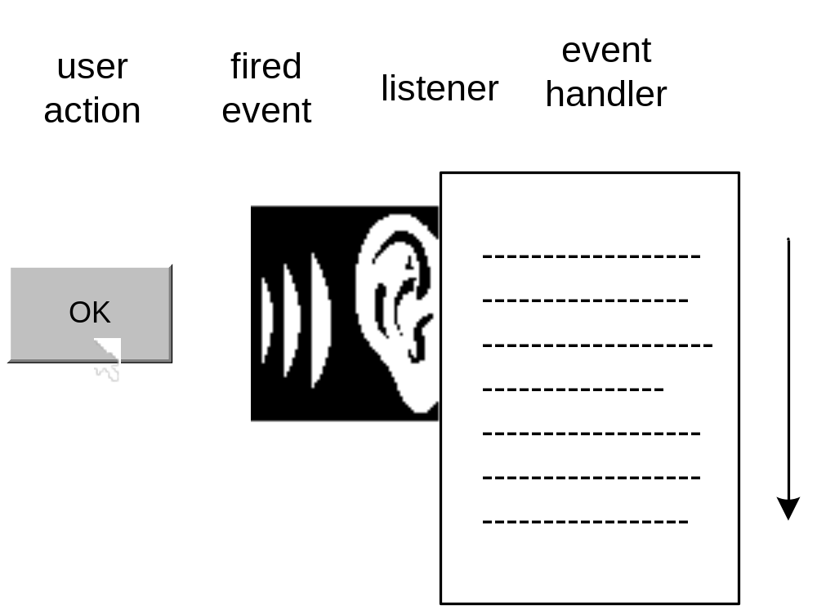
Event-Driven Programming Basics
6
What happens when a button is pressed:

Slide 7
GUI Classes and Packages
7
In writing a GUI program, use Java's pre-built GUI classes. For example:
  Use the pre-built JButton class when you need a button.
  Use the pre-built Color class when you need to specify a color.
In the first Java compiler, JDK 1.0, all GUI classes were bundled into one library known as the Abstract Windowing Toolkit (AWT).
The AWT's component classes were less than ideal in terms of portability, so Sun developed a set of more-portable GUI components and put them in a new GUI library named Swing.
The Swing library adds lots of functionality to the AWT, but it does not replace the AWT entirely.
Today, Java GUI application programmers use both libraries - Swing and the AWT.
The primary Swing package is javax.swing. The primary AWT packages are java.awt and java.awt.event. Get used to importing those three packages in all of your GUI programs.

Slide 8
A Simple Window Program
8
import javax.swing.*; // for JFrame & JLabel
import java.awt.*; // for FlowLayout
public class SimpleWindow extends JFrame
{
private static final int WIDTH = 300;
private static final int HEIGHT = 200;
public SimpleWindow()
{
setSize(WIDTH, HEIGHT);
setTitle("Simple Window");
setLayout(new FlowLayout());
setDefaultCloseOperation(EXIT_ON_CLOSE);
createContents();
setVisible(true);
} // end SimpleWindow constructor
private void createContents()
{
JLabel label = new JLabel("Hi! I'm Larry the label!");
add(label);
} // end createContents
public static void main(String[] args)
{
new SimpleWindow();
} // end main
} // end class SimpleWindow

Slide 9
JFrame Class
11
The JFrame class:
  Should be used as the superclass for most of your GUI application windows, so programmer-defined windows should extend the JFrame class.
  Is in the javax.swing package, so import that package. (As explained in Chapter 15, you can use an * as a wildcard to import all the classes within a particular package.)
  Is called a container class because:
    It contains things (like labels, buttons, menus, etc).
    It's derived from the Container object.
  Implements all the standard window features such as:
    a border, a title bar, a minimize button, a close-window button (the "X"), the ability to resize the window, etc.

Slide 10
JFrame Class
12
JFrame methods:
  setTitle - Displays a title in the current window.
  setSize - Sets the width and height dimensions in pixels of the current window.
    Your monitor will be set to a certain number of pixels (e.g., 800x600, 1024x768, etc.). The pixel setting is called the resolution. A pixel is a monitor's smallest displayable unit.
  setLayout(new FlowLayout()) - Assigns a specified layout manager to the current window.
    The layout manager determines the positioning of components.
  setDefaultCloseOperation(EXIT_ON_CLOSE) - Enables the close-window button (the "X" in the top-right corner) to work properly.

Slide 11
JFrame Class
13
JFrame methods (continued):
  add - Adds a specified component to the current window.
    Once the component is added to the window, it stays with the window for the life of the program.
    Thus, in the SimpleWindow program, even though label is defined locally within createContents, label stays with the window after createContents finishes.
  setVisible(true) - Displays the window. Make sure you call setVisible at the end (after you've added all of the window's components).
  setVisible(false) - Hides the window.

Slide 12
Java Components
14
Example Java components:
  JLabel, JTextField, JButton,
  JCheckBox, JRadioButton, JComboBox, JList, JTextArea
  JMenuBar, JMenu, JMenuItem
All of these component classes are in the javax.swing package so import that package.
All of these component classes are descendants of the JComponent class. The JComponent class supports many useful inheritable features. Along with many other methods, it contains methods that handle a component's:
  foreground and background colors
  text font
  border appearance
  tool tips
  focus

Slide 13
JLabel Component
15
JLabel component interface:
  JLabel is a read-only component; the user can read the label's message, but cannot update it.
  JLabel is a single-line component; \n won't work.
How to implement a label:
  Instantiate a JLabel object:
    <reference-variable> = new JLabel(<label-text>);
  Add the JLabel object to the window.
    add(<reference-variable>);
  The JLabel class is in the javax.swing package so import that package.
optional

Slide 14
JLabel Component
16
Here are API headings and descriptions for two of the more popular JLabel methods:
  public String getText()
    Returns the label's text.
  public void setText(String text)
    Assigns the label's text.

Slide 15
JTextField Component
17
JTextField component interface:
  The user can enter text into a text box.
How to implement a text box:
  Create a JTextField object with the JTextField constructor:
    <reference-variable> = new JTextField(<default-text>, <width>);
  Add the JTextField object to the window.
    add(<reference-variable>);
  The JTextField class is in the javax.swing package so import that package.
optional

Slide 16
This program demonstrates text boxes and labels. When the user presses enter in the text box, the text box's value displays in the bottom label.
18
import javax.swing.*;
import java.awt.*;
import java.awt.event.*;
public class Greeting extends JFrame
{
private static final int WIDTH = 325;
private static final int HEIGHT = 100;
private JTextField nameBox; // holds user's name
private JLabel greeting; // personalized greeting
//*******************************************
public Greeting()
{
setTitle("Greeting");
setSize(WIDTH, HEIGHT);
setLayout(new FlowLayout());
setDefaultCloseOperation(EXIT_ON_CLOSE);
createContents();
setVisible(true);
} // end constructor
//*******************************************
// Create components and add them to window.
private void createContents()
{
JLabel namePrompt =
new JLabel("What's your name?");
nameBox = new JTextField(15);
greeting = new JLabel();
add(namePrompt);
add(nameBox);
add(greeting);
nameBox.addActionListener(new Listener());
} // end createContents
//****************************************************
// Inner class for event handling.
private class Listener implements ActionListener
{
public void actionPerformed(ActionEvent e)
{
String message; // the personalized greeting
message = "Glad to meet you, " +
nameBox.getText() + "!";
nameBox.setText("");
greeting.setText(message);
} // end actionPerformed
} // end class Listener
//****************************************************
public static void main(String[] args)
{
new Greeting();
} // end main
} // end class Greeting

Slide 17
JTextField Component
19
Here are API headings and descriptions for some of the more popular JTextField methods:
  public String getText()
    Returns the text box's contents.
  public void setText(String text)
    Assigns the text box's contents.
  public void setEditable(boolean flag)
    Makes the text box editable or non-editable.
  public void setVisible(boolean flag)
    Makes the text box visible or invisible.
  public void addActionListener(ActionListener listener)
    Adds a listener to the text box.

Slide 18
Component Listeners
20
When the user interacts with a component (e.g., when the user clicks a button or presses enter while in a text box), the component fires an event.
If the component has a listener attached to it, the fired event is "heard" by the listener and consequently handled by the listener.
The listener handles the event by executing its actionPerformed method.

Slide 19
Component Listeners
21
How to implement a listener for a text box:
  Define a class with an implements ActionListener clause (that means that the class is an implementation of the ActionListener interface).
  Include an actionPerformed event handler method in your listener's class.
    private class Listener implements ActionListener
    {
    public void actionPerformed(ActionEvent e)
    {
    <do something>
    }
    }
    Note that if the ActionEvent event-handler parameter (e, above) isn't used, you must define it still.
      Why?
      Because when a text-box-enter event occurs, the JVM looks for an actionPerformed method with an ActionEvent parameter. If the JVM can't find that exact method, then no event handling takes place.

Slide 20
Component Listeners
22
How to implement a listener for a text box (continued):
  Register your text box listener object. For example, in the Greeting program, the createContents method does this:
    nameBox.addActionListener(new Listener());
  Import the java.awt.event package. Event handling requires the use of the ActionListener interface and the ActionEvent class. Those entities are in the java.awt.event package, so that package must be imported for event handling to work.

Slide 21
Interfaces
23
An interface is a class-like thing whose methods are all empty.
If a programmer uses an interface to derive a new class, the compiler requires the new class to implement methods for all of the interface's methods.
So what's the point of having a class-like thing with all empty methods?
  It can be used as a template/pattern when creating a class that falls into a certain category.
More specifically, what's the point of the ActionListener interface?
  Since all component listeners must implement it,
    It means that all component listeners will be similar and therefore understandable.
    It means that all component listeners will implement the actionPerformed method with the proper heading (and that ensures that component events will be received properly).

Slide 22
Inner Classes
24
If a class is limited in its scope such that it is only needed by one other class, then define the class as an inner class (a class inside of another class).
Since a listener is usually limited to listening to just one class, listeners are often implemented as inner classes.
To further the goal of encapsulation, "hide" the inner class by declaring it with the private access modifier.

Slide 23
Inner Classes
25
Besides furthering the goal of encapsulation, what's another reason to use an inner class as opposed to a top-level class? (Top-level class is the official term for a regular class - a class not defined inside of another class.)
  An inner class can directly access its enclosing class's instance variables. And listeners normally do need to access their enclosing class's instance variables so this is an important benefit.

Slide 24
Greeting Program with an Anonymous Inner Class
26
import javax.swing.*;
import java.awt.*;
import java.awt.event.*;
public class GreetingAnonymous extends JFrame
{
private static final int WIDTH = 300;
private static final int HEIGHT = 200;
private JTextField nameBox; // holds user's name
private JLabel greeting; // personalized greeting
//**********************************************
public GreetingAnonymous()
{
setTitle("Greeting Anonymous");
setSize(WIDTH, HEIGHT);
setLayout(new FlowLayout());
setDefaultCloseOperation(EXIT_ON_CLOSE);
createContents();
setVisible(true);
} // end constructor
//***********************************************
// Create components and add them to window.
private void createContents()
{
JLabel namePrompt = new JLabel("What's your name?");
nameBox = new JTextField(15);
greeting = new JLabel();
add(namePrompt);
add(nameBox);
add(greeting);
nameBox.addActionListener(
// anonymous inner class for event handling
new ActionListener()
{
public void actionPerformed(ActionEvent e)
{
String message; // the personalized greeting
message =
"Glad to meet you, " + nameBox.getText();
nameBox.setText("");
greeting.setText(message);
} // end actionPerformed
} // end anonymous inner class
); // end addActionListener call
} // end createContents
//****************************************************
public static void main(String[] args)
{
new GreetingAnonymous();
} // end main
} // end class GreetingAnonymous

Slide 25
Anonymous Inner Classes
27
The point of using an anonymous object is to avoid cluttering up the code with a variable name when an object only needs to be used one time.
The point of using an anonymous inner class is to avoid cluttering up the code with a class name when a class only needs to be used one time.
For example, if a particular listener class listens to just one object, then the listener class needs to be used only one time as part of an addActionListener() method call. Therefore, to unclutter your code, you may want to use an anonymous inner class for the listener.

Slide 26
Anonymous Inner Classes
28
Syntax:
  new <interface-name>()
  {
  <class-body>
  }
Example:
  nameBox.addActionListener(
  new ActionListener()
  {
  public void actionPerformed(ActionEvent e)
  {
  ...
The anonymous inner class implements the specified interface.
ActionListener is an interface

Slide 27
JButton Component
29
Button component interface:
  A button component acts like a real-world button - when you press/click it, something happens.
How to implement a button:
  Create a button component with the JButton constructor:
    JButton helloButton = new JButton("Press me");
  Add the button component to the
    window:
    add(helloButton);
  The JButton class and the add method are both in the javax.swing package so import that package.
button label's text, OK to omit argument

Slide 28
JButton Component
30
How to implement a button (continued):
  Implement a listener class that includes an actionPerformed event handler method:
    private class Listener implements ActionListener
    {
    public void actionPerformed(ActionEvent e)
    {
    <do something>
    }
    }
  Register your button-listener object:
    helloButton.addActionListener(new Listener());

Slide 29
JButton Component
31
Here are API headings and descriptions for some of the more popular JButton methods :
  public String getText()
    Returns the button's label.
  public void setText(String text)
    Assigns the button's label.
  public void setVisible(boolean flag)
    Makes the button visible or invisible.
  public void addActionListener(ActionListener listener)
    Adds a listener to the button. The listener "listens" for the button being clicked.

Slide 30
When the user 1) clicks the button or 2) presses enter in the input text box, the entered number's factorial displays in the output text box.
32
import javax.swing.*;
import java.awt.*;
import java.awt.event.*;
public class FactorialButton
extends JFrame
{
private static final int WIDTH = 300;
private static final int HEIGHT = 75;
private JTextField xBox; // user entry
private JTextField xfBox; // factorial
//************************************
public FactorialButton()
{
setTitle("Factorial Calculator");
setSize(WIDTH, HEIGHT);
setLayout(new FlowLayout());
setDefaultCloseOperation(
EXIT_ON_CLOSE);
createContents();
setVisible(true);
} // end FactorialButton constructor
//*******************************
private void createContents()
{
JLabel xLabel = new JLabel("x:");
JLabel xfLabel = new JLabel("x!:");
JButton btn = new JButton("Factorial");
Listener listener = new Listener();
xBox = new JTextField(2);
xfBox = new JTextField(10);
xfBox.setEditable(false);
add(xLabel);
add(xBox);
add(xfLabel);
add(xfBox);
add(btn);
xBox.addActionListener(listener);
btn.addActionListener(listener);
} // end createContents

Slide 31
Factorial Button Program
33
//***********************************
// Inner class for event handling.
private class Listener implements
ActionListener
{
public void
actionPerformed(ActionEvent e)
{
int x; // user entered number
int xf; // x factorial
try
{
x = Integer.parseInt(
xBox.getText());
}
catch (NumberFormatException nfe)
{
x = -1; // indicates invalid x
}
if (x < 0)
{
xfBox.setText("undefined");
}
else
{
if (x == 0 || x == 1)
{
xf = 1;
}
else
{
xf = 1;
for (int i=2; i<=x; i++)
{
xf *= i;
}
} // end else
xfBox.setText(
Integer.toString(xf));
} // end else
} // end actionPerformed
} // end class Listener

Slide 32
Factorial Button Program
34
//**************************************
public static void main(String[] args)
{
new FactorialButton();
} // end main
} // end class FactorialButton

Slide 33
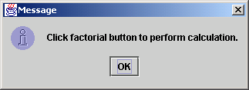
JOptionPane Dialog Box
35
A dialog box is a simple window that contains a message. For example:
To generate a simple output dialog box, call JOptionPane's showMessageDialog method:
  JOptionPane.showMessageDialog(null, <message>);
Example:
  JOptionPane.showMessageDialog(null,
  "Click factorial button to perform calculation.");

Slide 34
JOptionPane Dialog Box
36
JOptionPane's showMessageDialog method is a class method so call it using <class-name> dot syntax.
showMessageDialog's first argument specifies the position of the dialog box. If the argument is null, the dialog box appears in the center of the screen.
The JOptionPane class is in the javax.swing package so import that package.

Slide 35
Distinguishing Between Multiple Events
37
For listeners that are registered with multiple components, when the listener "hears" an event firing, the listener usually needs to identify which component was responsible for the fired event.
To identify the component whose event was fired:
  Within the actionPerformed method, use the actionPerformed method's ActionEvent parameter to call getSource.
  The getSource method returns the address of the component whose event was fired so to check which component is returned, use == with the original component reference variable.

Slide 36
Updated listener for the factorial-button program:
When the user presses enter in the input text box, a warning dialog box is displayed.
38
private class Listener implements ActionListener
{
public void actionPerformed(ActionEvent e)
{
...
if (e.getSource() == xBox)
{
JOptionPane.showMessageDialog(null,
"Click factorial button to perform calculation.");
}
else
{
try
{
x = Integer.parseInt(xBox.getText());
}
...
}
} // end actionPerformed
} // end class Listener

Slide 37
Using getActionCommand to Distinguish Between Multiple Events (optional)
39
We call getSource to identify the component whose event was fired. That works fine most of the time, but not all of the time. Note the following cases where calling getSource is inadequate:
  If the event-firing components are in a different class from the listener class.
    The listener class's getSource method can successfully retrieve the component responsible for the fired event, but there is no way to identify the type of the returned component because that requires comparing the returned component with the original components (using ==).
    If the original components are in a different class and private, using them in the listener class generates a compile error.

Slide 38
Using getActionCommand to Distinguish Between Multiple Events (optional)
40
Note the following cases where calling getSource is inadequate (continued)
  If there's a need to have a modal component.
    A modal component is a component with more than one mode.
    For example, suppose there's a button whose label toggles between "show details" and "hide details." The two labels correspond to two different modes of operation – in one mode details are shown, and in another mode details are hidden.
    If a modal button is clicked, getSource can retrieve the button, but it cannot retrieve the button's mode. So the getSource method cannot reveal anything about the intended action (e.g., show details vs. hide details).

Slide 39
Using getActionCommand to Distinguish Between Multiple Events (optional)
41
What's the solution?
  To identify the event that was fired, use the actionPerformed method's ActionEvent parameter to call getActionCommand. The getActionCommand method returns the "action command" associated with the component whose event was fired. Typically, the action command is the component's label.
  For example, the default action command for a button is the button's label and the default action command for a menu item is the menu item's label.
  Example code:
    if (e.getActionCommand().equals("Factorial"))
    ...

Slide 40
Color
42
Most GUI components are comprised of two colors - foreground color is the color of the text, background color is the color of the area behind the text.
Here's how to create a red button with white text:
  JButton btn = new JButton("Click Me");
  btn.setBackground(Color.RED);
  btn.setForeground(Color.WHITE);
And here's what the red-white button looks like:

Slide 41
Color Methods
43
The setBackground and setForeground methods are standard mutator methods. Here are the API headings and descriptions for their associated accessor methods:
public Color getBackground()
  Returns the component's background color.
public Color getForeground()
  Returns the component's foreground color.
Example:
  JTextField nameBox = new JTextField();
  Color originalBackground = nameBox.getBackground();
  Color originalForeground = nameBox.getForeground();

Slide 42
Color Named Constants
44
Color's variables (all of which are named constants):
  Color.BLACK Color.GREEN Color.RED
  Color.BLUE Color.LIGHT_GRAY Color.WHITE
  Color.CYAN Color.MAGENTA Color.YELLOW
  Color.DARK_GRAY Color.ORANGE
  Color.GRAY Color.PINK
The Color class is in the java.awt package so import that package.

Slide 43
Color Objects
45
To obtain a color that is not in the Color class's list of named constant colors, instantiate a Color object with a specified mixture of red, green, and blue.
Here's the Color constructor call syntax:
  new Color(<red 0-255>, <green 0-255>, <blue 0-255>)
Each of the three Color constructor arguments is an int value between 0 and 255. The int value represents the amount of color, with 0 indicating no color and 255 indicating the maximum amount of color.
For example, this statement sets a button's background color to purple:
  button.setBackground(new Color(128, 0, 128));

Slide 44
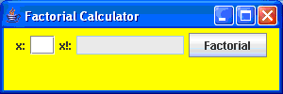
JFrame Background Color
46
To set the background color for a JFrame window, you first have to get the JFrame's content pane and then you apply the background color to the content pane.
To get the content pane, call the JFrame class's getContentPane method.
This code sets the background color to yellow:
  getContentPane().setBackground(Color.YELLOW);
content pane

Slide 45
This program's buttons allow the user to set the window's background color to light red or light green.
47
import javax.swing.*;
import java.awt.*;
import java.awt.event.*;
public class ColorChooser
extends JFrame
{
private JButton stopButton;
private JButton goButton;
//****************************
public ColorChooser()
{
setSize(300, 200);
setTitle(
"Background Color Chooser");
setDefaultCloseOperation(
EXIT_ON_CLOSE);
createContents();
setVisible(true);
} // end ColorChooser constructor
//****************************
private void createContents()
{
setLayout(new FlowLayout());
stopButton = new JButton("Stop");
stopButton.setBackground(Color.RED);
stopButton.addActionListener(
new ButtonListener());
add(stopButton);
goButton = new JButton("Go");
goButton.setBackground(Color.GREEN);
goButton.addActionListener(
new ButtonListener());
add(goButton);
} // end createContent

Slide 46
Background Color Chooser Program
48
//***************************************
// Inner class for event handling.
private class ButtonListener implements ActionListener
{
public void actionPerformed(ActionEvent e)
{
Container contentPane = getContentPane();
if (e.getSource() == stopButton)
{
// Change the window background color to pink.
contentPane.setBackground(Color.PINK);
}
else
{
// Change the window background color to light green.
contentPane.setBackground(new Color(220, 255, 220));
}
} // end actionPerformed
} // end class ButtonListener
//**************************************
public static void main(String[] args)
{
new ColorChooser();
}
} // end class ColorChooser

