Slide 1
Chapter 2 - Algorithms and Design
1
print Statement
input Statement and Variables
Assignment Statement
if Statement
Flowcharts
Flow of Control
Looping with Flowcharts
Looping with Pseudocode
Tracing
Pseudocode Syntax Summary
Loop Terminatation
  Counter loop
  User query loop
  Sentinel value loop
Nested Loops

Slide 2
print Statement
2
Here's a pseudocode algorithm that calculates the area of a rectangle:
  print "Enter a length: "
  input length
  print "Enter a width: "
  input width
  set area to length * width
  print "The area is " area
The print statement causes the specified item(s) to be displayed.
For example, the first line in the above algorithm causes this to be displayed:
  Enter a length:
You can print different types of items. Later we'll talk about printing numbers, but for now, let's focus on printing characters….
If you want to print a sequence of characters, surround the characters with quotes. A sequence of characters surrounded by quotes is called a string. For example, in the first line, "Enter a length: " is a string.
print statement

Slide 3
input Statement & Variables
3
  print "Enter a length:"
  input length
  print "Enter a width:"
  input width
  set area to length * width
  print "The area is" area
The input statement:
  Causes the algorithm to wait for the user to enter a value.
  After the user enters a value, the value is stored in the specified variable.
A variable is a box/container that can hold a value.
The first two print statements are called prompts because they prompt the user to enter a value.
input statement

Slide 4
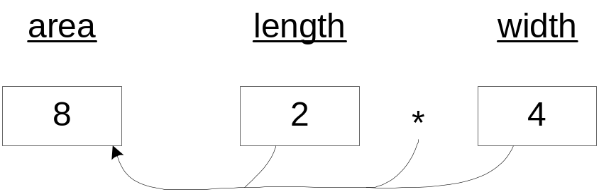
Assignment Statement
4
  print "Enter a length:"
  input length
  print "Enter a width:"
  input width
  set area to length * width
  print "The area is" area
The assignment statement:
  Puts the right-hand-side expression's value into the left-hand-side variable.
Suppose that 2 and 4 were entered as input for the above algorithm. Here's a picture of what the assignment statement does:
assignment statement

Slide 5
if Statement
5
Use an if statement if you need to ask a question in order to determine what to do next.
There are three forms for an if statement:
  “if”
  “if, else”
  “if, else if”
Format for the “if” form of the if statement:
  if <condition>
  <statement(s)>
Classroom notation: I use angled brackets "<>" to surround a description of what should be placed at a particular position. Thus, don't enter the word "condition," the word "statement(s)," or the <>'s. Instead, enter an actual condition and an actual statement(s).
Don't forget to indent.

Slide 6
if Statement
6
A condition is a question whose answer is either yes or no. The answer to the condition’s question determines which statement executes next.
How the “if” form of the if statement works:
  If the condition is true, execute all subordinate statements, i.e., execute all indented statements immediately below the “if.”
  If the condition is false, jump to the line after the last subordinate statement, i.e., jump to the first un-indented statement below the “if.”

Slide 7
if Statement
7
“if” example:
  print “What is your favorite shape? ”
  input shape
  if shape is a circle
  print “Enter a radius value: ”
  input radius
  set area to 3.1416 * radius * radius
  print “The area is ” area
  print “End of shape algorithm. Seeya!”
condition
These four statements are subordinate to the encompassing if statement.

Slide 8
if Statement
8
Format for the “if, else” form of the if statement:
  if <condition>
  <statement(s)>
  else
  <statement(s)>
How the “if, else” form of the if statement works:
  If the condition is true, execute all statements subordinate to the “if,” and skip all statements subordinate to the “else.”
  If the condition is false, skip all statement(s) subordinate to the “if,” and execute all statements subordinate to the “else.”
“if, else” example:
  if grade is greater than or equal to 60
  print “Pass”
  else
  print “Fail”

Slide 9
if Statement
9
Format for the “if, else if” form of the if statement:
  if <condition>
  <statement(s)>
  else if <condition>
  <statement(s)>
  .
  .
  .
  else
  <statement(s)>
How the “if, else if” form of the if statement works:
  For the first condition that's true, execute its statement(s) and skip the other statement(s).
  If none of the conditions are true, execute the else statement(s) (if there is an else).
more else if's here (optional)
optional

Slide 10
if Statement
10
“if, else if” example:
  if grade is greater than or equal to 90
  print "A"
  else if grade is greater than or equal to 80
  print "B"
  else if grade is greater than or equal to 70
  print "C"
  else if grade is greater than or equal to 60
  print "D"
  else
  print "F"

Slide 11
if Statement
11
If statement summary:
  Use the first format (if by itself) for problems where you want to do something or nothing.
  Use the second format (if, else) for problems where you want to do one thing or another thing.
  Use the third format (if, else, if, else) for problems where you want to do one thing out of three or more choices.
Practice problems:
  Write an algorithm that prints "warm" if temperature (a variable) is above 50 degrees and prints "cold" otherwise.
  Write an algorithm that prints "No school!" if temperature is below 10 degrees.
  Write an algorithm that prints "too cold" if temperature is below 50 degrees, "OK" if the temperature is between 50 and 90 degrees, and "too hot" if the temperature is above 90 degrees.

Slide 12
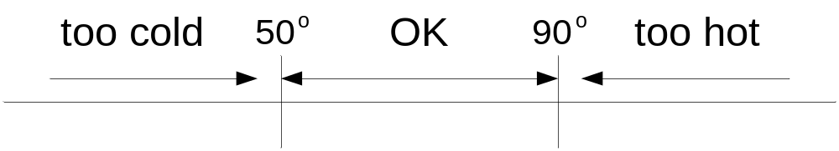
if Statement
14
Write an algorithm that prints "too cold" if the temperature is below 50 degrees, "OK" if the temperature is between 50 and 90 degrees, and "too hot" if the temperature is above 90 degrees.

Slide 13
Flowcharts
15
Flowchart = a pictorial representation of a program's logic.
Flowchart symbols:
  Surround print, input, and assignment statements with rectangles:
  Surround questions (for if conditions and loop conditions) with diamonds:
  Connect the rectangles and diamonds with arrows, which show the direction of the logic flow:

Slide 14
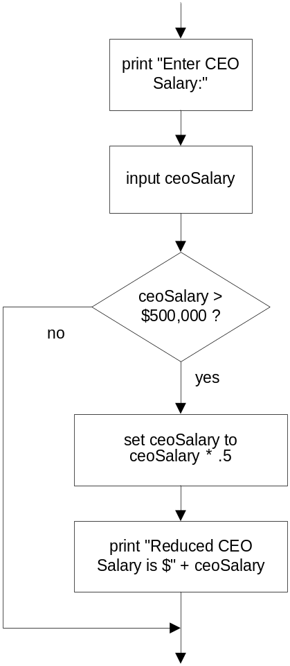
Flowcharts
16
Example algorithm that cuts a CEO’s large salary in half:
  print "Enter CEO salary: "
  input ceoSalary
  if ceoSalary is greater than 500000
  set ceoSalary to ceoSalary * .5
  print "Reduced salary is $" ceoSalary
Note the spelling of the ceoSalary variable name. If a variable name requires multiple words (e.g., “CEO salary"), omit the spaces between the words and use all lowercase except for the first letter of the 2nd, 3rd, etc. words.
Equivalent flowchart:

Slide 15
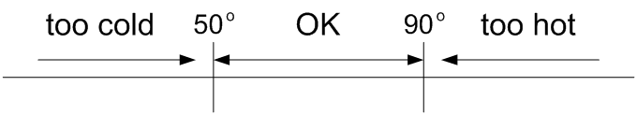
Flowcharts
17
Draw a flowchart that prints "too cold" if temperature is below 50 degrees, "OK" if the temperature is between 50 and 90 degrees, and "too hot" if the temperature is above 90 degrees.
Flowchart:

Slide 16
Flow of Control
19
Flow of control – the order in which a program's statements are executed.
Statements are grouped according to their flow of control.
  Sequential statements are executed in sequence, one after the other. Sequential statement examples – print, input, assignment.
  Branching statements contain one or more choices and only one of the choices is executed. Branching statement examples – the three forms of the if statement.
  Loop statements cause you to jump back to a previously executed statement. By continuing at that previous statement, a loop is formed.

Slide 17
Looping with Flowcharts
20
Let's first implement a loop using a flowchart (later we'll implement loops using pseudocode):
  Draw a flowchart that prints "Happy birthday!" 100 times.
Note: We don't need any new flowchart symbols for loops. Flowchart looping is implemented by an arrow going to a previously executed statement.
Flowchart:

Slide 18
Looping with Pseudocode
22
Use a loop statement if you need to do the same thing repeatedly.
loop format:
  while <condition>
  <statement(s)>
How the while loop works:
  While the condition is true, execute the statement(s) and jump back to the condition.
  When the condition finally becomes false, jump below the subordinate statement(s) and continue with the next statement.
the loop's heading
the loop's body

Slide 19
Looping with Pseudocode
23
Loop terminology:
  The number of times that the loop repeats is called the number of iterations.
  It's possible for a loop to repeat forever. That's called an infinite loop. (Note: It's also possible for a loop to repeat zero times.)
Example:
  Write an algorithm that prints "Happy Birthday!" five times.
    set count to 1
    while count is less than or equal to 5
    print "Happy birthday!"
    set count to count + 1

Slide 20
Tracing
24
What is tracing?
  It's when a human executes an algorithm (or a program) line by line and carefully records everything that happens.
  It's used to 1) verify that an algorithm is correct or 2) find errors/bugs in an algorithm.
How to trace:
  Setup:
    If there is input, provide a column heading labeled "input."
    Provide a column heading for each variable.
    Provide a column labeled "output."
  Whenever there's an input statement, cross off the next input value under the input column heading.
  Update a variable's value by writing the new value underneath the variable's column heading and crossing off the old value.
  Whenever there's a print statement, write the printed value under the output column heading.
  For full credit on the homework, your variable and output values must be 100% accurate.

Slide 21
Pseudocode Summary
25
print <variables, strings, math expressions>
Use quotes to surround strings.
input <variable>
Variables (no spaces, all lowercase except for first letter of 2nd, 3rd, etc. words)
Assignment statement
  set <variable> to <value>
math operators: +, -, /, *
if <condition>
else if <condition>
else
while <condition>

Slide 22
Loop Termination
26
There are three basic ways to terminate/exit loops:
  Counter loop
    Use a counter variable to keep track of the number of iterations.
    Example - "Happy birthday" algorithm.
  User query
    Ask the user if he/she wants to continue.
    Example - print the squares algorithm (coming up).
  Sentinel value
    Use a special value to indicate that there's no more input.
    Example - bowling scores algorithm (coming up).

Slide 23
User-Query Example
27
Write an algorithm that repeatedly asks for numbers and prints their squares. The program should continue as long as the user answers "y" to a "Continue?" prompt.
  set continue to "y"
  while continue equals "y"
  print "Enter a number: "
  input num
  set square to num * num
  print num " squared is " square
  print "Continue? (y/n): "
  input continue

Slide 24
Sentinel Value Example
28
Write an algorithm that reads in bowling scores repeatedly until a sentinel value of -1 is entered. Print the average score. As always, your algorithm should be robust.
(Robust means that the algorithm works even for the weird cases, not just the easy cases.)

Slide 25
Sentinel Value Example
31
Remember: Your algorithms should be robust.
Is the bowling score algorithm robust?
Note: Division by zero in an actual computer program causes the program to "crash" (= terminate immediately) rather than continuing to the end of the program.
Moral: Prevent division by zero by using an appropriate if statement.

Slide 26
Nested Loops
32
A nested loop is a loop that's inside another loop.
Example: Write an algorithm that plays multiple games of “Find the largest number.” In each game, the user enters a series of nonnegative numbers. When the user enters a negative number, the algorithm prints the largest number in the series and asks the user if he/she wants to play another game.

Slide 27
Nested Loops
33
set continue to “y”
while continue equals “y”
set biggest to -1
print “Enter a number (negative to quit): ”
input num
while num is greater than or equal to 0
if num is greater than biggest
set biggest to value of num
print “Enter a number (negative to quit): ”
input num
if biggest is not equal to -1
print “The Biggest number entered was ” biggest
print “Play another game? (y/n): ”
input continue

