Slide 1
overview of folders
ADBASIC Files – contains .bas, .TB1, and .Bak files which configure the adwin; the .bak and .bas files seem to be identical text files? The .TB1 appear to be compiled binaries
Atomic Data – contains .m matlab files which do some helpful atomic physics calculations.
BreitRabiK.m and BreitRabiRb.m – zeeman effect for ground manifold
FrequencytoField.m – calculates field required for transition of K or Rb in particular mF states
TransitiontoFrequency.m – inverts the previous operation for an input field
GUI Functions – some “random” GUI callbacks
LatSeqVisualization – rhys says this is not used at all
Main Functions - “behind the scenes” code which sends commands to experiment
Old and Working Adwin File – contains a single .TB1 file
Sequence Files – “user interface” code where you define the sequence
ShortVerticalCurrents – many text files of currents
Transportsplines – many text files of currents
VerticalCurrents – many text files of currents

Slide 2
‘Plot’ -> PlotSequenceVersion2(sequencefunc,startcycle,plotchannels,plot_times)
(Plots channels for the current sequence as specified in the Plot GUI)
SequencerGUI()
(creates the GUI)
‘Plot GUI’ -> PlotGUI(hFigure)
(generates list of channels to plot)
LatticeSequencerInitialize()
(defines seqdata and adwin communication)
GUI Functions (Callbacks)
‘Reset’ -> resetADWIN()
(calls cycle_sequence with a ‘reset_sequence’
That resets channels to defaults using Reset_Channels)
‘Abort’ -> abort_process()
(similar to stop, but can abort
A running process. Calls resetADWIN())
initialize_channels()
(defines properties for all adwin channels [names, default settings, calibrations, etc…])
‘Stop’ -> stop_process()
(attempts to stop cycle after current cycle completes)
‘Run’ -> cycle_sequence(sequencefunc,waittime,targettime,startcycle,endcycle)
(runs the cycle indicated by sequencefunc)
getRunStatus()
(queries AdWin run status)
CleanUpTimers()
(this is what actually stops the AdWin)
cycle_sequence_callback(obj,event,curcycle,endcycle,fhandle,waittime,targettime,newcycle)
(not sure why this also needs to exist, but runs sequence given by fhandle)

Slide 3
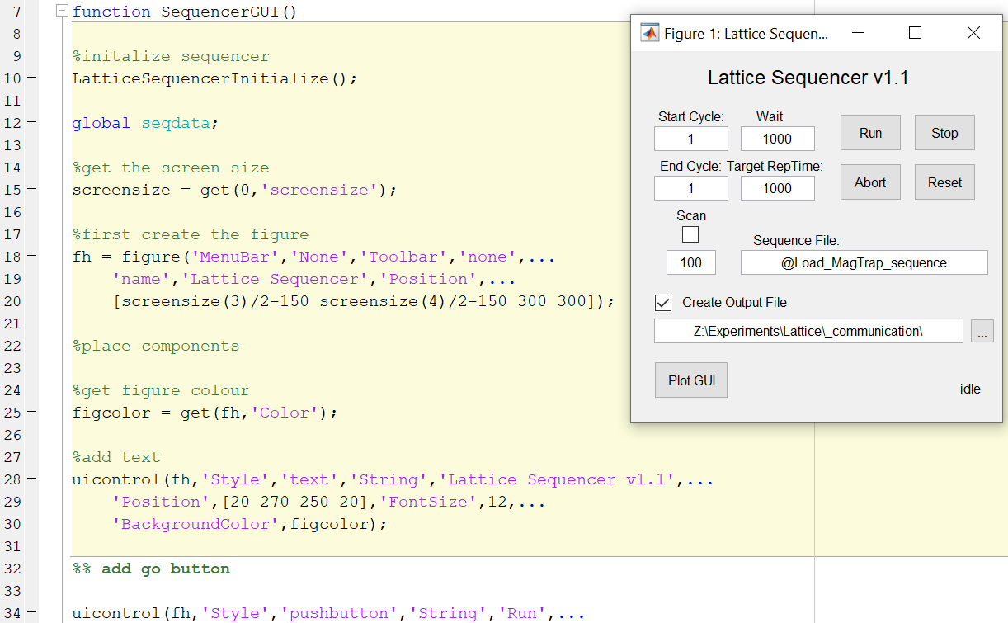
SequencerGUI.m
This is the main “root” function of the code.
Initializes the GUI
Initializes the sequencer
gui init;
Refs. simple callbacks in “guifunctions”
*the callbacks in GUI Functions can probably be condensed into this code*

