Slide 1
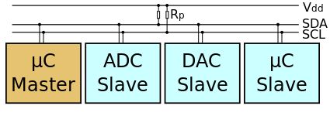
I²C architecture
Introduced by Phillips semiconductors (now NXP semiconductors)
Serial communication bus with master-slave architecture.
Slaves with individual addresses.
Communication scheme (from master’s POV):
Send start signal (start clock (SCL)), followed by slave address; do not send stop (indicates that next message is for addressed slave)
Await slave’s acknowledgement (pulling the data line (SDA) low for next SCL cycle)
Send start signal, followed by slave command (e.g. telling a DAC that channel #2 will be set)
Await slave’s acknowledgement
Send start signals, followed by additional message bytes (e.g. the most and least significant bytes (MSb, LSb) defining the DAC set value); await acknowledgement from slave after each byte.
Send stop signal
Also possible:
Slave may be prompted by the command byte to send data; sent data will be acknowledged byte-wise by master.
Address convention:
7 bits defining the address, followed by a R/iW bit – hence one byte in total
“broadcasting” addresses may be used in some cases to communicate with multiple slaves at once

Slide 2
I²C on a Raspberry Pi 2
This worked on Raspberry Pi 2, Model B with preinstalled Raspbian operating system (included Python 2.7 and Python 3.4 with IDLE)
I²C bus needs to be activated in RasPi configuration; enter via sudo raspi-config > Advanced Options > I2C
Update and upgrade packages using apt-get (just because … it will take some time, though): sudo apt-get update sudo apt-get upgrade
Install python smbus package (can also be done via pip and virtual environments): sudo apt-get install python-smbus or sudo apt-get install python3-smbus
Install i2c-tools package: sudo apt-get install i2c-tools
Run i2cdetect from i2c-tools to check bus (adapt as necessary): i2cdetect –y 0 (to list devices on bus No. 0) or i2cdetect –y 1 (for No. 1) The latter works on the Pi 2/B, the former most likely on older 256MB versions
Can now use i2cset and i2cget to write and read on the I2C bus; writing Python or C code is more useful, though.

Slide 3
Setup of the Raspberry Pi 2
Some useful things to be done after taking the Raspberry Pi out of the package (assuming preinstalled Raspbian)
Put the board into an enclosure for protection! Don’t wing it.
Add WiFi dongle, keyboard and mouse, HDMI cable to screen, and finally the power cable to start.
Could enter setup during start-up to make changes to e.g. date and time, or call it later via sudo raspi-config

Slide 4
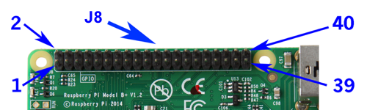
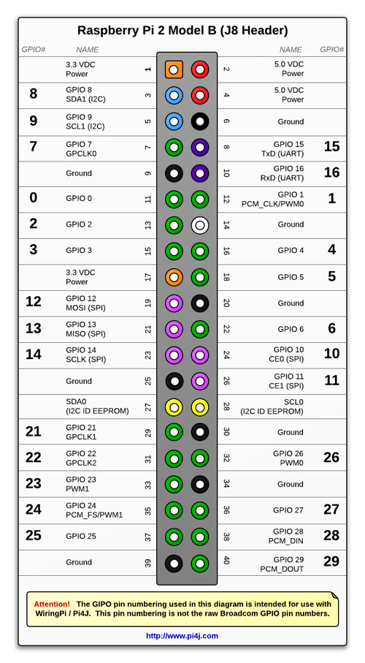
I²C on a Raspberry Pi 2; hardware
The four marked pins are used for the I²C communication: 3.3V, GND, SDA, and SCL. (see filled circles in pin-out diagram)
To protect the Raspberry Pi, use an I²C isolator (e.g. ISO1541), or an isolating SMBus multiplexer (e.g. TCA9544A). Choose secondary supply voltage according to application (could e.g. be 5V). Filter supply voltages on either side with capacitors .
Some devices may require certain pull-up resistors between SDA/SCL and the positive supply voltage (Vdd). 1.5k resistors seem to work in most cases; connect (SDA-1.5k-Vdd) and (SCL-1.5k-Vdd) on either side of the isolator / multiplexer.
Connect I²C device(s), avoiding ambiguous addresses. To check whether devices are properly connected run i2cdetect

Slide 5
I²C in python
With hardware present, the SMBus (python-smbus) package can be used to communicate via an I²C bus: from smbus import SMBus # (s)ystem (m)anagement (b)us class bus = SMBus(0) # this will open the serial bus listed as No.0
I2C data can be written to and read from this bus using bus.write_i2c_block_data(addr, cmd, byte_array) byte_array = bus.read_i2c_block_data(addr, cmd)
where addr is the address byte (7-bit address plus R/iW bit as LSB), cmd is the command byte (see respective datasheet), and byte_array is the array of bytes sent by either the master or the slave according to the command byte.
The bytes in python are basically 8-bit integers; entering them in binary, e.g. 0b01100101 may be helpful. Long bytes are read as two-element byte arrays with the first and second elements being the MSb and LSb, respectively.
I²C in C
The equivalent package exists for C (actually the origin of the python package) and the commands are basically the same.

Slide 6
py2C module
Disclaimer: there are many py2C packages that show up on google. Some are python-2-C converters (of code, specific functions, data types, …), some are i2c related and some are something else. I’m referring to my own module here (which I probably should rename)
The py2C module is supposed to provide comprehensive classes for I2C interfacable devices. At the center stands the class I2c_device(), which provides general read/write functions and register handling. It sources from the smbus package, which works well with Raspberry Pi.
A general communication structure for an I2C is:
Master transmits 7-bit address + R/iW bit; slave acknowledges
Master transmits 8-bit register pointer targeting a register in the slave device
If writing: Master transmits new content for that register (number of bytes may vary) If reading: Slave transmits content of that register
The I2c_device() interface is written for this general scheme.
Note: Some I2C devices have simpler communication schemes (e.g. “writing” 0x00 to an HIH8000 sensor triggers a measurement; reading from it (without transmitting pointer) triggers the device to send 4bytes corresponding to the recent conversion.
WORK IN PROGRESS!

Slide 7
py2C module
I2c_device().CONF_REG : This (constant) attribute should hold information about any register that contains configuration details for the device. It is a dictionary with keys ‘KEY’ referring to a tuple (pointer, start-bit, n-bits, description, value-interpretation), meaning: KEY: a keyword chosen during implementation of the device’s class; may refer to datasheet pointer: the address pointer to the register that holds the configuration detail start-bit: the lowest bit index at which the entry starts in the register n-bits: the length-in-bits of the entry in the register description: a string that provides a two/three-word descritpion value-interpretation: an array of interpretations of the possible entry values (may be as simple as [“LO”,”HI”]) The last two are just used for inline help (called via method 2c_device().config_info ). Additionally, CONF_REG must contain a key ‘nbytes’ that refers to the number of bytes per register (e.g. ADS1015 has a 16-bit architecture, i.e. 2 bytes per register – see next slide)
In similar fashion, I2c_device()has a place holder STAT_REG for registers holding status information (this may be merged with STAT_REG in the future.
WORK IN PROGRESS!

Slide 8
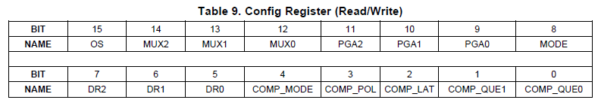
py2C module
CONF_REG example: ADS1015 (4-channel ADC with programmable gain and comparator) The class ADS1015() indirectly inherits from I2c_device() (directly from ADS1015()), the CONF_REG dictionary is directly derived from the datasheet.
CONF_REG = {\ 'nbytes':2,\ 'OS':(0x01,15,1,'Operative status',['CONV','IDLE']),\ 'MUX':(0x01,12,3,'MUX setting',\ ["AIN0-AIN1","AIN0-AIN3","AIN1-AIN3","AIN2-AIN3",\ "AIN0-GND","AIN1-GND","AIN2-GND","AIN3-GND"]),\ 'PGA':(0x01,9,3,'PGA setting',\ [6.144,4.096,2.048,1.024,0.512,0.256,0.256,0.256]),\ 'MODE':(0x01,8,1,'Conversion mode',["CONT","SNGL"]),\ 'DR':(0x01,5,3,'Data rate',[128,250,490,920,1600,2400,3300]),\ 'COMP_MODE':(0x01,4,1,'Comparator mode',[0,1]),\ 'COMP_POL':(0x01,3,1,'Alert-pin polarity',[0,1]),\ 'COMP_LAT':(0x01,2,1,'Comparator latch',[0,1]),\ 'COMP_QUE':(0x01,0,2,'Comp. queuing',[1,2,4,"OFF"]),\ }
WORK IN PROGRESS!

