Slide 1

Inheritance
Capability to Inherit Other Properties
SoftUni Team
Technical Trainers
Software University
https://softuni.bg
Notes:
1
© SoftUni – https://softuni.org. Copyrighted document. Unauthorized copy or reproduction is not permitted.

Slide 2
Table of Contents
Inheritance
The super() method
Forms of Inheritance
Single Inheritance
Multiple Inheritance
Multilevel Inheritance
Hierarchical Inheritance
Mixins
2
Notes:
2
© SoftUni – https://softuni.org. Copyrighted document. Unauthorized copy or reproduction is not permitted.

Slide 3
Have a Question?
sli.do
#python-advanced
3

Slide 4

Inheritance
Capability to Inherit Other Properties

Slide 5
The Four Basics Concepts of OOP
Inheritance - extend the functionality of the code's existing classes to eliminate repetitive code
Encapsulation - stop objects from interacting with each other so classes cannot change or interact with the specific variables and functions of an object
Abstraction - isolate the impact of changes made to the code so the change will only affect the variables shown and not the outside code
Polymorphism - allows different classes to have methods with the same name
5

Slide 6
Inheritance
Inheritance is the capability of one class to inherit the methods and properties from another class
Benefits of inheritance:
Code reusability
Add features to a class without modifying it
It is transitive in nature
6

Slide 7
Example: Inheritance
class Person:
def __init__(self, first_name, last_name):
self.first_name = first_name
self.last_name = last_name
def get_full_name(self):
return f'{self.first_name} {self.last_name}'
class Student(Person):
pass
# An Object of class Student
student = Student("John", "Smith")
print(student.get_full_name())
# John Smith
Subclassing
7

Slide 8
The super() Method
Built-in method which returns a temporary object of the superclass
Allows you to call methods of the superclass in your subclass
The primary use case of this is to extend the functionality of the inherited method
8

Slide 9
Example: super() Method
class Person:
def __init__(self, name, age):
self.name = name
self.age = age
def get_info(self):
return f'{self.name} is {self.age} years old.'
class Student(Person):
def __init__(self, name, age, student_id):
super().__init__(name, age)
self.student_id = student_id
def get_id(self):
return self.student_id
# Create an object of the superclass
person = Person("John", 25)
print(person.get_info())
# returns 'John is 25 years old.'
# Create an object of the subclass
student = Student("Leo", 20, 10035464)
print(student.get_info())
# returns 'Leo is 20 years old.'
print(student.get_id())
# returns 10035464
9

Slide 10
Problem: Food
Create two classes named Food and Fruit
Food will receive expiration_date upon initialization
Fruit will receive name and expiration_date upon initialization
Fruit should inherit from Food
10

Slide 11
Solution: Food
class Food:
def __init__(self, expiration_date):
self.expiration_date = expiration_date
class Fruit(Food):
def __init__(self, name, expiration_date):
super().__init__(expiration_date)
self.name = name
11

Slide 12

Forms of Inheritance
Single, Multiple and Multilevel

Slide 13
Forms of Inheritance
There are four types of inheritance
Single
Multiple
Multilevel
Hierarchical
Hybrid Inheritance - consists of multiple types of inheritance
13

Slide 14
Single Inheritance
When a child class inherits properties from a single parent class only
class Parent:
def say_hi(self):
return "Hello!"
class Child(Parent):
def go_school(self):
return "I go to school."
child = Child()
print(child.say_hi()) # Hello!
print(child.go_school()) # I go to school.
14

Slide 15
Problem: Single Inheritance
Create two classes named Animal and Dog
Animal with a single method eat() that returns: "eating…"
Dog with a single method bark() that returns: "barking…"
Dog should inherit from Animal
15

Slide 16

Solution: Single Inheritance
class Animal:
def eat(self):
return "eating..."
class Dog(Animal):
def bark(self):
return "barking..."
# dog = Dog()
# print(dog.eat())
# print(dog.bark())
16

Slide 17
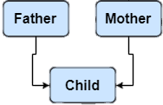
Multiple Inheritance
When a child inherits from more than one parent class
Allows modeling of complex relationships
17

Slide 18
Example: Multiple Inheritance
class Father:
def __init__(self):
self.father_name = 'Taylor Evans'
class Mother:
def __init__(self):
self.mother_name = 'Bet Williams'
class Daughter(Father, Mother):
def __init__(self):
Father.__init__(self)
Mother.__init__(self)
def get_parent_info(self):
return f'Father: {self.father_name}, Mother: {self.mother_name}'
child = Daughter()
print(child.get_parent_info())
# Father: Taylor Evans, Mother: Bet Williams
Calling constructors of both parent classes
18

Slide 19
Problem: Multiple Inheritance
Create three classes named Person, Employee and Teacher
Person with a single method sleep() that returns: "sleeping…"
Employee with a single method get_fired() that returns: "fired…"
Teacher with a single method teach() that returns: "teaching…"
Teacher should inherit from Person and Employee
19

Slide 20
Solution: Multiple Inheritance
class Person:
def sleep(self):
return "sleeping..."
class Employee:
def get_fired(self):
return "fired..."
class Teacher(Person, Employee):
def teach(self):
return "teaching..."
20

Slide 21

Multilevel Inheritance
When a child class becomes a parent class for another child class
In Python, multilevel inheritance can be done at any depth
21

Slide 22
Example: Multilevel Inheritance (1)
class Parent:
def __init__(self, name):
self.name = name
def get_name(self):
return self.name
class Child(Parent):
def __init__(self, name, age):
super().__init__(name)
self.age = age
def get_age(self):
return self.age
22

Slide 23
Example: Multilevel Inheritance (2)
class GrandChild(Child):
def __init__(self, name, age, address):
super().__init__(name, age)
self.address = address
def get_address(self):
return self.address
grand_child = GrandChild("Grand Name", 19, "Address 15-17")
print(grand_child.name) # Grand Name
print(grand_child.age) # 19
print(grand_child.address) # Address 15-17
23

Slide 24
Problem: Multilevel Inheritance
Create three classes named Vehicle, Car and SportsCar
Vehicle with a single method move() that returns: "moving…"
Car with a single method drive() that returns: "driving…"
SportsCar with a single method race() that returns: "racing…"
SportsCar should inherit from Car and Car should inherit from Vehicle
24

Slide 25
Solution: Multilevel Inheritance
class Vehicle:
def move(self):
return "moving..."
class Car(Vehicle):
def drive(self):
return "driving..."
class SportsCar(Car):
def race(self):
return "racing..."
25

Slide 26
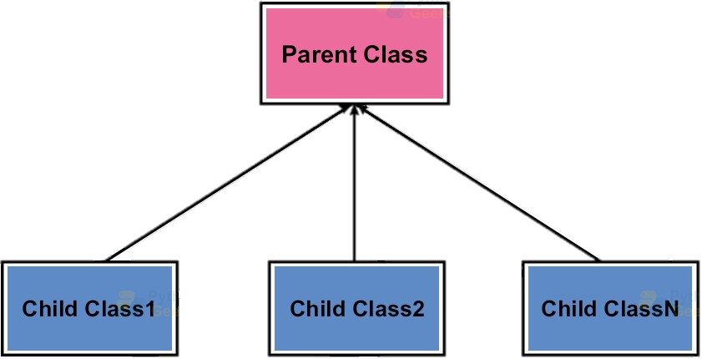
Hierarchical Inheritance
When more than one child classes are created from a single parent class
26

Slide 27
Example: Hierarchical Inheritance
class Parent:
def init(self, name):
self.name = name
def say_hi(self):
return f"Hi! I am {self.name}"
class Daughter(Parent):
def __init__(self, name):
super().__init__(name)
def relation(self):
return "I am my parent's daughter"
class Son(Parent):
def __init__(self, name):
super().__init__(name)
def relation(self):
return "I am my parent's son"
Both child classes reuse the same code
27

Slide 28
Problem: Hierarchical Inheritance
Create three classes named Animal, Dog and Cat
Animal with a single method eat() that returns: "eating…"
Dog with a single method bark() that returns: "barking…"
Cat with a single method meow() that returns: "meowing…"
Both Dog and Cat should inherit from Animal
28

Slide 29
Solution: Hierarchical Inheritance
class Animal:
def eat(self):
return "eating..."
class Dog(Animal):
def bark(self):
return "barking..."
class Cat(Animal):
def meow(self):
return "meowing..."
29

Slide 30

Method Resolution Order
In Python 3

Slide 31
MRO in Python 3
It is the order in which methods should be inherited in the presence of multiple inheritance
Python 3 uses the C3 linearization algorithm for MRO
It is possible to see MRO of a class using mro() method of the class
31

Slide 32
Example: MRO
class Parent:
pass
class FirstChild(Parent):
pass
class SecondChild(Parent):
pass
class GrandChild(SecondChild, FirstChild):
pass
print(GrandChild.mro())
# [<class '__main__.GrandChild'>, <class '__main__.SecondChild'>, <class '__main__.FirstChild'>, <class '__main__.Parent'>, <class 'object'>]
The Diamond Problem
32

Slide 33

Mixins
"mix in" extra properties and methods

Slide 34
Mixins
A mixin is a class that is implementing a specific set of features that is needed in many different classes
A mixin is a class which has no data, only methods
Mixins cannot be instantiated by themselves
We use mixins to extend functionality
34

Slide 35
Mixins Advantages
Provides non-complex mechanisms of multiple inheritance
Provides code reusability
Allow inheritance and use of only desired features from the parent class, not all of them

Slide 36
Example: Mixins
class Vehicle:
def __init__(self, position):
self.position = position
def travel(self, destination):
pass
class Car(Vehicle):
pass
class Clock():
pass
class RadioMixin():
def play_song_on_station(self, station_frequency):
return f'playing song on radio frequency {station_frequency}'
class Car(Vehicle, RadioMixin):
pass
class Clock(RadioMixin):
pass
car = Car('Sofia')
clock = Clock()
print(car.play_song_on_station(95.0)) # playing song on radio frequency 95.0
print(clock.play_song_on_station(100.3)) # playing song on radio frequency 100.3
36

Slide 37

Summary
Inheritance is the capability to inherit the properties from some another class
super() method allows us to call methods of the superclass in your subclass
Mixins implement a set of features that is needed in many different classes
37
Notes:
37
© SoftUni – https://softuni.org. Copyrighted document. Unauthorized copy or reproduction is not permitted.

Slide 38
Questions?
Notes:
38
© SoftUni – https://softuni.org. Copyrighted document. Unauthorized copy or reproduction is not permitted.

Slide 39













SoftUni Diamond Partners

Slide 40


Educational Partners

Slide 41

License
This course (slides, examples, demos, exercises, homework, documents, videos and other assets) is copyrighted content
Unauthorized copy, reproduction or use is illegal
© SoftUni – https://about.softuni.bg
© Software University – https://softuni.bg
41
Notes:
41
© SoftUni – https://softuni.org. Copyrighted document. Unauthorized copy or reproduction is not permitted.

Slide 42
Trainings @ Software University (SoftUni)
Software University – High-Quality Education, Profession and Job for Software Developers
softuni.bg, softuni.org
Software University Foundation
softuni.foundation
Software University @ Facebook
facebook.com/SoftwareUniversity
Software University Forums
forum.softuni.bg
42
Notes:
42
© SoftUni – https://softuni.org. Copyrighted document. Unauthorized copy or reproduction is not permitted.

