Slide 1
ENERGY DEMAND PREDICTION USING MACHINE LEARNING
GROUP-6

Slide 2
Team Members
Tia Moncy
Ann Rachel Sujith
Megha B
Aazim Rahman
Mityish Manoj Nair

Slide 3
INTRODUCTION
Electricity demand varies throughout the day and across different seasons due to changes in weather conditions and human activities. Factors such as temperature, time of day, and special events significantly influence energy consumption patterns. During extreme weather conditions, such as very high or very low temperatures, electricity usage tends to increase. Accurate prediction of energy demand is essential for efficient power generation, proper distribution, and reducing energy wastage. In this project, machine learning techniques are used to analyze historical data and forecast future electricity demand more effectively.

Slide 4
Problem Statement
The objective of this project is to predict electricity demand in megawatts using historical environmental and time-based data. Since energy demand is a continuous numerical value, the problem is approached using supervised machine learning regression techniques. The model analyzes features such as temperature, hour, day, month, and holiday information to identify patterns and generate accurate demand predictions.
Predict Energy_Demand_MW accurately
Use historical temperature and time-based features
Apply supervised machine learning (Regression)
Improve forecasting accuracy
Support efficient power generation and distribution

Slide 5
Dataset Overview
The dataset used in this project consists of historical electricity consumption data along with environmental and time-based variables. These features help capture daily patterns, seasonal trends, and special event variations in energy usage. The dataset is structured to support supervised learning, where input features are used to predict electricity demand in megawatts.
Dataset Characteristics:
Contains historical energy demand records
Includes environmental and temporal features
Structured for regression modeling
Captures daily and seasonal consumption patterns
Used for training and testing machine learning models

Slide 6
Data Cleaning
The dataset underwent a comprehensive data cleaning process to ensure accuracy and reliability before analysis. Initially, duplicate records were identified and removed to prevent redundancy and bias in the results. The Timestamp column was then converted into a proper datetime format to enable accurate time-based analysis. From this timestamp, additional features such as Hour, Day, and Month were extracted to capture hourly trends, daily patterns, and seasonal variations in electricity consumption. Finally, outliers in energy usage were treated using the Interquartile Range (IQR) method by calculating Q1, Q3, and the IQR to remove values falling outside the acceptable range. These steps enhanced the overall quality, consistency, and suitability of the dataset for regression modeling and machine learning analysis.

Slide 7
Exploratory Data Analysis (Overview)
Exploratory Data Analysis (EDA) is a crucial step performed before building machine learning models, as it helps in understanding the structure, patterns, and distribution of the dataset. Through EDA, we analyze trends, variations, and anomalies in electricity consumption to gain meaningful insights. It helps identify relationships between energy usage and features such as time, environmental factors, and seasonal changes. By examining correlations and patterns, EDA enables better feature selection and improves understanding of how variables influence the target value. This process ultimately supports informed decision-making and helps in selecting the most suitable regression models for accurate prediction of electricity demand.

Slide 8
Feature Engineering
Feature engineering was performed to enhance the predictive capability of the model by creating meaningful new variables from existing features. An interaction feature, Temperature × Hour, was created to capture how temperature impacts electricity demand differently at various times of the day. For example, high temperatures during peak hours may result in significantly higher demand compared to the same temperature at night. Additionally, a Temperature² (squared temperature) feature was introduced to model the non-linear relationship between temperature and demand. Since electricity usage increases at both very high and very low temperatures, linear features alone cannot capture this curved pattern effectively. Incorporating non-linear features improves model accuracy by allowing it to better understand complex relationships within the data.

Slide 9
Model Building
To predict electricity demand accurately, multiple machine learning models were implemented and compared. Linear Regression was used as a baseline model to understand the direct relationship between input features and energy demand. It assumes a linear relationship and provides a simple, interpretable foundation for comparison. Ridge Regression was then applied to improve performance by adding regularization, which helps reduce overfitting and manages multicollinearity among features. Finally, Random Forest was implemented as an advanced ensemble model that builds multiple decision trees and combines their outputs for better accuracy. Unlike linear models, Random Forest can capture complex and non-linear relationships in the data, making it highly effective for electricity demand forecasting.

Slide 10
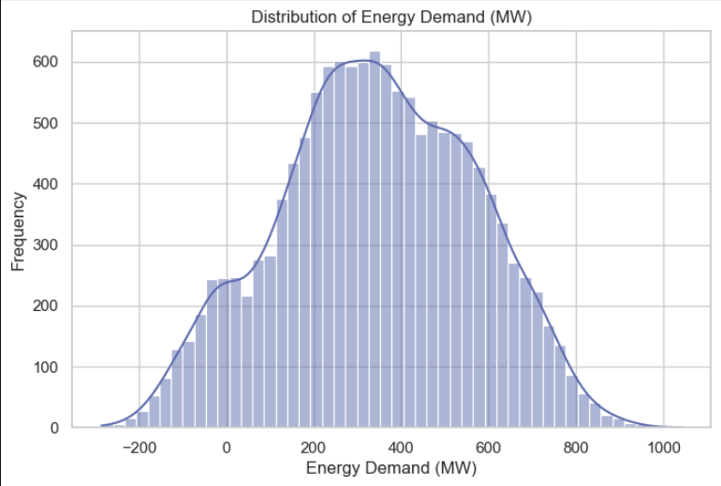
Distribution of Energy
Demand (MW)
The histogram shows the overall distribution of energy demand values.
Most demand values are concentrated in the mid-range.
The distribution appears slightly skewed, with some extreme high and low values.
Presence of outliers suggests occasional unusually high demand periods.

Slide 11
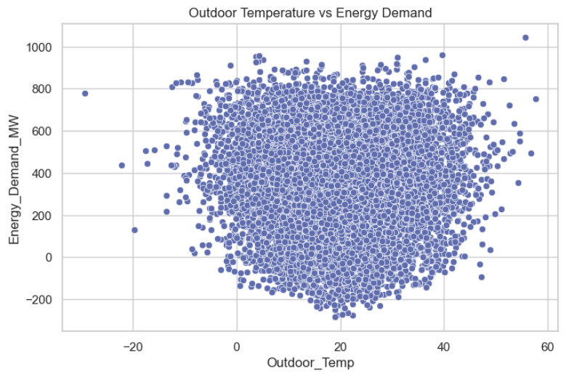
Temperature vs Energy Demand
The scatter plot shows a non-linear relationship between outdoor temperature and energy demand.
Demand increases at very low temperatures (heating usage).
Demand also rises at high temperatures (air conditioning usage).
Moderate temperatures show comparatively lower demand.

Slide 12
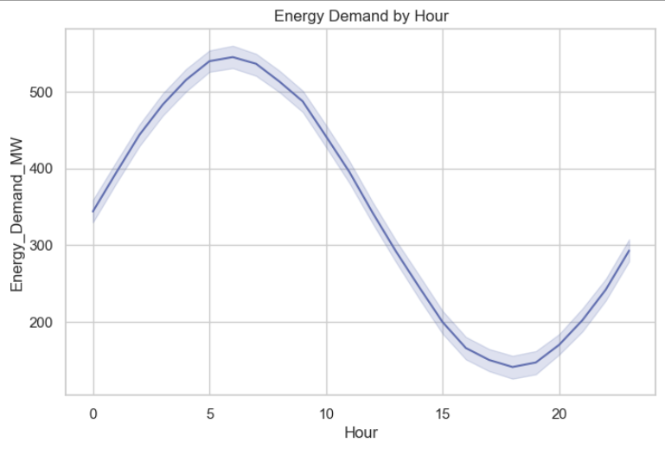
Energy Demand
by Hour
The line plot shows a clear daily demand pattern.
Demand peaks in the early morning hours.
It gradually decreases in the afternoon.
The lowest demand occurs in the late afternoon/evening before rising again at night.

Slide 13
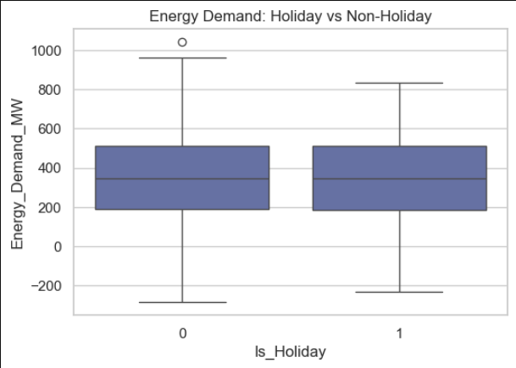
Energy Demand:
Holiday vs Non-Holiday
The boxplot compares electricity demand on holidays (1) and non-holidays (0).
The overall distribution and median demand are quite similar.
Slight variations suggest changes in residential vs commercial usage patterns.
A few outliers indicate occasional unusually high or low demand.

Slide 14
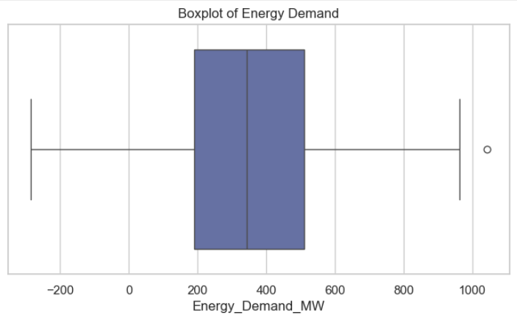
Boxplot of Energy Demand
The boxplot summarizes the spread of energy demand values.
The median demand lies in the mid-range, showing typical daily consumption levels.
The wide interquartile range (IQR) indicates significant variability in demand.
Presence of outliers suggests occasional extreme demand spikes.

Slide 15
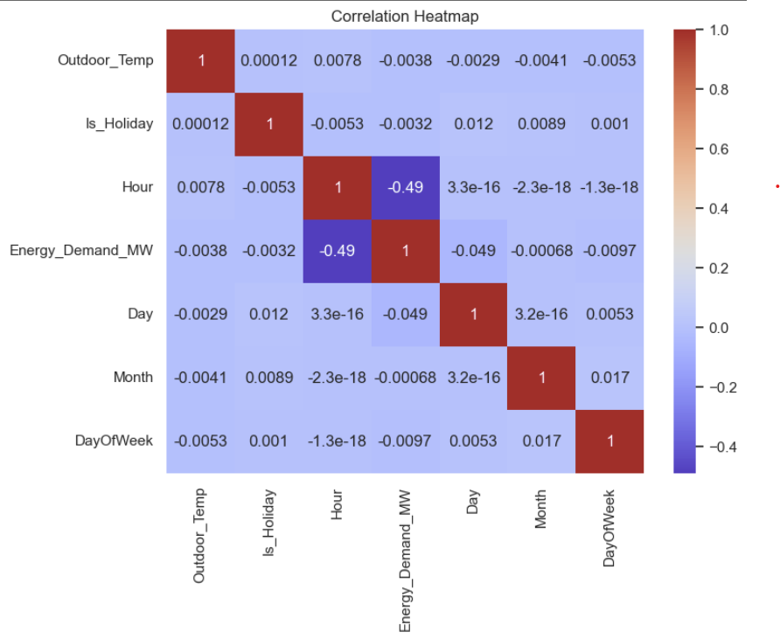
Correlation Heatmap
The heatmap shows the correlation between all features and energy demand.
Hour has the strongest relationship with energy demand (moderate negative correlation in this dataset).
Most other features show weak linear correlation.
No strong multicollinearity is observed between input features.

Slide 16
Time-Series Feature Engineering
-Created Lag_1 and Lag_24 features
-Added rolling mean & rolling standard deviation
-Captured temporal dependency in energy demand
-Improved model accuracy compared to basic regression

Slide 17
Model Comparison Table
The problem shows strong linear dependency once temporal features are added. Therefore, regularized linear models achieved excellent performance.
Model | R² Score
Linear | 0.960212
Ridge | 0.960218
Random Forest | 0.960220

Slide 18
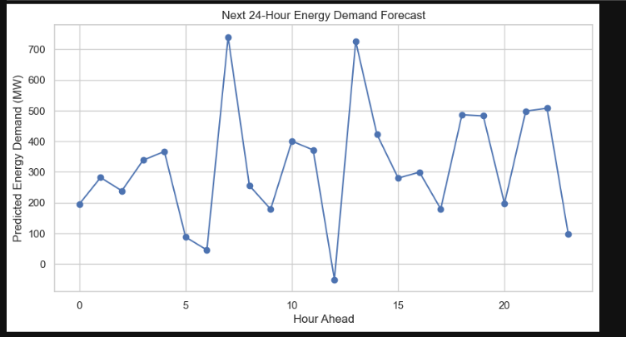
24-Hour Forecast Visualization
Demand peaks during specific hours
Model captures hourly trend
Useful for generation planning

Slide 19
Temperature Spike Simulation
Demand rises significantly during temperature spike
Highlights risk during heatwaves
Supports proactive grid planning

Slide 20
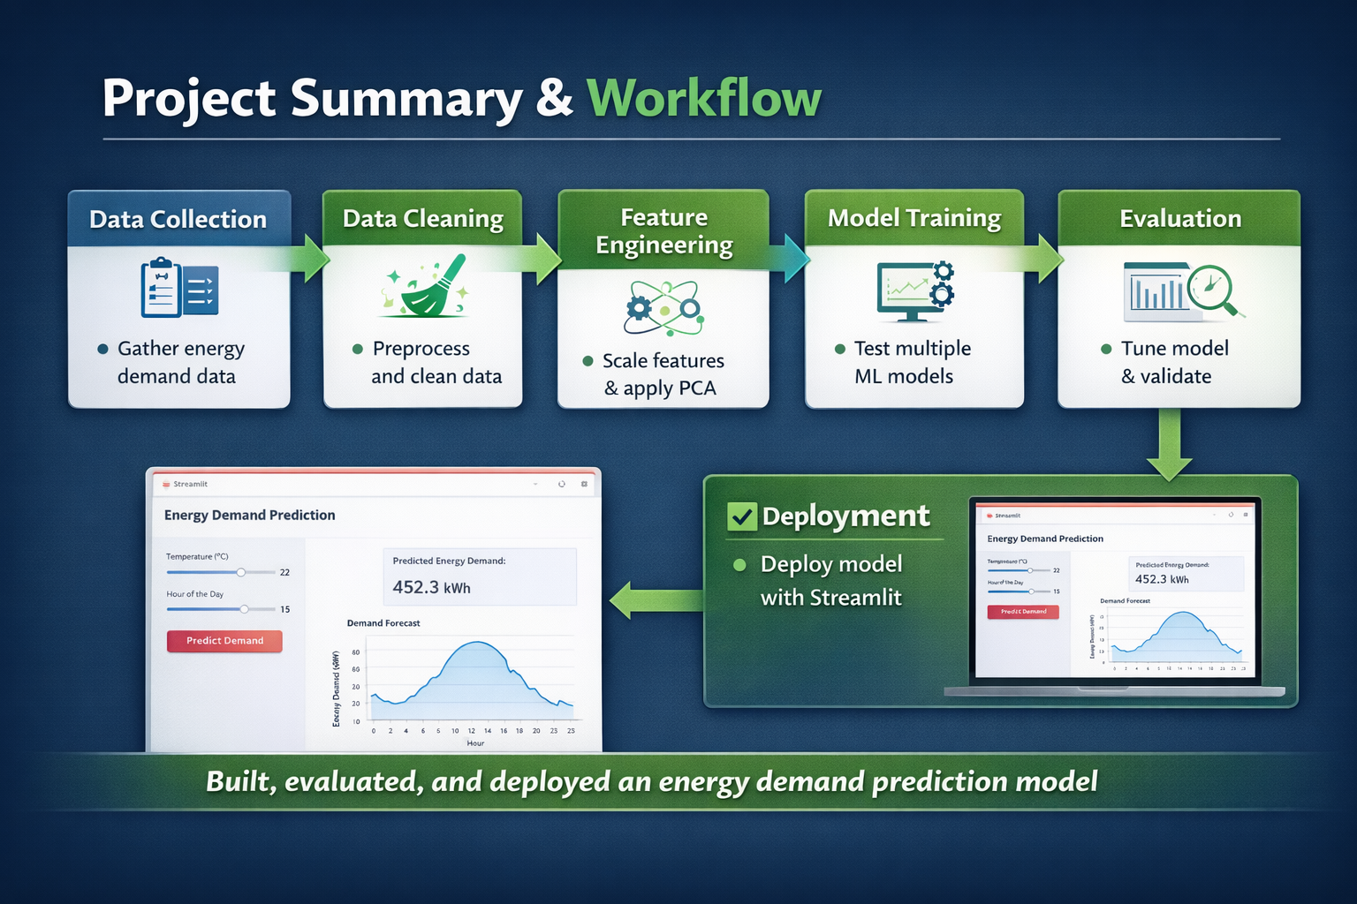
Project Summary & Workflow
Project Summary
Collected and preprocessed energy demand dataset
Performed exploratory data analysis to identify patterns
Applied feature scaling and dimensionality reduction
Trained multiple machine learning models
Compared model performance using cross-validation
Selected best model based on evaluation metrics
Built end-to-end machine learning pipeline
Workflow

Slide 21
Key Findings & Model Performance
Key Findings
Energy demand strongly depends on temperature variations
Time-based features (hour/day patterns) influence consumption
Non-linear relationships exist within the dataset
Feature preprocessing improves prediction accuracy
Model Performance
Linear models provided baseline results
Ridge regression improved stability
Random Forest achieved highest accuracy
Cross-validation confirmed model reliability
Key Learnings
Model selection significantly affects performance
Hyperparameter tuning improves results
Ensemble models handle complex patterns better

Slide 22
Deployment & Final Conclusion
Final Conclusion
Successfully developed an energy demand prediction system
Random Forest selected as final optimized model
Temperature and time are key predictors
Deployment makes model accessible and practical
System supports data-driven energy management decisions
Cross-validation ensured model generalization
Model reduces blackout risk
Supports sustainable grid management
Deployment
Model deployed using Streamlit application
Interactive interface for user input
Real-time energy demand prediction
Model saved and loaded using joblib

Slide 23
THANK YOU

