Slide 1

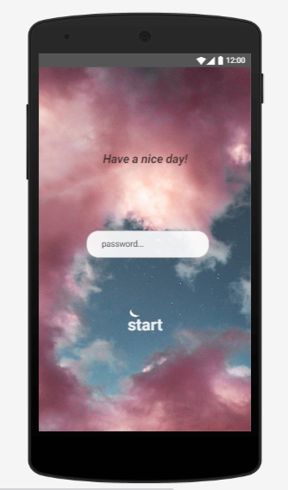
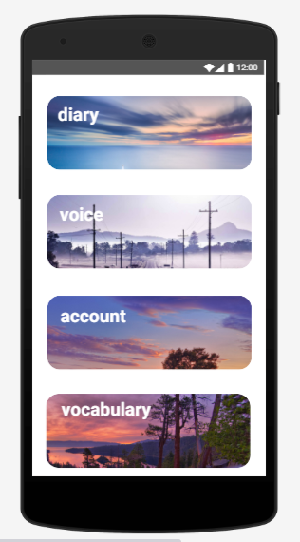
Android application (Xamarin)
Dairy
Voice
Account
Vocabulary
Anniversary
https://modao.cc/app/MQuCiQ6pqLN0dUQD7Nr00equsoi88nE

Slide 2
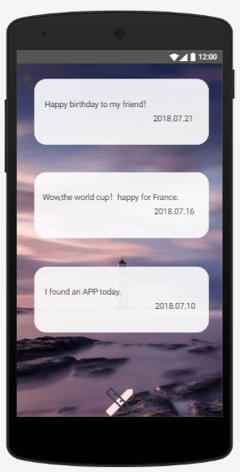
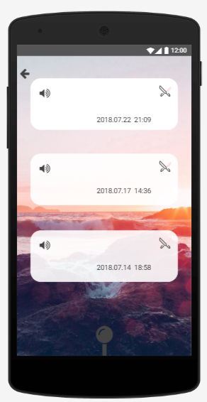
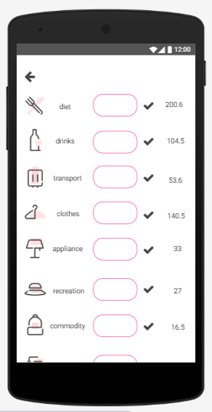
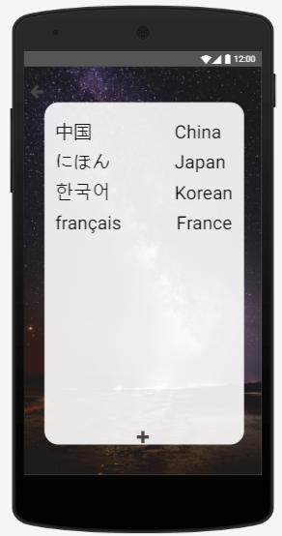
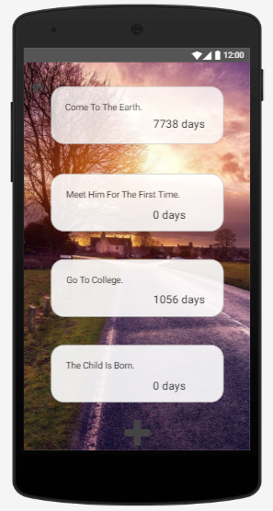
Diary Voice Account Vocabulary Anniversary

