Slide 1
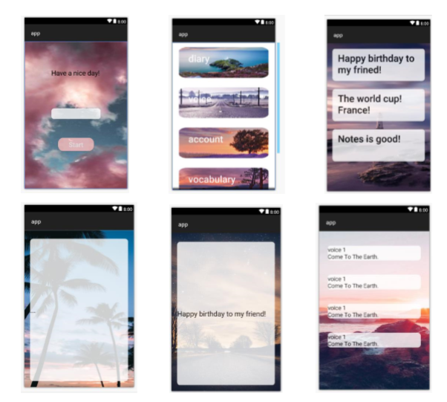
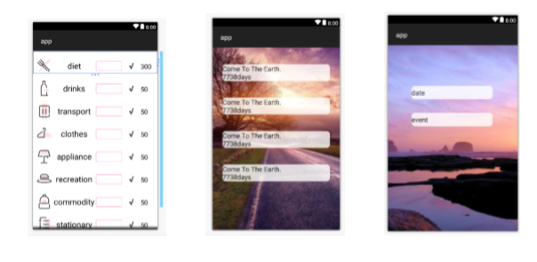
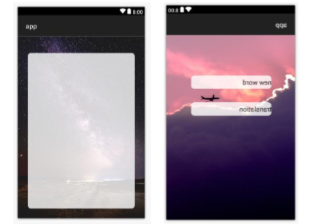
Finished all layouts

Slide 2
Plan 1. layout optimization 2. add activity https://github.com/tia0518/SIT313_code

