Slide 1
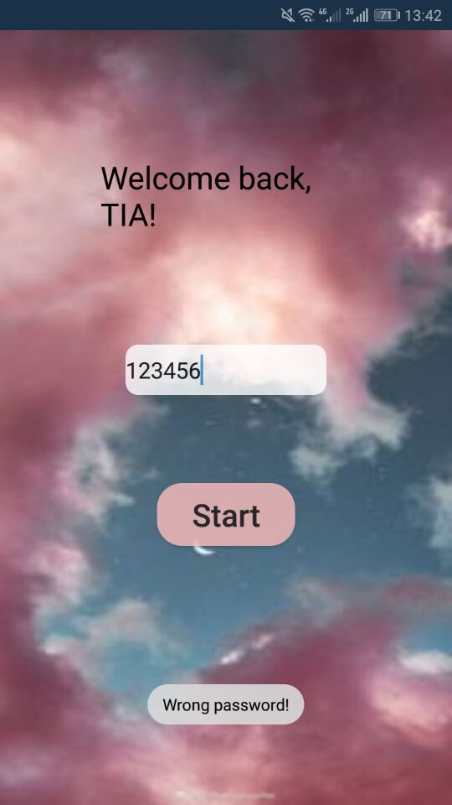
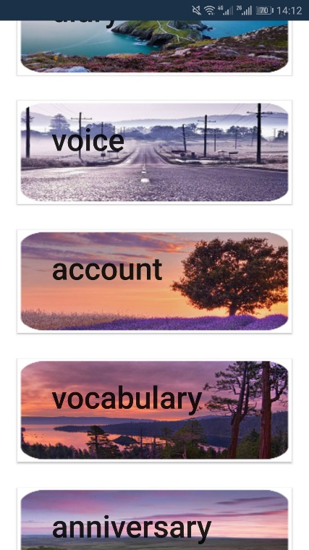
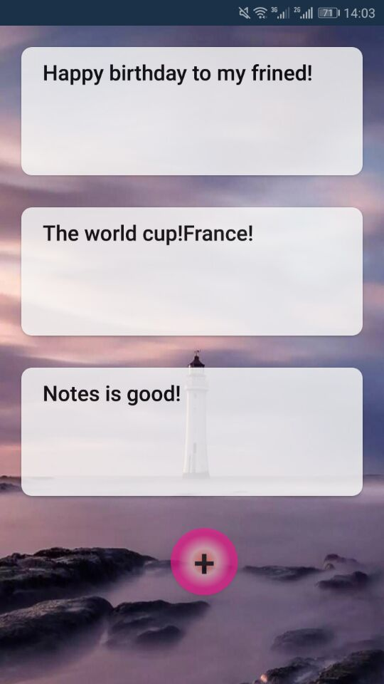
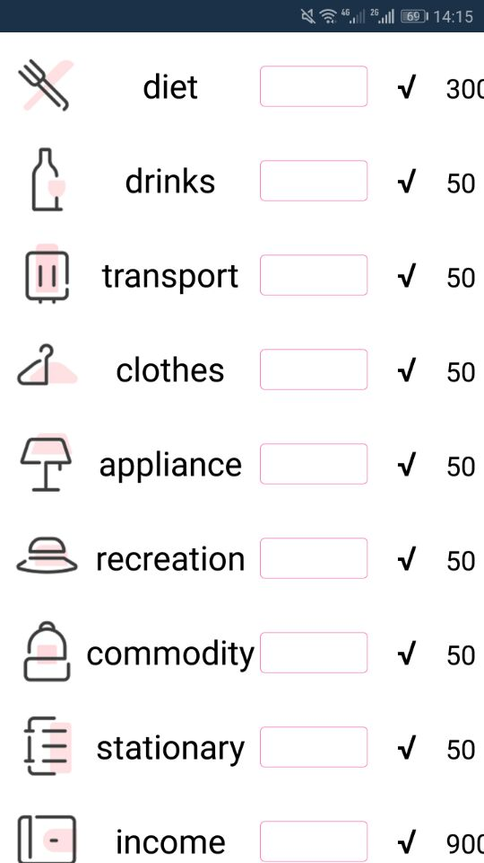
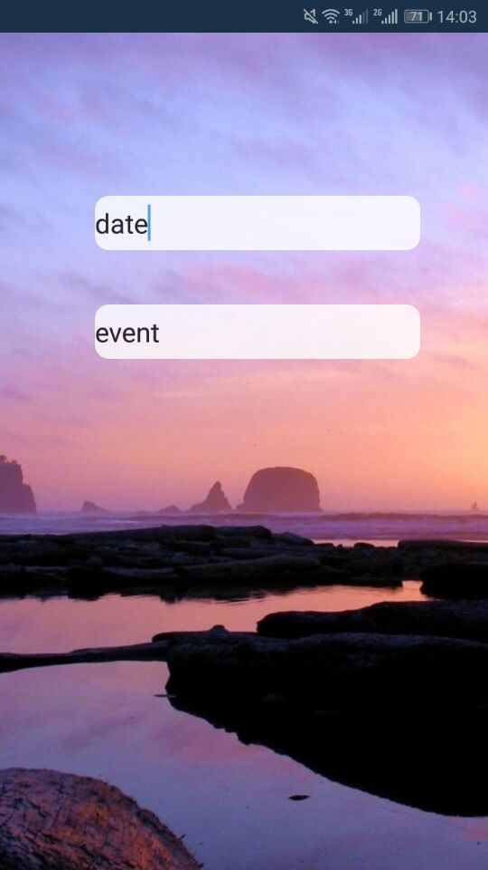
What I have implemented and time spent
1. finished all layouts optimization (1 day)
2. finished logical structure of the application (2 days)

Slide 2
Plan
1. edit / add new file
2. save file
3. play / add new audio
4. save account
5. calculate the number of days
https://github.com/tia0518/SIT313_code

