Slide 1
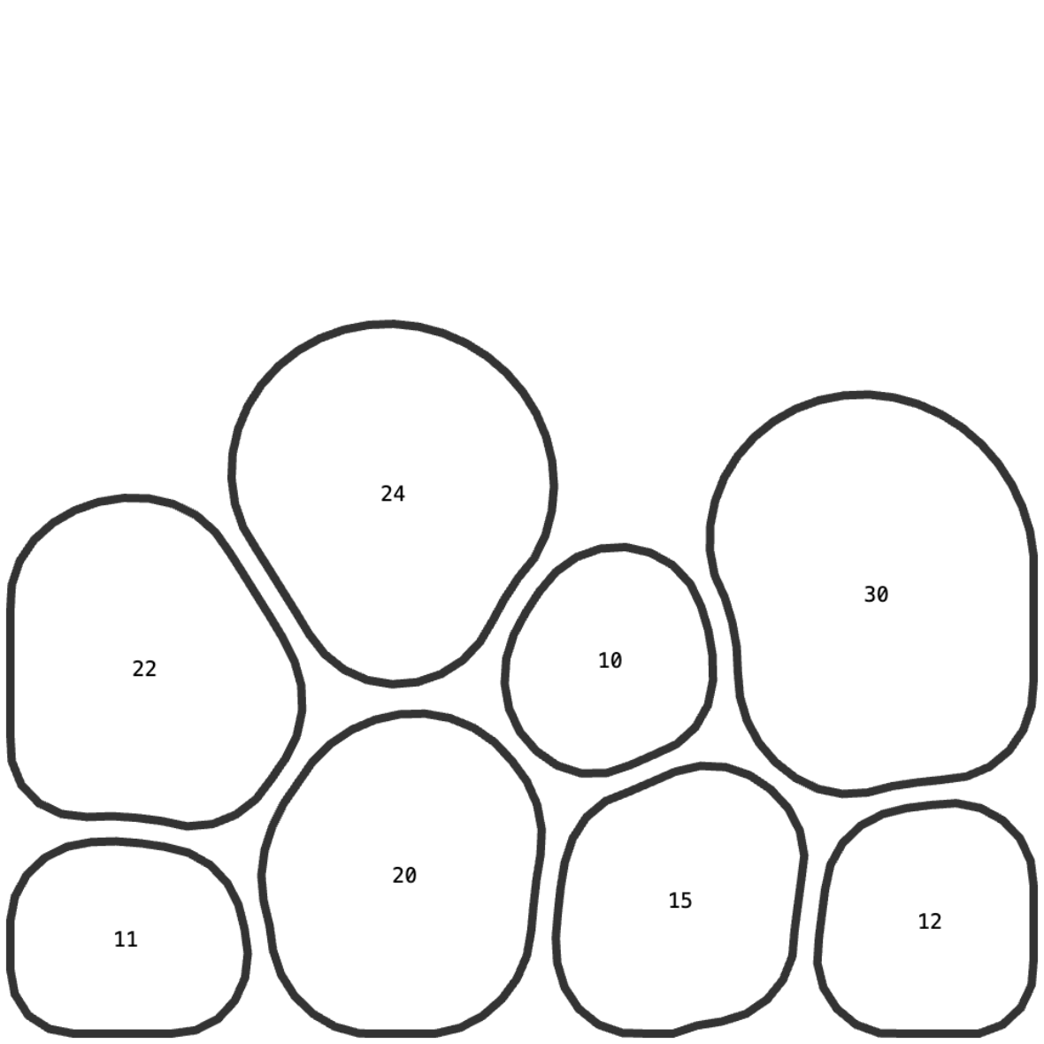

Slide 2
A
B

Slide 3
A
B

Slide 4
B
A

Slide 5
A
B

Slide 6
A
B

Slide 7
A
B

