Slide 1
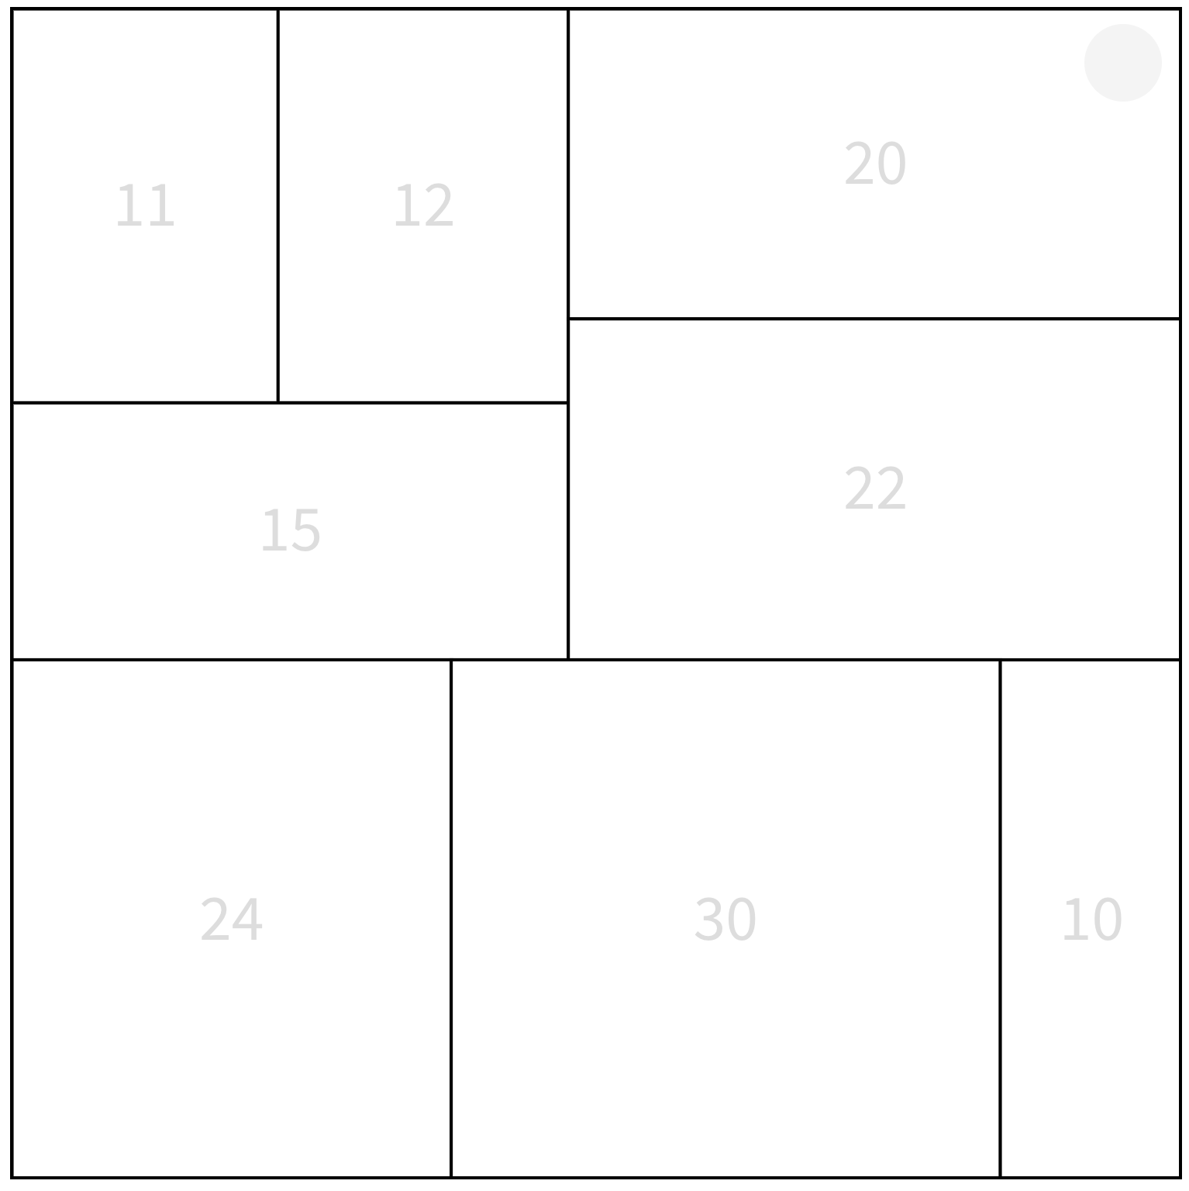

Slide 3
B
A

Slide 4
A
B

Slide 5
B
A

Slide 6
B
A

Slide 7
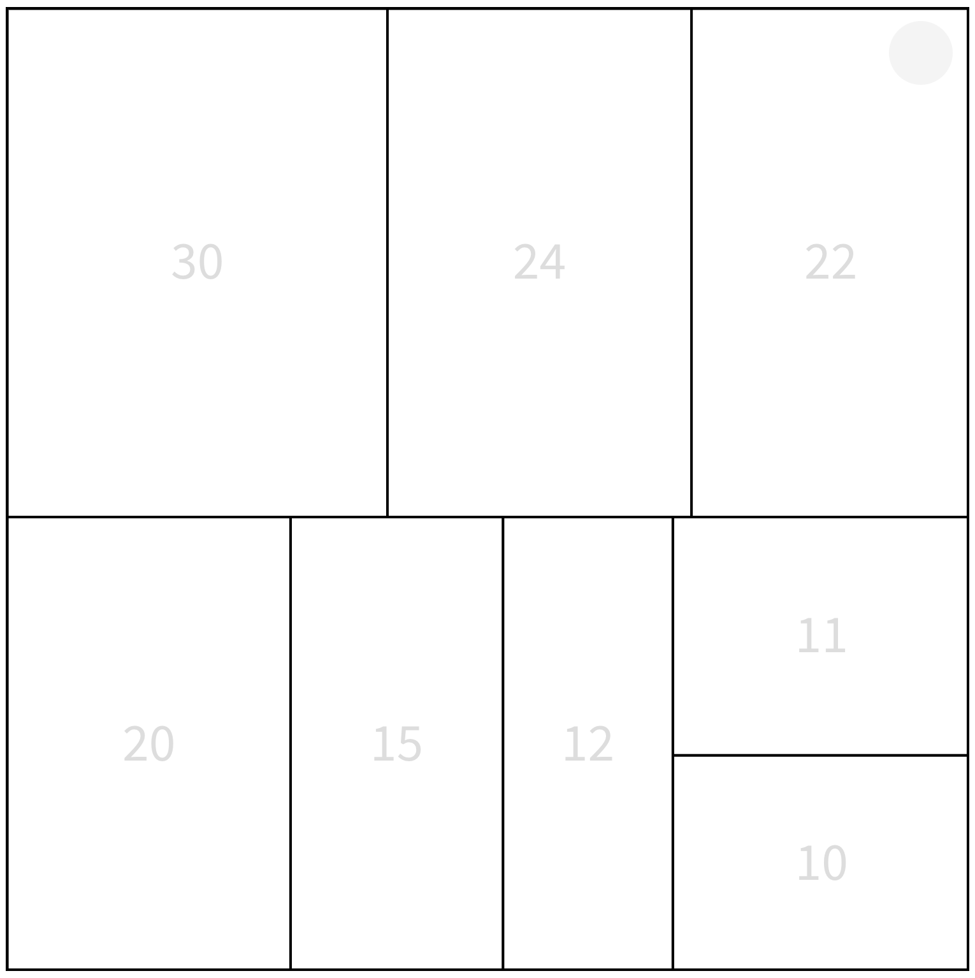

Slide 8
A
B

Slide 9
B
A

