Slide 1
From IoT Devices to Analytics – Generic Data Flow
ARCHITECTURE
IOT & CLOUD ARCHITECTURE
IoT & Connectivity
Cloud & Big Data
Business Apps
Big Data Architecture
IoT Gateway
Some functions applied to data
Data Buffer
Data aggregation
Security validations
Quality of Service (QoS) SLAs
Data Storage
Application of business rules
Data warehousing
Data Lake storage
Analytics
Recommendation Systems
Predictive analytics
Reporting
Sensors
Stream / Edge Analytics
Storage & Analytics Architecture
Analytics
Clustering
Recommendation Systems
Discussion of Results

Slide 2
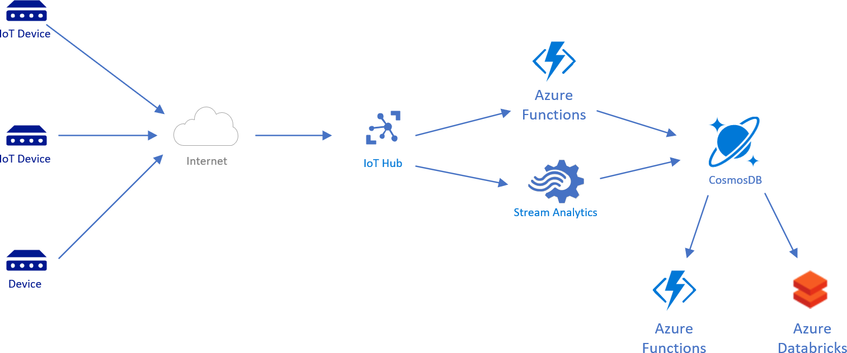
From IoT Devices to Analytics – Azure IoT Serverless Architecture
ARCHITECTURE
IOT & CLOUD ARCHITECTURE
Big Data Architecture
Our goal: simplicity, scalability and application interoperability
over unneeded functionality
Storage & Analytics Architecture
Analytics
Clustering
Recommendation Systems
Discussion of Results

Slide 3


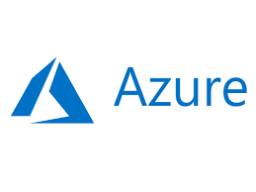
Big Data – Why Azure Databricks?
ARCHITECTURE
IoT & Cloud Architecture
BIG DATA ARCHITECTURE
Big Data Environment for fast Spark development and low maintenance costs
Reduces the need for cluster management
Ensures the compatibility of code history and Spark Versions
Very extensive API for app development
Integration with a wide variety of data stores and services such as Azure SQL Data Warehouse, Azure Cosmos DB, Azure Data Lake Store, Azure Blob storage, and Azure Event Hub
Storage & Analytics Architecture
Analytics
Clustering
Recommendation Systems
Discussion of Results

Slide 4
Storage – Why Azure Cosmos DB?
ARCHITECTURE
IoT & Cloud Architecture
BIG DATA Architecture
In our serverless architecture, Azure Cosmos DB provides the ideal integration to store IoT data. Azure provides a straightforward cloud solution for IoT scenarios:
IoT Hub (getting the data from IoT devices)
Azure Functions (to apply some kind of logic to data or to identify the database)
Azure Cosmos DB, to store the data and provide a persistence layer for both data science and dev teams data
Cosmos DB in short:
A globally replicated and scalable database
A complete SDK available in multiple programming languages
An API oriented towards modern web app development
Connectivity to Databricks (both read and write)
STORAGE & ANALYTICS ARCHITECTURE
Analytics
Clustering
Recommendation Systems
Discussion of Results

Slide 5



Analytics – Power BI and connectivity to Databricks
ARCHITECTURE
IoT & Cloud Architecture
BIG DATA Architecture
Power BI is a business analytics service providing interactive visualizations with self-service business intelligence capabilities.
In our context:
Power BI can turn insights stored in Databricks tables into easy-to-set visualizations which can be shared across the entire organization
Clustering and recommendation systems can be built via scripting in R or Python
Power BI can be embedded in web applications, easing the development time and cost of analytical solutions
Power BI itself is very easily extendable through its marketplace and API
If needed, Power BI also provides a high-level ETL framework via its “Query Editor” and the M language
STORAGE & ANALYTICS ARCHITECTURE
Analytics
Clustering
Recommendation Systems
Discussion of Results
+
+
=

