Slide 1
Mini project Fundamentals in Statistical Pattern Recognition
Group 1: Batzianoulis Iason, Mirrazavi Salehian Seyed Sina
Reviewed by Group 7: Braun Fabian, Marija Nikolić, Tiago de Freitas Pereira
Lausanne, 22.05.2015.

Slide 2
Pen Digit Recognition
Objective: development of a system for recognizing hand-written digits using SPR techniques
Data: collected using a track-pad and a stylus
3748 examples for training, 1873 examples for development, 1873 examples for testing
Methodology:
k-Nearest Neighbors & Principal Component Analysis
Gaussian mixture model & Principal Component Analysis
Open source machine learning package: scikit-learn

Slide 3
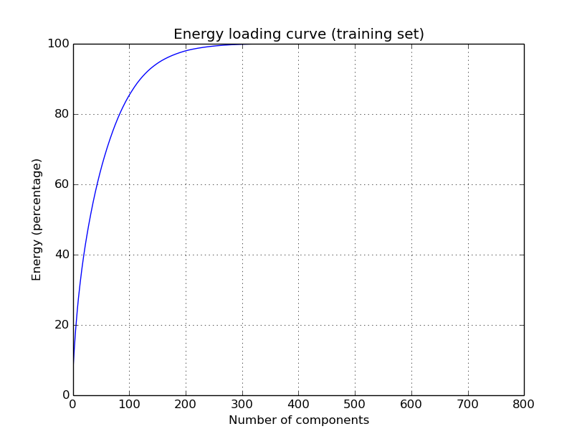
Principal Component Analysis (PCA)
PCA for dimensionality reduction
Selected configuration: PCA=10 (25.91% of the energy)
Is sufficient information preserved?
Projection matrix: 10 x 784

Slide 4
kNN & PCA
Simple strategy
Training phase: storing the feature vectors and class labels of the training samples (capacity=0)
Classification phase: a test point is assigned to the class most common amongst its k nearest neighbors measured by a distance function
PCA for dimensionality reduction
Selected configuration: k=9 and PCA=10 (25.91% of the energy)

Slide 5
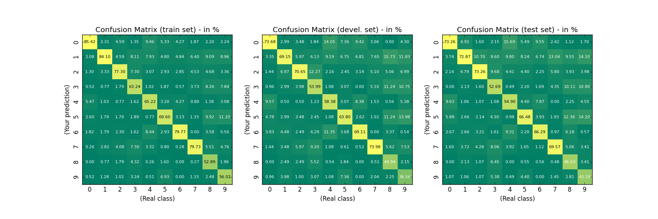
kNN & PCA - Results
Good tradeoff between dimensionality and CER with 10 PC
$ python mini_project.py -PCA -c 10 -kNN -nn 9
CER_{Train}: 28.50%
CER_{Devel}: 38.07%
CER_{Test}: 37.91%

Slide 6
kNN & PCA - Remarks
Choice of the number of principal components (PC) to keep
kNN - parameter k selection
Sensitivity analysis
kNN advantages
The cost of the learning process is zero
No assumptions have to be done
kNN drawbacks
May be computationally expensive to find the k nearest neighbors and to calculate the corresponding distances when the dataset is very large
The model can not be interpreted

Slide 7
GMM & PCA
Generative approach to model the digits
PCA for dimensionality reduction
Data points and their labels are used for training
One GMM to model all digits (the means automatically “move” to the digits)
The whole training set is modeled using 150 gaussian components (capacity=450)
Classification:
Calculate the probability for a given point and for all labels based on the estimated GMM
Select the class/label corresponding to the highest probabilility

Slide 8
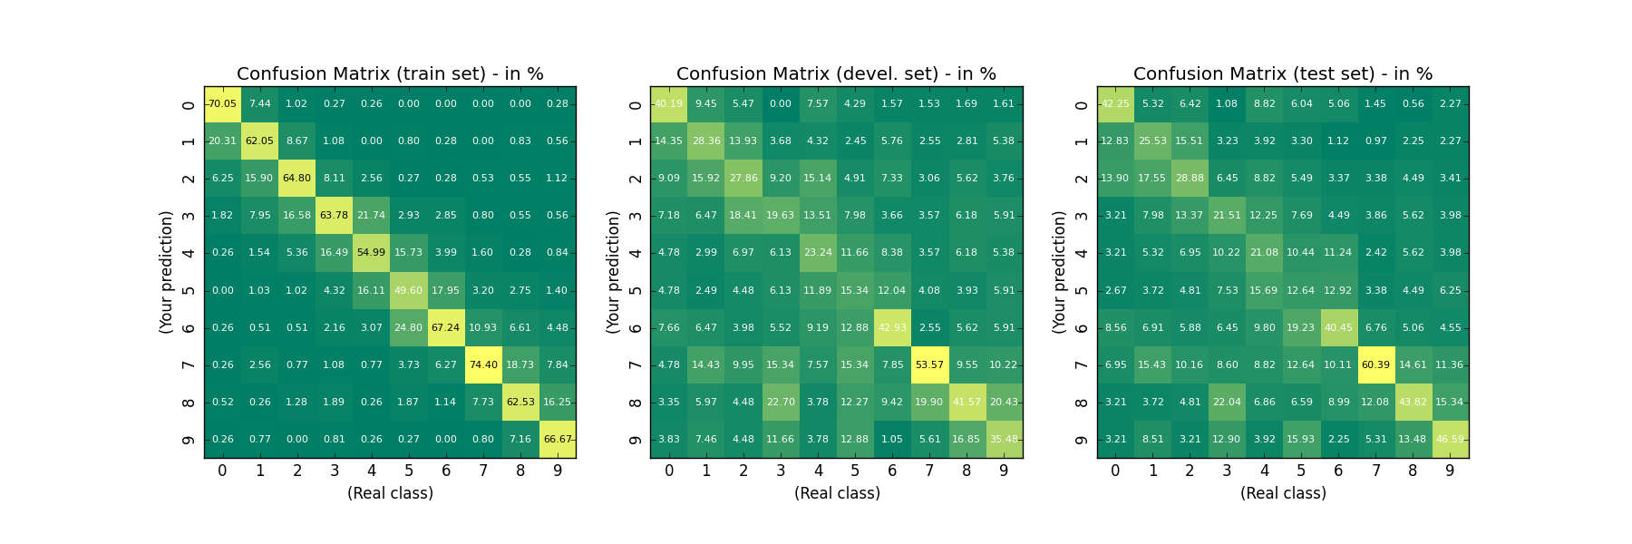
GMM & PCA - Results
Clear overfitting (using the FULL covariance matrix)
$ python mini_project.py -PCA -c 10 –GMM –nb_gaus 150
CER_{Train}: 36.45%
CER_{Devel}: 66.68%
CER_{Test}: 65.62%

Slide 9
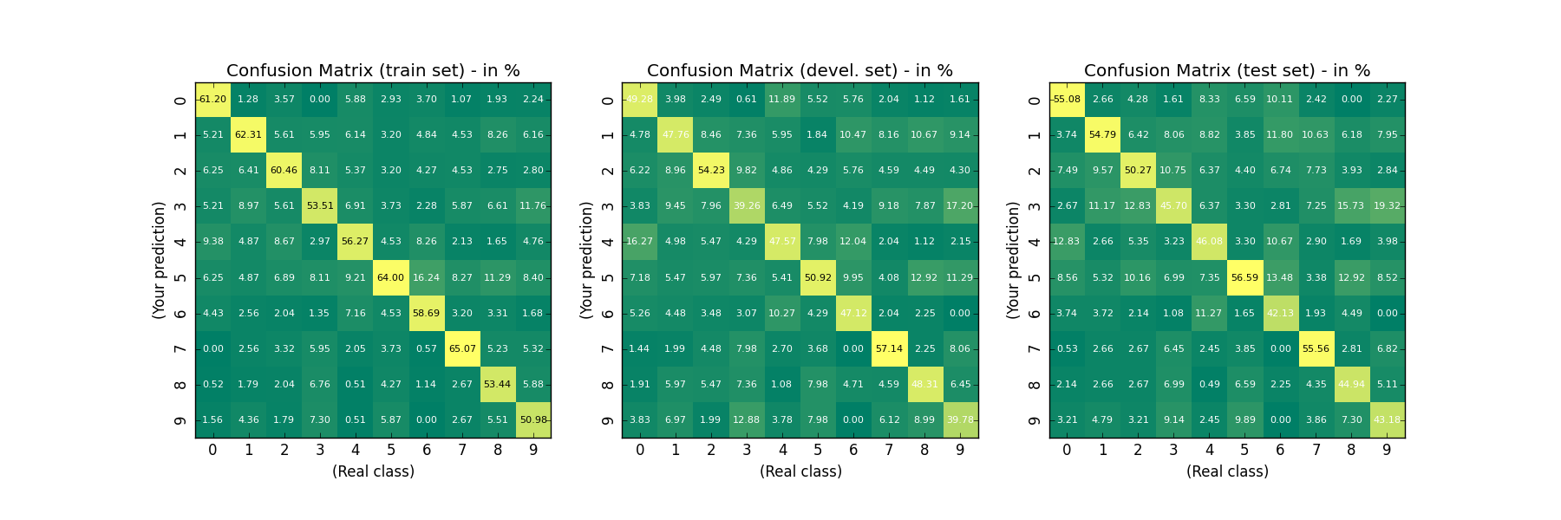
GMM & PCA - Results
Using Diagonal Covariance matrix
$ python mini_project.py -PCA -c 10 –GMM –nb_gaus 150 --cov_type diag
CER_{Train}: 41.33%
CER_{Devel}: 51.68%
CER_{Test}: 50.45%

Slide 10
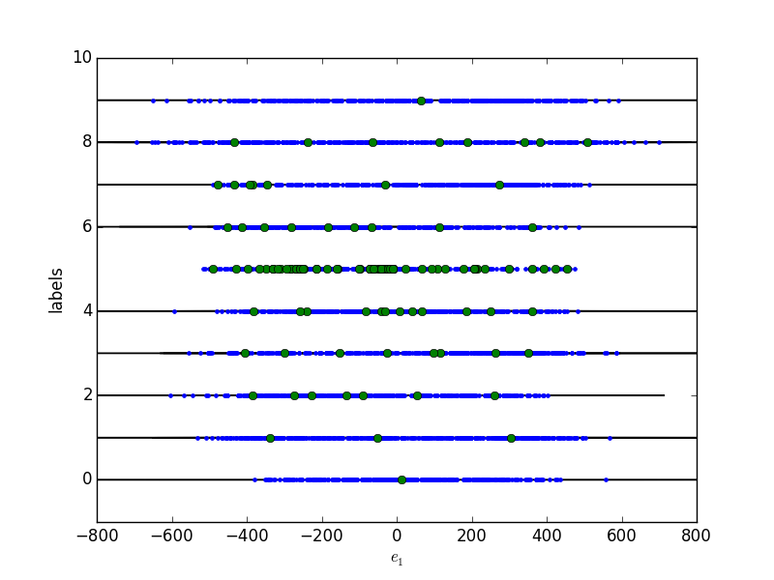
GMM & PCA - Remarks
How the means move along the space? Example with 150 gaussians.
Possible overfitting on the number 5
Possible underfitting on the numbers 9,0 and 1

Slide 11
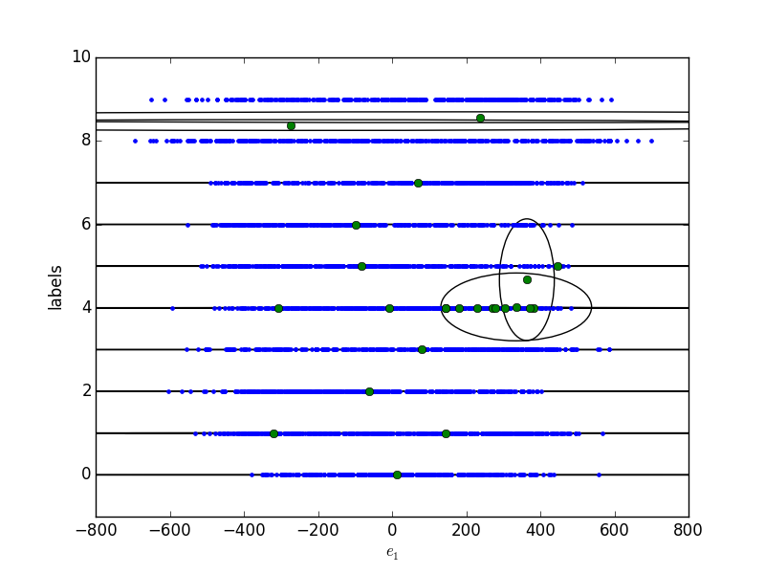
GMM & PCA - Remarks
How the means move along the space? Example with 24 gaussians.
Diagonal covariance
[[ 7.71279485e+03 1.00000123e-02]
[ 1.99321693e+03 1.00000000e-02]
[ 7.21106645e+03 1.00000000e-02]
[ 1.92641293e+02 1.00000000e-02]
[ 3.29071183e+04 1.00000000e-02]
[ 1.59875255e+04 1.00000000e-02]
[ 6.09943336e+03 1.00000000e-02]
[ 3.12765518e+04 2.56880915e-01]
[ 2.70854969e+03 1.00000000e-02]
[ 3.61342145e+04 2.59261314e-01]
[ 7.52141798e+04 1.00000000e-02]
[ 1.38324272e+04 1.00000000e-02]
[ 4.97549309e+04 1.00000000e-02]
[ 8.02827841e+03 1.00000000e-02]
[ 3.25641184e+04 1.00000000e-02]
[ 1.48142400e+03 2.91374230e+00]
[ 6.41723388e+04 1.00000000e-02]
[ 6.02484636e+03 1.00000001e-02]
[ 1.16635171e+04 1.00000036e-02]
[ 5.53486069e+04 1.00000000e-02]
[ 5.66339402e+03 1.00000000e-02]
[ 4.30077826e+04 1.00000000e-02]
[ 4.06755640e+03 1.62449588e+00]
[ 6.01247404e+04 1.00000000e-02]]

Slide 12
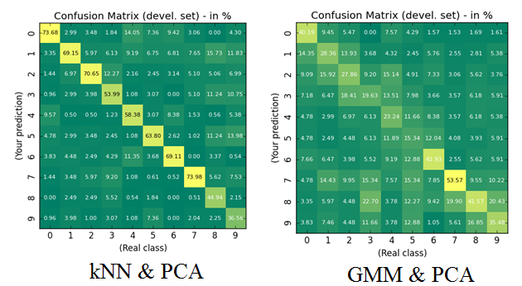
kNN & PCA vs. GMM & PCA
Aggregated level: CER
CER_{Devel} (kNN & PCA): 38.07%
CER_{Devel} (GMM & PCA): 66.68%
Disaggregated level: Confusion matrices

Slide 13
Conclusion
Simple solution is better (kNN & PCA)
The results are reproducible
Suggestion (GMM & PCA): Model one GMM per digit

Slide 14
GMM & PCA - Remarks
Modelling with less gaussian components (#components=16, capacity=48):
$ python mini_project.py -PCA -c 10 –GMM –nb_gaus 16
CER_{Train}: 62.54%
CER_{Devel}: 67.70%
CER_{Test}: 65.46%
Correctness of the adopted strategy
Our suggestion:
Split the training data into classes according to their labels
Assume a mixture of Gaussian distributions for each class
Estimation of the model parameters using only training data without their labels
Assign the class labels for test points by comparing the posterior densities of all classes

