Slide 1


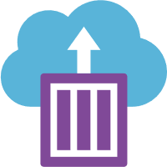


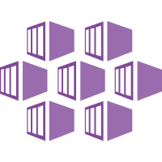


Trigger DevOps
Production Release Pipeline
Azure Notebooks
ML Pipeline, Train, Eval Scripts
Azure DevOps
Azure DevOps
DevOps Build Pipeline
Deploy Infrastructure, Train, Evaluate
DevOps Release Pipeline
Development / QA
Azure DevOps
Check-in script
DevOps Release Pipeline
Production
Build Artifacts
Azure DevOps Repo
Version control project artifacts
Trigger DevOps
Release Pipeline
Create Linux VM
Create/Get AML Workspace
Create/Get AML Compute
Run ML Pipeline,
Version Data, Register Model & Container
Create Linux VM
Deploy ACI Web Service
Trigger DevOps
Build Pipeline
Pre- Deployment Approval
Create Linux VM
Deploy AKS Web Service
Register model
Register image
Container
Instance
Deployed Model Monitoring
Uses Scoring Image
AML Model Registry
Version models
Container Registry
Web service container image
Scoring Web Service
Model deployed in web service
AKS Cluster
Application Insights
Collect & monitor scoring service telemetry
Azure Storage
Collect scoring service model input and predictions
Scoring Web Service
Model deployed in web service
Log telemetry, inputs and predictions

Slide 2
AML Compute Instance
(notebook experience)
ML Pipeline, Train, Eval Scripts
Azure DevOps
Azure DevOps
DevOps Build Pipeline
Deploy Infrastructure, Train, Evaluate
DevOps Release Pipeline
Production
Build Artifacts
Azure DevOps Repo
Version control project artifacts
Trigger DevOps
Release Pipeline
Create Linux VM
Create/Get AML Workspace
Create/Get AML Compute
Run ML Pipeline, Register Model & Container
Pre- Deployment Approval
Create Linux VM
Deploy AKS Web Service
Trigger DevOps
Build Pipeline
Register model
Register image
Deployed Model Monitoring
AML Model Registry
Version models
Container Registry
Web service container image
AKS Cluster
Application Insights
Collect & monitor scoring service telemetry
Azure Storage
Collect scoring service model input and predictions
Scoring Web Service
Model deployed in web service
Log telemetry, inputs and predictions

Slide 3
Prepare Data
Build & Train Models
Deploy & Predict
Data
Ingestion
Data Snapshots (versioning)
Data
Preparation
Model Building
& Training
Model
Deployment
Normalization
Hyper-parameter
tuning
Deployment
Transformation
Automatic model
selection
Batch scoring
Validation
Model testing
Data storage
locations
Featurization
Model validation

