Slide 1
FLOOR 0 EDIFICIOS | 1 | 2 | 3 | 4 | 5 | 6 | 7 | 8 | 9 | 10 | 11 | 12
Comprimento(m) | 5.2 |  | 6.54 | 6.54 | 6.54 | 6.54 | 6.54 | 6.54 | 6.54 | 6.54 | 6.54
Largura(m) | 5.2 |  | 3.4 | 3.4 | 3.4 | 3.4 | 3.4 | 3.4 | 3.4 | 3.4 | 3.4
Area(m^2) | 27.04 |  | 22.24 | 22.24 | 22.24 | 22.24 | 22.24 | 22.24 | 22.24 | 22.24 | 22.24 | -
Nº outlets | 6 | 2 | 6 | 6 | 6 | 6 | 6 | 6 | 6 | 6 | 6 | 0

Slide 2
FLOOR 1 EDIFICIOS | 1 | 2 | 3 | 4 | 5 | 6 | 7 | 8 | 9 | 10 | 11 | 12 | 13 | 14 | 15 | 16 | 17 | 18 | 19 | 20
Comprimento(m) | 9.9 | 6 | 6 | 9.4 | 6.54 | 6.54 | 6.54 | 6.54 | 6.54 | 6.54 | 6 | 6 | 5.57 | 5.57 | 5.57 | 5.57 | 5.57 | 5.57
Largura(m) | 6.92 | 3.84 | 3.84 | 4.42 | 3.85 | 3.85 | 3.85 | 3.85 | 3.85 | 3.85 | 3.85 | 3.85 | 3.85 | 3.85 | 3.85 | 3.85 | 3.85 | 3.85
Area(m^2) | 68.508 | 23.04 | 23.04 | 41.548 | 25.18 | 25.18 | 25.18 | 25.18 | 25.18 | 25.18 | 23.1 | 23.1 | 21.44 | 21.44 | 21.44 | 21.44 | 21.44 | 21.44 | 0 | 0
Nº outlets | 14 | 6 | 6 | 10 | 6 | 6 | 6 | 6 | 6 | 6 | 6 | 6 | 6 | 6 | 6 | 6 | 6 | 6 | 0 | 0

Slide 3
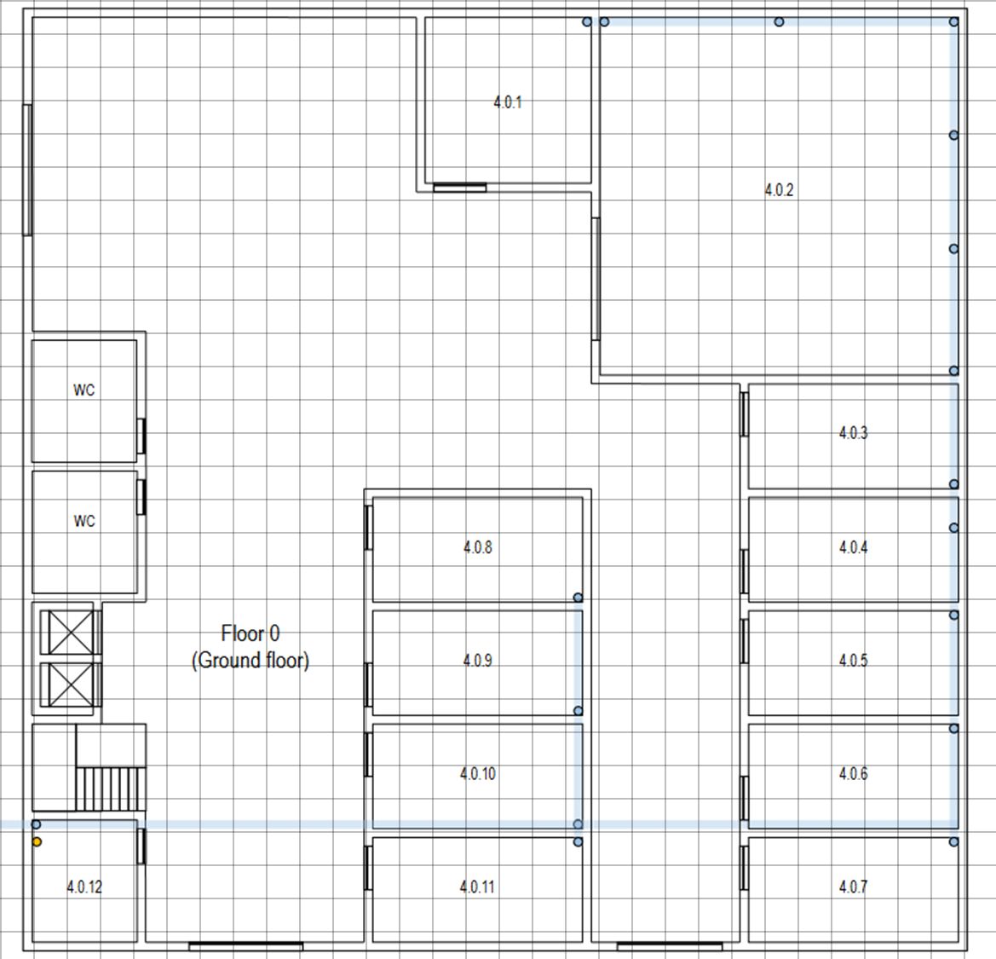


Slide 4
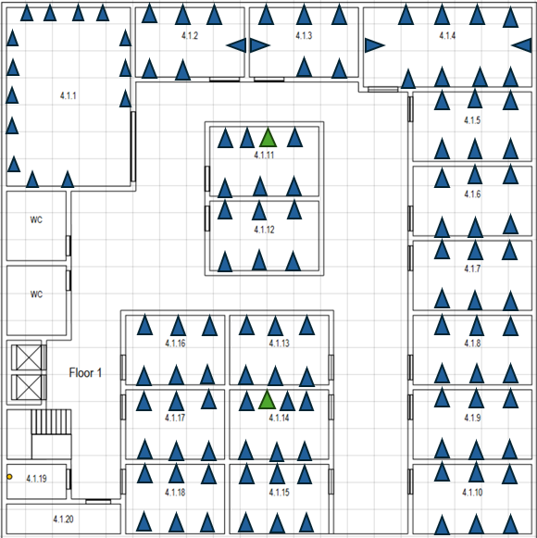
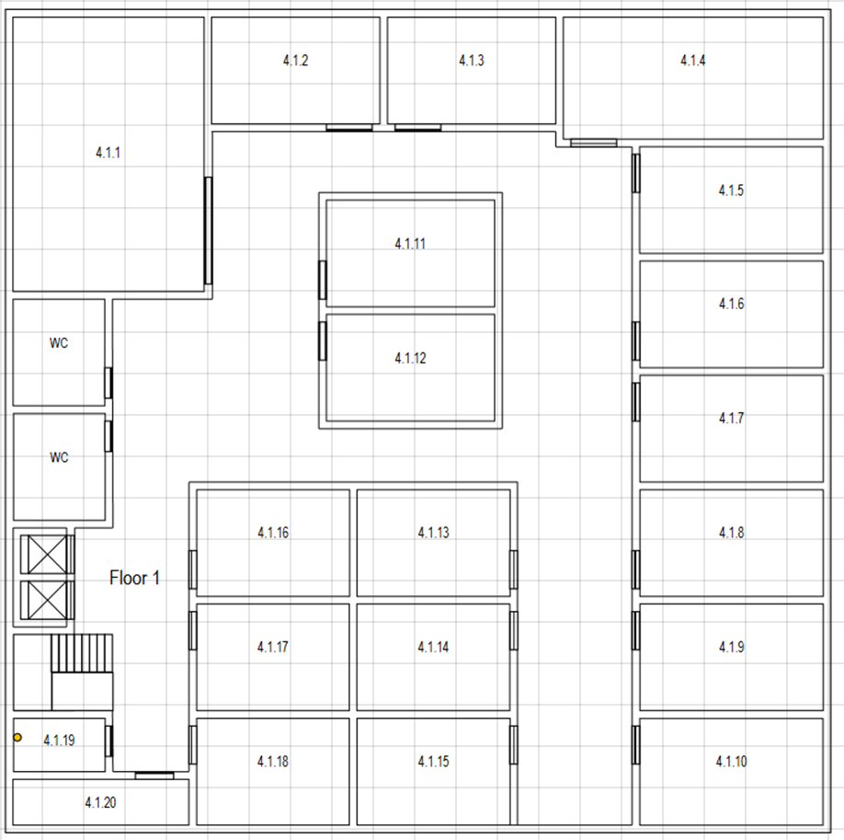
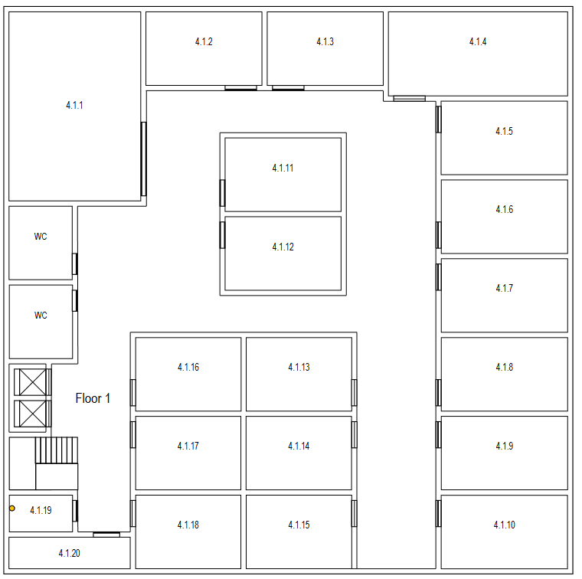

Slide 6
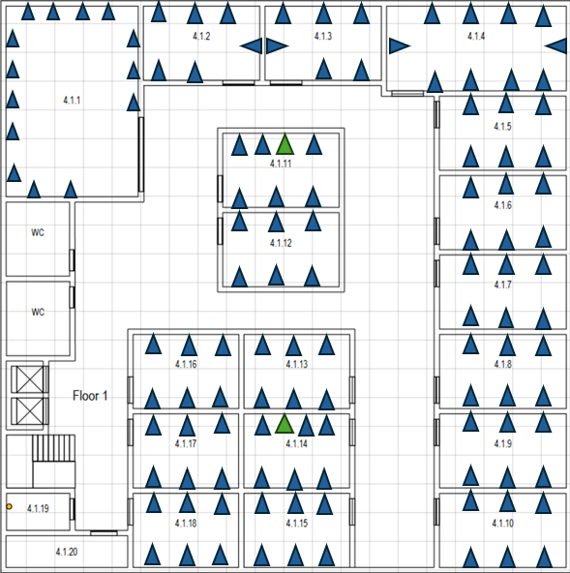

Slide 7
1
1
1
1
1
1
1
6 5 4
3 a1 2 1
1
6 5 4
1
1
2
3 2
1
1
IC
HC
1
1
3 2 1
6 5 4

Slide 8
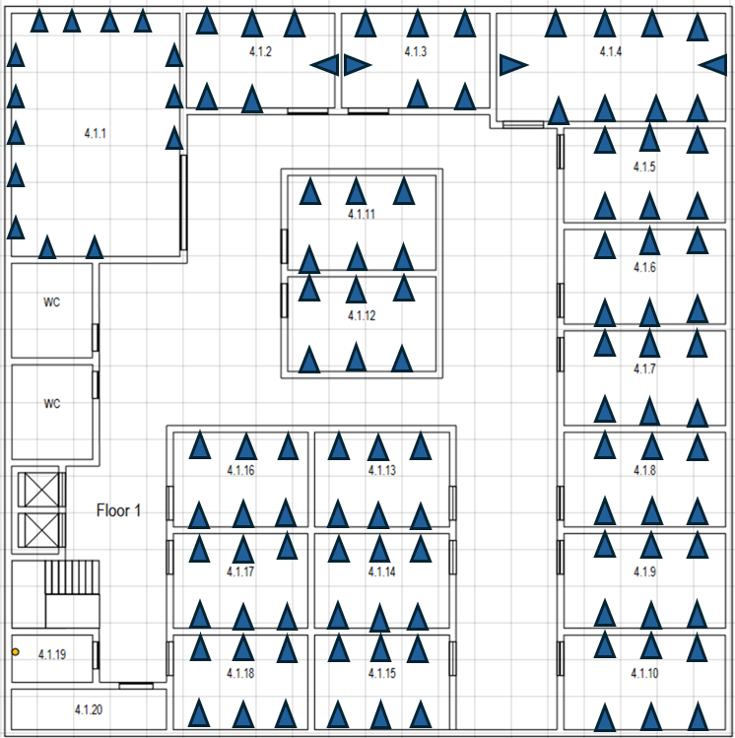
1
1
1
1
1
1
1
1
1
1
1
1
1
1
1
1
1
1
1
1
1
1
HC
HC
1
1
1
1

