Slide 1
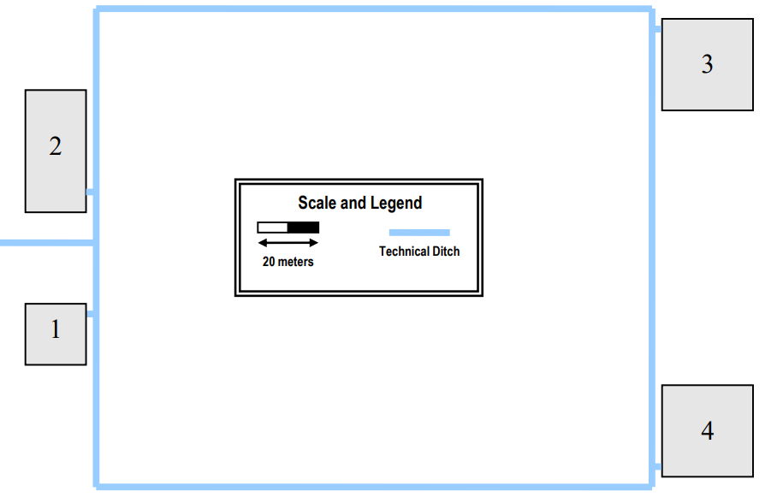
~ 186m
~ 150m

Slide 2
~ 186m
~ 150m

